Slide 1
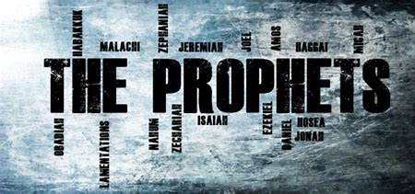
1 Kings 2.1-12
BEFORE
Praise be Adonai our God, sovereign of the universe Who has chosen faithful Nevi’im to speak words of truth. Praise be You, Adonai, for the revelation of Torah, for Your servant Messiah, for Your people and for Nevi’im of true righteousness.

Slide 2
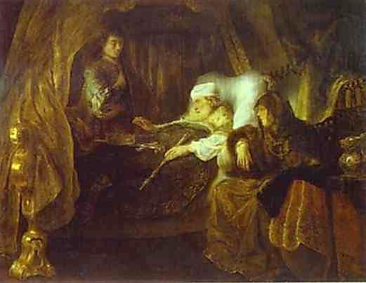
1 Kings 2.1-12
After
Praise to You Adonai our God, sovereign of the universe, Rock of all creation, Righteous One of all generations, the Faithful God, Whose Word is deed, Whose every command is just & true. For the Torah, for the privilege of worship, for the Nevi’im and for this Shabbat that You, Adonai our God, have given us for holiness and rest, for honor and glory.

Slide 3


Connection
The patriarchal promise is at risk and again an aged and ailing patriarch solemnly undertakes to reconnect and secure the minds of the next generation of the promises of Yahweh.

Slide 4
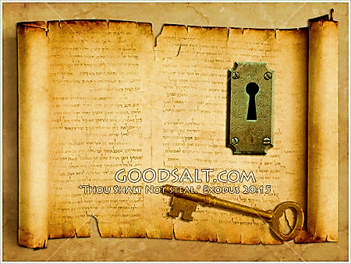
KEY
Hashem’s sworn promises shall be upheld even till the Royal figure of Davidic dynasty comes to claim dominion that is His due.

Slide 5

Fulfilled
Each one of us (true Believers) is the fulfillment of Yahweh’s promise to Abraham, regarding the Redeemer & His redemptive blessing.
Is. 65.17, 2Pe. 3.13, Re. 21.5

Slide 6

1
We should affirm our faith by acknowledging the reliability of Yah’s sworn promise to the patriarchs in reverence
2
We are not to take vengeance or bear a grudge. Our spitefulness can diminish Yah’s good intentions
3
Though we may not see justice taken place in our time, be assure Adonai will see to it in His time.

Slide 7
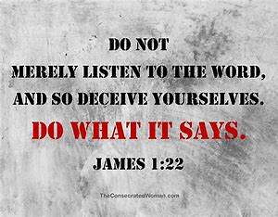
Application
Pay attention to the final charge that is filled with covenant promises and anticipate the fulfillment of spiritual blessing in the coming Redeemer Y’shua Messiah.

Slide 8
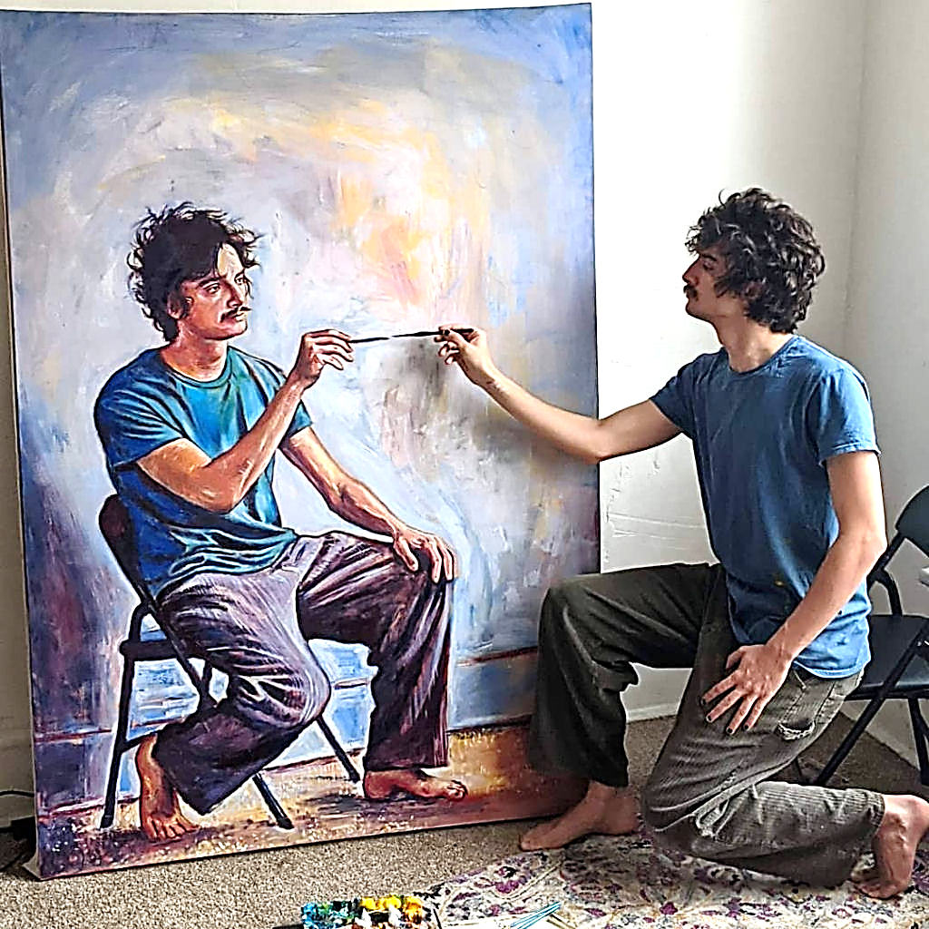
Applying the living & active word of Yah
HOW?
MEDITATE Psalms 1.2, 3
MEMORIZE Psalms 119.9,11
STUDY Acts 17.11
HEAR Ro. 10.17
READ, OBEY Revelation 1.3

Slide 9
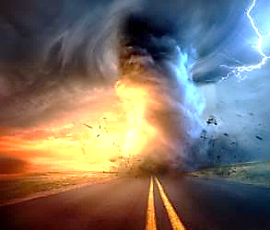
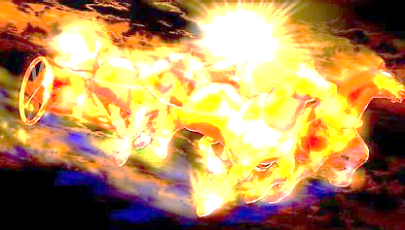
Communication of YHvH
“Just Let It Happen To You!”

