Slide 1
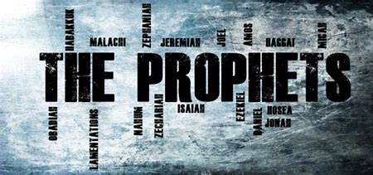
1 Kings 3.15-4.1
BEFORE
Praise be Adonai our God, sovereign of the universe Who has chosen faithful Nevi’im to speak words of truth. Praise be You, Adonai, for the revelation of Torah, for Your servant Messiah, for Your people and for Nevi’im of true righteousness.

Slide 2
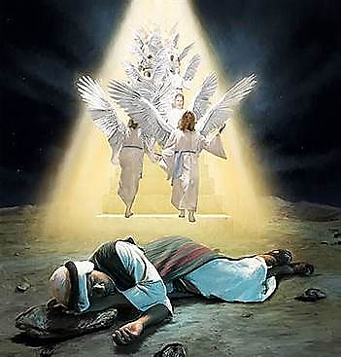
1Kings 3.15-4.1
After
Praise to You Adonai our God, sovereign of the universe, Rock of all creation, Righteous One of all generations, the Faithful God, Whose Word is deed, Whose every command is just & true. For the Torah, for the privilege of worship, for the Nevi’im and for this Shabbat that You, Adonai our God, have given us for holiness and rest, for honor and glory.

Slide 3

Connection
PENTATEUCH
PROPHETS
Yah is a promise keeper. Ask and you shall receive. Situations constantly occur in life which require more than human knowledge to navigate or resolve. God’s wisdom is needed in situations to highlight man’s limitations and God’s eternal perspective. Adonai’s wisdom does not come through human traditions.

Slide 4
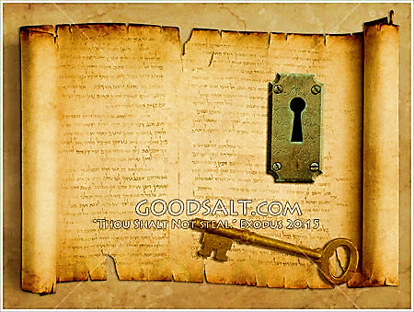
KEY
All of us have a calling and a purpose, yet all of us battle sin. This is another reminder of the crippling nature of sin and how desperate we must be for Yeshua. The Lord desires us to look to him for wisdom, knowledge and understanding.

Slide 5

Fulfilled
We live in a world where everything is a finger touch away, but in this information age the most important questions cannot be answered without seeking after the Lord’s wisdom. Only Adonai can give direction, leadership and courage. Wisdom isn’t about what you know. Wisdom happens when you take knowledge and apply it to your life. (James 1:5)

Slide 6

1
God wants to work through us. We have a role He’s placed us in and wants us to rely on Him so He can accomplish His plan. we should pray for discernment to act in His will.
2
Don’t waste your time on worldly pursuits. The world will not and cannot satisfy your desires for worth, joy, wisdom, and knowledge. The Lord is the answer to our wants and needs.
3
God Tests You Through Trials to show His Wisdom in Your Life, Obedience brings the blessings of a prolonged life

Slide 7

Application
Adonai’s wisdom requires fearing Him!
So, FEAR Him!
Proverbs 1:7; 2:5

Slide 8
Fear of God
Not “fear” of being punished, but NOT being with the Father; NOT judgment of God, but of being distant from Him. [Prov. 1.7; 29-33]
Fear is healthy, good, respectful and driven by love for the Father.
Based on our knowledge of His love, mercy & goodness [Pr. 9.10]
We show fear by taking refuge in Him. To draw near [Psalms 31.20(19)
Being aware of what is holy and what is profane then making a conscious effort to avoid evil.
Affectionate reverence that we as Believers bend our knee in humility to our father showing respect through knowledge gained of Who He is.

Slide 9
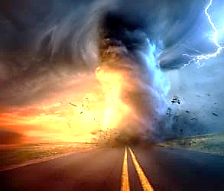
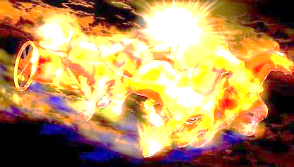
Communication of YHvH
“Just Let It Happen To You!”

