Slide 1
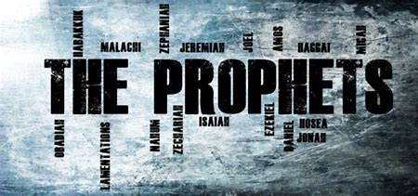
Isaiah 27.6-28.13
BEFORE
Praise be Adonai our God, sovereign of the universe Who has chosen faithful Nevi’im to speak words of truth. Praise be You, Adonai, for the revelation of Torah, for Your servant Messiah, for Your people and for Nevi’im of true righteousness.

Slide 2
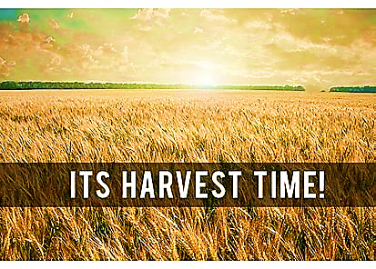
Isaiah 27.6-28.13
After
Praise to You Adonai our God, sovereign of the universe, Rock of all creation, Righteous One of all generations, the Faithful God, Whose Word is deed, Whose every command is just & true. For the Torah, for the privilege of worship, for the Nevi’im and for this Shabbat that You, Adonai our God, have given us for holiness and rest, for honor and glory.

Slide 3


Connection between the
Prophet & Parashah
In both the Prophet reading and Parashah Sh’mot Adonai is preparing to render a judgement that will destroy with the utmost precision according to His prerogative; unfolding His thorough, elaborate plan of redemption and restoration

Slide 4
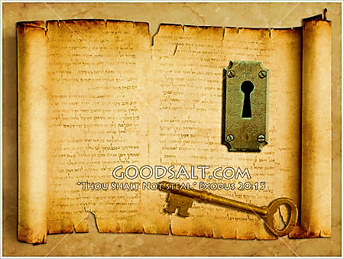
KEY
Adonai’s ultimate goal is for His people to be free from the bondage and influence of sin and know the dignity and splendor of being under the rule of their True King. Every generation is to remember and worship Yud Heh Vav Heh; every tribe is to return to The I AM That I Am.

Slide 5
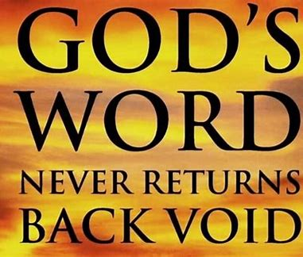
Fulfilled
The exile Adonai had Isaiah prophesy occurred just as Yah said it would and Adonai is even now calling His people back to Israel. He has given His word that Israel will be restored to the promised land and made one under Messiah.

Slide 6
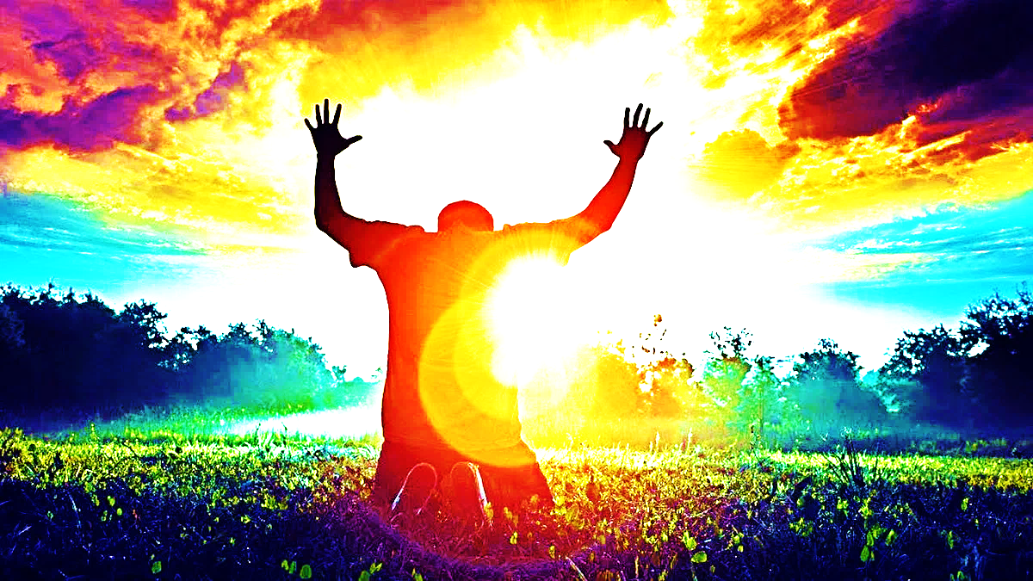
1
Only Yah knows how to accomplish all of His purposes
2
Adonai will not suffer His people’s delusion of comfort with sin or the enemy’s interference. He is utterly committed to His plan.
3
Adonai’s rebuke is an instrument of restoration and the wise do not reject it.

Slide 7
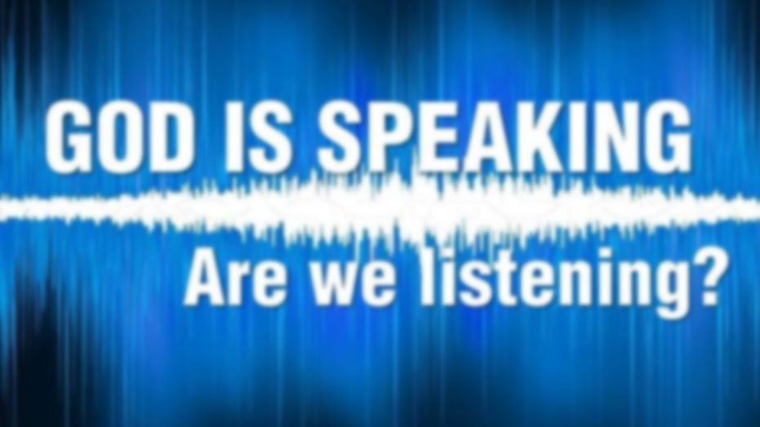
Application
Listen when Adonai sends warnings through His prophets. Trust Him to bring us to the goal.

Slide 8
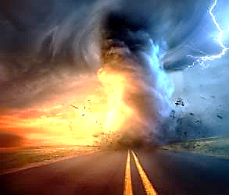
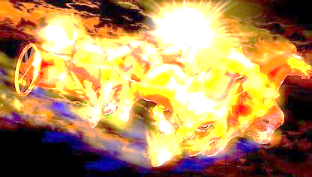
Communication of YHvH
“Just Let It Happen To You!”

