Slide 1
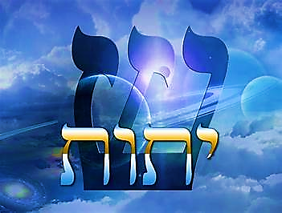
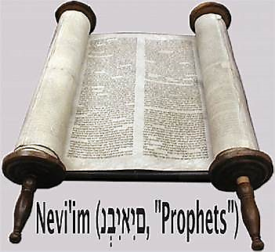
8 Adar 5784

Slide 2
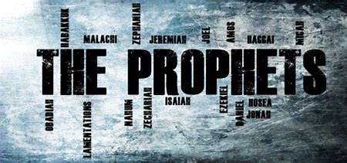
1Kings 5:26-6:13
BEFORE
Praise be Adonai our God, sovereign of the universe Who has chosen faithful Nevi’im to speak words of truth. Praise be You, Adonai, for the revelation of Torah, for Your servant Messiah, for Your people and for Nevi’im of true righteousness.

Slide 3
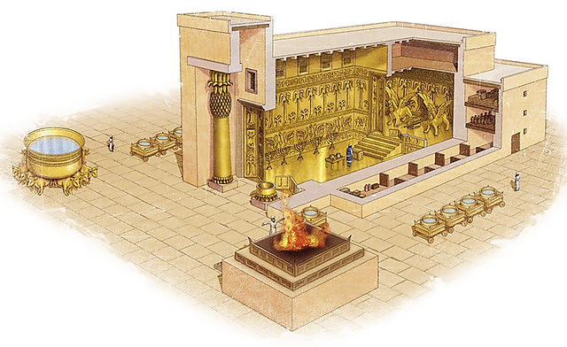
1Kings 5:26-6:13
After
Praise to You Adonai our God, sovereign of the universe, Rock of all creation, Righteous One of all generations, the Faithful God, Whose Word is deed, Whose every command is just & true. For the Torah, for the privilege of worship, for the Nevi’im and for this Shabbat that You, Adonai our God, have given us for holiness and rest, for honor and glory.

Slide 4


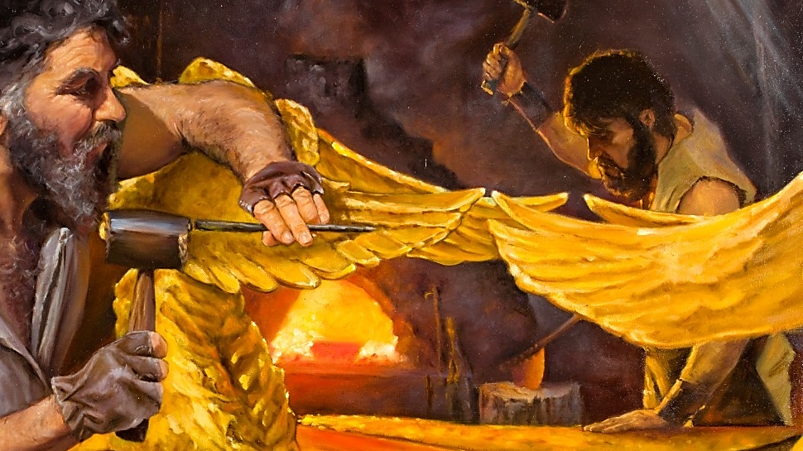



Connection between the
Prophet 1Kings & Parashah Trumah
The tabernacle and temple were built on the direction, authority, and guidance of Adonai’s instructions to Moshe to build a tabernacle and Shlomo to build a temple, where He can live amongst His people.

Slide 5
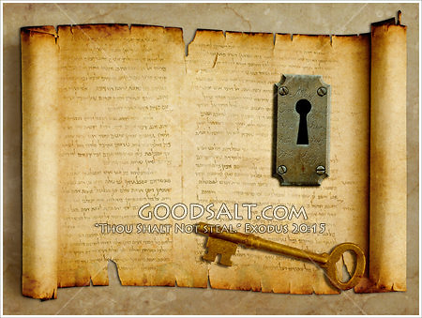
KEY
Our lives should resemble the set apartness, meticulous care, and purposeful love as temples that Yah has called us to be.

Slide 6

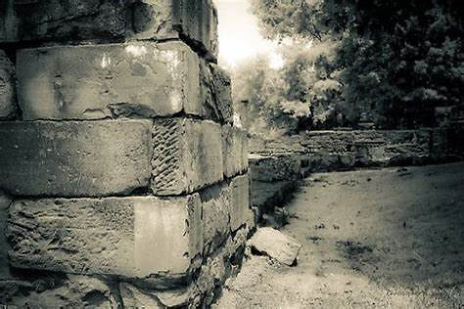



Fulfilled
Yeshua is the cornerstone of this Holy temple and the High Priest so we can be the spiritual dwelling place of Ruach HaKodesh.
Psalms 118.22 & Mt. 21.42

Slide 7

1
Adonai’s plans for His people have the highest standards which is Holiness.
2
Our bodies are to represent living lives that exhibit God character.
3
There is no temple without Yeshua being the “Rock” of our foundation

Slide 8





Application
These structures speak of the great love and care Our Father has for us and He wants us to have a relationship with Him by offering ourselves as a sacrifice and living set apart for Him. This will please Him; it is the logical “Temple worship” for us.

Slide 9
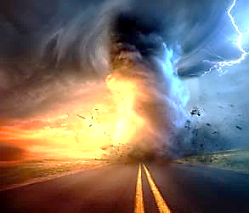
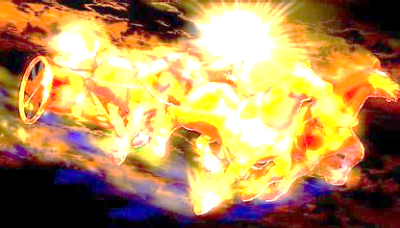
Communication of YHvH
“Just Let It Happen To You!”

