Slide 1
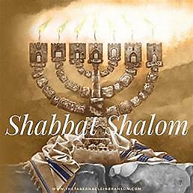
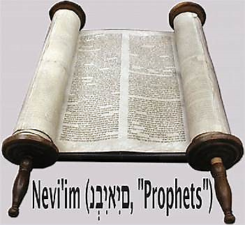
6 Adar II 5784

Slide 2
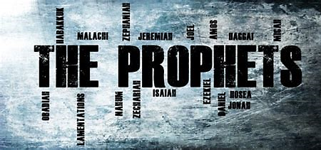
1 Kings 7. 51-8.21
BEFORE
Praise be Adonai our God, sovereign of the universe Who has chosen faithful Nevi’im to speak words of truth. Praise be You, Adonai, for the revelation of Torah, for Your servant Messiah, for Your people and for Nevi’im of true righteousness.

Slide 3
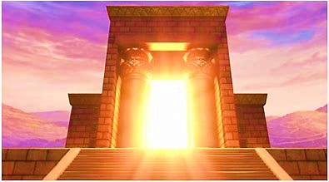
1 Kings 7. 51-8.21
After
Praise to You Adonai our God, sovereign of the universe, Rock of all creation, Righteous One of all generations, the Faithful God, Whose Word is deed, Whose every command is just & true. For the Torah, for the privilege of worship, for the Nevi’im and for this Shabbat that You, Adonai our God, have given us for holiness and rest, for honor and glory.

Slide 4
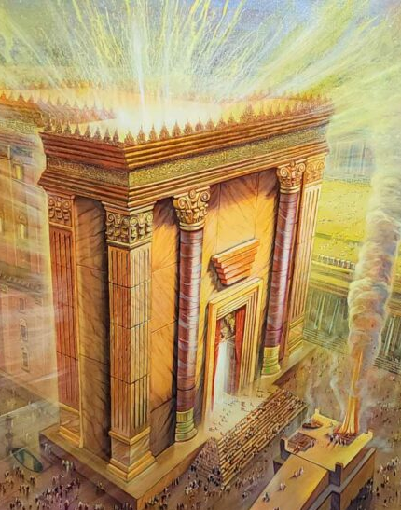
Connection between the Prophet & Parashah Ex 35.21-40.38
Moshe & Shlomo each were shown the pattern of the House of Yehovah and met the conditions presented by Yah (Everything was made exactly as Yah commanded) mirroring the work of creation.

Slide 5
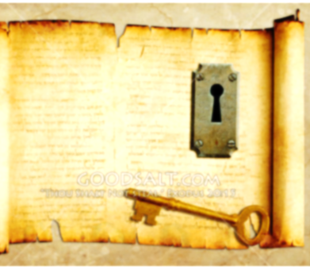
KEY THOUGHT
The Shekinah of Yah is His radiance embodying all of His attributes brought near to man.

Slide 6
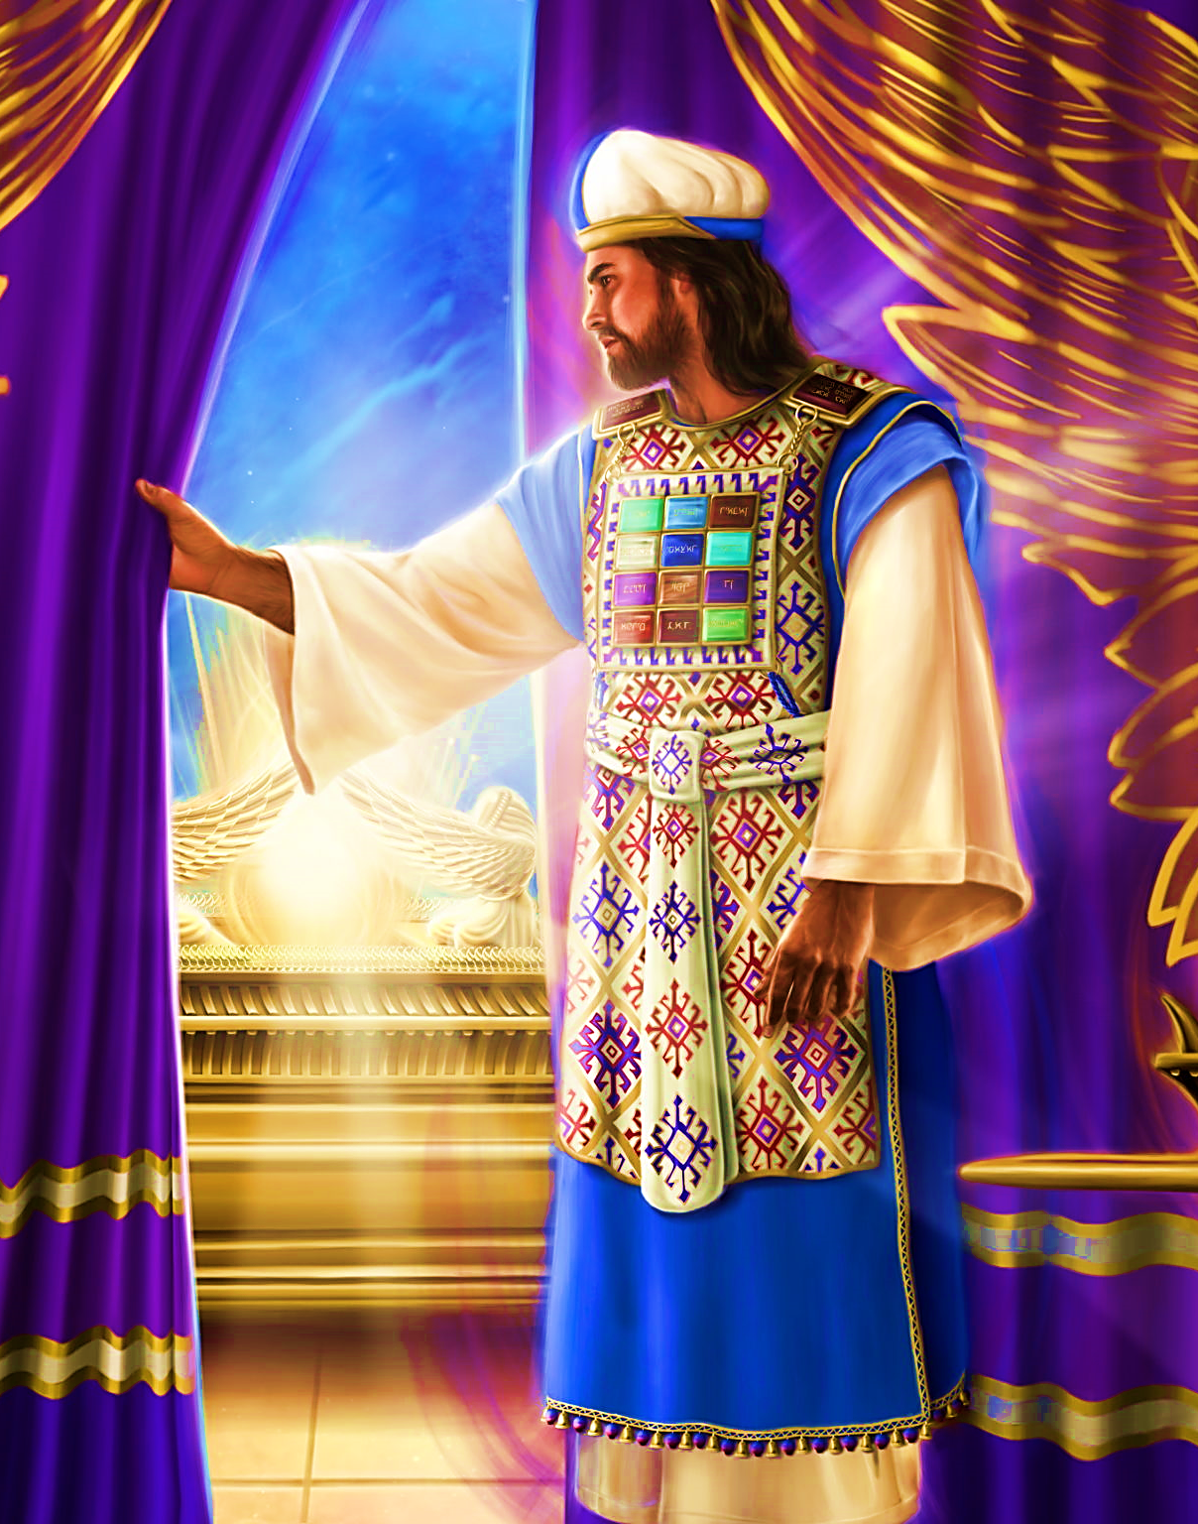
Fulfilled
Yeshua proclaimed the Messianic era had come John 2.19-21 and that He was the Mishkan of Yah and the presence (Shekinah) dwelled within Him. We the Body of Messiah have this same presence once we have put our trust in Yeshua as Lord & His Divine atoning work [Romans 10.9] at this point we become the Mishkan of Yah. [Hebrews 9.11-12]

Slide 7

1
Every work assigned by Yah should mirror His action in creation having single-minded, indisputable focus.
2
Yah’s faithfulness is both the subject of praise & moves us into obedient living that will bear witness to others.
3
When the indescribable beauty of Yah’s Shekinah is seen it returns us to humble devotion and wisdom, undoing the growing arrogance.

Slide 8
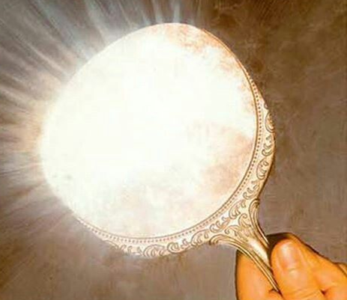
Application
Know you are the Temple (Mishkan) 1Cor 3.16-17 where His presence dwells. Let us mirror our Teacher [John 13.13-17, 1Jn 2.6, 1Pe 2.21, Eph 5.12]
Do I Look like my Savior?

Slide 9
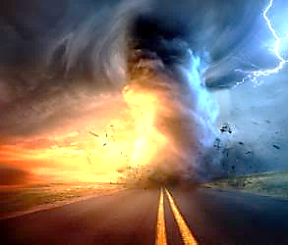
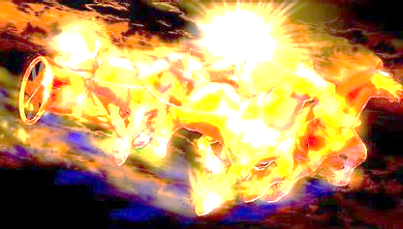
Communication of YHvH
“Just Let It Happen To You!”

