Slide 1
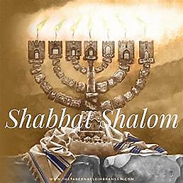
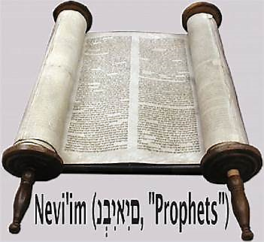
13 Adar II 5784

Slide 2
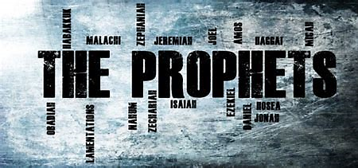
Isaiah 43.21-44.23
BEFORE
Praise be Adonai our God, sovereign of the universe Who has chosen faithful Nevi’im to speak words of truth. Praise be You, Adonai, for the revelation of Torah, for Your servant Messiah, for Your people and for Nevi’im of true righteousness.

Slide 3

Isaiah 43.21-44.23
After
Praise to You Adonai our God, sovereign of the universe, Rock of all creation, Righteous One of all generations, the Faithful God, Whose Word is deed, Whose every command is just & true. For the Torah, for the privilege of worship, for the Nevi’im and for this Shabbat that You, Adonai our God, have given us for holiness and rest, for honor and glory.

Slide 4

Connection between the Prophet & Parashah
In both the Prophet reading and Parashah Vayikra, Adonai, bears witness to His holiness and declares His purpose for His people.

Slide 5
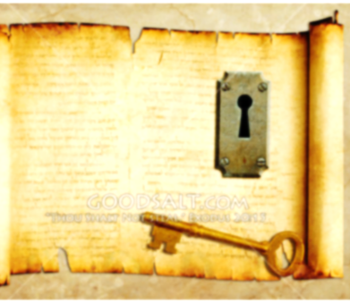
KEY THOUGHT
The servants of the Lord have a predetermined purpose: to be in union with Him and attest to His holiness.

Slide 6
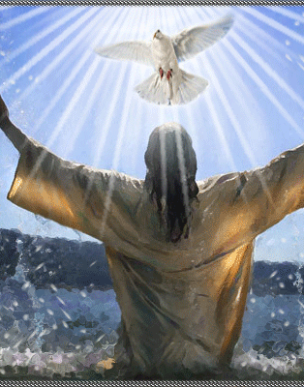
Fulfilled
Messiah Y’shua did not deviate from the very purpose for which He came. All that Y’shua does proclaims the holiness of God.

Slide 7

1
We’ve been built to bring Adonai an offering and we’ve been going outside of the purpose for which we were made.
2
Our devotion belong to Yah. When we resist Adonai’s call on our lives, we give evidence that we are deceived.
3
Adonai has called us His witnesses so we must repent for resisting His high calling and proclaim His praise.

Slide 8
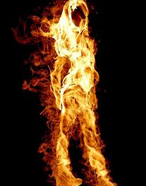
Application
We are to be witnesses to Adonai’s great deeds and who He is. We have to proclaim the Name of the Lord. [1 Peter 2:9]

Slide 9
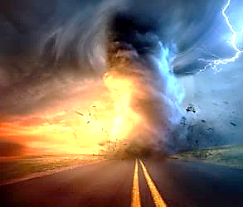
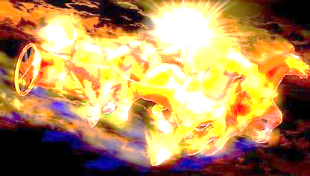
Communication of YHvH
“Just Let It Happen To You!”

