Slide 1
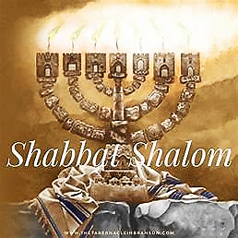
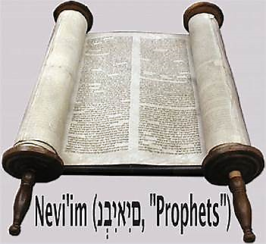
20 Adar II 5784

Slide 2
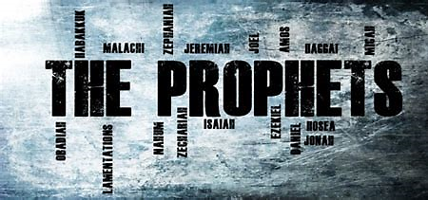
Jeramiah 7.21-8.3
BEFORE
Praise be Adonai our God, sovereign of the universe Who has chosen faithful Nevi’im to speak words of truth. Praise be You, Adonai, for the revelation of Torah, for Your servant Messiah, for Your people and for Nevi’im of true righteousness.

Slide 3

Jeramiah 7.21-8.3
After
Praise to You Adonai our God, sovereign of the universe, Rock of all creation, Righteous One of all generations, the Faithful God, Whose Word is deed, Whose every command is just & true. For the Torah, for the privilege of worship, for the Nevi’im and for this Shabbat that You, Adonai our God, have given us for holiness and rest, for honor and glory.

Slide 4
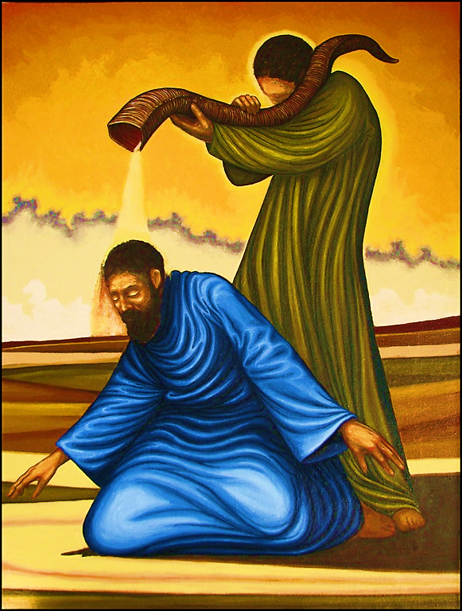
Connection between the Prophet & Parashah
Yah desires to create a holy people in His character, through consecration, for service unto Him.

Slide 5
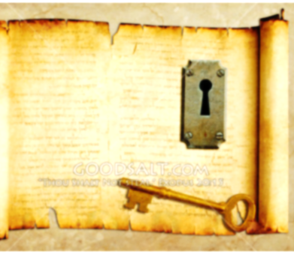
KEY THOUGHT
The Alef and The Tav, YHVH, The Complete One, demands nothing less than our complete devotion to Him.

Slide 6
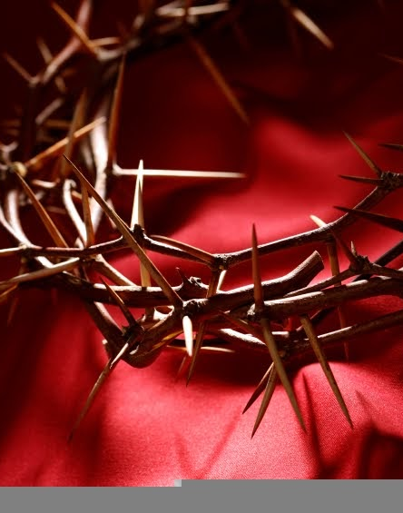
Fulfilled
Through the atoning Blood of Messiah Yeshua and the power of Ruach Kodesh, ADONAI consecrates believers for service to Him (1 Pet. 1:1-2)

Slide 7

1
Everything set aside for holiness to Yah must be consecrated.
2
Living by Ruach Kodesh requires instructions in holiness and godliness; seeing the spiritual purpose of the duties given.
3
Yah consecrates His servants from the inside-out (heart); ensuring our heart is fully and thoroughly devoted to Him.

Slide 8

Application
Examine your heart (character) and repent. Give ADONAI your whole heart, learn of His ways, and obey Him.

Slide 9
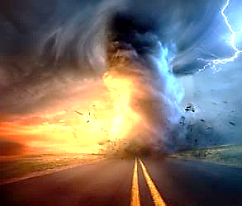
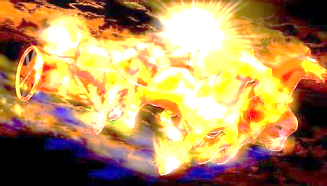
Communication of YHvH
“Just Let It Happen To You!”

Slide 10
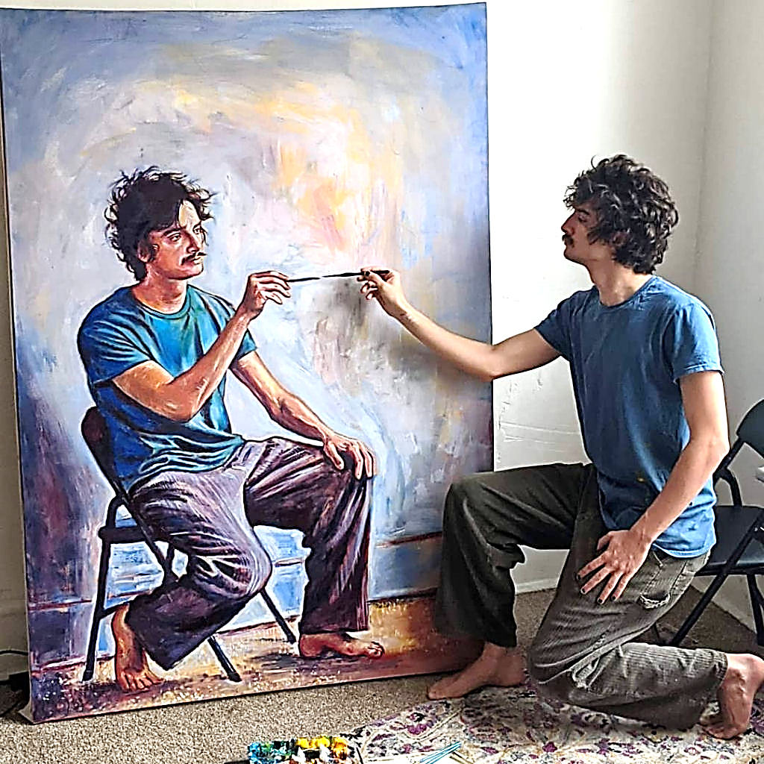
Applying the living & active word of Yah
HOW?
MEDITATE Psalms 1.2, 3
MEMORIZE Psalms 119.9,11
STUDY Acts 17.11
HEAR Ro. 10.17
READ, OBEY Revelation 1.3

