Slide 1
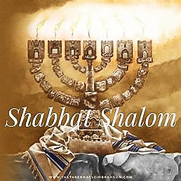
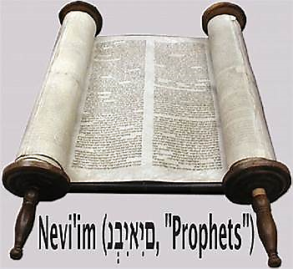
19 Nisan 5784

Slide 2
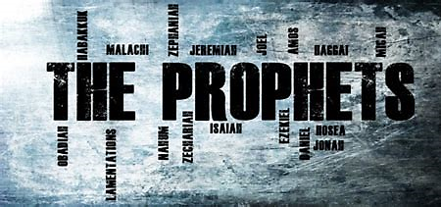
Ezekiel 22.1-19
BEFORE
Praise be Adonai our God, sovereign of the universe Who has chosen faithful Nevi’im to speak words of truth. Praise be You, Adonai, for the revelation of Torah, for Your servant Messiah, for Your people and for Nevi’im of true righteousness.

Slide 3
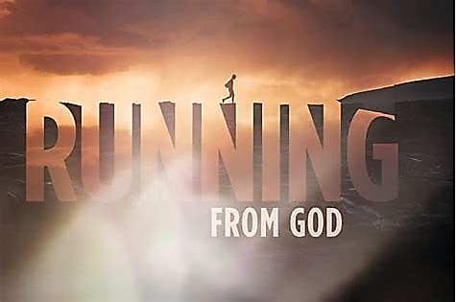
Ezekiel 22.1-19
After
Praise to You Adonai our God, sovereign of the universe, Rock of all creation, Righteous One of all generations, the Faithful God, Whose Word is deed, Whose every command is just & true. For the Torah, for the privilege of worship, for the Nevi’im and for this Shabbat that You, Adonai our God, have given us for holiness and rest, for honor and glory.

Slide 4
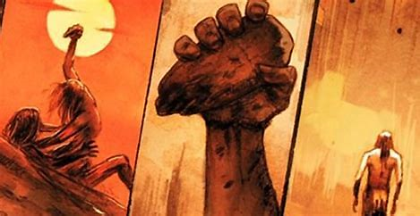
Connection
Prophet & Parashah: Acharei Mot
The Prophet relates to the Parashah in reference to the matter of bloodshed. However, in the Parashah, bloodshed is held as sacred as it was performed unto YHVH for the payment for sin and the foreshadow of a better Way yet to come. Meanwhile, the Prophet reading illustrates there was no regard for any of YHVH’s commands including bloodshed.

Slide 5
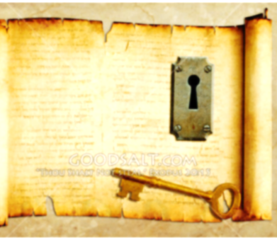
KEY THOUGHT
Obedience to YHVH’s instruction is an act of worship and is for our safe keeping. Meanwhile, disregard for YHVH’s commands lead to spiritual death.

Slide 6
Fulfilled
We fulfill the highlighted Scriptures by acknowledging we have been those who have acted impurely, committing acts in opposition to what YHVH has commanded, and deserving of judgement. Instead of continuing in sin, we can turn to Yeshua, our High Priest, who has ministered the blood atonement on behalf of our sins.
Yeshua is the fulfillment of the sacrificial system of atonement and the Redeemer for the one headlong in sin looking for a way of escape.

Slide 7

1
Every ritual act in YHVH’s Sacrificial system points to and is fulfilled by Yeshua.
3
Grief, confession and repentence for sin comes from a heart that values a relationship with YHVH
2
Disobedience to YHVH’s commands breaks covenant and causes separation from YHVH.

Slide 8

Application
Idolatry, self-will, and unconfessed sin will take us far outside of the will of YHVH. At that time, we are guilty and rife for YHVH’s judgment upon ourselves. We must stop to ask ourselves, do we want what our defiant sin is calling for. Since the answer is no, we must then confess, repent, and return to our merciful Deliverer.

Slide 9
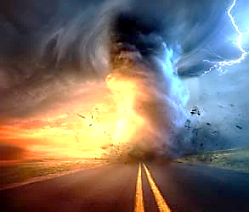
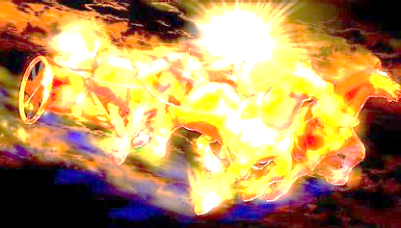
Communication of YHvH
“Just Let It Happen To You!”

Slide 10
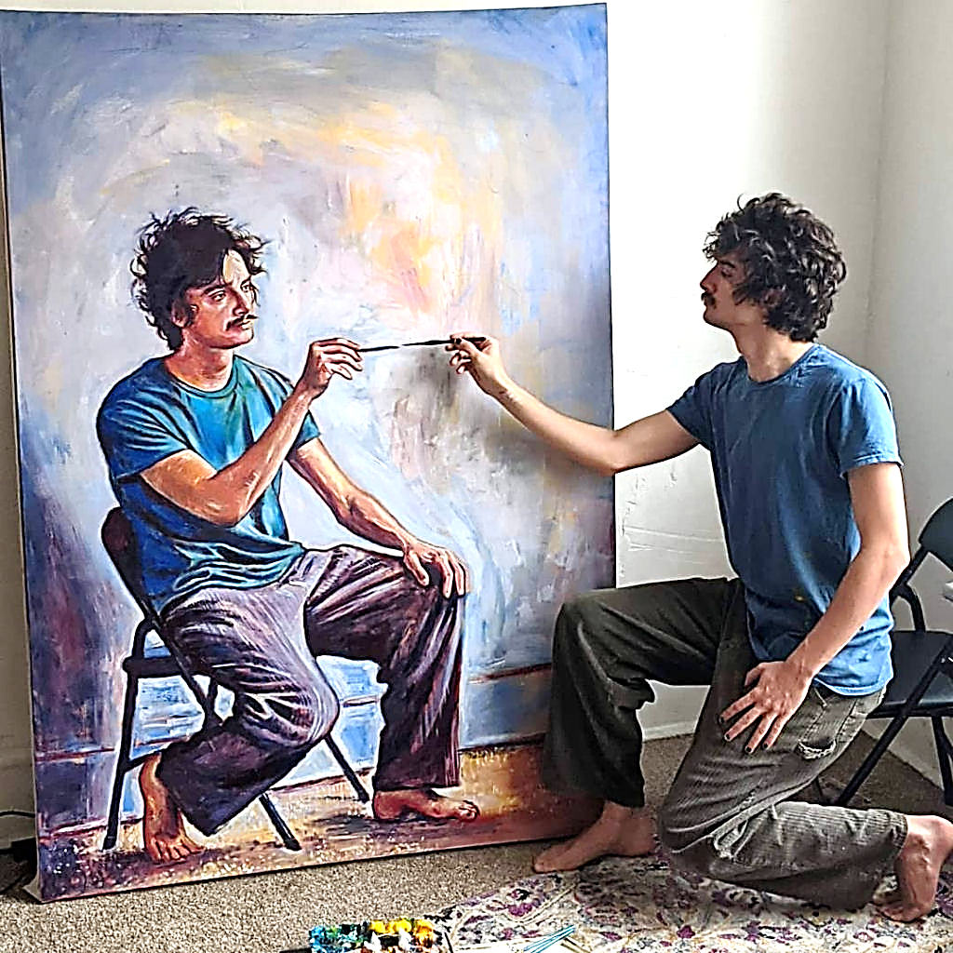
Applying the living & active word of Yah
HOW?
MEDITATE Psalms 1.2, 3
MEMORIZE Psalms 119.9,11
STUDY Acts 17.11
HEAR Ro. 10.17
READ, OBEY Revelation 1.3

