Slide 1
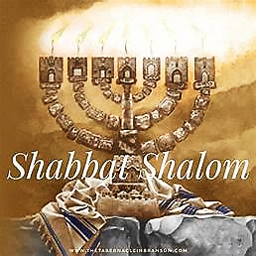
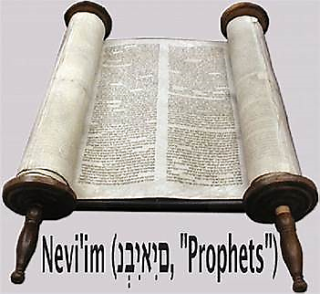
26 Nisan 5784

Slide 2
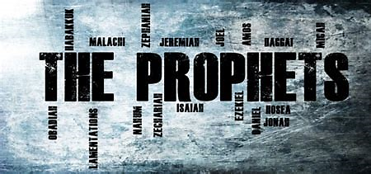
Amos 9.7-15
BEFORE
Praise be Adonai our God, sovereign of the universe Who has chosen faithful Nevi’im to speak words of truth. Praise be You, Adonai, for the revelation of Torah, for Your servant Messiah, for Your people and for Nevi’im of true righteousness.

Slide 3
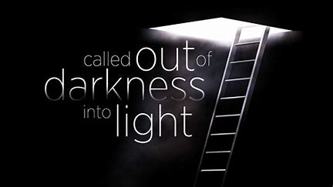
Amos 9.7-15
After
Praise to You Adonai our God, sovereign of the universe, Rock of all creation, Righteous One of all generations, the Faithful God, Whose Word is deed, Whose every command is just & true. For the Torah, for the privilege of worship, for the Nevi’im and for this Shabbat that You, Adonai our God, have given us for holiness and rest, for honor and glory.

Slide 4
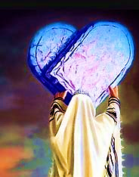
Connection
Prophet & Parashah: K’doshim
Yah will never lower His standards of holiness, yet He has given us the means to come into His Will, by providing the perfect sacrifice (Yeshua), the Ruach and His Torah to be in our hearts.

Slide 5
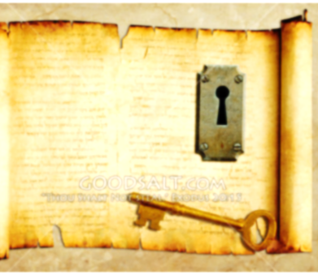
KEY THOUGHT
You people are to be Holy because I, Adonai your God, am Holy.

Slide 6
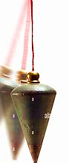
Fulfilled
Yeshua represents the plumbline standard based on holiness, salvation, repentance, forgiveness, righteousness, obedience and love for doing the Father’s Will.

Slide 7

1
Adonai’s rules, regulations and commands are not optional or based on your feeling to comply with.
2
With the love of Yeshua and Ruach, the Father’s commands aren’t burdensome to follow.
3
It only through Yeshua we can be saved and restored.

Slide 8
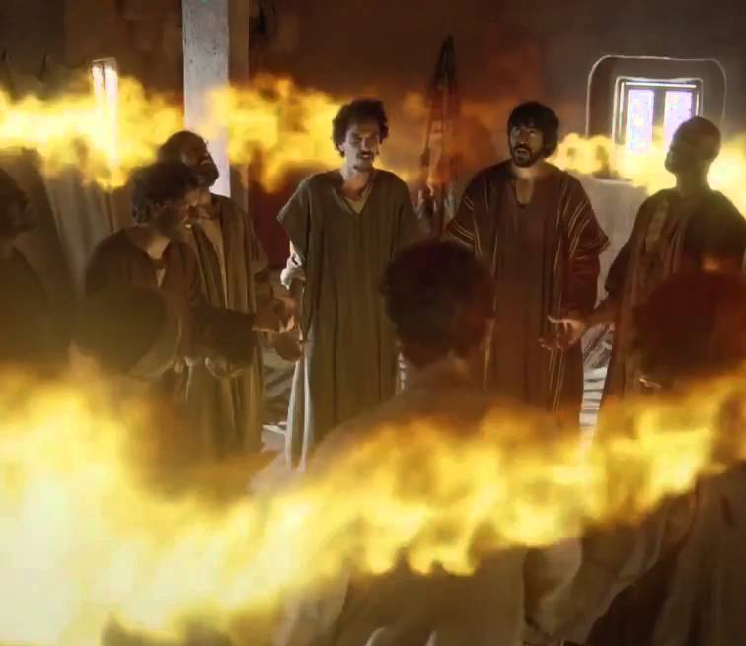
Application
We are a chosen people, the King’s Cohanim, a Holy nation, a people for God to possess! Why?
“In order for you to declare the praises of the One who called you out of darkness into his wonderful light.” (1 Peter 2.9)
.

Slide 9
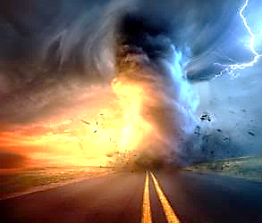
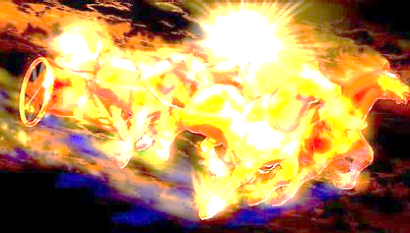
Communication of YHvH
“Just Let It Happen To You!”

Slide 10
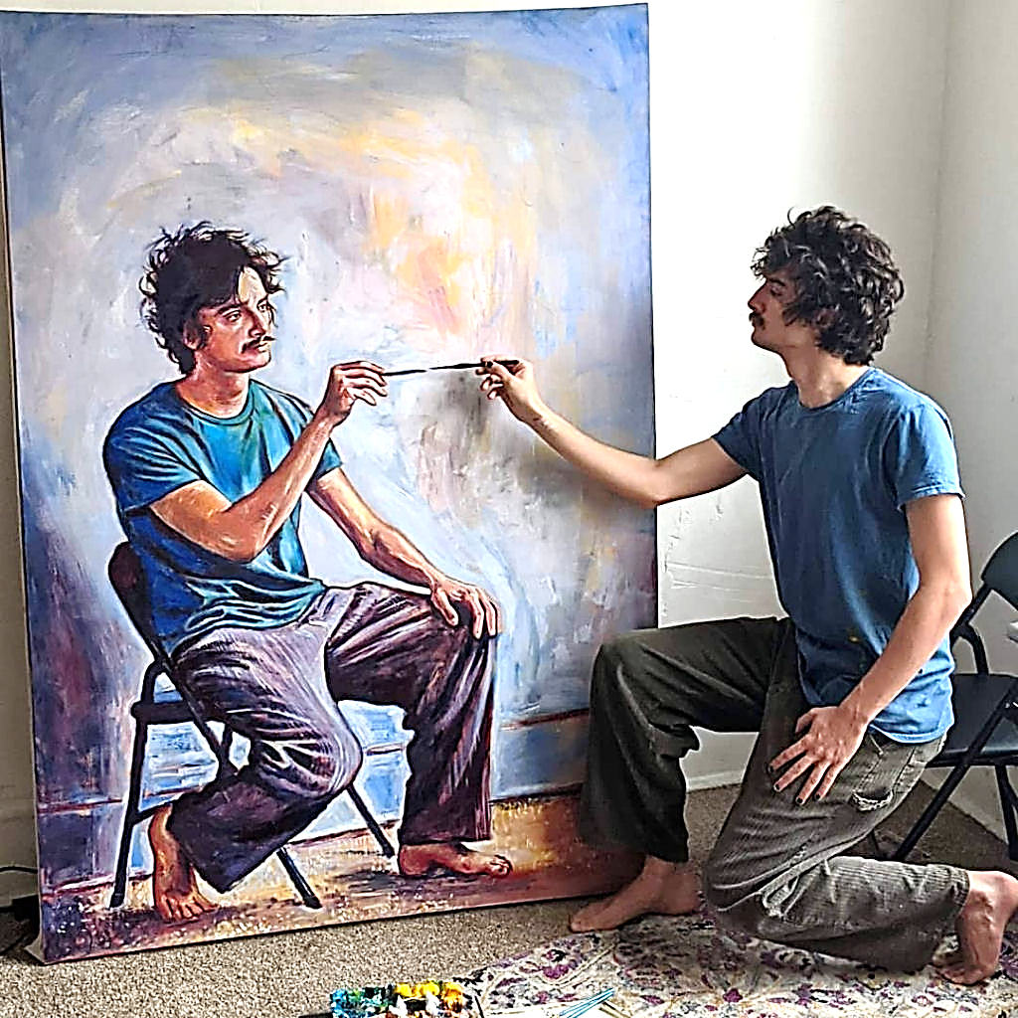
Applying the living & active word of Yah
HOW?
MEDITATE Psalms 1.2, 3
MEMORIZE Psalms 119.9,11
STUDY Acts 17.11
HEAR Ro. 10.17
READ, OBEY Revelation 1.3

