Slide 1

5785 Iyar 5
Radiance,
Blossom & healing
Tribe of Issachar

Slide 2

The power of Yah’s Word
“Covenant”

Slide 3
Why should we study Yah’s covenants
They are the key to Yah’s redemption plan. To restore humanity to its divine calling.
Broadens our understanding of Yah’s character
Establishes our beliefs, strengthens us in preparation for Eternal life.
Allows us to move from chaos to His order (The framework which He uses is Israel)
3 Types of Covenants
Unconditional: given by Yah, eternal promise does not require certain behavior
Conditional: require each person to do something or it becomes invalid
Reinforced: connects to previous

Slide 4

What is a covenant?
A total commitment, an absolute requirement, to do or not to do something, with consequences, even at the cost of one’s life.
Blood is needed for a covenant i.e., circumcision, immersion. Symbolic of dying to oneself.

Slide 5
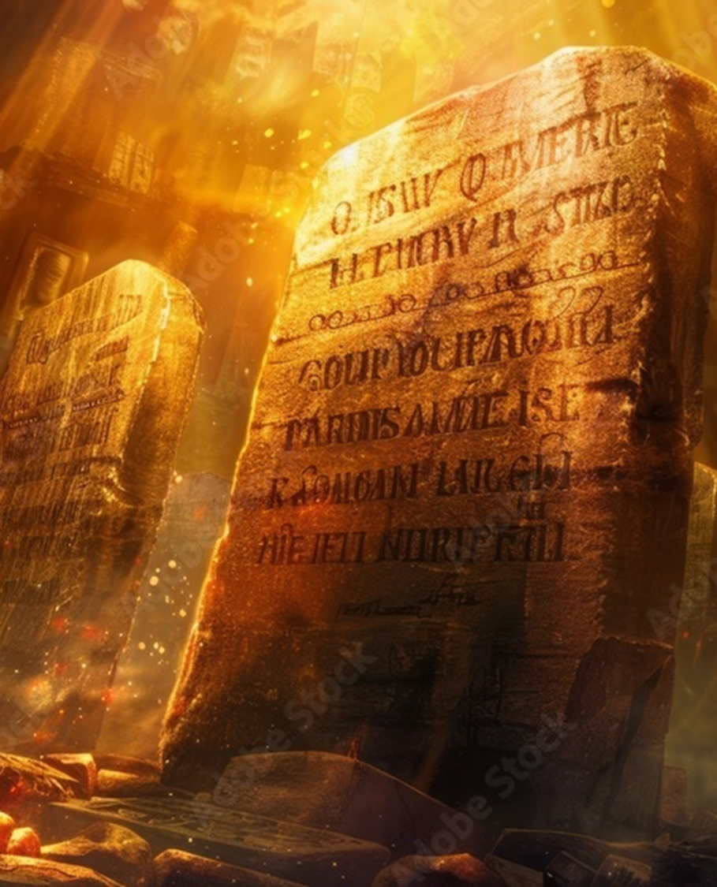
Covenant
To fully understand all of God’s covenants, it’s important to ask the following questions:
Who is the covenant cut with?
What is the gift?
Is it conditional or unconditional?
Purpose?
Temporary or permanent?

Slide 6
Psalms 25.14
The secret of the LORD - describes something that is hidden from others, information known only to a special group and even something that baffles and cannot be explained. It is divine, it is supernatural. And it is available only from Adonai, the Sole Possessor. He makes available to those who are His possession by grace through faith in Messiah. Yah makes it intelligible to the hearts of natural man who are in Christ. The first requirement to receive the blessing of this divine communication is that the recipient knows Yeshua Messiah as Savior and Lord of their life. Yeshua is the "Door" of this secret which is accessible to you. John 10.7-9
“Adonai relates intimately with those who fear Him; He makes them know His covenant.”

Slide 7
Connecting the Dots…..
Yeshua
Renewed
Adamic
Noahic
Abraham
Moses
Davidic
Edenic

Slide 8

Edenic Covenant [“gan” enclosure]
Genesis 1.27-28
Not termed as a covenant, but its nature is of a covenant.
Words, promises & terms of the covenant
Blood of the covenant
Seal of the covenant

Slide 9
Edenic Covenant- Words & Promises
Made in the image of Yah. (Able to reason)
Bear fruit & multiply: Spiritual qualities reflect transformation
Subdue Gen 1.28 (Kavash=H3533 footstool [Ez. 28.11-19]
Have dominion
Natural & spiritual.
You are not able to bear fruit until you know your identity in Messiah.
You cannot subdue until you bear fruit (fruit of Spirit Gal 5.22, 23)
Cannot exercise dominion until it has been subdued.
To know our identity- begin fruit bearing, subduing & having dominion.

Slide 10
Gift/Promises
EAT: Know what I have before it is not available (Tree of Knowledge) to me. [Ro 8.32]
BLOOD: Gen 2.21 Adam’s side typified Messiah’s side (Bride is the work of Yah, she was built)
SEAL: Tree of Life, represents Messiah. Eternal life
CONDITIONAL: Based upon faith and obedience.
PURPOSE: RULE with Yahweh [Psalm 8.6]
TEMPORARY: We can’t live eternally in sin-we had to chose obedience.

Slide 11
Our Identity & How we are Wired
Created to be lights in the world. Lights of different kinds.
Parsha Sh’mot i.e., Moses
Born of Levitical family
Mother saved his life (history/stories of Levi at Shechem)
Struck down Egyptian abuse
Moses was being shaped by events in his life.
He was wired to take action against oppression & injustice
Cared deeply about truth
Could not see falsehood or truth, without acting.

Slide 12
4 Areas That contribute…
How Yah used the setting in which we were born to shape us. (family, generation, location, etc.)
Natural or creational inheritance (Inborn)
Acquired skills or abilities (training or educations, things studied, learned, taught)
Spiritual gifts (unique capacities imparted by Ruach to empower work of Yah)
When our wiring is working well, our natural abilities acquired skills and spiritual gifts will work in partnership, they will feed off of, and feed into each other.
Romans 8:28

Slide 13
Next Shabbat Covenant
WHO | GIFT | CONDITIONAL or Un | PURPOSE | Temp/Perm
NOAH
SCRIPTURE

Slide 14
WHO | ADAM
SCRIPTURE | Genesis 3:15-21
GIFT/PROMISE | Repentance, Sacrifice, Instruction/Warning, Responsibility, Clothing
CONDITIONAL OR UN | Conditional until death Unconditional in Yahweh’s Purpose for the Covenant
PURPOSE | Redemption, Obedience, Reshaping into image of Yah, Magnifying Yah’s glory and provision, To reveal that humankind cannot obey Yah in our own power and perspective.
TEMP/PERM | Temporary: in the natural Permanent: displaying that death is defeated and the mercifulness of Yahweh

Slide 15
Adamic Genesis 3.15 REDEMPTION
Seed of a woman? (men have the seed- masculine) Promise of Yeshua born of a virgin.
Seed of the serpent: Anti-Christ; Yeshua will defeat him
Yeshua crushed Satan’s head (Authority in sacrifice)
Yeshua heal would be bruised. Demonstrated at the cross
Blood covenant: Gen 3.21 animal was slain for sake of Adam & Eve. Offering taught to sons: Able gave what was satisfying
Seal: Coat of skin - Isaiah 61.10 Represents the righteousness of Yah

Slide 16
Faithfulness of YHVH
COVENANT | SCRIPTURE | PURPOSE
EDENIC | Gen 1 | RULE
ADAMIC | Gen 3.15-21 | REDEMPTION
NOAHIC | Gen 6.9-10.32

Slide 17
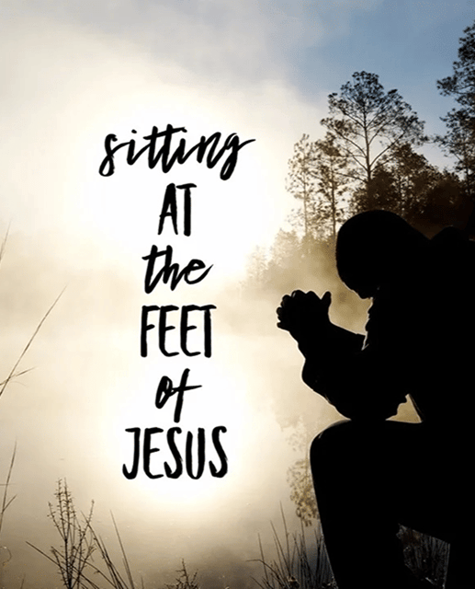
Homework
Connecting the Dots!
How does the covenant cut with Noah relate to me?
Do I see myself in the actions of Noah?

Slide 18
What needs to be done?
Ruach, my ears were meant to be instruments to hear Your voice. I ask that You reveal to me the things that are blocking me from hearing You.
Father, I repent of _________. I renounce any involvement in this activity an sever any curse attached to it now in Yeshua’s Name. I declare my ears open to hear Your voice, open to receive new revelation, open to hear Your plans and purposes. I release the voice of the Lord over my ears in Yeshua’s Name
Old covenants must be broken with the enemy!
Ears: single purpose-to hear. [Ps 95.7-9] deaf & dumb spirit [Mk 9.25] seek to make one dull of hearing & unable to discern Yah’s voice leading to reprobate mind.
Mat 13.19-23, Mk 7.33-34

