Slide 1

5785 Iyar 12
Radiance,
Blossom & healing
Tribe of Issacher

Slide 2
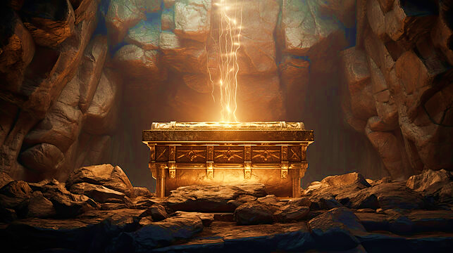
The power of Yah’s Word
“Covenant”

Slide 3
Why should we study Yah’s covenants
They are the key to Yah’s redemption plan. To restore humanity to its divine calling.
Broadens our understanding of Yah’s character
Establishes our beliefs, strengthens us in preparation from Eternal life.
Allows us to move from chaos to His order (The framework which He uses is Israel)
3 Types of Covenants
Unconditional: given by Yah, eternal promise does not require certain behavior
Conditional: require each person to do something or it become invalid
Reinforced: connects to previous

Slide 4
Grafted in
If one takes a small piece of dough from the whole lump, it should provide a good representation of the whole batch. If the piece is holy, then the whole batch is holy. If the roots from which the whole tree gets its life are holy, then the branches are holy. The original faith of the Israelites (e.g., Jacob, etc.) as being good and holy, and acceptable to God. The foundation is good enough to build upon rather than to start over.
Believers of Yeshua as Messiah are grafted into Israel, so all these conditional covenants apply to every believer, as well as Israel. [Romans 11.17-24]
V.16 This refers to the first portion of dough that was used for the Bread of Presence in the Sanctuary.

Slide 5

Grafted in Israel
Believers will gain its life from the root of the tree. The branch is dependent upon the root rather than the root upon the branch. This speaks of how the original community of Israel have adopted the Non-Jewish community into them through Messiah Yeshua rather than becoming something completely new.

Slide 6
Heretic of Christianity
Marcion or Marcionism sect in Turkey (Asia Minor) believed in two separate deities in Scripture and is still the debate (Korah) today.
Marcion’s wealth and status provided him with the means and platform to propagate his beliefs in Rome after leaving Turkey where his father was a bishop who disagreed with his beliefs and teaching.
The God of the Old Testament was evil and therefore Jesus was
Marcion believed there was a radical disjunction between the Old Testament law and the "good news" that Jesus brought. He argued that the God who gave the gospel couldn’t be the same God who gave the law.

Slide 7
Heretic of Christianity
According to Marcion, the law was given to the Jews by their own God, whereas the gospel was given by Jesus, who came from a different, higher God. This led Marcion to conclude that the God of Jesus wasn’t the God of the Jews.
Thus: Hebrews 8.13 “By using the term, new, he has made the first covenant old, and something being made old, something in the process of aging, is on its way to vanishing altogether”
2 Peter 3.16 Acts 20.27
2 Tim 3.16,17

Slide 8
Psalms 25.14
The secret of the LORD - describes something that is hidden from others, information known only to a special group and even something that baffles and cannot be explained. It is divine, It is supernatural. And it is available only from Adonai, the Sole Possessor. He makes available to those who are His possession by grace through faith in Messiah. Yah makes it intelligible to the hearts of natural man who are in Christ. The first requirement to receive the blessing of this divine communication is that the recipient knows Yeshua Messiah as Savior and Lord of their life. Yeshua is the "Door" of this secret which is accessible to you. John 10.7-9
“Adonai relates intimately with those who fear Him; He makes them know His covenant.”

Slide 9
Connecting the Dots…..
Yeshua
Renewed
Adamic
Noahic
Abraham
Moses
Davidic
Edenic

Slide 10
Days of Noach
Biblical Name: Rest, comfort; settle down or have peace.
Before this Universal flood, there were four generations of preachers. (Enoch, Jude 14 & 15, Methuselah, Lamech & Noah, 2 Pe 2.5) Yet none repented! There was no clear connection with the lost nor with those of his household.
Miracle of the covenant? Lasting connect with Yah & partnership.
Righteous: Not of himself, righteous not blameless [Psalm 119.72, Ezekiel 14.19-20]
6.13,17 “I will destroy them along with the earth.” Yah will and has revealed His activity to His prophets. [Amos 3.7] Yah opened His plan of salvation.

Slide 11
KPR is a Semitic root- Arabic
V.14 Pitch or Atonement? (K.F.R. or Kafar) meaning deny, Kipper, made atonement.
Not just pitch but also camphor or henna, a bush that has bunches of fragrant flower & fruits used as a deodorant to keep the ark habitable.
Hebrew: The basic meaning of the root is "to cover", but it is used in the sense "to conceal" and hence "to deny“ & apostacy
Yah tells Noah to deny the people outside even as they deny him and YHVH’s truth.
Therefore, make the ark worthy of salvation dedicated through the act of atonement [kipper] and all within are an atonement unto the Lord

Slide 12
Days of Noach
V.16 “opening for daylight …” The view from the window was only to give observation to the horizon-Noah was not able to see down or outward to determine the conditions.
One single door i.e., Jn 10.7-9
Yah remembered Noah, meaning that Yah turns His attention to Noah and fulfills His purpose.
The world is re-set not recreated.
Gen 6.5-7 vs 8.20-21 Aroma is Yeshua Messiah [Rev. 13.8]
V7.1 “Come into the ark…” (Lord is drawing us into Himself) The Lord shut him inside. [Col 3.2-3] no escape.
“Clean & unclean animals” Levitical language, not Mosaic law [distinction is not removed]
But why seven couples of clean animals? Sacrifice!
Supernatural (none gave birth, none died, food lasted, etc.

Slide 13
Next Shabbat Covenant
WHO | GIFT | CONDITIONAL or Un | PURPOSE | Temp/Perm
Noach
SCRIPTURE
Gen 6-10

Slide 14
What Can we Learn from Noah?
CHARACTER
When the “ark” rested it is a reference to Shabbat (17th day in 7th month = Tishri)
The warnings of Noah is as the announcement of Angels in Revelation 14.
V.7 “Fear God & give glory…”
V.8 “Come out of her:
V.9 “Last opportunity to be sealed, shut in, Kafar.”
Patience
Persistence
Unwavering
Faithful to YHVH
Weakness only revealed itself after a great accomplished trial

Slide 15
WHO | Noach
SCRIPTURE | Genesis 6-10
Within the covenant that Yahweh made with Noah, every living creature that was with Noah and all generations to come, is found the gift of grace, preservation, renewal, rebirth, atonement, mercy, His ordered cycle, a way of escape, justice, and the rainbow, which is Yah’s promise to remember that He is in covenant with His creation. This covenant is conditional because obedience is necessary to remain under it, and it is also unconditional because Yah said it. The purpose of this covenant is Yahweh’s restraint to never again destroy the earth with a flood even though He knew that sin would once again fill the earth. This covenant of Yahweh is permanent (Genesis 9:16).

Slide 16
Faithfulness of YHVH
COVENANT | SCRIPTURE | PURPOSE
EDENIC | Gen 1 | RULE
ADAMIC | Gen 3.15-21 | REDEMPTION
NOAHIC | Gen 6-10 | RESTRAINT
ABRAHAMIC | Gen 15.9-21; 17.1-21
MOSAIC
DAVIDIC
RENEWAL

Slide 17
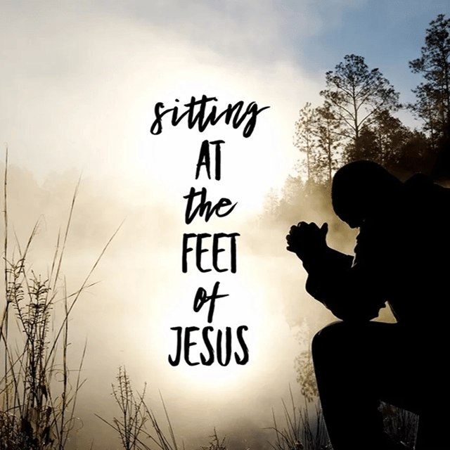
Homework
Connecting the Dots!
How does the covenant cut with Abraham relate to me?
Do I see myself in the actions of Abraham?
The narrative of Abraham
(Lekh-L’kha) “Get yourself out of here” Genesis 12-17
SCRIPTURE | WHO | COVENANT
Genesis 15.9-21 | Abram, his descendants | Land & blessing
Genesis 17.1-21 | Abraham, | Descendants & prosperity

Slide 18
What needs to be done?
Ruach, my ears were meant to be instruments to hear Your voice. I ask that You reveal to me the things that are blocking me from hearing You.
Father, I repent of _________. I renounce any involvement in this activity an sever any curse attached to it now in Yeshua’s Name. I declare my ears open to hear Your voice, open to receive new revelation, open to hear Your plans and purposes. I release the voice of the Lord over my ears in Yeshua’s Name
Old covenants must be broken with the enemy!
Ears: single purpose-to hear. [Psalm 95.7-9] deaf & dumb spirit [Mark 9.25] seek to make one dull of hearing & unable to discern Yah’s voice leading to reprobate mind.
Mat 13.19-23, Mk 7.33-34

