Slide 1
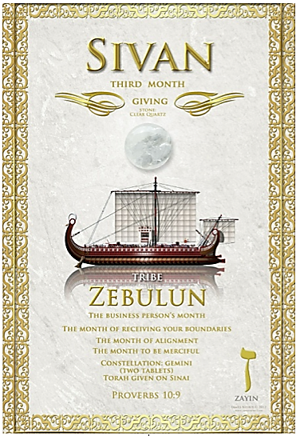
5785 Sivan 11
Re-alignment
Giving & Receiving
Power & Provision

Slide 2

The Power of
Yah’s Word
“Covenant”

Slide 3
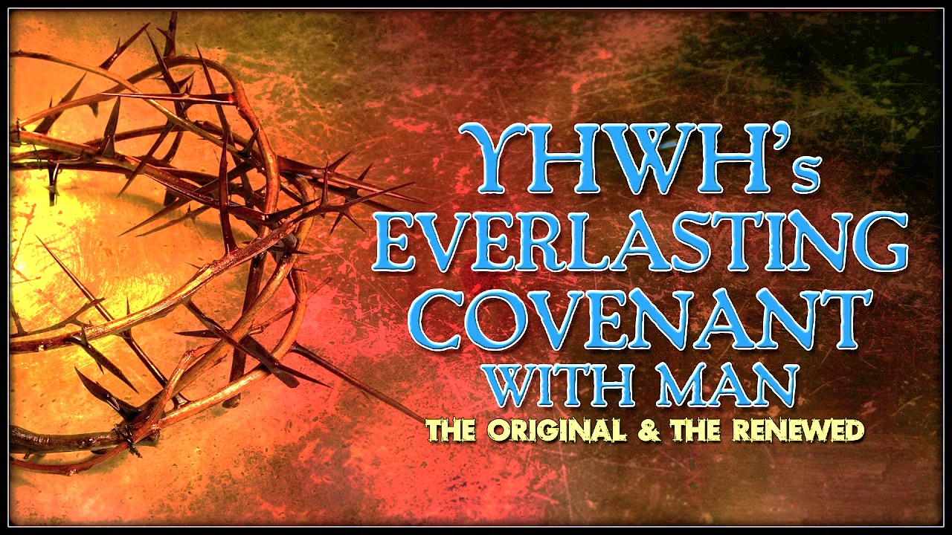
Renewed Covenant
The strength of a covenant is dependent on the faithfulness of the mediator.
Combine the covenant with the servant’s character (personal integrity) would be effective in sealing the covenant.

Slide 4
No one truly kept the covenant – Mercy
“But YHVH”
 | Grafted into Israel
Adam | Sinned & brought disobedience [Ro 5.16-19]
Noah | Effective in saving humanity
Abraham | Blessed & obedient on Mt. Moriah [Gal 3.19-20]
Moses | Faithful – unable to enter promise land
David | Loved by YHVH

Slide 5
Renewed Covenant in Messiah
Ezek. 34.23-31 Flock of Messiah [Jn 10.16, Rev 7.17]
Messiah, peace, blessing, deliverance & prosperity
Hosea 2.20-22: To the Bride
Eternal Life [John 17.3]
Isaiah 2.2-4; 42.1-4 The 1000-year reign of Messiah fulfills prophecy of all covenants & promises. [Rev 20.4-6]
We no longer must depend on fallible men. Our dependence is in Messiah “Seed”. [Isaiah 52.13-53-12] Who perfectly obeys His Father [Isaiah 50.4-9]
Rev 21.6; 22.17 (water is metaphor for Torah)
Isaiah 55.1-6 Universal call [Isaiah 56.6-8]

Slide 6
Faithfulness of YHVH
COVENANT | SCRIPTURE | PURPOSE
EDENIC | Gen 1 | RULE
ADAMIC | Gen 3.15-21 | REDEMPTION
NOAHIC | Gen 6-10 | RESTRAINT
ABRAHAMIC | Gen 15 & 17 | RESTORE
MOSAIC | Ex 19-24 | REVEAL
DAVIDIC | 2 Sam 7, 1 Ch 17.18 Jer 33.27, Ps 89 | REIGN
Y’SHUA MESSIAH | Jer 31.31-34, Isa 42.6; 49.8-9 56.6-8; 55.3-5, Mt 26.26-29 | RENEWED

Slide 7
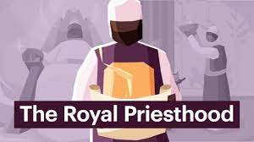
Key in Each Covenant
Holy Relationship & Royal Priesthood!
Adam
Noach
Abrahamic
Mosaic [Mi 6.4] King
David
Working & Worshipping

Slide 8

Our Covenant Keeper
Calls us to “Eat” Rev 2.7; 22.1-5
22.5 The saints will reign as priests in one kingdom as in Rev. 1.6
Y’shua Messiah has restored all things according to HaShem's will.
Say Amen! El Melekh Ne’eman
“God is a Faithful King”.

Slide 9
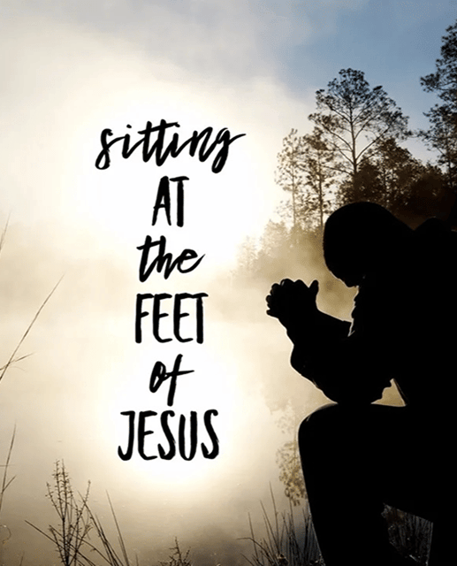
Homework
Connecting the Dots!
How does the covenant to Yah’s “seed” Messiah relate to me?
Do I see my inheritance in Messiah

Slide 10
WHO | DAVID
SCRIPTURE | Exodus
GIFT/PROMISE
CONDITIONAL OR UN-CONDITIONAL
PURPOSE
TEMP/PERM

Slide 11
Connecting the Dots…..
Yeshua
Renewed
Adamic
Noahic
Abraham
Moses
Davidic
Edenic

