Slide 1
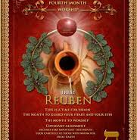
5785 Tammuz 23
A Month
of
Vision, Worship & Staying Devoted

Slide 2
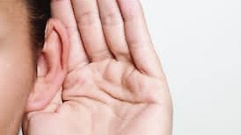
The Power of
Communication

Slide 3
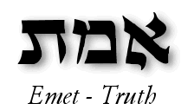
Communication
I.e., Daniel explained to Nebuchadnezzar in chapter 2
Ruach HaEmet Jn. 14.6, 15.26, 16.13
Gen. 2.3 Yah created reality to do La'asotַעֲשֽׂוֹת) is the infinitive of the verb asaשה), ) which means "to do" or "to make“.
During the singing of Adonai’s Name (YHVH) there was a huge comet or rock from space with the word “Truth” carved in it, in fire. On the Earth were the Pyramids. On them was written “False.” The Rock smashed into the Pyramids and as it crushed them, a vibration rippled through the Earth destroying every false thing.

Slide 4

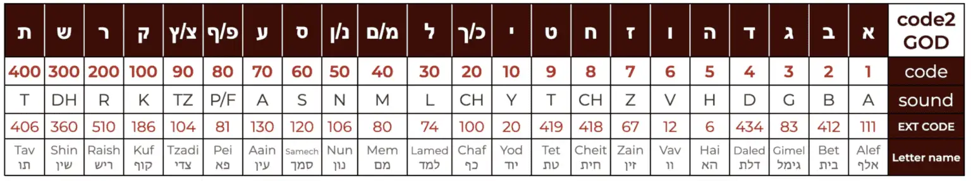

“EMET” is all encompassing since Emet is spelled with the first, middle and last letter of Hebrew alphabet.
If we remove the Aleph from the word, we are left with the word “dead”

Slide 5
Continue
“To do” means it is our responsibility as Yah’s creatures to complete doing of His creation.
TRUTH is about doing, not being, not just sincerity
Pilate asked, “What is truth”?
Truth is about Who (dynamic & forceful person) not what, a factual but complete wholeness.

Slide 6
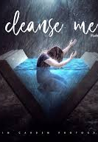
Communication
This morning after entering the Sanctuary and while sitting in the back, I smelled a fragrance that smelled like soap.
H1287 Borith (Bo-reeth) sope, soap
Jer 2.22 Addresses Judah’s idolatry. Human ingenuity, even with the strongest detergent, cannot erase covenant unfaithfulness.
Mal. 3.2 Emphasize both the pain & necessity of sanctification-Messiah’s purifying ministry among his people.

Slide 7
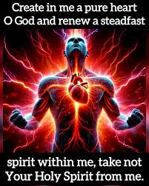
Continue
In both texts “soap” imagery underscores that covenant breach leaves an indelible mark unless Yahweh Himself intervenes.
Psalms 51.7 “Cleanse me with hyssop, and I will be clean.”

Slide 8
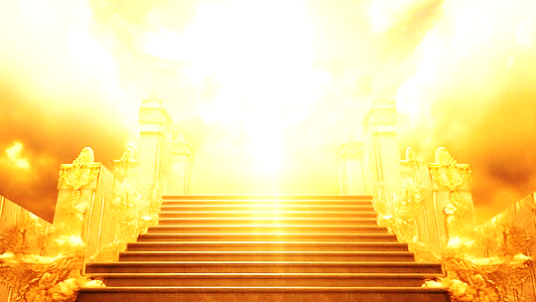
Communication
As I entered the Sanctuary during soaking, I heard ,”Who sits enthroned above the Heavens and earth? It is Adonai Tz’vaot. He is The Glorious One!”
The Lord of Sabaoth, While YHVH Sabaoth can be seen as an intimate God who is with us in the details of our human experience (like Hannah in her plight of barrenness) 1Sam1.11, He is also a warrior God who commands armies on behalf of His People. Amos 4.13

Slide 9
Communication
It is a dimension that Satan does not know. It’s the secret place of “The Most High” so when we’re operating in love then we get into a dimension that torments the enemy.
1Cor 13.2 Speak of the superiority of love over all gifts. If we don’t have love none of the gifts work
1 John 4.8
Love conquers Satan
Helps us to understand the attacks against husbands & wives, parents and children, body of Messiah.
As Pastor spoke about, “It is that serious”, I saw something like a chuppah around/over the cabinet.
The chuppah is covenant. Covenant is love and love, Yah’s unconditional love is foreign to the enemy
John 3.16
Colossians 2.6 Hiding place. Walking means we are walking inside of Messiah.

Slide 10
Communication
As Pastor brought up how the Lord is teaching us about The End times and preparing us before we go out to Garfield Park, I felt a sharp pain in my left outer ankle.
Am I going where Yah wants me to go?
As the Daniel Chapter 7 teaching started, I felt a sharp, quick pain in my right eye, but it felt as though it was the properties of the eye and travelled downwards in my face near my sinuses.
Symbolize understanding, insight, judgment, Divine observation, instructions.
Filled with light (generous) or dim (self-consumed)

Slide 11
HOMEWORK
How has Adonai revealed His truth and the future of things to prepare you to receive it?
Is there a dream/vision that Yah gave you that He is still expanding to bring full revelation?
Do you view Yah’s word differently after realizing that world history was revealed in the book of Daniel regarding Alexander the Great?
At what moment or point of time have you “Purged & Reset” during the study of the Book of Daniel?

Slide 12
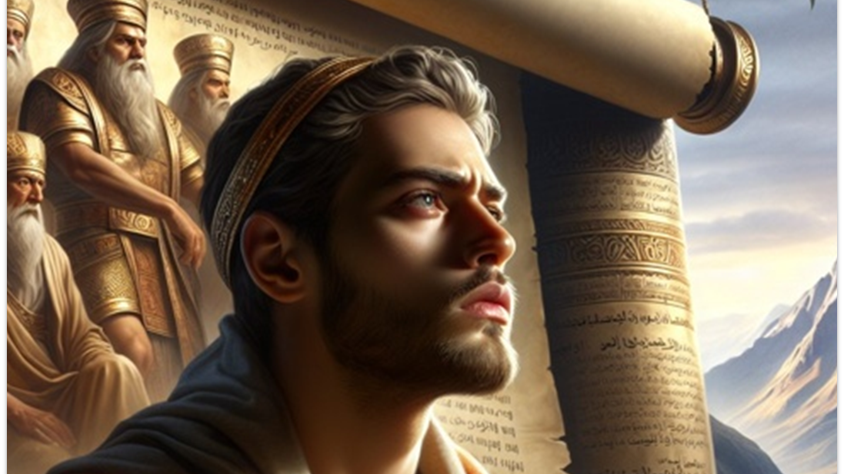
Book of Daniel
Chapter 5

Slide 13
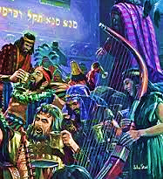
12 October
539 BC
“Wickedness is shallow in thought and action, either deliberately or intentional putting HaShem and His standards out of mind, needing to be reminded by someone wiser Who HaShem is.”

Slide 14
Daniel 5
Outer walls:17 miles, 22 feet thick, 90 feet high, guard towers 100 feet high gates made of bronze.
“Many today think that the best response to dangerous times is to forget about it and escape into the pursuit of pleasure.”
Drunkenness [Eph 5.18] “dissipation” meaning waste of resources, spiritual decline and linked to rejecting God’s commands. [Pro 23.31-35]
Belshazzar lost of self-control gave a blasphemous street party using the sacred vessels of Yahweh.
The purpose for using the Lord’s sacred vessels was a reminder to the party goers of previous victories even though the hostile joint forces of Medes-Persians were outside the walls.

Slide 15
Vs.5, 6“…Suddenly-same hour the fingers…the king’s hip joint & countenance changed…” The King cried out…v7 Bring the exorcists, astrologer, etc.
Advance and innovated: Square root , facts & figures, 60 sec & minutes, 360 degrees, Eco., receipt letters compound interest and dark arts.
Unable to interpret? Was there a veil over the minds of the sages? Everyone thrown into confusion.
Daniel is summoned after queen mother reminds him of a man with Yah’s spirit.
Queen refers to Daniel by his given name first (respect) then the name given to him.
Daniel interprets the ordinary Arabic units and weight. But before Daniel interprets, he tells the King that his sin is counted more gravely than his father because he failed to follow the lesson he knew & mocked the God of Israel.

Slide 16
EXAMPLES
Man collecting wood [Numbers 5.32-36]
Nadav & Avihvu [Leviticus 10.1-3
Achan [Joshua 7]
Anania & Sapphira [Acts 5]
Romans 1.18-23
Each person has enough knowledge to be held accountable.
Luke 12.47-48
For those who knew will be held more accountable.
Immediate judgment

Slide 17
Keep your gifts: Daniel rejected the King’s reward [Micah 3.11a]
Daniel knew that the fall of Babylon was now; and anything received would be short lived.
In the midst of a feast comes a supernatural hand; MENE, MENE, TEKEL, UPHARSIN," meaning that Belshazzar had been weighed in the balances and found wanting, and that his kingdom would be divided and given to the Medes and Persians.
The symbolism offer profound insights into Yah's sovereignty, judgment, and the consequences of pride and disobedience.
We have witness Yah's direct intervention in human affairs. It serves as a reminder of His ultimate authority and power over earthly kingdoms and rulers. The message written on the wall emphasizes the principle of divine accountability, in which even the most powerful rulers are subject to God's judgment.

Slide 18
Given to Medes & Persians
Babylon was conquered because of Yah’s hand and strategies. The Persian diverted the flow of the Euphrates into nearby swamp. Lowering the river so troops marched through the water under the gates. [Isa 45.7 & Jer 51.53,58]
Daniel is promoted [v29] and held the position for only a few hours. (temporary rewards & accolades of the world) Either Belshazzar knew Daniel was right and tried to do the best under the inevitable, or he disbelieved the whole thing.
Death of Belshazzar shows the reliability of Yah’s word.

Slide 19
LESSONS
v1 | When the party is at its highest, all is going well, the hand of the Lord will reveal a sobering message.
v1 | Yah’s servants are mocked, neglected and even hidden away, but there will come a time that the wicked will cry for the one who has the Spirit of Yahweh.
v2 | Do not use the holy things of Yahweh for the purpose of your entertainment.
v4 | If Yah held Belshazzar responsible for the ray of light he knew of, how much more the blaze of “Light” which illuminates from Y’shua will we be held accountable of a better witness.
Chapter 5

Slide 20
2030 AGENDA
1) No Poverty | 2) Zero Hunger
3) Good Health | 4) Quality Education
5) Gender Equality | 6) Clean Water
7) Affordable & Clean Energy | 8) Decent Work/ Eco. Growth
9) Industrial Innovation | 10) Reduced Inequalities
11) Sustainable Cities | 12) Responsible Consumption
13 Climate Action | 14) Life Below Water
15) Life On Land | 16) Peace, Justice & Strong Institutions
17) Partnership for the G.O.A.L.S.
Sustainable Goal (SDG) &
Global Digital Cooperation

