Slide 1
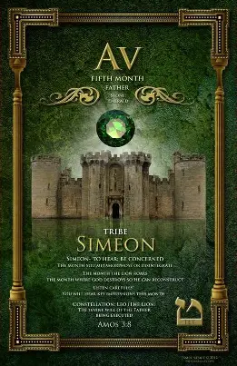
5785 AV 1
(AV = Comforter, Father)
Amos 3.8
Simeon - “Hear”
A Month
Of
Supernatural
Grace and Favor

Slide 2

The Power of
Communication

Slide 3

Communications
During the song ‘Let Praises Rise’, everyone in the Sanctuary was on clouds and as we sang the song, the sunlight rays hit us, and the rays became brighter.
Could this be an answer to prayer? [Num 6.25]
“To shine” reference to Hashem's presence, to make us light and bless us giving eternal life so others might be lit.
Dan. 9.17 Symbolizes the outpouring of Divine love and salvation [Ps 67.1-2]

Slide 4

Communications
Note: This is not contrary to His message of love and reconciliation, nor an endorsement for violence.
This sword involves spiritual separation, transformation by the power of Yah’s Word. Our allegiance to Messiah can and will bring hostility.
Again, this sword will require separation in relationships, political and religious.
During the song ‘Let Praises Rise’, I saw a large object that looked like a sword or a plumb line coming down from the sky.
Matthew 10.34-36: Y’shua is saying that His coming will bring conflict and division, metaphorically represents a sword.
His sword exposes sin and invites repentance.

Slide 5

“Divine standard do not bend to human preferences [Isa 38.17]
Isaiah 28.9-10: Idea of teaching line upon line, precept upon precept because of spiritual dullness and trivializing or resisting Yah’s word.
Perfect moral standard comes from our Creator, ensuring each stone (teaching) is aligned properly, maintain His accuracy.
Rather a sword or plumb line, that comes from the sky is none other than the perfect, unassailable Y’shua HaMashiach, that is Yahweh’s only source of salvation and holiness.

Slide 6
HOMEWORKK
Now that you have learned that “Truth” (emet) and “Love” is the God-head, how will you now view the reality of your life?

Slide 7
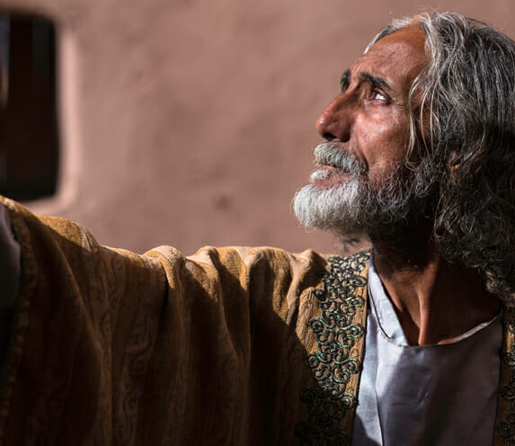
Book of Daniel
Chapter 6

Slide 8
Chapter 6
“How to live in these End Times”
Daniel is no longer being tested for his faith – He is simply found faithful
  He is around eighty years old. Out of retirement and is found once again standing in the favor of Adonai.
What can we find in chapter 6?
  Faithfulness of Daniel and how it leads to favor
  Integrity- A foundation of truth
  The value of a habitual Prayer life
  Demonstration of how Yahweh honor those who honor Him
  Trials that lead to greater testimonies
  How Adonai’s sovereignty overrules the schemes of the Adversary
  Adonai’s faithfulness
  Adonai’s protection
  Final lesson on how Adonai’s glory should be our goal

Slide 9
Chapter 6
Daniel proved himself more capable (integrity), so the King thought to set him over the whole realm.
Why did the chiefs & viceroys want to find fault with Daniel?
Could be jealousy
Halting corruption within the government
They can no longer improperly profit from their positions
King Darius divided the kingdom into 120 providences and appointed satraps over them.
Daniel is one of the three Prime Ministers who are to supervise and protect the King’s interest. (v2 So the king would not suffer lost)
His way to deal with corruption by false accounts.

Slide 10
Root to unseat Daniel
Spiritual deception. Unable to find carnal weakness to exploit, they resorted to the invention of a spiritual issue to separate the King and Daniel.
V.7 Was there a consensus or a lie? After all Daniel wasn’t at the meeting.
Daniel’s reaction to the decree was to be constant in action and thought. [1Thes 5.17- pray regularly]
Daniel is not engaged in a “crisis prayer meeting”, but he maintains what a lifestyle has produced.
The accusers did not simply tell the King that Daniel violated the decree, but stressed “He respects neither you, your majesty nor your decree...he continues to pray three times a day” Making certain there is a break in their relationship.

Slide 11
Note: The accusers believed that Daniel’s faith could be compromised, yet the king believed his faith would be affirmed.
Yahweh saved Daniel out of the lion’s den, not from it. Ps 146.1-6, Phil 1.20
Key thought in Daniel comes from 1 Peter 5.8-9 2 Timothy 4.17 & v. 23 “…because he trusted in his God.”
Darius & Daniel position (i.e., World’s & a Believer)
Darius had no peace vs. Daniel was at perfect peace
Darius in danger of his council vs Daniel by Yah’s protection held in safety
Darius struggled to save Daniel vs Daniel spoke to King of Glory
Darius was a slave vs. Daniel was a prince in Yah’s eyes

Slide 12
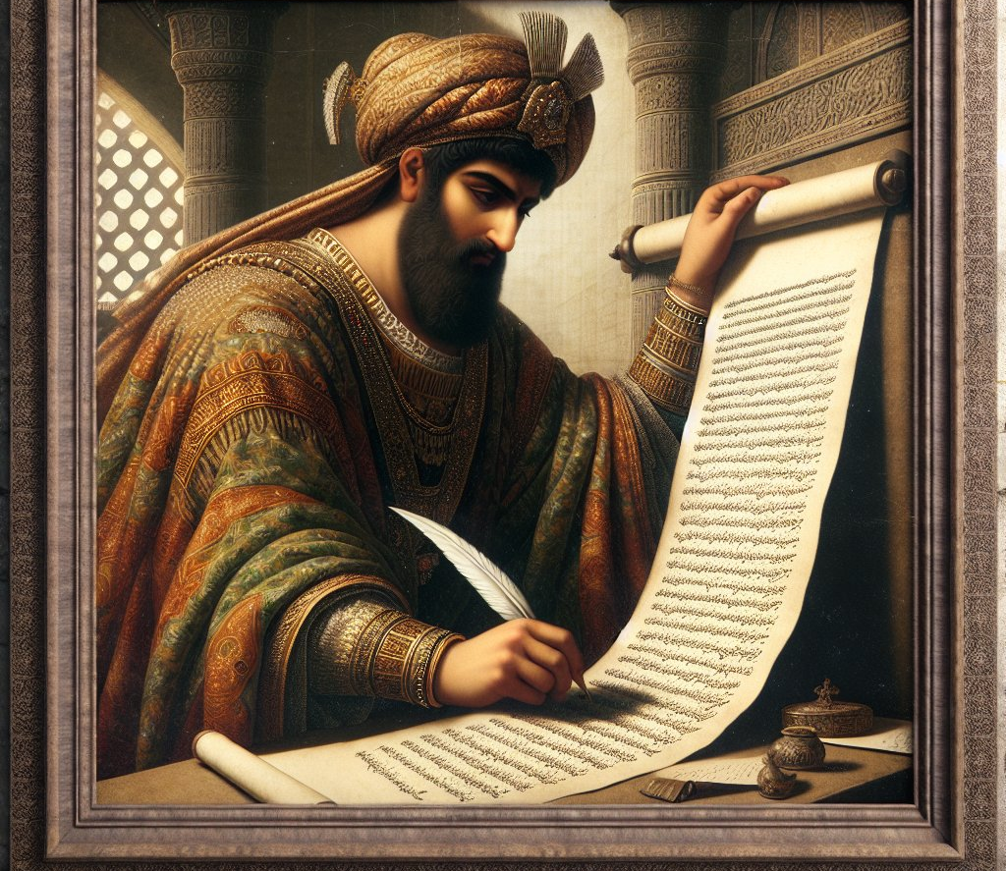
Daniel lived his entire adult life in an idolatrous and heathen land. [Jn 17.16] carries with it a testimony of commitment & faithfulness – of Yah & Daniel.
Ps 18.17-24
The same unyielding, unchangeable law that dictated Daniel to be thrown in the den was the same for the punishment of the offenders.

Slide 13
LESSONS
A believer’s life should serve as a dual witness: To some a testimony that encourages a heart to embrace Messiah; to others it is a testimony of judgment.
The only safe place is in the will of Yah. Should we not rather die in obedience to Yah and His way instead of outside His will? [Rev 2.10]
In these “end times” we cannot afford to wait and then engage in a “crisis prayer meeting”; be a house of prayer.
The Adversary will use men of the world to devour you, 1 Pet 5.8-9
Phil 1.20 “It all accords with my earnest expectation and hope that I will have nothing to be ashamed of; but rather, now, as always, the Messiah will be honored by my body, whether alive or dead.”
Chapter 6

Slide 14
2030 AGENDA
1) No Poverty | 2) Zero Hunger
3) Good Health | 4) Quality Education
5) Gender Equality | 6) Clean Water
7) Affordable & Clean Energy | 8) Decent Work/ Eco. Growth
9) Industrial Innovation | 10) Reduced Inequalities
11) Sustainable Cities | 12) Responsible Consumption
13 Climate Action | 14) Life Below Water
15) Life On Land | 16) Peace, Justice & Strong Institutions
17) Partnership for the G.O.A.L.S.
Sustainable Goal (SDG)
&
Global Digital Cooperation

