Slide 1
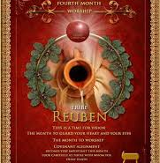
5785 Tammuz 16
A Month
of
Vision, Worship & Staying Devoted

Slide 2

The Power of Communication

Slide 3
Psalms 73:16, 17
The appendages and black sludge show us the call for purity in worship, not just external rituals but the inner disposition of the worshiper.
It may seem that the height and prosperity of the wicked is sure, but it has an end. All things will come to an end in the sight of righteousness (Sanctuary of God).
The Psalm speaks of the transformative experience of Asaph when he entered the sanctuary of Yahweh.
He took his doubts and uncertainties into the Sanctuary of Yah and there in the calmness of the sacred court it repress the spirit of murmuring and doubt.

Slide 4
New Year 5786 ENGLISH
5 HEY: Grace/revelations
7 ZAYIN: Weapon, crown spiritual warfare, completion (sustain)
8 CHAT: Life, new beginning or gates
6 VAV: hook or nail, humanity connection
A year of grace, with spiritual conflict allowing new beginnings with human connection and sacrifice unto Yah.

Slide 5
New Year 5786 HEBREW
5000 Current millennium/omitted
400 TAV: Sign, mark, seal, final, judgment (drawing divine line) end of season, beginning of fulfillment or shifting
300 SHIN: Teeth, Judgment, refining fire, purifying
80 PEY: Mouth, speech, power of Yah’s word, prophetic voice
6 VAV: Hook/nail, Connecting, critical joining, securing alignments, #man, transition (counterfeit 2Thess 2.3 political, spiritual, globally)
“Sealed & marked (TAV) for judgment or deliverance, set into the fire for refinement or wrath (SHIN) as decreed by the Word of Yah (PEH) according appointed times of Yah’s calendar.”

Slide 6
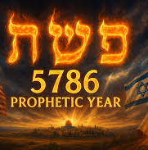
Month of ELUL
COMMUNION BETWEEN HEAVEN & EARTH
(Yom Teruah /Rosh Hashanah)
Year of transition & potential
New Beginnings
1) Second Pandemic
2) Consequences of:
Acts of compromise
Covenant Violation

Slide 7
HOMEWORK
Read Daniel chapter 7, Rev13:1-9 chap.17
In what way(s) did Nebuchadnezzar’s approach to Adonai’s revealed truth in chapters 3 & 4 give warning to you?
The “Men of Judah” said to the King “…if our God, whom we serve, is able to save us, He will save us from the blazing hot furnace and from your power. But even if he doesn’t, we want you to know, your majesty, that we neither serve your gods nor worship the gold statue which you have set up.”
On what occasion have you presumed Adonai’s will, and became fatal to your faith?

Slide 8

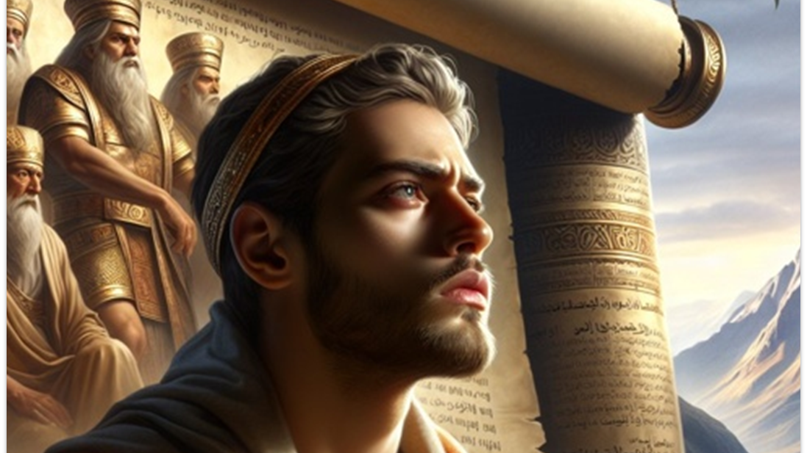
Book of Daniel Chapter 7

Slide 9
Introduction Chapter 7
Chapters 1-6 Tells the history of Daniel in a gentile court
Chapters 7-12 Tells of the future events from the time of Daniel and after
In this vision of Daniel’s, God has a way of revealing the truth and the future in a way as to prepare the heart to receive it
Adonai uses the principle of repeating and expanding about the meaning of the prophecies.
Unlike Neb. [1Cor 13.12] Daniel dream/vision was written down main facts with the importance of future comfort and wisdom. (Book of Rev. reveals more)

Slide 10
Daniel 7
SUCCESSION
Nebuchadnezzar | 43 yr reign Jer 27.5-8
Merodach (son) Assassinated by brother-in-law | 2 years 2Ki 25.27-30, Jer 52.31
Nergla-Sar’etzer | 4 years Jer 39.3,13
Laborosoarchd Beaten to death | 9 months Not in the canon-written by Ptolemy
Naboniduse Appointed by gang | Went to fight Medo-Persians army
Belshatzar Co-regent
7:1 In the first year of Belshatzar

Slide 11
Daniel 7
“Great Sea” Mediterranean Sea (each empire mentioned had a geographical connection) arousing the beast from its depths.
4 Winds: Cardinal points represent turmoil, strife, war and destruction. Hostile, unruly yet under Yah’s control [Ps 104.6-9; 148.7, Job 26.12-13] [Jer 25.31; Rev 7.1, 3
The Sea is sometimes used as a picture of the gentile nations [Ps 74.13; 89.9, Isaiah 57.20]

Slide 12
4 Beast Parade of Gentile History [2Pe 1.19]
Lion: “King” But this beast was humbled (wings were plucked off) given a human heart.
This is what happened to King Neb/Babylon (its wings i.e., (kingdom taken away) then returned by Yah’s grace. [Jer 49.19-22]
BEAR: Slower, stronger crushed the lion. Had a ravenous appetite for conquest. (Medo-Persian empire/partnership)
3 Ribs: Military conquest of Babylon, Egypt & Lydia. Overwhelmed by size & strength.

Slide 13
4 Beast
4^{th:} Horned, dreadful with extra horn.
Indescribable, uniquely horrific in power & conquest.
Roman Empire, most unified & enduring of all
Another horn that disposes 3 by its roots. Boastful mouth (speaking pompous words)[Rev 13.5]
The horn: Antichrist government or administration Rev 13.5-6
Anti-Christ coming through 2030 - United union
LEOPARD: Sudden, unexpected attacks rep. by 4 wings & 4 heads. Greeks.
Alexander conquered world by age 28.
At death divided 4 parts (Casander, Lysimachus, Seleucus, Ptolemy)

Slide 14
Little Horn with eyes & 2030
Its arrogance broke far beyond the other kingdoms, so judgment is pronounced upon it.
But, before judgment it was overcoming the saints (cruel & systemic pressure). Dan 7.25
17 Sustainable goal & Global Digital cooperations
In this global control governance, every road will lead to undo free speech and determine what needs to be heard.
Reshape our world
2030 is made up of experts not those voted by democratic system.

Slide 15
2030 AGENDA
1) No Poverty | 2) Zero Hunger
3) Good Health | 4) Quality Education
5) Gender Equality | 6) Clean Water
7) Affordable & Clean Energy | 8) Decent Work/ Eco. Growth
9) Industrial Innovation | 10) Reduced Inequalities
11) Sustainable Cities | 12) Responsible Consumption
13 Climate Action | 14) Life Below Water
15) Life On Land | 16) Peace, Justice & Strong Institutions
17) Partnership for the G.O.A.L.S.
Covers All Life and everyone on earth.

Slide 16
7.9-10 “Ancient of Days”
The Judgment of the fervent splendor of the heavenly court.[Rev 1.14;20.4]
Judicial authority was displayed in the river of fire (vast destruction, Isa 66.15-16 and thousand at His call Rev 5.11.
Thrones i.e., Rev 4.4
Son of Man [Rev 1.13;14.14] He was given everlasting dominion [Jn12.34]
7:11-14 The horn is conquered by the Son of Man! Daniel 7.26
Kingdom & dominion given to saints of Most High (Millennial earth)

Slide 17
DANIEL “Little Horn” | REV. Beast “Anti-Christ”
BEAST: Daniel 7.8 [7.7, 11, 19, 23] | TEN HORN v. 12; Rev 13.1; 17.3, 16
Persecute Saints 7.25 | Persecute Saints 13.7
Destroyed by Messiah 7.26-27 | Destroyed by Messiah at return 2 Thess 2.8; Rev 19.19-20
Authority give 3 ½ yrs. 7.25 | Rev. 13.5
Wage War 7.21 | Power to make war Rev 13.7
Yah interrupts & est. His Kingdom 7.11, 26 | Yahweh est. His Kingdom Rev, 19.19-20
Posse eyes & mouth speaks 7.8 | Mouth speaks arrogant & blasphemies Rev 13.5

Slide 18
Lesson
It is easier to die for Messiah than to live for Him under constant harassment and strain (these are saints during tribulation)
Do not simply spiritualize God’s word or believe it to be fulfilled in early church therefore it has no merit for today.
As Daniel when we encounter Yah powerful vision our countenance should change.
If a teaching or word does not align with Yah’s standard it is from Antichrist spirit.
Do not expect a peace-loving world in last days.

Slide 19
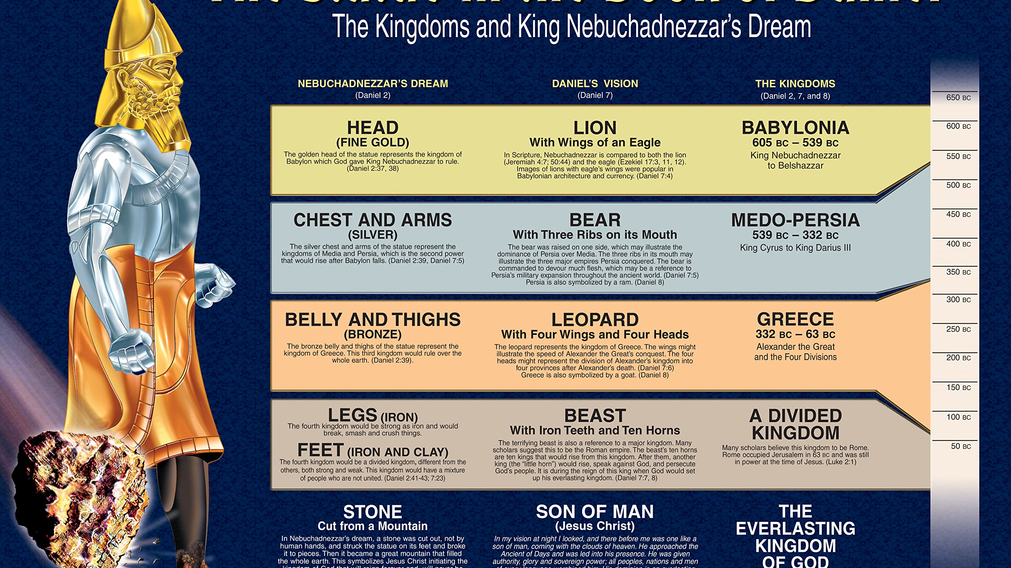

Slide 20
TIMELINE
Alexander the Great and his generals (the goat).
Kingdom of Ptolemy I Soter (Egypt)
Kingdom of Cassander (Greece)
Kingdom of Lysimachus (Turkey)
Kingdom of Seleucus I Nicator (Syria) ending with Antiochus IV in the Kings of the North in Book of Daniel

Slide 21
VISION | DANIEL | REV
3 ½ years | 12.7 | 11.9, 11
10 Horns | 7.8 | 12.3; 13.1;17.3, 8
Lion, Bear, Leopard | 7.4-6 | 13.2
Boasting Mouth | 7.8, 11 | 13.5
War against Saints | 7.21 | 13.7
Beast Statue | 3.5-7, 15 | 13.15
Son of Man | 7.13 | 1.7; 14.14

