Slide 1
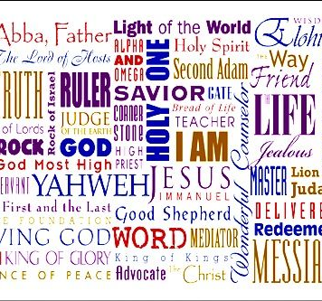
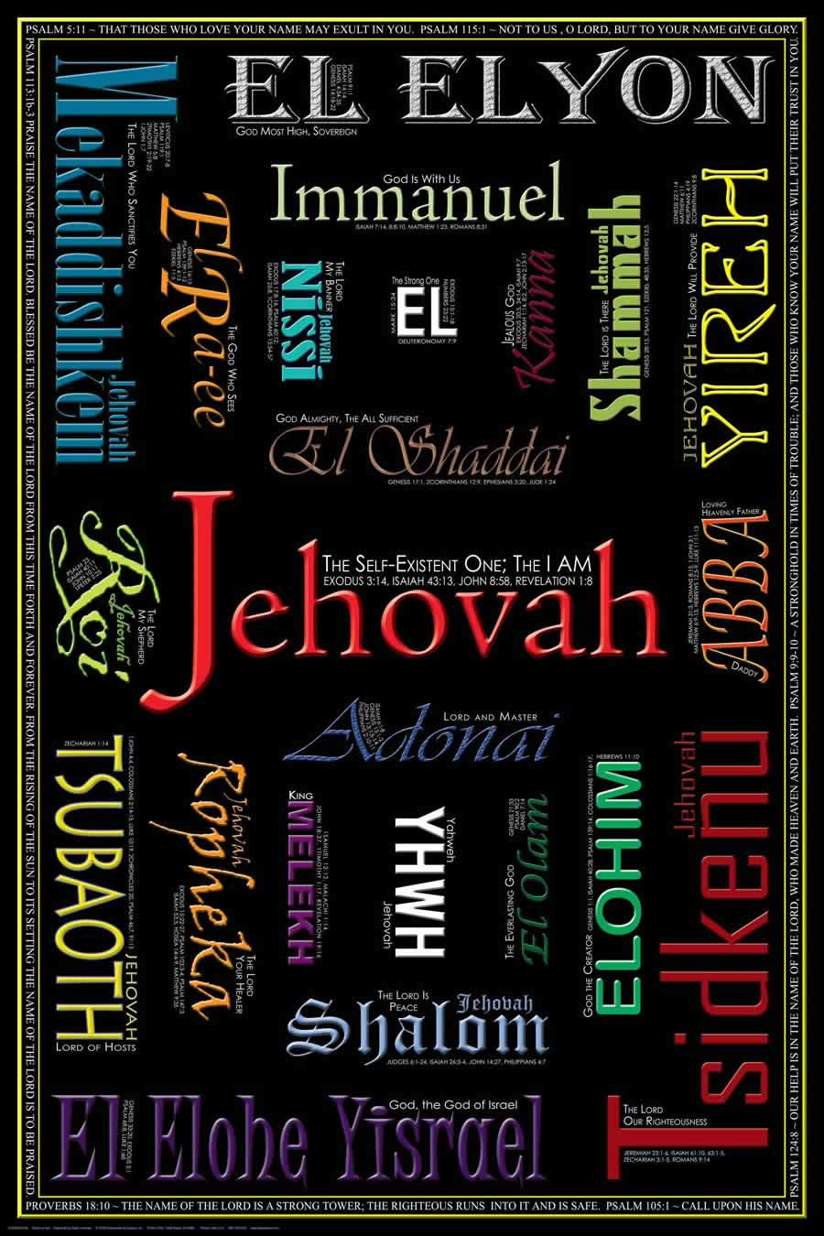
OPEN INTERCESSION
Prayers for the
lost, sick, mercy, grace thanksgiving,
Hand of Adonai.

Slide 2
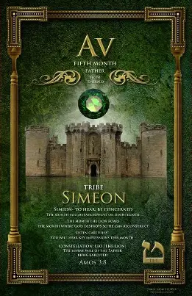
5785 AV 22
(AV = Comforter, Father)
Amos 3.8
Simeon - “Hear”
A Month
Of
Supernatural
Grace and Favor

Slide 3

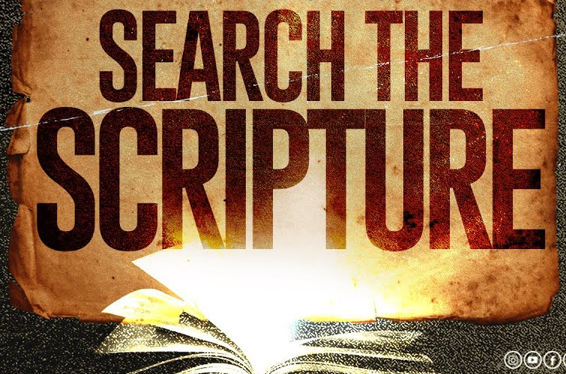
HOMEWORK
From each chapter of the Book of Daniel write one thing that describes “How you should Live in These End Time”.

Slide 4
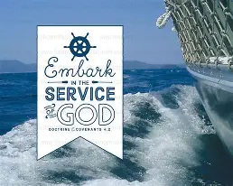
Upcoming Yom Teruah
September 21st Holiday Boat Charter
Warring in the atmosphere and Commanding the Corners
“Warfare is an honorable pursuit; it’s fought by Yah’s people for His purpose.”
1Sam 21.6(5) & 2Sam 11.6-13
September 23rd FOTBG 6:30 pm

Slide 5
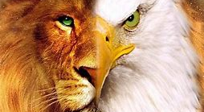
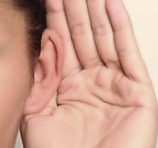

The Power of Communication Amos 3.7-8

Slide 6
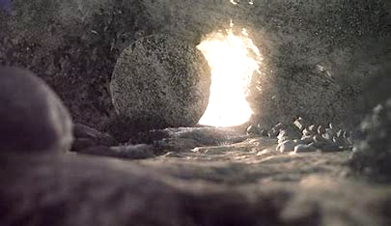
Communication
As the Community was bowed down to Yah during the Teaching, there was a person in a sealed cave with a stone over it. It was dark. The person had sores, malnutrition and their eyes were weak. The stone was removed by a being dressed in light, the being reached out his hand to the person in the cave. Then the person grabbed the being’s hand and was walked out of the cave. The being put ointment on the sores and touched the person’s eyes and fed them.

Slide 7
Continue
SEALED inside of a cave; represents a place of darkness (mental, spiritual & demonic torment)
STONE covered it: Illusion of being caged in-convinced without truth, self-sabotage.
SORES/Scars: Emotional trauma, broken relationship, rejection, doubleminded, etc.
(Our scars do not define us its used in our witness & testimony of the faithfulness of Yah.) Ro 8.16-17, Phil 3.10, 1Peter 4.12-13,16
MALNOURISHED & WEAK EYES: No Word or consistency, false, error, milk. There is no spiritual insight, their reality is seen through the scars.
Hashem sends rescue and the person received what has been offered. Y’shua opened the graves & triumph over the enemy [Col 2.11-15]
OINTMENT: Ez.16.8-9, Jer 8.21-22 Leaves Ez 47.12, Ps 1.2,3, Rev 22.2

Slide 8
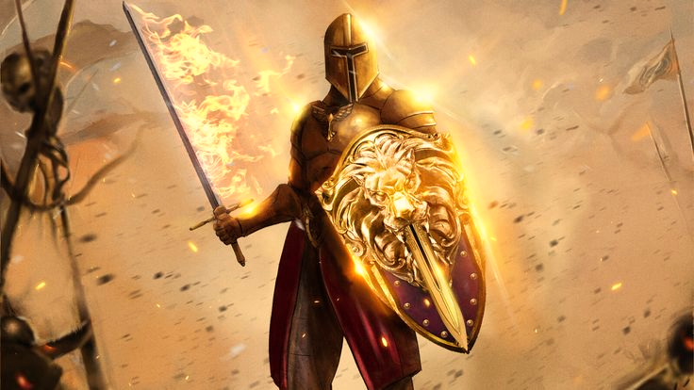
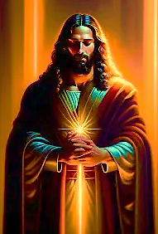
Communication
During the song ‘Spirit of The Lord’, I saw Yahweh above the white of the room, and he had something like armor on that shown brightly.
The High Priest had 2 sets of clothing (white/gold) when the gold was worn with his crown inscribed on plate of pure gold he held a golden image. [Ps 21.3, Isa 13.12]
This golden image of Messiah is only a reflection of His real appearance-gold describes Messiah who shines with the glory of Yahweh.

Slide 9
Communication
After the song ‘Spirit of The Lord’, Yahweh said, Pray again for Garfield Heights”.
Jeremiah 29.7 “Seek the welfare of the city to which I have caused you to go into…pray to Adonai on its behalf; for your welfare is bound up in its welfare.”
2 Chr. 7.13 “Use our authority and power over Garfield-help us prosper in things of the Lord”.
Josh 1.3 “Every place the soles of our feet tread on”
2Ki 6 Elisha & prophetic insight to see the plans of the enemy to prevent disaster (King of Syria planned to send troops & take Israel.
1Chr. 4.10 Jabez prayer was not just about enlarging his territory, but He invoked in confidence; prayed according to Yah’s plan and purpose.
Show us how to set the soles of our feet on all the land and take up doorway so we can dig more wells and vineyards and plant so the lost will come into the kingdom.

Slide 10
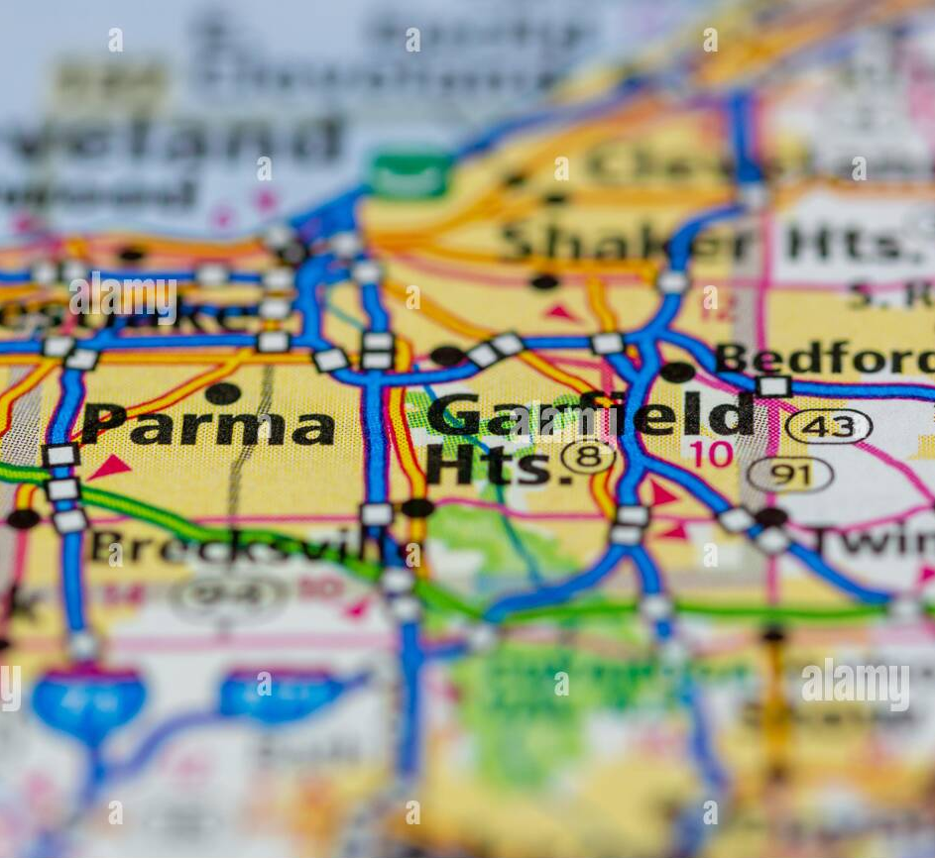
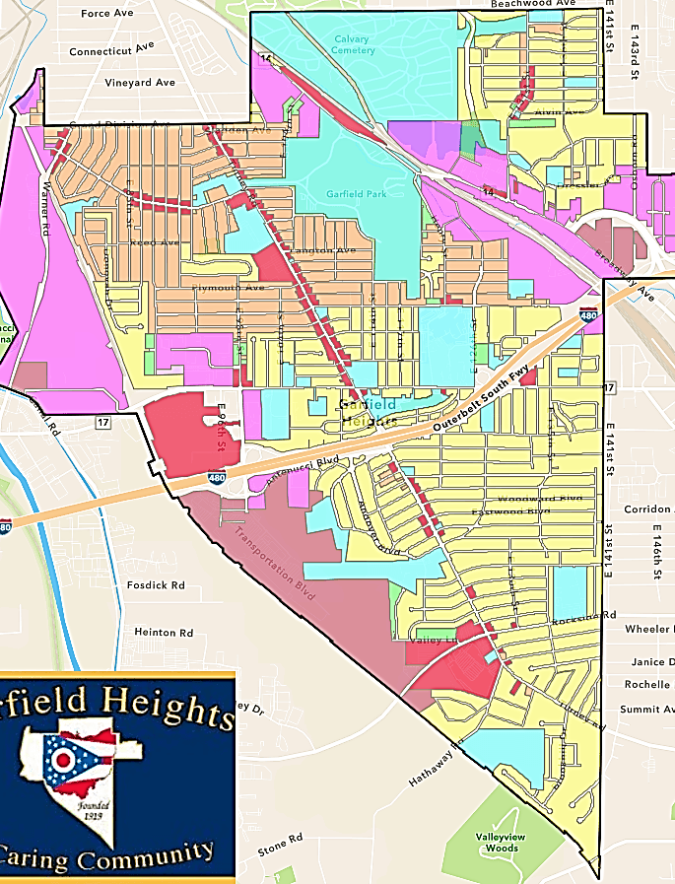
Garfield Heights
Spiritual Mapping
Schools & Board of Ed.
[Ps 127.3, Mt. 19.14]
5 Elementary (1charter)
1 Middle
2 High (1 charter)
Churches
“They have not prayed according to My will.” [Ez 9.1-2]
3 Exits off I480 (portals)
“Your descendants will possess the gates of their enemies” [Gen 22.17]
Accurate Assessment
& Preparedness

Slide 11
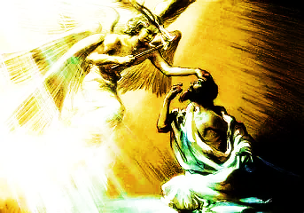
Communication
Then pointed to the ones they did not go to; however, I could not see who the individuals were who were not touched
As The Body laid before The Lord during the Daniel Teaching, I saw bright beings or angels go to (some) individuals in The Sanctuary (Ruach said, “The Holy Place – My High Holy Place where my people run to and are safe”).. The angels touched the people they went to with something like coals that were aflame while smiling. [Isa 6.6-9]

Slide 12
Communication
‘While we were on our faces giving up our issues/struggles to The Lord after confessing fear, I heard “Gideon”.
Judges 6.1-16 esp. v.3 ”Cycle of forgetting and remembering”
Even though Israel witness the previous miraculous events, written in the scrolls, and taught, passed down, people discount and forget what they personally had not experienced
Human behavior and memory often focuses on immediate circumstances.
Trauma, oppression and disobedience can and will overshadow, making the idea of deliverance distant and feeling remote. Yet, Y’shua said He would never leave nor forsake.
Here is Yah’s invitation to testing and trusting. No need to layout a cloak.

Slide 13
Communication
As Pastor prayed for us that Yah would wash us and we would burst out anew, I heard, “Na’aman”.
2 Kings 5.1-27
Highly admired captain of the army of Aram.
Secret struggle (leper) stronghold familiar spirit, etc.
Entreats Elisha-there is no pomp, no elaborate solution. “Go wash in the dirtiest of rivers and be clean.”
i.e., bowing down or laying before Him.
Jordan River was an obstacle and pathway for many (Abraham & Lot, Moses & Israel)
Reveals profound encounter with Adonai’s power, grace, universal plan for humankind. (How does Y’shua’s blood make you clean?)
Luke 4.27 Adonai’s plan transcends culture and boundaries.

Slide 14
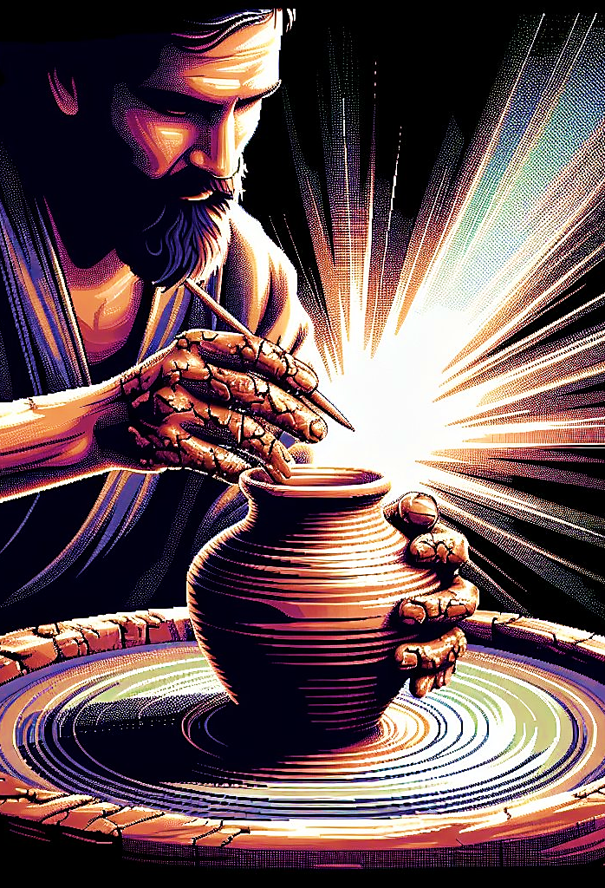
Communication
During Soaking, I saw what appeared to be the Hands of the Lord around a clay cup spinning on a potter’s table. The Lord was using His finger to sculpt the clay cup. He was peeling away some pieces while at the same time etching something into the clay cup. When it was time to make the handle, the Lord sculpted the handle around His own hand as if fusing the clay cup to Himself.

Slide 15
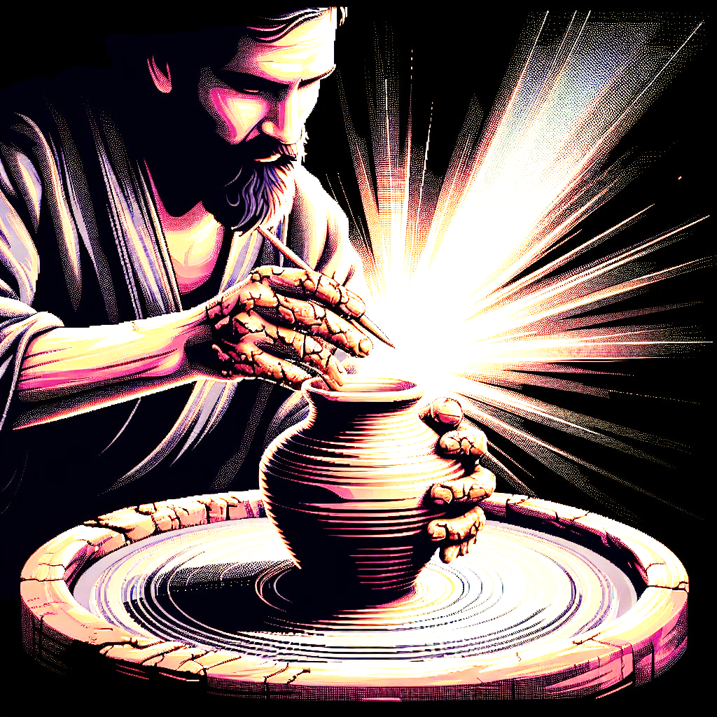
Jer. 18.1-10 Jeremiah was instructed to go to the Potter’s house there Adonai would reveal His message.
Purposefully shaping the clay with the intent of beauty and usefulness in mind. Something goes wrong the clay became disfigured in his hands-it wasn’t responding to the Potter’s touch. It was falling short of its purpose, delaying its fulfillment.
The clay wasn’t thrown away-the Potter reworked it, unrelenting.
In the vision the Lord fused it with His own hand, reminding us of Yah’s abundant grace despite human sin He will bring to pass His overarching purpose through us.
The Potter’s Wheel continues to turn!

Slide 16
2030 AGENDA
1) No Poverty | 2) Zero Hunger
3) Good Health | 4) Quality Education
5) Gender Equality | 6) Clean Water
7) Affordable & Clean Energy | 8) Decent Work/ Eco. Growth
9) Industrial Innovation | 10) Reduced Inequalities
11) Sustainable Cities | 12) Responsible Consumption
13 Climate Action | 14) Life Below Water
15) Life On Land | 16) Peace, Justice & Strong Institutions
17) Partnership for the G.O.A.L.S.
Sustainable Goal (SDG)
&
Global Digital Cooperation

Slide 17
Sustainable GOALS
What is it or What’s its purpose?
What does Yahweh say about it?
What are the benefits?
Are there areas that does not offer clear understanding?
How will it affect Body of Messiah as well as all humankind?
What is being taken away?
No Poverty Francis
Zero Hunger De. Leigh
Good Health Robin

