Slide 1
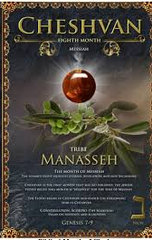
5786, 10 Cheshvan
1Kings 6.38 “Bul”
8th Month (Judgment, hardship & new beginnings)
Tribe of Menasheh (Manasseh)
HEBREW LETTER: Nun (50)
SYMBOL: Palm tree [Ps 92.12]
STONE: Onyx

Slide 2
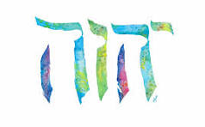
SING MY NAME
Isaiah 44.5
“One will say, I belong to Adonai, another will be called by the name of Ya’akov, yet another will write that he belongs to Adonai and adopt the surname Isra’el”
(Ps 29; 1Ch 16.28-34)

Slide 3

Difference between
Authority
(Exousia G1849)
&
Power
(Dunamis G1411)
Authority | Always attached to obedience. Therefore, it only come through a relationship (oneness & effort) with Yahweh. Mt 9.6; 86;10.1 Luke 10.19 “Authority to tread…”
Power | Power is a gift; its creative Acts 1.8
Lk 17.11-19 | Healing: Removal of something Miracle: To make one whole

Slide 4
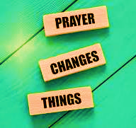
Intercession & Supplication
NIGERIA
DETROIT
Christians being slaughtered
Sharia Law Overthrow

Slide 5
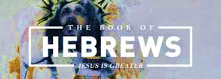
CHAPTER TEN

Slide 6
Torah (teaching)
Refers to first five (5) books of the Bible.
“Has in it a shadow of the good things to come [John 1.1]
Luke 24.27 “Then, starting with Moshe and all the prophets, He explained to them the things that can be found throughout the Tanakh concerning Himself.”

Slide 7
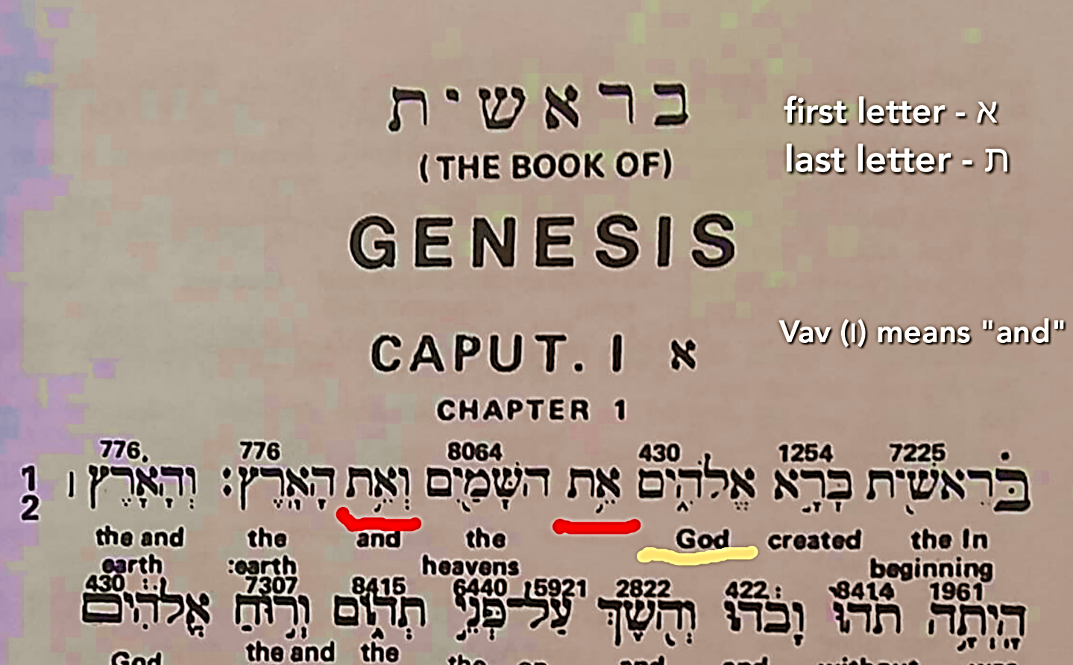
Alef & Tav
Beginning & End [Rev 1.8; 11; 21.6a, 22.13]
את is the 4th word, the number 4 in Hebrew points to the Messiah! For instance, the 4th day of creation we have YHVH creating the greater light to rule the day (foreshadow of Yeshua) [Gen 1:14-19]

Slide 8
1) GENESIS: Eden | Tree of Life: Source of eternal life Rivers: Life giving Angel of the Lord
ADAM (1st & Last) | Both direct seed of Yahweh. Story of redemption (Salvation 152 times in OT)
2) EXODUS | Blood of the sacrifice/Doorpost (Passover Lamb) Torah, Consecrated Priest, Melchizedek Moedim (appointed days)
3) LEVITICUS | “Spiritual center of 5 books” Direct message of Yah, Holiness, Miskan, Atonement & Ark.
4) NUMBERS | Tribal names Ruben “I see a son” Judah “praise” Tallit, Temple, Bronze Serpent, Mediator
5) DEUTERONOMY | A Prophet i.e., Moshe Fire by night, cloud by day

Slide 9
“The” BLOOD V.4
Leviticus 17.11 (hemoglobin is fluorescent, it emits high energy, which is light)
The blood of an animal was to forgive past sins – a year at a time.
Yeshua’s blood is retroactive, meaning it's timeless to forgive past, present & future sins.
The living component of our soul resides mostly in our blood, it is the first to live, last to die.
The blood nourishes and transports liquid to all organs
Yeshua’s blood had the DNA of Yahweh

Slide 10
V5 “It has not been your will…”
What Yah always wanted was absolute loyal obedience to His will.
That desire has been realized [Ph 2.7, 8] Messiah identified Himself with humanity to such an extent that His life of total obedience to the Father, became the act of obedience for all who acknowledge & identify with Yeshua and are set-a-part.
Every Believer now stands perfected by means of the perfect obedience of Yeshua Messiah [Ro 5.18, Heb 5.8-9]

Slide 11
Consciousness of Sin & Permanence
Impossible for animal’s blood to ‘permanently’ take away sin. Lev 5.16b the involuntary death of irrational beast was a visible symbol of something better.
It is the willing dedication of a man’s total divine will to offer His blood one time [1Sam 15.22, Hos 6.6, Ps 51.18, 19]
V11: Sin will be a force on earth until the Messianic Age and Yeshua banishes Satan.
V13: “Footstool”, is a metaphor for decisive defeat of the enemies [Joshua 10.24, Psalm 110.1]
Read Verses 16, 17

Slide 12
HOMEWORK
Just as the priest received an animal for the worshipper’s sin offering, it was the animal that was examined for flaws, not the worshipper. So, the Father examines the Lamb (Messiah) not you when you have sinned. Since this is the case, what should your answer be when the Adversary begins to accuse you, speaking in your ear and taunting you? Give one scripture as your answer!

Slide 13
V19 “Confidence to use the way into…”
After confronting our theological views on the Superiority of Messiah against the inferior mindset, he returns to the real purpose of Book of Hebrews.
Urges Believers to take advantage of the privilege of worship and drawing near the presence of Yahweh.
Confidence (If we don’t have confidence, we will be handicapped in our walk)
Blood of Yeshua (expressed freedom of speech)
High Priest waiting beyond the veil the Most Holy place
Rejoice have boldness (a vivid sense of freedom) bring request to Yah.

Slide 14
V24-25 “Keep paying attention to one another…”
Yahweh designed humans for community and warns against isolation.
Mutual interaction of Believers is necessary for one to be assured of continual spiritual development.
Isolation is unthinkable to the writer- when one had leprosy they were isolated from community.
Isolation (Me, Myself & I) Proverbs 3.7; 26.12; 14.12
“The most effective and fruitful Believers are those who distrust themselves enough to seek out guidance.” [Pr. 28.26; Jer 17.5; 9]
Sweetness of friendship Proverbs 27.5-9

Slide 15
V26-31 Warning against defecting
The coming day of judgment is reason for continued mutual edification in love and good works.
A true Believer will have a lifelong commitment to stay focused on Y’shua Messiah not self.
Jn 14.6 “Way, Truth and Life”
Explains the consequences of apostasy-psychologically hardened to the point where one sees no redeeming value in Messiah’s death.
Now considers Messiah’s sacrifice as common and cheapens it.
There is no more sacrifice for him, only thing he can look forward to is a greater judgment.

Slide 16
Call to Endurance
The normal routine of life, uninterrupted by persecution, is often the real test of genuineness of one’s stability (spiritual drifting, sluggishness & lethargy)
The need to persevere, be patient and do the will of Yah. You will receive His promises. He is coming!
This will lead to preservation of one’s soul.
The distress of imprisonment, loss of property is less difficult than death itself. However, they had persevered in all such abuses because of the certainty they had of better & lasting eternity.

