Slide 1
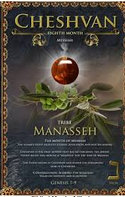
5786, 17 Cheshvan
1Kings 6.38 “Bul”
8th Month (Judgment, hardship & new beginnings)
Tribe of Menasheh (Manasseh)
HEBREW LETTER: Nun (50)
SYMBOL: Palm tree [Ps 92.12]
STONE: Onyx

Slide 2
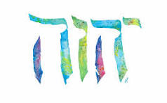
SING MY NAME
Isaiah 44.5
“One will say, I belong to Adonai, another will be called by the name of Ya’akov, yet another will write that he belongs to Adonai and adopt the surname Isra’el”
(Ps 29; 1Ch 16.28-34)

Slide 3
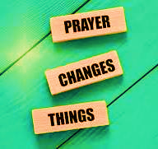
Intercession & Supplication
NIGERIA
“The United States cannot stand by while such atrocities are happening in Nigeria, and numerous other Countries,” he added. “We stand ready, willing, and able to save our Great Christian population around the World!”
Christians being slaughtered

Slide 4
Intercession & Supplication
Dearborn Heights Police Department in Michigan was considering allowing its officers to wear an “optional patch” on their uniforms that includes writing in both English and Arabic.
“They told us they were trying to establish a caliphate. Are you listening now?”
Nov. 6th Governor Abbott bans Sharia Law in Texas
DETROIT
Caliphate: The rule & reign of a chief Muslim religious ruler
Sharia Law Overthrow

Slide 5
Night Watches Intercession for January & February
WATCH HOUR | DATE
3rd 12:00 midnight 3:00 am | Jan 1-10th
4th 3-6:00 am | Jan 11-20
21-31st Reflect, revelation, direction, encourage, answered prayers
1st 6-9:00 am | Feb 1-10
2nd 9-12 noon | Feb 11-20

Slide 6
Mark 11.22-26
Y’shua gives us our weapon to exercise an effective prayer life!
Have Faith in Yahweh
Speak to the mountain
Do not doubt but believe
You will have what you say
Walk in forgiveness toward all
James 5.16 Righteous Believer should be armed with effective prayers
Effective: One knows how to pray properly
Fervently: To put forth with power

Slide 7
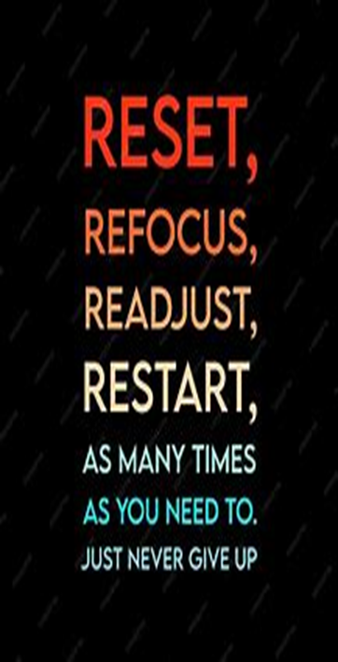
Clean the Holy Space
Ezekiel 42.13-14 Room set aside for holy things of Yah
Nehemiah 13.4-9 Serve notice and put them out.

Slide 8

PURGE & RESET
Recognize
Repudiate
Remove
Restore

Slide 9
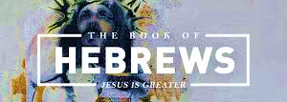
CHAPTER ELEVEN

Slide 10
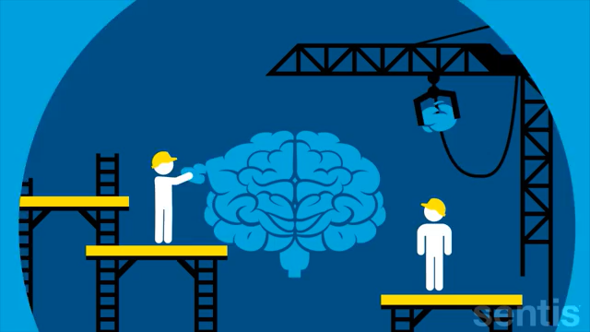
Neuroplasticity is the medium of neural network in the brain to change through growth and reorganization.
Neuroplasticity refers to the brain's ability to reorganize and rewire its neural connections, enabling it to adapt and function in ways that differ from its prior state. Occurs in response to learning new skills, experiencing environmental changes, etc.

Slide 11
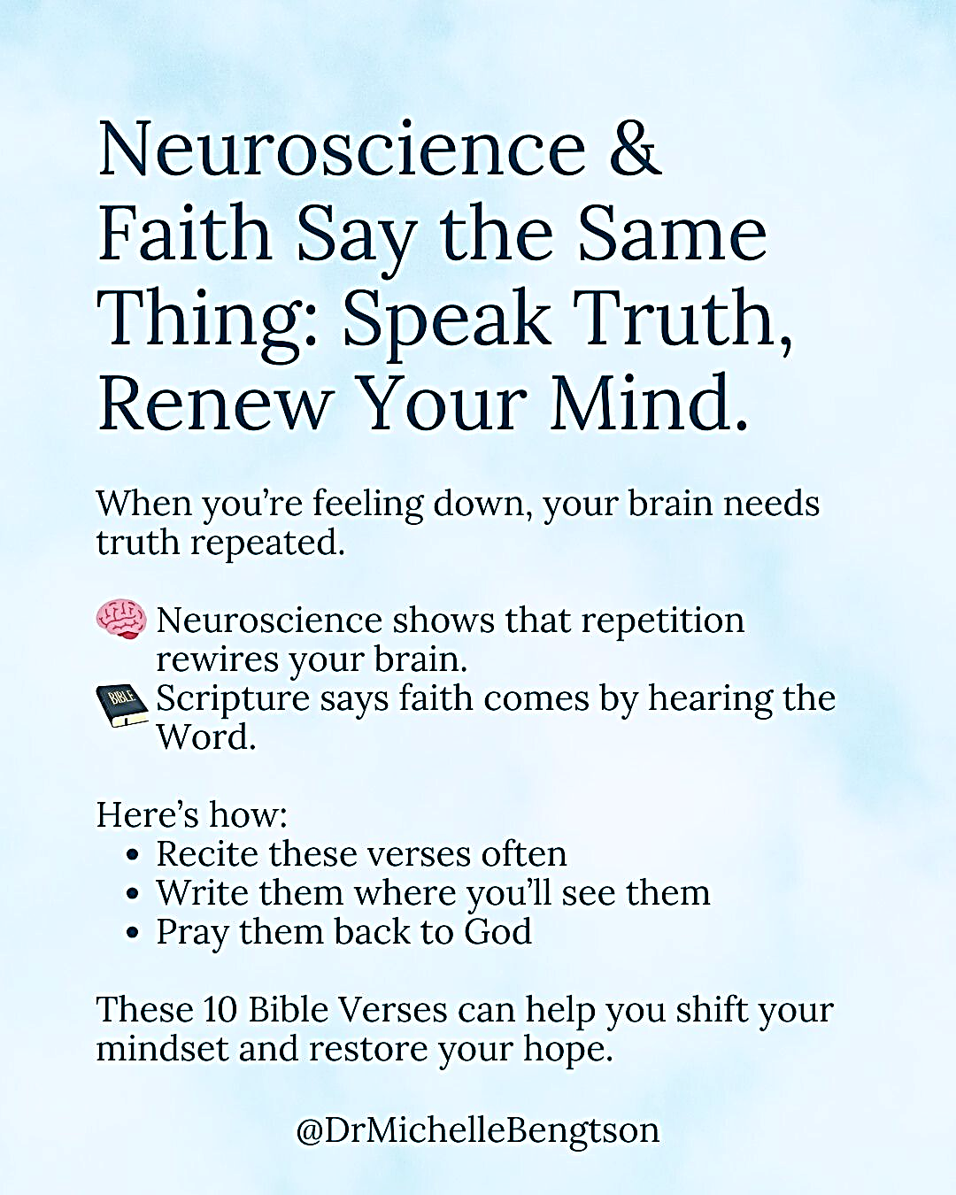
Rewire Your Brain
Just as Y’shua answered the Adversary with Scripture, we will rewire our brains to respond to every situation as Y’shua by speaking His Word.
Let us shift our mind set.

Slide 12
Hebrews 11 Introduction
At the end of Chap. 10 Apostle Paul urges the readers to be steadfast in their beliefs, not to waver. Saying, “we are NOT those who shrink back and are destroyed, on the contrary we keep trusting and thus preserve our lives” – this is the essential nature of faith.
Now in Chap. 11 he expounds on the nature of faith with examples and principles.
V. 1 defines faith: Faith is real, a spiritual substance. It is the underlying basis of things that we hope for (being fully confident)
Without faith, hope has no solid basis.

Slide 13
Yahweh’s order!
Faith relates to the unseen.
Faith is a conviction concerning things that are not seen. When we see, we don’t need to believe. But in God’s order, believing comes first and seeing follows.
Jn 11.40 Y’shua said to Martha; “Didn’t I say to you if you keep trusting, you will see the glory of Yah.”
Jn 20.25 Toma says “I refuse to believe unless I see it…”
It’s difficult for the human mind to relate to the unseen. In Scripture we find that people couldn’t hold on in the Spirit to the “unseen”, so they return to the material and the visible. In so doing, they loose out on spirituality.

Slide 14
V.2 Same principle for today
V.3 The world was framed by Yah’s “rhema” spoken word not man’s theory [Ps 33.6; 9] Behind the visible is the invisible (true reality) Every condition can be changed by Yah’s word being spoken.
V.4 Abel: Blood sacrifice verses the fruit of one’s own labor (under curse). A religious spirit, murdering spirit [Rev. 18.24] Spirit of Abel still speaks.
Faith was the key component for our forefather’s victories, and it would be the same for us today.
It is the key to success and victory: Without it, it is impossible to connect us to His presence, power and purposes.

Slide 15
Hebrews
V5 Enoch: Translated from one realm to another because he walked with Yah and pleased Him. (simplicity of relationship not religion). Picture of the rapture of Believers
V6: Believe & exercise Faith [James 2.19]
We must approach Yah with expectation [Ps 18.25-26]
V7 Noah: Dominated by godly fear. Picture of Jewish nation-70th week
V8 Abraham: Pitched his tent and built an altar, showed the right priorities (the dwelling was not as important than his relationship with Yah) and three generations prospered.

Slide 16
Hebrews
Abraham didn’t ask for a complete map; he took the first step of faith. Josh 3.8
V10: “Looking forward to a city…” [Luke 11.33] We cannot receive our God-given inheritance without renouncing our worldly inheritance.
V11 Sarah: She was not just an appendage; she was an essential part of the plan. Fearlessness leads to authority!
Vs. 14-16 Because our desire wants what He has worked out for us, calling attention to His superior worth to all. Therefore, “God is not ashamed to be called our God. [Heb 2.11]
V17: One of a kind son prefigures Golgotha (place of the skull) saying: “We will worship, we will return”.

Slide 17
God of Avraham, Yitz’chaz, Ya’akov
Exodus 3.15 Yahweh has chosen to be linked with these three men of faith as a memorial to all generations. Simply because they made the right confession. Therefore, He is not ashamed to be called their God.
Our destiny is one with our confession.
V23: Moses: Faith delivers from fear from the edicts of ungodly leaders/rulers.
Moses renounced his position- he knew that the pleasures of sin would be short lived; honoring the promise of the “anointed one” of Yah. Each of us should renounce the pleasures of the world.
Seeing the invisible is key for endurance. [Heb 12.2; 2Co 4.17-18]

Slide 18
Faith of Moses
Pesach: Foreshadow of the Lamb of God; His sacred blood never to be trampled over but transferred from basin to doorpost brought deliverance. [Rev 12.11] Confessed openly.
Red Sea [1Co 10.1-4] The crossing initiated by act of faith of raising of hands & immersed.
It was the water that finally separated them from Egypt. The work of Ruach sets us apart from our pass.

Slide 19
V30 Joshua precursor of Book of Revelation
Y’hoshua & Y’shua = Salvation
Y’hoshua is to recapture the Promise land. Y’shua-disposses Earth of its usurpers.
Y’hoshua sends two spies. Two witnesses come before the 7 judgments i.e.; the walls of Jericho encircled 7times.
Silence in Heaven before great shofar is sounded. i.e., Shofar is blown, they shout…
Sun stood still Josh. 10.12-13; Revelation 6.12-14
Cave of the Rich: Josh. 10.22-26; Rev 6.15-17
Rahab - picture of gentiles being grafted into the tree of Israel.

Slide 20
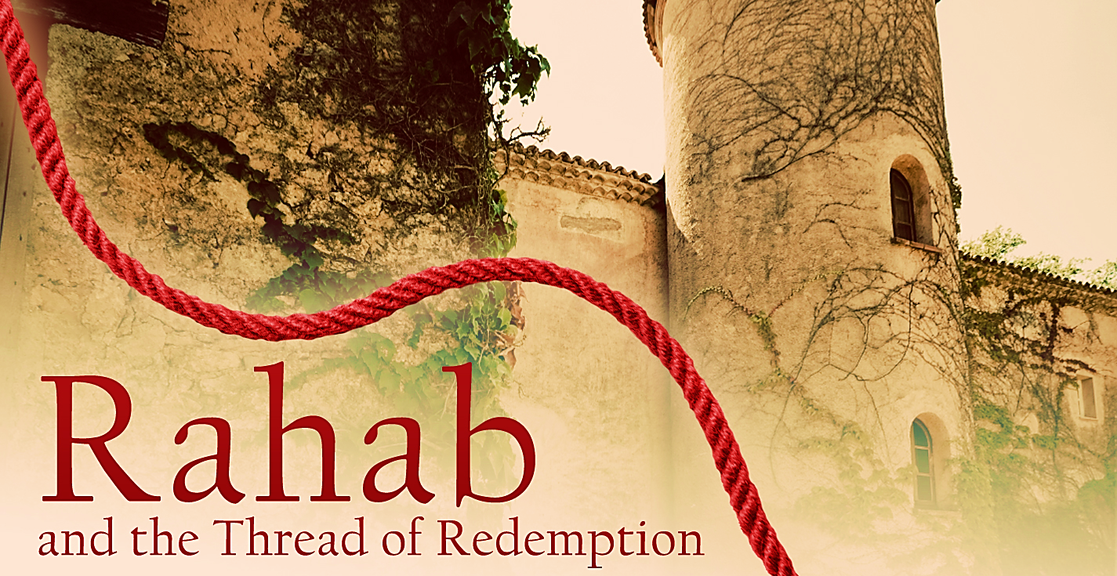
V31. Rachav
Ra’hab the harlot? Picture of the nations [Isa 56.1-6; Rev 21.24-27]
G4202 Porneia translate harlot, meaning any form of idolatry [Hos 1.2, Jn 8.41, Rev 2.21, Isa 23.15-18, Jer 3.9]
13th Century changed meaning to prostitute

Slide 21
Yah planned something better that would involve us…”
True purpose of Chapter 11 was not the list of our great ancestors but for us to understand Vs 39 & 40.
“They did not receive…The final provision for salvation had not been given only partial fulfillments.
Believers are living in the age of fulfillment-realized in Messiah
How much greater should our faith and loyalty be to Yah, than the ancient.
Implying that the men of faith and Believers alike belong to one people of Yah who together are made perfect.
Therefore, Ch. 12 heroes of faith become spectators cheering the Believer toward the goal.

Slide 22
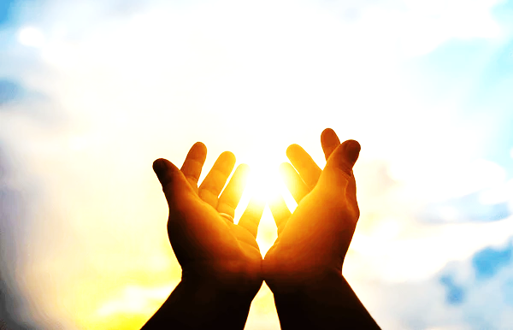
Bless & Encourage Your Brother
1 | May Abba establish your path this week
2 | May Shalom be with in you
3 | May Adonai dress you with wisdom and strength
4 | May you escape every hunter’s trap
5 | May Yahweh's will be done in your life

