Slide 1
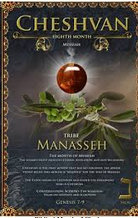
5786, 24 Cheshvan
1Kings 6.38 “Bul”
8th Month (Judgment, hardship & new beginnings)
Tribe of Menasheh (Manasseh)
HEBREW LETTER: Nun (50) Jubilee
SYMBOL: Palm tree [Ps 92.12]
STONE: Onyx

Slide 2
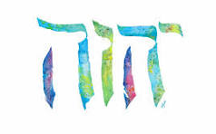
SING MY NAME
Isaiah 44.5
“One will say, I belong to Adonai, another will be called by the name of Ya’akov, yet another will write that he belongs to Adonai and adopt the surname Isra’el”
(Ps 29; 1Ch 16.28-34)

Slide 3
Night Watches Intercession for January & February
WATCH HOUR | DATE
3rd 12:00 midnight 3:00 am | Jan 1-10th
4th 3-6:00 am | Jan 11-20
21-31st Reflect, revelation, direction, encourage, answered prayers
1st 6-9:00 am | Feb 1-10
2nd 9-12 noon | Feb 11-20

Slide 4
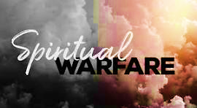
3rd Watch Hour Level of Spiritual Warfare
Seasoned Intercessors
Stop the attacks of the enemy over situations [2Ch 32.21]
Come against Night Stalkers railing against believers while sleeping
Release angelic (Angels do Yah’s pleasure through the spoken Word)
The Unseen Battle

Slide 5
3rd Watch Hour Level of Spiritual Warfare
Binding The Strongman: Neutralizing the deceptive hold or enchantment that demonic powers have achieved over human subjects. Help process truth at a heart level.
Occult Level: Intercessory confrontations with demonic forces operating through satanism, witchcraft, shamanism, esoteric philosophies and similar occult activities.
Strategic Level: Intercessory confrontations with demonic power concentrated over given cities, cultures and peoples.
Territorial Spirits: Demonic powers that have been given controlling influence over specific sites, peoples and areas, i.e., deities linked to homes, temples, clans, cities, valleys and nations.
Principalities And Powers: Demonic agents and structures that exert deceptive control over conspirators of human political kingdoms and systems.
Rulers Of Darkness Of This World: Demonic forces involved in deceptive and destructive manipulation of natural elements and systems

Slide 6
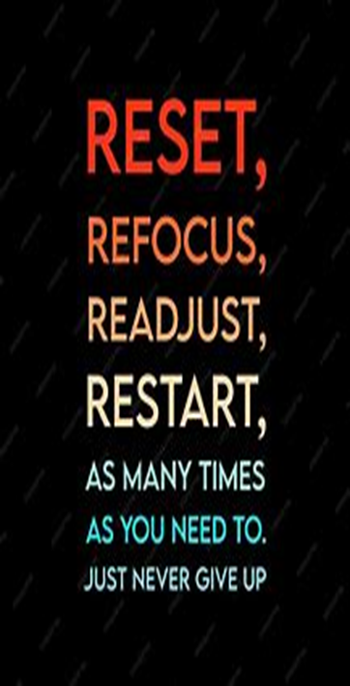
Clean the Holy Space
Ezekiel 42.13-14 Room set aside for holy things of Yah
Nehemiah 13.4-9 Serve notice and put them out.

Slide 7

PURGE & RESET
Recognize
Repudiate
Remove
Restore

Slide 8
CLOSE PORTALS
PRAYER​
REDEDICATE HOME
REDEDICATE FAMILY​
Ask the Lord for discernment.
Repent
Appropriate Blood of Yeshua over: Home, rooms, Individual Family members with anointing oil
Psalms 4.7(6)-9(8)
Proverbs 3.33
Isaiah 32.18
Ps 51 Spiritual purification
Verbally Bind & Loose
Mt. 18.18
Individual members
Prayers of protection (sickness, premature death, no miscarriages, etc.)
Psalms 91
Prayers of Thanksgiving

Slide 9

Neuroplasticity is the medium of neural network in the brain to change through growth and reorganization.
Neuroplasticity refers to the brain's ability to reorganize and rewire its neural connections, enabling it to adapt and function in ways that differ from its prior state. Occur in response to learning new skills, experiencing environmental changes, etc.

Slide 10

Rewire Your Brain
Just as Yeshua answered the Adversary with Scripture, so we will rewire our brains to respond to every situation as Yeshua by speaking His Word.
Let us shift our mind set.

Slide 11
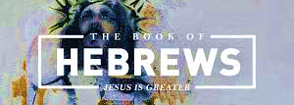
CHAPTER TWELVE

Slide 12
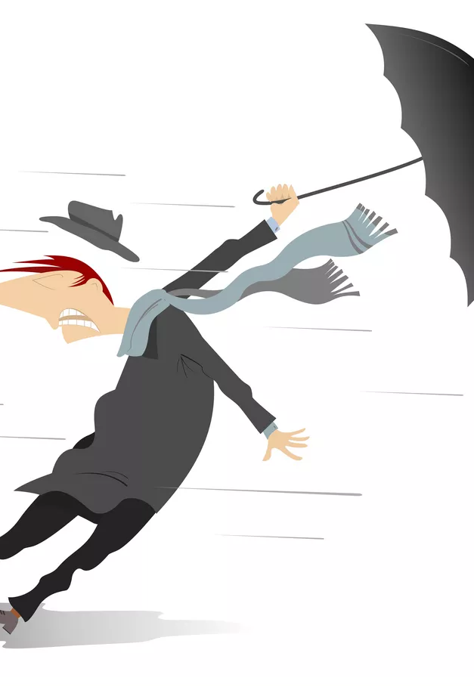

Chapter 12
V.1 The heroes of faith enumerated in chapter eleven is pictured as spectators in an amphitheater, as witnesses.
They encourage the runner (Believers) onward by their own lives, that facilitates success of persistent participation. So, throw (strip) off what hinders.

Slide 13
Worldly Allurements
Lot’s Wife
Gen 19.26 Prevented her escape.​
Nehemiah 4.10
Discourage men opposed building the wall.​
Ephesus​
Lost of love toward saints Rev 2.1-7.
Family Ties
Luke 9.59 “…first let me go…”

Slide 14
Our Goal - Messiah
The hampering effects of a restraining robe, which refers to sins of drifting, dullness, lack of spiritual exercise and immaturity, could lead one to lose the race of life.
Each runner’s (Believer) eyes should be fixed only on the goal – the goal is Messiah
Messiah who is the object of our faith, vision and our greatest encouragement is the Initiator/Author (He participated in believing, blazing the trail for Believers in faith living) and Completer/Perfector (All faith & hope finds its consummation in Messiah)

Slide 15
The Joy (Simcha) Set Before Him
This Joy is rooted in His relationship with the Father. It is not set on external circumstances. [Jer 33.11]
Messiah saw the cross as joy before Him and pleasing to the Father.
Unlike Esau who traded what could have been joy for a meal (immediate circumstances determined his behavior)
Believers should consider their suffering in light of Messiah’s; it is a small price to pay for the prize to be secured at the end. Romans 8.18
Messiah’s suffering resulted in being exalted in victory at Yah’s right hand.

Slide 16

Press forward!
Therefore, this bold life of Y’shua is a call to perseverance. It is not a short dash to glory as some desire, but a distance race calling for endurance.

Slide 17
Discipline an Educational Process
The Adversary uses an earthly father who is estranged, abusive, absent and neglectful to cause one to deny and reject the love of Yah, making it difficult for them to accept the principle of Yah’s discipline of love which is to be received with joy.
Yahweh is a Father to the fatherless Ps 68.6(5)
“Even though my father and mother have left me, Adonai will care for me”. Ps 27.10
Let us pray!

Slide 18
Discipline as Educational Process
Those who despised correction in Rev. 16.11 verses Rev 3.19
Believers should see Yah’s discipline as a necessary element in the Father-child relationship, which makes us fit to share Yah’s holiness.
If you are not being educated you are not a legitimate son -submission attitude is needed.
Even though earthly father’s discipline with what seems right for them, it is not the same with Yah.
Yah’s discipline produces a harvest of righteousness – that is for those who have the capacity of responding rightly to Yah’s order of their destiny, which stimulates your utmost prosperity.

Slide 19
Purpose of Discipline
Produces Wisdom Pro 22.15 (counters the act of foolishness, that has no regard for things of Yahweh) Proverbs 2.2-11
Loving Protection
Joy (rest) Proverbs 29.17
Love Proverbs 3.11, 12; 13.24
Submission (respect)

Slide 20
V 12 “Strengthen your Drooping Arms…”
Isaiah 35.3-4 Bridges the tribulation period and millennial Kingdom-Yah’s restoration
Yah wants His people comforted for His purposes and wants them to know He is coming and indeed here; not to question His ability to save.
In Verse 12 In light of Messiah, He will bring restoration so there is no time to have weak arms(hands for battle/combat doing the Lord’s work) or knees (progress and in prayer)
Assurance is found in the transformation ministry of Messiah illustrated in His many healings.

Slide 21
Homework
Give one example of what can STOP your forward movement and then give another example of what can possibly HINDER your desire to endure in your race for Messiah. (Use Scripture to support your answer)
What Scripture would you give the enemy to combat this assault

Slide 22
Month of Cheshvan Palm Tree 92.12
Decorated the Temple 1K 6.29-35
Cart of Bronze 1K 7.36-37
Ps 92.12-15 Good people budding (date) palm trees.
Righteous people thrive and produce fruit rooted in Temple of Yah; showing forth His faithfulness.
Palm branches celebrated Messiah in Jn 12.13 a symbol of victory.
Lev 23.39-40 8th Day Shemini Azeret
Rev. 7.9 Praise Yah in heaven & earth

Slide 23
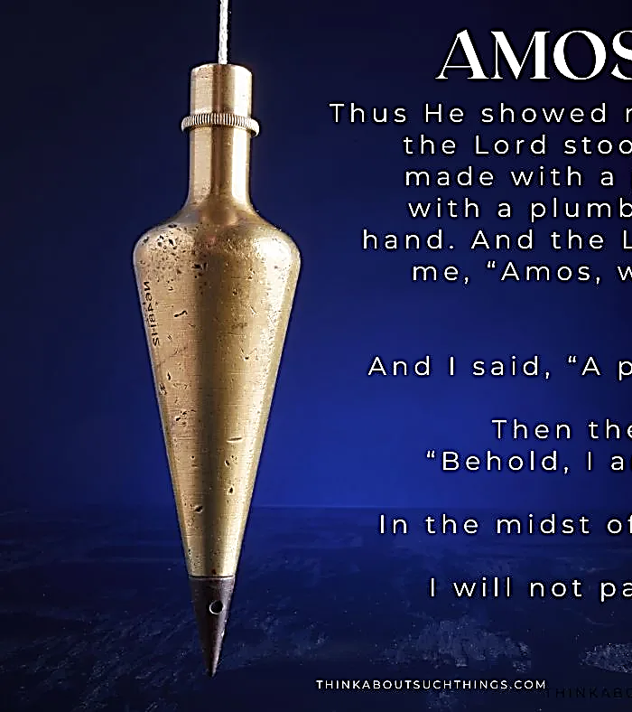

Plumb Line & Commandments
Amos 7.7-8 Perfect vertical line in the midst of His people
Yahweh measures people’s character by the standard of Messiah
“By obeying the commandments of the Yahweh, we can be upright like a palm.”
READ: Psalm 119.169-176

Slide 24
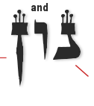
Number “50” Nun
Divine empowerment, renewal, spiritual growth and restoration (Jubilee)
Picture of the “Faithful One” (Y’shua) who is upright and one who becomes faithful (Believer) who is bent.

Slide 25
Care for the Body of Messiah
V.15 The power of the Body of Messiah is to make sure that no one misses the grace of Yah, falling behind by not keeping the pace.
Guard against bitter root, [Dt 29.18-19] one whose heart is turned away from the Lord & causing poison in the Body.
No second Esau arises: Not valuing spiritual things.
V14 Pursue peace, this is acceptable worship i.e., Matthew 5 esp. v.8 “How blessed are the pure in heart, for they will see God!.

Slide 26
V18 Physical vs Spiritual Mountain
The Heavenly Jerusalem has brought about an atmosphere of joy and peace, confidence and awe. We will be gathered not separated at Sinai (firstborn).
We are called to the festive assembly of myriads of angels; our Judge made all men righteous because of the blood of Yeshua that speaks a better word than Abel’s
Abel’s blood cried out for revenge, Messiah’s blood pleads forgiveness.
The Heavenly Jerusalem is the real world, spiritual and eternal. The physical, or former induced an atmosphere of dread that the people begged to hear no more [Dt 4.11] Even Moses quaked with dread.

Slide 27
Final Warning
If refusing Yah’s love and covenant made on Sinai meant death, how much more to refuse or despise His love through His “One and Only Son” means far greater judgement.
This is to reject Yah Himself.
Sinai was shaken by the “Voice” of Yah. According to Haggai 2.6-7 Yah now plans to shake the entire universe [2 Pe 3.7] so those who belong to an unshakeable order will survive. Dan 2.44
You have a cause to be thankful; you will emerge in full glory– worship your King.

