Slide 1

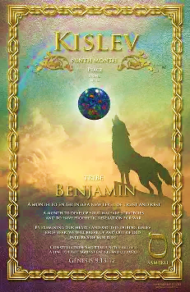
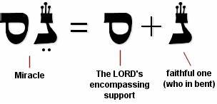
5786, 3 Kislev
TRIBE: Benjamin “Son of My Right Hand”
LETTER: Samech
GEM: Opel/Jasper (many colors i.e., rainbow)
NUMBER: 60 meaning support, strength, self, Divine protection
Aligned with miracles, trust. Focus on faith in Yah’s promise, reflect, embrace Divine protection

Slide 2
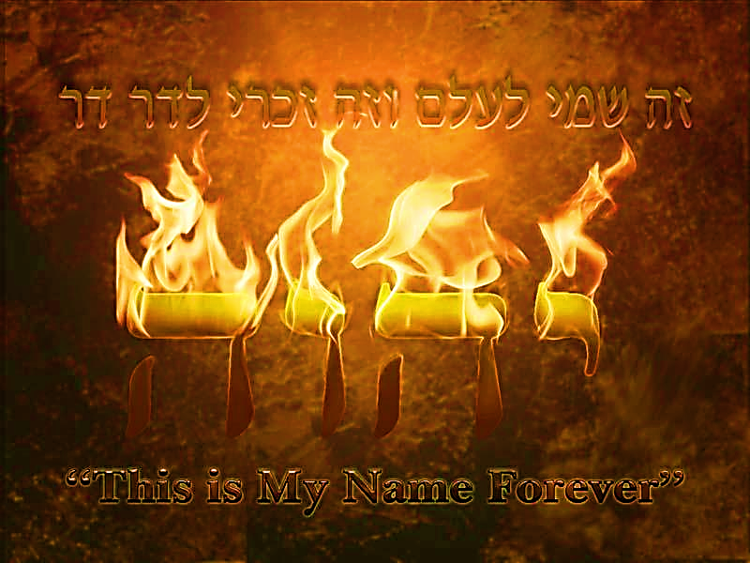
SING MY NAME
Isaiah 44.5
“One will say, I belong to Adonai, another will be called by the name of Ya’akov, yet another will write that he belongs to Adonai and adopt the surname Isra’el”
(Ps 29; 1Ch 16.28-34)

Slide 3
Night Watches Intercession for January & February
WATCH HOUR | DATE
3rd 12 midnight-3:00 am | Jan 1-10th
4th 3-6:00 am | Jan 11-20
21-31st Reflect, revelation, direction, encourage, answered prayers
1st 6-9:00 pm | Feb 1-10
2nd 9-12 midnight | Feb 11-20

Slide 4

Clean the Holy Space
Ezekiel 42.13-14
Room set aside for holy things of Yah
Nehemiah 13.4-9
Serve notice and put them out.

Slide 5

PURGE & RESET
Recognize
Repudiate
Remove
Restore

Slide 6
CLOSE PORTALS
PRAYER​
REDEDICATE HOME
REDEDICATE FAMILY​
Ask the Lord for discernment.
Repent
Appropriate Blood of Yeshua over: Home, rooms, Individual Family members with anointing oil
Psalms 4.7(6)-9(8)
Proverbs 3.33
Isaiah 32.18
Ps 51 Spiritual purification
Verbally Bind & Loose
Mt. 18.18
Individual members
Prayers of protection (sickness, premature death, no miscarriages, etc.)
Psalms 91
Prayers of Thanksgiving

Slide 7
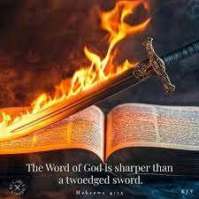
Praise!!! Psalm 149.5-9
Praise is in the prayer spectrum.
Praise came first then prayer (6b) the prayer. They created an atmosphere of authority.
V7. Justice and government change.

Slide 8
Psalms 48
BEFORE
AFTER
Blessed are You, Lord our God King of the Universe, Who sanctifies us with Your commandments and commanded us to engross ourselves in the words of Torah
Blessed are You, Lord our God, King of the Universe, Who gave us the Torah of Truth and set everlasting life in our midst. Blessed are You Oh Lord Giver of the Torah

Slide 9

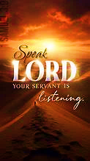
Psalm 48 A Song of Zion
Yah is praised as the Ruler and defender of the holy city, Jerusalem, Who keeps the city secure and so stimulates the praise of His people.
1 SAMUEL 3

Slide 10
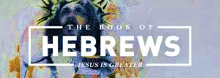
CHAPTER THIRTEEN

Slide 11
Introduction Chapter 13
The 13th chapter is said to conclude Hebrews with a series of exhortation, giving insight of how to live a life of faith. It also includes pastoral benediction and personal greetings.
Exhortation Definition: Urge, strengthen, comfort, offer words of advice to promote good attributes through maturity of Biblical truth i.e., Barnabus

Slide 12
Introduction Chapter 13
I want to cause you to see deeper into this final message. View Paul’s closing insight as his conclusion of the Superiority of Messiah, and Messiah’s honor for Hashem’s divine purpose for humankind, most importantly His holiness.

Slide 13
Brotherly love
John 13.34-35 “New Command”, not new in expectation of Yah’s desire, only because we now have seen Him face to face in Messiah and His actions.
Ephesian 5.1-2 We please Yah by imitating Yeshua in His love for others that will cause us to make personal sacrifices.
In every epistle we are called to love our brothers and sisters in Messiah. Since we are all of One Body, Yah’s family, we will experience unity and be compelled to share all resources.

Slide 14
“Let Brotherly Friendship continue” V.1
Meaning they were actively operating in love, and they understood that the principle of brotherly love is deeply rooted in Torah 1Thess. 4.9-12, Messiah’s character and His teaching
1Peter 4.8-10 “…because love covers many sins.”
From the following list of traits of brotherly love; list one that currently challenges you to express to your fellow servant.
Selflessness, forgiveness, sacrifice, support in adversity, respect/honor, burden bearing, love, humility and or unity

Slide 15
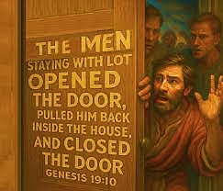
V.2 “…friendly to outsiders…” Angelic Visitation
Each of the following encounters of the spiritual realm listed below was unique in their experience. Use ONE of the Scripture references and explain why it’s important not to reject heavenly visitation (strangers).
See chart on Homework page.

Slide 16
V.2 “…friendly to outsiders…” Angelic Visitation
Psalm 8.5 & Heb 2.7-9 Humanity & Messiah held a temporary lower position than angels (incarnate).
If we remember in Hebrews Paul reminds his audience of the Superiority of Messiah over angels.
Angels made from the fire of Yah [Ps 104.4, Heb 1.7b]
These fiery ones worship Yahweh and therefore, Yeshua. [Heb 1.6b, Matthew 26.53]
They were made to serve humankind. [Heb 1.14, Ps 103.20-22] These unseen messengers of fire are always present and ready to assist Those who walk in Biblical authority. [Ps 35.27]
Angels are committed to us, as we are made in the image of Yah. (placed above angels in rank and authority)

Slide 17
Biblical Authority?
The Adversary knew enough of spiritual authority that through his deception of Adam; the Adversary obtained what we are to use in our position of authority as Yah’s servants.
Yes, he asked for Moses’ body [Jude 9]; and had the audacity to offer territory to Yeshua when in the wilderness.
We have untapped resources. We need to understand our authority in Messiah’s resurrection. Yeshua obtained and recovered the keys [Col 2.15, Rev 1.18] and restored our authority.
Even angels are not used to the full capacity. They are waiting for humankind to incorporate the word of Yah so they can execute their office.

Slide 18
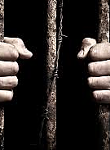
V.3 “Remember those in prison…”
We are not just to remember but, identify with them as Messiah did for us who were in the prison of our minds at the hands of the Adversary.
Prayer & intercession allows us to identify with them showing sympathy.
Loving Believers should be moved as Yeshua to meet their needs.
2 Tim 1.16-18 Onesiphorus

Slide 19
V4. Pure Marriage
Hashem's original plan for humankind to experience the miracle of oneness, purity, unity and what it means to cling in His supernatural redemptive plan
Yahweh did not give us marriage just for a mechanism to satisfy the needs of our flesh. [1Co 7.9; Mt. 5.31-32]
Have you reduced Hashem’s divine purpose for marriage to meet your carnal needs?
Hoshea 3.1 Adulteress bride, who was more interested in self-pleasure.
Yahweh will judge!
When Eve was tempted, giving in to what her eyes saw and gave to her husband, he ate also. Love made Adam decide what Eve would endure for her sin, so would he.
Yeshua the last Adam, identified with His bride (us) and took on sin so she would be magnified.

Slide 20
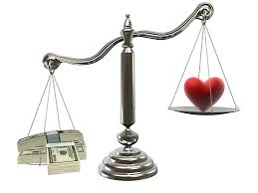
V.5 “Keep your lives free…love of money…”
Be content, real security is in the care and love of Hashem.
Money is necessary in this world. It is the love of money not the use of it that hardens our heart to the free hand of Yahweh.
Our love should be expressed in seeking first the kingdom of Yah. [Mt 6.33]
The enemy wants you to submit to a spirit of mammon causing you to be controlled and chase wealth.

Slide 21
Vs.7-8 The greatest of pattern is Yeshua
V.9 Strange teaching? [1 Tim 4.1-3]
Yeshua is the only foundation of our faith and He never changes. [1Co 3.11] Don’t be too changeable; don’t be continually aiming at something new; i.e., what’s the latest doctrine or the latest revelation. In a certain sense, the writer is warning us against always looking for something new and strange.
A Believer should not be regulated by external; a heart strengthened by grace
Human leaders will pass away, but Yeshua, the supreme object and subject of our faithful teaching, remains the same.
God-given Leaders are to model a life of faith, which other believers can imitate and ponder on. A life that lives by both right doctrine and right living.

Slide 22
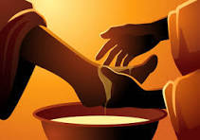
“Obey, submit…they keep watch over you…”
Ephesians 4.11 Key: Is to build up believers to maturity and arrive at the unity in trusting & knowing the Son of Yah.
This corporate leadership will render an account: To give a report of how well you fulfilled your service in bringing them to the goal.

Slide 23
Outside the Camp
The high priest carried the blood of animals into the Holy Place, but the bodies were burned outside the camp.
Yeshua was taken outside the city gate to suffer for the purification of His people by His offering.
We are called to identify with Yeshua, bearing His disgrace.
The Blood of the Eternal covenant: Zech 9.11 Yeshua by virtue is supreme Mediator of new covenant- John 1.17 Yah is now ready to equip us for good works.
Let us offer Hashem a sacrifice of praise continually…Worship with our lips are not enough.
A life of sacrifice which emulates Yeshua HaMashiach

Slide 24
Isaiah 57.19 Yah create the right words…
Shalom, shalom, to those far off.
When Hashem heals us, restores us to His favor, He creates fruit for our lips which is confessing His name.
“He sits on the praises of His people…” Psalms 22.3
John 12.49 Speaking on Yah’s account, not His own.
Jeremiah 1.9 Indicates cleansing and enabling. The prophet’s words must be identical with Yahweh’s word.
Isaiah 6.7 The refusal to listen to the prophet does not cast doubt on the truth of the prophet’s words but rather confirms it.

Slide 25
“Pray for us…we have a good conscience…”
…want to conduct ourselves properly in all things.”
Should we be discriminating in the people we pray for.
The primary object of prayer for Believers and the government under which they lived. [Eph 6.18-19]
And second, the ministers of the gospel
We have family members that are a heartache and a problem and you pray for them. How much time do you spend praying where Yah has told you to stop [Jer. 7.16]
Paul is saying, we’re leading the kind of life which will enable us to receive all the prayer you give us. It won’t be wasted; or spilled.”

Slide 26
V.21 Benediction?
Apart from Yah there is no peace. [Philippians 4.7]
Hashem can and will equip us completely. However, there are four conditions.
To do His will
Do whatever pleases Him
For His glory
All blessings are manifested through Yeshua HaMashiach.

Slide 27
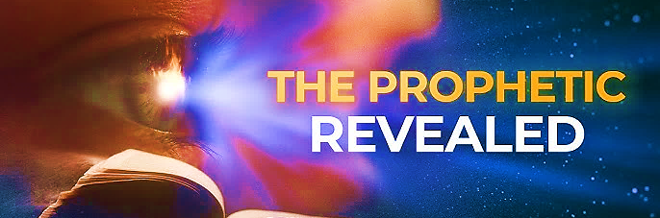
Speak Lord, we’re listening
Renewing the Prophetic stream

Slide 28
Communications
As we prayed for Sister Stephanie, I saw a person with a weak human spine get ripped out of their body and replaced with a solid metal. It looked like iron and held the person up straight.
IRON: Strength, endurance, resilience and power
Deut. 8.9 “…a land where you will eat food in abundance and lack nothing in it; a land where the stones contain iron and the hills can be mined for copper.
Land of iron imply spiritual growth.
Just as iron is strong, so too can one’s strength be rooted in faith and divine support.

Slide 29
Communications
As Stephanie received prayer, bright beings came and touched her feet and her hip joints as she sat. Then, something like a red blanket came from above and draped over her from head to toe.
Hip joint: Genesis 32.35-26 Jacob struggle with unwillingness to trust.
Before Jacob enters the land of promise He clings to Yahweh acknowledging he has no human strength
Jacob goes through a spiritual rebirth, now know as Israel.

