Slide 1
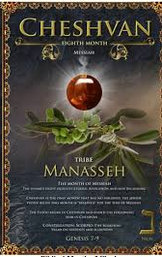
5786, 3 Cheshvan
1Kings 6.38 “Bul”
8th Month (Judgment, hardship & new beginnings)
Tribe of Menasheh (Manasseh)
HEBREW LETTER: Nun (50)
SYMBOL: Palm tree [Ps 92.12]
STONE: Onyx

Slide 2
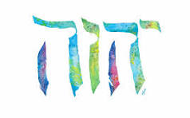
SING MY NAME
Isaiah 44.5
“One will say, I belong to Adonai, another will be called by the name of Ya’akov, yet another will write that he belongs to Adonai and adopt the surname Isra’el”
(Ps 29; 1Ch 16.28-34)

Slide 3
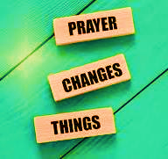
Intercession & Supplication
NIGERIA
JERUSALEM
DETROIT
Christians being slaughtered
Anti-Semitism
Sharia Law Overthrow

Slide 4
Intercession & Supplication
Witchcraft
Dark day Halloween

Slide 5

Difference between Authority (Exousia G1849) & Power (Dunamis G1411)
Authority | Always attached to obedience. Therefore, it only comes through a relationship (oneness & effort) with Yahweh. Mt 9.6; 8.6;10.1 Luke 10.19 “Authority to tread…”
Power | Power is a gift; its creative Acts 1.8
Lk 17.11-19 | Healing: Removal of something Miracle: To make whole

Slide 6
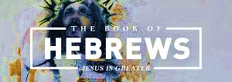
CHAPTERS EIGHT & NINE

Slide 7
Greater Priesthood
Melchizedek’s priesthood combines priesthood and kingship. The priesthood, under the original Covenant, was assigned to the tribe of Levi with kingship to Judah and no interchange was permitted.
Melchizedek gave to Abraham bread and wine, emblems of the Re-newed Covenant not previously given by Abraham. But the Levitical priests only gave back to the Israelites part of the sacrifices previously received from them. They had to receive before they could give.
Melchizedek receives tithes/offering from Abraham. The Levitical priests gave tithes through Abraham.

Slide 8
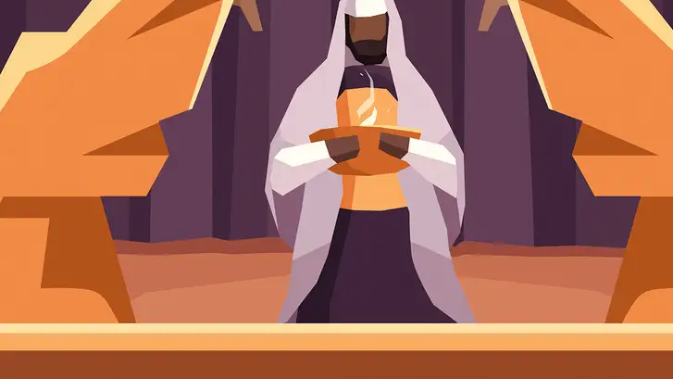
Melchizedek, because of an indestructible life, had a permanent priesthood which never passed by succession to others, nor would Yeshua have a successor. The Levitical priests, because of mortality, had only a temporary priesthood.
Melchizedek does not trace his genealogy from Abraham. The Levitical priests must be descended from Abraham.
Melchizedek blessed Abraham; therefore, he is greater. The Levitical priests owe their blessing to Abraham; therefore, they are less.

Slide 9
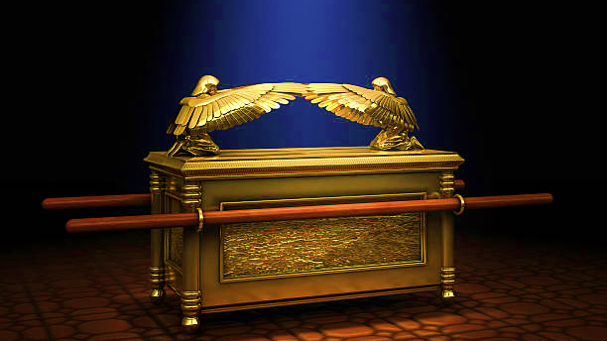
Melchizedek provided direct access to Yah and perfection. The Levitical priesthood could not provide direct access or perfection.
Melchizedek was priest by the power of an indestructible life. The Levitical priests was based on a physical requirement.
Melchizedek was appointed with Yahweh’s oath. The Levitical priests were appointed without an oath.
Melchizedek insures a superior covenant. The Levitical priests were linked to an inferior covenant.

Slide 10
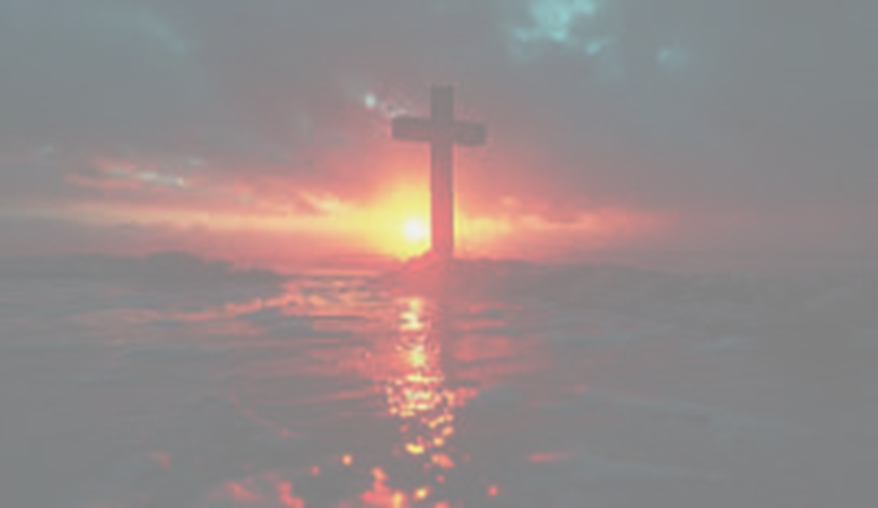
Melchizedek priesthood provides one all sufficient priest. But, the Levitical priest, because of death, had to be many and were never sufficient.
Melchizedek, through his priesthood, in the person of Yeshua can save completely and forever. The Levitical priests are unable to save.
Yeshua as the priest after the order of Melchizedek did not need to offer sacrifice for His own sins. He had none. But the Levitical priests needed to sacrifice first for their own sins.
Melchizedek’s priesthood provides as a priest Yah’s perfect Son. The Levitical priesthood provides only men with human frailty.

Slide 11
Proverbs 2.1-5 “Keeping our Focus”
“Son”, He's addressing a born-again believer. Receive & treasure Adonai’s word and commands 1Jn 5.3
Attentive to wisdom [Jam 1.5; Pro. 5.1&2] Humility and being willing to be taught.
Raise your voice…Impromptu or importune prayer
Seek as silver: Hidden from carnal eyes. [Mt. 13.44-46]
Fear of Yah gains knowledge: Fear is key to knowledge. The secret of Adonai is with those who fear Him- who will receive eternal reward.

Slide 12
“He does sit at the right hand of Greatness”
“Sit” represents the finished redemption work that satisfied the Father, never needing to repeat His sacrifice. (There were no seats in the Tabernacle-their work was never complete)
“In Heaven” His ministry is real; its sphere of operation is the real world; not earth bound.
Yeshua serves in the “True Tent of Meeting”. There was no place for Yeshua in the earthly sanctuary by virtue of His descent from Judah.
Ex 25.8-9 Exact replica: True reality begins in the spiritual; not what our limited vision believes.

Slide 13
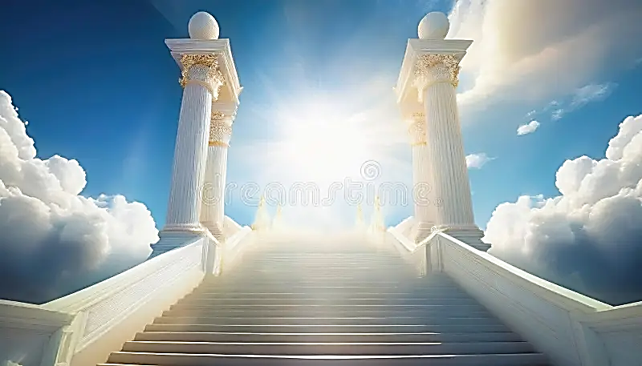
Shamayim & Aretz
Shamayim, heaven is plural, but Aretz, meaning earth is not.
The earth is singular. Now that which belongs to the physical realm is finite, limited or limitations.
Only that which is spiritual is unlimited.

Slide 14
8.6 Work of Yeshua is superior (covenant)
The covenant between Adonai and man is not between two parties, rather Yah is the sole initiator. He invites men to join with Him [Dt. 4.13]
Yah recognized that to err is human [Heb 5.2] therefore, He provided through the sacrificial system. But there was no sacrifice for willful rebellion/sin.
There is a complete forgiveness of sin in Yeshua Messiah. A promise before time [Titus 1.1-3]
We are able to draw near Yahweh who has written His word on our hearts so our will conforms to the will of God by a direct personal communication and influence (Ruah) [Ro 7.22; 8.4]

Slide 15
V13 Road to Apostasy & Replacement Theology
Written by Marcion the heretic who believe that the God of the old testament was different than the God of New Testament
He also claimed, was a lesser being—a jealous, materialistic, vengeful, evil god whose created world was an inherently flawed place of misery and death.
Claimed Jesus was the messenger of a new god, the real god of Christianity. This God, was merciful, and forgiving. According to Marcion, Jesus's only task was to convince weak minded to abandon that faith and embrace the more powerful God of the New Testament.
Marcionism in the twenty-first century is foundation for Gnosticism

Slide 16
Chapter 9 “A Tent”
The Tent of Testimony attest to Scripture, the Spirit of Prophecy. Everything clearly depicts the Pattern Son, Messiah.
The placing of the altar of incense-behind the curtain only on Yom-Kippur.
Except for the High Priest (one day) everyone was kept at a distance; the gifts offered were not sufficient for a clear conscience –until the time of a new order.

Slide 17
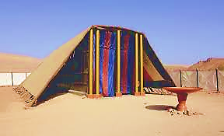
HOMEWORK
What does it mean that the Tent/Tabernacle was a copy or shadow of the Tent in Heaven?

Slide 18
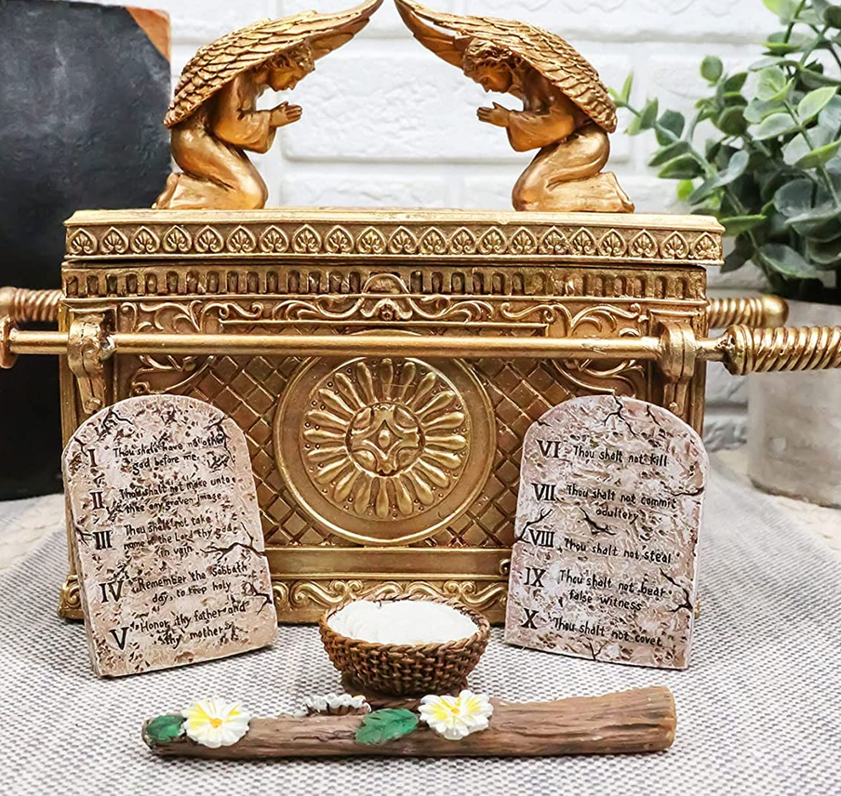
Chapter 9 “Ark”
(Cherubim) Interjected between Yah and the people’s sin was the place of atonement.
Inside and next to the Ark, elements of Yeshua. Commandment (Plumb line)Amos 7.7-8, Aaron’s staff (Chosen Son) Manna [Jn 6.56-58]

Slide 19
Clear Conscience
Rooted in consistent alignment with Yah’s moral standard [Acts 24.14-16, 1Tim 1.4-5, 1Pe 3.16]
1Tim 4.1-2 Cauterize (burn, stop the bleeding).
Eph 4.18-24 One has lost all sensitivity-do wrong without raising any objection.
A good conscience is powered by Ruach [Jn16.8]
Set by the word of Yah and cleansed by blood of Messiah [Heb 9.14]
The effectiveness of the Blood of Messiah is seen in its ability to purify the conscience leading to the ability to serve the living God.

Slide 20
Vs. 12-15 Altar & Holy of Holies
Messiah enters by virtue of one final sacrifice as mediator of a renewed will.
Messiah’s altar was the cross. The Ultimate and cosmic altar was not the end, but the beginning.
The Messiah’s sacrifice gives a believer access to go where one never could go before, to open doors, to enter the realm of the holy and in the Spirit to stand & dwell in heavenly places.
This is the better sacrifice [Psalm 40.7(6)-9(8)

Slide 21
It is Finished!
Messiah has cleared the conscience of the believer from their sense of guilt and has brought him as a worshipper into the very presence of Yah.
Revelation 15.5-8
We can see that heavens activity is centered around the temple.
The temple centered around the tabernacle and the tabernacle centered around the ark of the covenant. In a certain sense, all Yah’s dealings in eternity and time centers around His covenant.

Slide 22
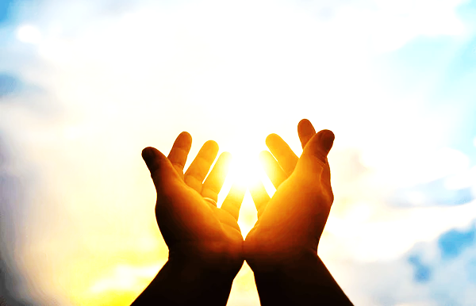
Bless & Encourage Your Brother
1 | May Abba establish your path this week
2 | May Shalom be with in you
3 | May Adonai dress you with wisdom and strength
4 | May you escape every hunter’s trap
5 | May Yahweh's will be done in your life

