Slide 1
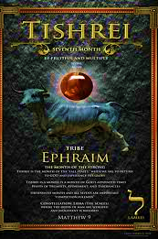





5786, 12
TRIBE: Ephraim
SYMBOL: Grapes
GEMSTONE: Agate (Onyx)
HEBREW LETTER: Lamed
NUMBER: 30

Slide 2
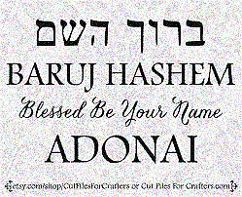
SING MY NAME
Isaiah 44.5
“One will say, I belong to Adonai, another will be called by the name of Ya’akov, yet another will write that he belongs to Adonai and adopt the surname Isra’el”
(Ps 29; 1Ch 16.28-34)

Slide 3
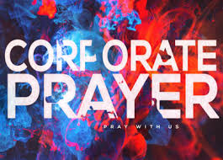
Intercession & Supplication
ISRAEL
Sharia Law, Islam
War, Peace Agreement
TEXAS
GARFIELD HTS.
Spiritual Gates & Favor

Slide 4

HOMEWORK
Read Psalm 41, write a short statement of what the Lord is saying to you about you.
Please be obedient to the Lord's instructions for engagement, which requires everyone's participation.

Slide 5
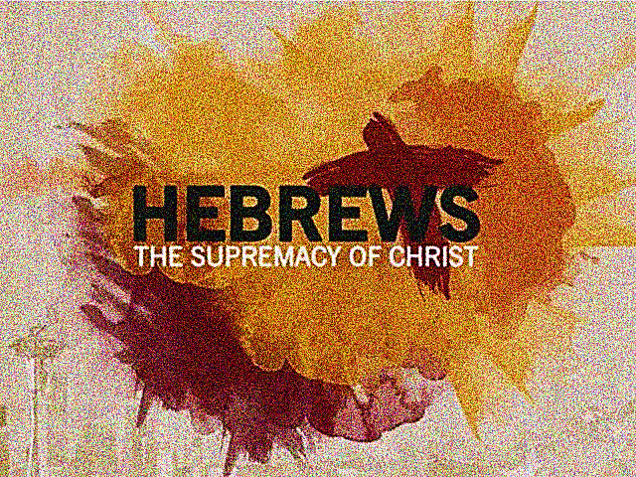
CHAPTER FIVE
Psalms 95

Slide 6
Priestly Qualifications
The High Priest is called to represent man in matters of God.
(1) Must be taken from among men:
Taken from among men, not an angel or any other celestial being
Only man is subject to human weakness -hence only man can understand human weakness in such a way as to deal gently with those who are ignorant and going astray.
Sympathizing with man’s frailty ad thus represent him fairly before Yahweh.
Yeshua had to be born into humanity to hold the position of High Priest.

Slide 7
Priestly Qualifications
(2) The appointment of High Priest must be God ordained.
This is an office so important that no man has the right to TAKE the honor. Only Yah has the prerogative of Priestly appointment.
No one voted for Aaron, the appointment of Yah alone [Num 16]
2 Sam, Saul was chosen but David, not only chosen he was in eternal covenant. Foreshadow of Yeshua Messiah.
Yahweh does not entertain an ongoing relationship with man unless the two conditions are met:
(1) Priest
(2) Covenant
Y’shua combined the role of High Priest with His status as “Son of Yah” after the order of Melchizedek [Ps 2.7, 110.4, 89.24-26]
Yahweh made the decision, Y’shua never took the initiative nor glorified Himself.

Slide 8
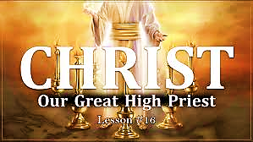
Homework
How is the portrayal of the High Priest of Yeshua shown in John 8.1-11?
Hebrews 5:4-5 “And no one takes this honor upon himself, rather, he is called by God, just as Aharon was.” (I.e., Num 16.1-11)
What does this say regarding Yeshua’s position?
Notes:
John 8.1-11 Yeshua’s Priesthood- Writing in the sand [Jer. 7.13]
The writing will disappear as opposed to the enduring character of with is written in Heaven’s book of life. Isa 4.3, Mal.3.16
The compassion is displayed as a Priest would sympathy to the embarrassment of the accused.
Administered good justice; both who were caught should have been brought forth. [Ex 20.13-14, Lev 20.10, Dt 22.22, Mt 5.27]
NOTE: After Yeshua asked the question of “who have ever sinned”: The older leaves before the younger.

Slide 9
Priestly Qualifications-Offer gifts & sacrifices
The High Priest duties was foundational in offering gifts and sacrifices to the spiritual life of Israel, serving as a precursor of the redemption work of Messiah Yeshua.
The High Priest maintained the covenantal relationship between man and Yah. Until Messiah His offering of prayers (petition/intercession) and supplications (asking for mercy) for us is vacuum-packed with His bloody sacrifice.
V.7 Yeshua’s prayers were constantly heartfelt, earnest and accompanied by tears. (offered to the One Who had the power to deliver Him from death?)
From death (save a person from dying)
Out of death (Let them die and bring them back Ps 89.26)
V8. He learned obedience through what he suffered: we leaned what it means to obey when encircled by human suffering.

Slide 10
V.9 “Learned obedience from suffering”
Yeshua’s sufferings and temptations were genuine. He learned what it meant to obey Yahweh when encircled by temptations & suffering.
The comparison of Adam (son of God- Luke3.38 who, when put to the test, chose to disobey the divine demand rather than submit; consequently, was the cause for death [Ro 5.18] Y’shua on the other hand was the infinite Son of God who nevertheless experienced the limits of space and time and life as we do
Adonai could have created a fully grown adult body for Y’shua as He did for Adam and rushed Him to the cross, but He didn’t. Instead, Jesus left heaven, entered time [Phil 2.5-8], and experienced for Himself ordinary human life from birth to adulthood to death. Learning and suffering and put to death as part of the life experience by all humankind, and Yah ensured (faithful to His Laws) that His own Son would be no exception.

Slide 11
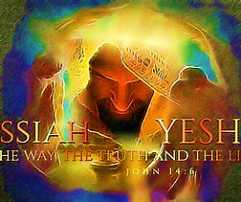
V.9 “Learned obedience from suffering”
Being God , Y’shua did NOT need to learn anything, especially obedience; yet, at His incarnation, Y’shua limited Himself to the human experience [Phil 2.7]. He chose the weak position of having to learn and grow [Luke 2.52]. Yeshua (Son of God) having obeyed completely became the source of eternal salvation. Salvation mediated through His role as high priest in the order of Melchizedek.

Slide 12
Heb 5.2b Ignorance?
Messiah’s compassion | Hebrews 5.2
Our Standing | Romans 6.3-23
The Lord’s coming | 1Thess. 4.13-17
Spiritual gifts | 1Corinthians 12
Original covenant | 1Corinthians 10.1
Purpose of Israel | Romans 11.25-26
Satan’s devices | 2 Corinthians 2.11

Slide 13
Vs. 11-13 “…applying the Word about …”
Milk of the Word are the fundaments- basic gospel revelation of Y’shua Messiah (death, burial & resurrection) that brings one to salvation.
STRONG MEAT: The word that challenges us. Requires change in lifestyle and repentance.
V.14 A mature believer should not have to struggle with their senses. Our senses should cooperate with holiness & righteousness.
Our senses need to be trained to discern good and evil, to be fully functional mature believer.
Engage in consistent spiritual discipline
Eat strong meat of the Lord (protein) we will not have brain fog (2Tim 3.2; 4.3), low energy (zealous for things of God)
Accept training & discipline Eph 4.12-14
Practice by turning away from evil
Worship & praising Yah through prayer, meditation, reading & studying His Word.

Slide 14
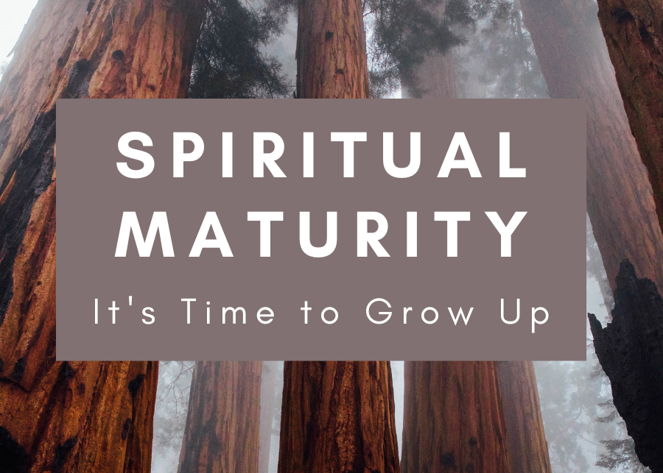
The more we train our senses to do the right thing the more we discern good and evil without trying we will reject evil.
Maturity is not with ageing but with genuine intent to rest if the Lord.

Slide 15
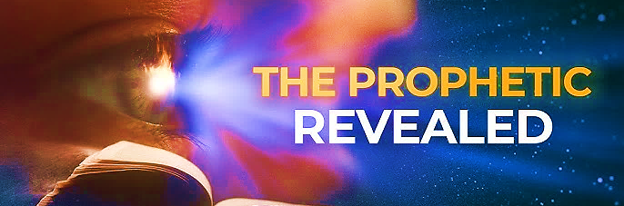
Speak Lord, we’re listening
Renewing the Prophetic stream

Slide 16
Communication
During the singing of the Lord’s Name, I saw something like spirits with the leading spirit holding something like an incense carrier. Then, a larger more prominently dark spirit attempted to take the roof off the Sanctuary (Ruach said, “Holy, healthy place where the sick are restored and disobedient flee”). The evil spirit reacted to someone in the room who was saying, “Hallelujah” – the spirit looked annoyed. Suddenly, the evil spirit was removed
(I didn’t see how), a translucent dome was placed around the building and the roof and put back in place, and the lessor spirits that had the incense were torn apart and removed. Then, angels came in the room doing something like dancing. Some had or held a banner that was yellow then also red.
YELLOW: Yah’s truth and grace (brimstone, fire)
RED: Sin, atonement and blood of Messiah
Together, divine presence and holiness of believers

Slide 17
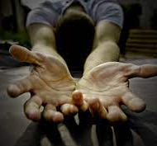
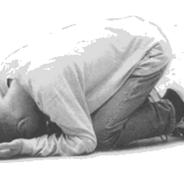
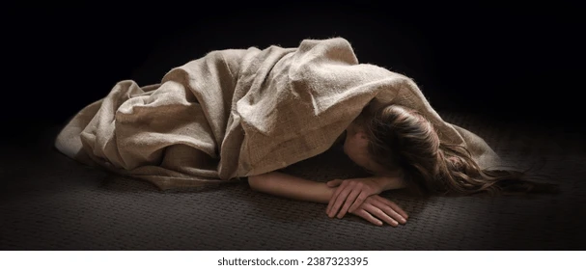
Communication
Before the song ‘He Is My Defense’ started, Yahweh sat on something like His Throne where the cabinet is. He said, “Lay before Me” in a soft voice as an invitation.

Slide 18
Communication “lay before Me.”
Resting before the Lord – although my eyes were closed, I saw the shadow of Yeshua’s foot approach and walk by on my left.
While we were resting before the Lord, and we started singing together (Spirit of Truth), I saw a laser like cord moving through the Sanctuary between us all. It looked like a cord on fire moving like a beam of light leaving its fire behind as it moved through the room between us all.
As we laid before Yah in the beginning of Service, I saw water coming up from the ground and it began to rain.
As we laid before The Lord, Yeshua came out of the Tent and laid next to Pastor and placed His Tallit over Himself and her. Yeshua did this to a few others in the room, then a giant tallit came down and covered everyone in the room.

Slide 19
Communication “lay before Me.”
When we lower ourselves, we are saying I’m removing my ego and submitting to Yahweh.
This is a major obstacle in our spirit growth
It’s a sign of selflessness, importance
Practice of self denial
This is NOT position of demons
2Chronicles 20.15-19 Tells of the Lord’s Great Victory. “Do not fear” We are forbidden to entertain even the least speck of fear.
We overcome fear by staying closer to Yah, worshipping (bowing) reading His word, making good confession and not dwelling on negative consequences.
Revelation 5.14

Slide 20
Communication “Songs of Worship”
“During the song ‘Fortify My Faith’, I saw a large shofar that was engulfed in flames descend into the Sanctuary.”
The Shofar stirs up the spirit and insist that one pays attention…
“During the song ‘Jesus Increase’, I saw a vast ocean with people in it. There were some who were submerged deep in the water and others who were floating like dead fish at the top. However, all the people were dressed in white.”
When Ruach pours living water on Yah’s people, some submerged and others will simply rest in His generosity.

Slide 21
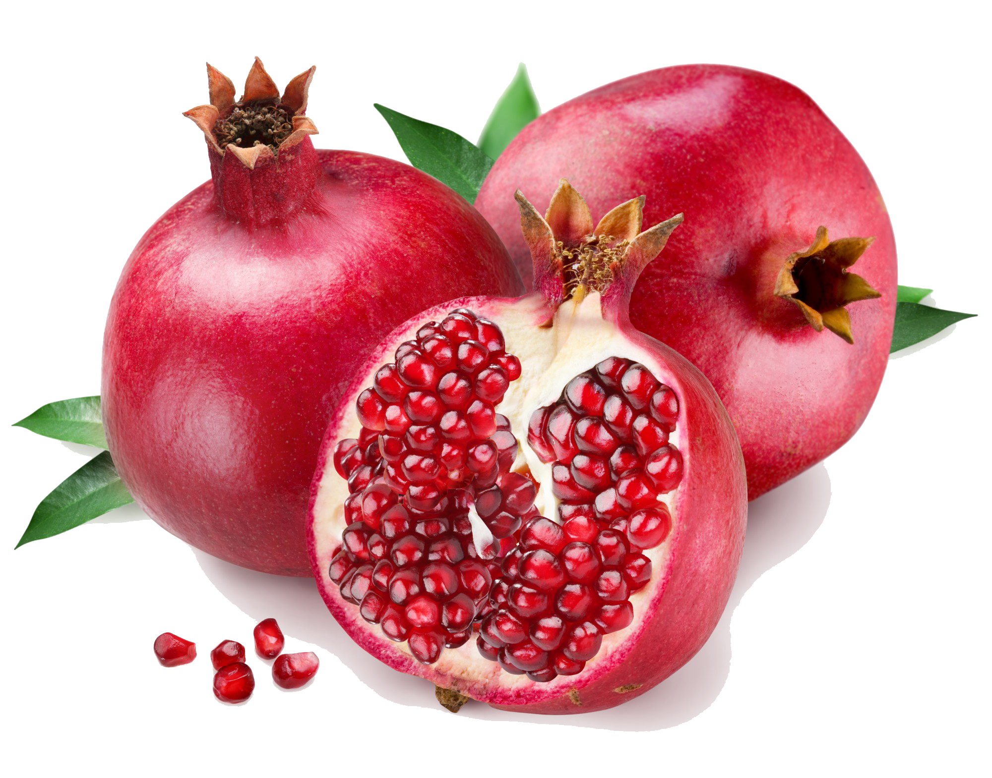
“As we sang the song ‘He’s Been Faithful’, I saw a pomegranate.”
Symbolize fruitfulness, abundance, prosperity, beauty and newness.
Priestly garments (Ex 38.33-38) represents the divine connection in covenant with Yah.
Soloman’s Temple (1Kings) Two columns – Jachin “He will establish” strength & stability evoke Yah’s promise to uphold His promises. Boaz “In Him is strength” Yah is …
Source of strength. Remind us to have faith, stability and strength; it also emphasizes that our life in Y’shua should be evidence of our faith & belief.
Song of Songs (6.7) speaks of His Beloved cheeks softness and radiance is veiled in mystery. “We have not seen the full beauty of our Savior.”

