Slide 1
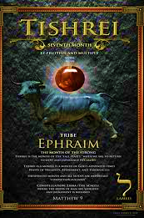





5786, 19
TRIBE: Ephraim
SYMBOL: Grapes
GEMSTONE: Agate (Onyx)
HEBREW LETTER: Lamed
NUMBER: 30

Slide 2
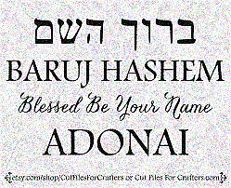
SING MY NAME
Isaiah 44.5
“One will say, I belong to Adonai, another will be called by the name of Ya’akov, yet another will write that he belongs to Adonai and adopt the surname Isra’el”
(Ps 29; 1Ch 16.28-34)

Slide 3
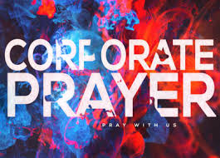
Intercession & Supplication
NIGERIA
Persecution of Believers
Shalom Ps 122.6
JERUSALEM
GARFIELD
Possessing the gates
Seasonal Spiritual darkness
WITCHCRAFT
Disobedience as Witchcraft
FOTBG

Slide 4

HOMEWORK
Read Psalm 42, write a short statement of what the Lord is saying to you about you.
Please be obedient to the Lord's instructions for engagement, which requires everyone's participation.

Slide 5
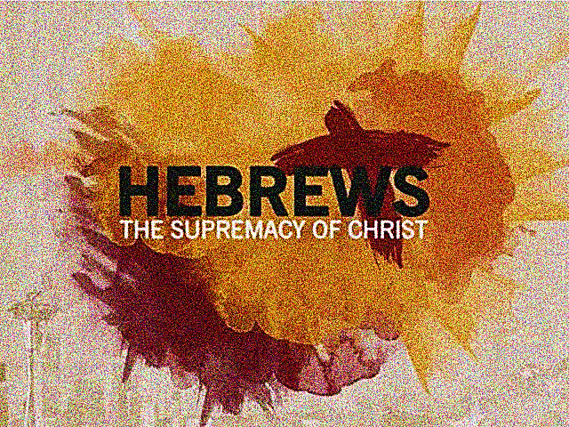
CHAPTER
SIX

Slide 6
Chapter 6.1 & 3
V.3 “And God willing, this is what we will do.”
This is a statement of hope and complete dependence on Yahweh. However, it also implies that some will not be able to advance, for by their own decisions they will have placed themselves beyond the range of God’s permission.
Yah gently encourage us to seek Him, respecting our decision; fostering a personal relationship. [Josh 24.15, Jn 3.14; 6.37, Ro 10.9, 1Tim 2.4, Rev 3.20]
“Therefore, leaving behind the initial lessons…turning from works that lead to death, trusting God.”
Spiritual maturity or immaturity is a matter of freewill. The writer urges his audience to personally surrender to active influence.
Those that are mature are those capable of understanding and appreciate being affected by “TRUTH”

Slide 7
V.4 “…Once enlightened…tasted”
ENLIGHTENED: The experience of Christ light shining on the mind and spirit (inner illumination). To respond to gospel.
TASTED: Real experience as in how Yeshua tasted death (the gift of Christ) a matter of grace and life procured by Messiah.
PARTAKERS OF RUACH: Receiving and fellowship with Ruach. Supernatural nearness.
GOODNESS OF GOD’S WORD: Not only experienced His word but saw its goodness at work in them.
POWERS OF THE ‘OLAM HABA: Each have experienced a portion of the coming age in the Feast, Shabbat, Resurrection, etc.
If they fall away…?

Slide 8
Impossible to renew them?
The word “impossible” is put in a position of emphasis. It is not merely difficult, but that it is without possibility.
The proof of genuiness of the Believer is a continuing loyalty which keeps faith to the very end.
Just as Israel left Egypt cross the Red Sea, they ate miracle meal, manna and saw the mighty acts of Adonai; yet only two entered Canaan.
The BOC has experienced a fuller expression of Adonai in Messiah- nonetheless, some will be capable in renouncing Yeshua in our inner attitude, then fall away.

Slide 9
Impossible to renew them?
This apostate, is not a result of a quick decision in a weak moment but a slow fade of unbelief or disobedience because of ignoring the foundation truths.
The decision has crystallized in a constant attitude of hostility toward Messiah (they crucify Him again) present tense.
Despite their impressive great spiritual experiences, they are in grave danger (Mt 7.21-23) I.e., Demas (Col 4.14, Ph 1.24, 2Tim 4.10)
Those who remain loyal to the end demonstrate that their confession was genuine.
Therefore, if one turns their back on Y’shua, don’t expect to find salvation anywhere else apart from the fullness of Messiah.

Slide 10
V. 7 “Earth receives rain, produce fruit”
The Earth fulfills its purpose and justifies the blessing of rain sent from above. Adonai looks for what grows in us after He blesses us, especially looking for what grows in maturity.
“But as time proves some soil produce thorns and thistles…being cursed; in the end, it will be burned.” Psalm 109.1-20
Growth and bearing fruit are important to keep one from falling away. When we bear fruit, we abide in Messiah [Jn 15.5] and not in danger of becoming sluggish.
Vs.4-8 These verses were to encourage the struggling Hebrews. Their spiritual danger was not so much out of a calculated rebellion, but more of their discouragement of being rejected by the leaders in the Temple.

Slide 11
Vs. 10-12
“Yah is not unfair as to forget your work…”God will not deny his own nature; he is not unjust. God sees and remembers.
  Sometimes our fear that God forgot comes from relying on attention and applause of people.
  “Keep showing the same diligence right up to the end, when your hope will be realized…” Press on as those who will inherit Yah’s promises [1Sam 30.6]
Abraham received a promise sealed with an oath. This oath showed that Yah’s promises like His character (swore of Himself) are unchanging.
  2 Unchangeable things; God’s Promise and Oath, it is impossible for God to lie!
Abraham’s trust was a gateway to the fulfillment of the promise.
The absolute reliability of Adonai should be impressed upon our hearts.

Slide 12
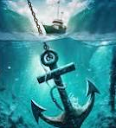
Our Anchor & Forerunner!
We are anchored to Messiah, Who is firm and has entered the Most Holy Place (out of sight) after the order of Melchizedek
We need an anchor to hold the ship and keep it from being wrecked, stabilize and maintain the progress it has made (not standing still but moving forward).
Our forerunner goes forward, knowing that others will follow behind. [Jn 14.2-3, Isa 45.2, Dt 31.8]

Slide 13
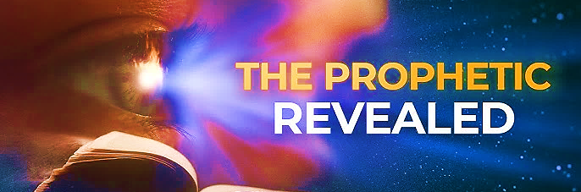
Speak Lord, we’re listening
Renewing the Prophetic stream

Slide 14
Communication
“During the singing of The Lord’s Name, in every area of creation, the stars, planets, forests, animals, seas, mountains and all of life, people of all races and lands praised Yah for His Greatness.”
Zechariah 14.16-21 Annual celebration of the feast of Tabernacle during the Millenium.
  Rely upon Yahweh not on natural resources.
Psalms 86.9 “All the nations You have made will come and bow before You, Adonai; they will honor Your Name.”

Slide 15
Communication
“During Pastor’s final prayer regarding being in different lands, from the Heavenlies, I saw Nigeria and all souls who are and were persecuted by the Adversary minions, those who lost their lives were in white linen. Those who were still present in the land, a wall of fire protected the Believer of Nigeria.”
Many believers are killed, particularly men, while women are often kidnapped and targeted for sexual violence.
More believers are killed for their faith in Nigeria than anywhere else in the world. These militants also destroy homes, churches and livelihoods. More than 16.2 million Christians in sub-Saharan Africa, including high numbers from Nigeria, have been driven from their homes by violence and conflict.

Slide 16
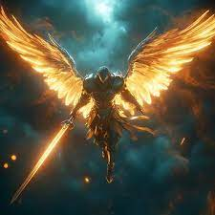
Communication
Just before Deacon Nichelle prayed, I saw angels in something like armor at the front of the Sanctuary behind the Bema where the cabinet is. Some were on one knee while one angel walked in front of them.
The angel who walked shouted something and the other angels repeated it also shouting. All the angels had swords. Suddenly, the angels left as though they went out with purpose. (This happened before Deacon Nichelle said, “Send Your angels” in prayer.

Slide 17
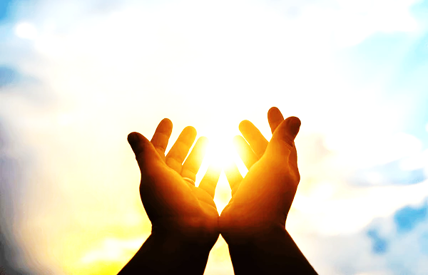
Bless & Encourage Your Brother
1 | May Abba establish your path this week
2 | May Shalom be with in you
3 | May Adonai dress you with wisdom and strength
4 | May you escape every hunter’s trap
5 | May Yahweh's will be done in your life

