Slide 1
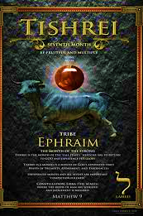










5786, 26

Slide 2
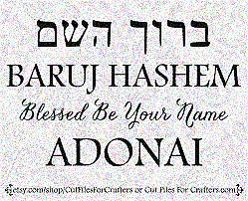
SING MY NAME
Isaiah 44.5
“One will say, I belong to Adonai, another will be called by the name of Ya’akov, yet another will write that he belongs to Adonai and adopt the surname Isra’el”
(Ps 29; 1Ch 16.28-34)

Slide 3
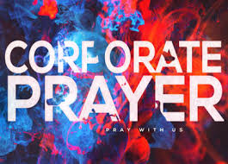
Intercession & Supplication
NIGERIA
  Psalms 140
JERUSALEM
  Jere 31.14-16 & Psalms 149
GARFIELD
  War Strategy * East Cleve
  Prayer Against Spiritual Blockage
FOTBG
  Decree a clean house

Slide 4
CLEAN HOUSE
Every Jezebel demon, whether in leadership or community come out of FRIENDS, shrivel up, and die, in Yeshua’s Name.
Let any path of the wicked that is assigned against FRIENDS and its member be diverted and uprooted. In Yeshua’s Name.
We remove and curse to the root every stubborn demonic, every manipulation devil, and every witchcraft devil now, in Yeshua’s Name.
As for me, FRIENDS and my house, we will serve Yeshua Messiah all the days of our lives.
Let goodness and mercies of Yahweh be poured over FRIENDS, our ministry & destiny. In Yeshua’s Name, amen.
Lord, God we repent for not being awaken to the witchcraft that we have allowed entrance to FRIENDS by breaking covenant.
We command every demonic spirit of mixture to come out of FRIENDS now, in the Name of Yeshua.
Every New Age demon, release FRIENDS now in Yeshua’s Name.

Slide 5
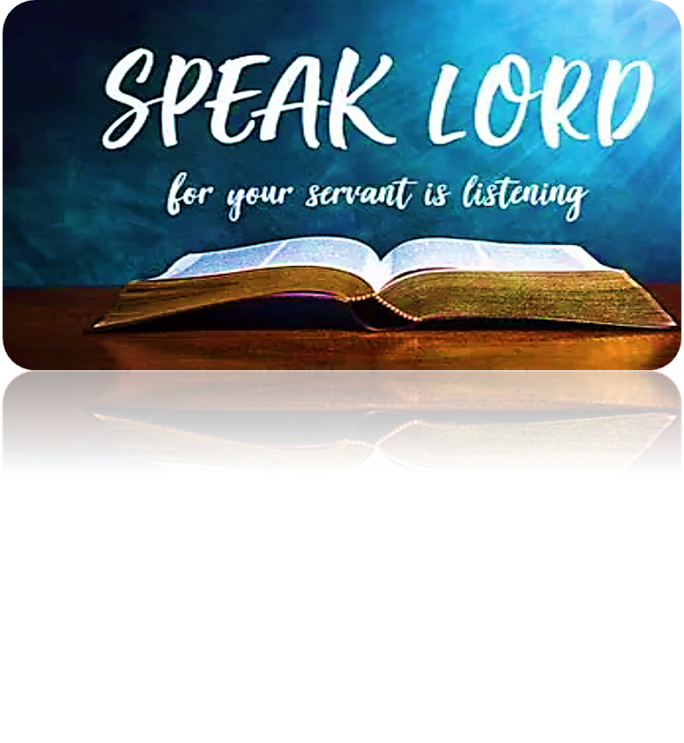
HOMEWORK
Read Psalm 43, write a short statement of what the Lord is saying to you about you.
Please be obedient to the Lord's instructions for engagement, which requires everyone's participation.

Slide 6
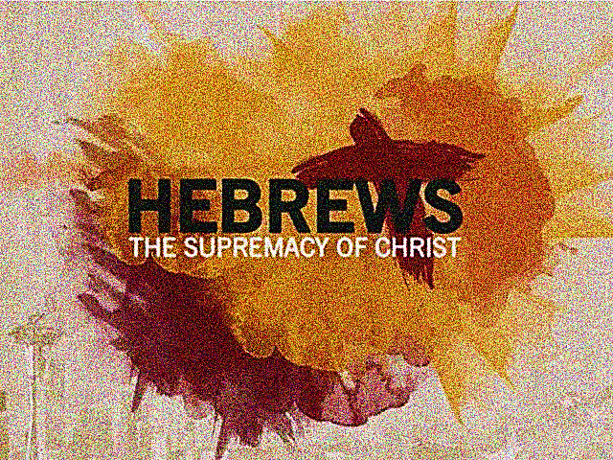
CHAPTER
SEVEN

Slide 7
The High Priesthood
The theme of High Priest began in Chap. 6:20 which will continue until Chap. 10:25.
The writer compares the Levitical priesthood with Melchizedek; the historical narrative is in Gen. 14.18-20 & Psalms 110.4.
Melek (King) this noun is not assigned to a glorified chief but Alpha of a complex government of Yah. Tzedek meaning (Righteousness or to be just)
In the introduction of Chapter 7, we are told that Malk-Tzedek the pre-Israelite Priest-King holds office in Shalem, (Shalom).
This is the ancient city of Jerusalem, renamed after Canaanite conquest

Slide 8
The High Priesthood
A cohen of God Ha’Elyon, met Avraham on his way back…provided bread and wine [Gen 14] and blessed him and Avraham gave Melchizedek a tenth (a sacred privilege) for honor.
He brought bread and wine [Mt 26.26-28] This is an outward evidence of a renewed covenant.
There was no such offering in the Levitical priesthood, but 400 yrs before then Yeshua at Passover.
Yeshua was saying to His disciples that the order has been restored.
Ratifies: Make binding and affective.
Luke 22.19b: “You must continually do this in memory of Me” or in remembrance.
So, every time we partake in communion, we are acknowledging Yeshua as our High Priest after the order of Melchizedek which is binding and affective.

Slide 9
No record of his father, mother, ancestry
V.3 Unlike Yeshua in Matthew, Melchizedek’s genealogy is not given in Hebrews. Simply mean that they are not named so the importance of what the writer is trying to express does not lose its focus.
The Targum identifies Shem, son of Noah as this mysterious Priest-King. Melchizedek is to be a picture of the incarnate Messiah as eternal High Priest.
Vs. 4-6: Four marks of Melchizedek being superior to Levitical priesthood.
  1) Avram gave him an offering
  2) Melchizedek blessed Avram
  3) Remain Priest forever (indestructible life) i.e., Yeshua resurrection)
  4) Greater than Levitical priesthood

Slide 10
V. 11 “Therefore if it had been…”
The Levitical priesthood was not the ultimate-One cannot stop there and reach perfection, maturity or completeness. There is a superior Priesthood.
V12. If the system of cohanim is transformed…transformation of Torah.” The “Torah” (teaching) was inseparably bound with the Levitical priesthood
If the Priesthood is to be brought to the original goal, then the Torah must also be brought to Yah’s original purpose.
Adam & Y’shua [Romans 5.12-14, 1Corinthians 15.45-49]
HOMEWORK:
Prophet, priest & king.

Slide 11
HOMEWORK
PROPHET​
PRIEST
KING​
TEACH
MEDIATE GOD’S VOICE AND STANDARD
MEDIATE
(ALLOW PEOPLE TO MAINTAIN RIGHT RELATIONSHIP WITH YAHWEH)
RULE & REIGN ACCORDING TO YAH’S STANDARD.

Slide 12
Prophet, Priest & King
Yahweh gave Israel the framework for their spiritual and political system for their protection. Henceforth, the word of Yah insist that a society is necessary to guard against one person having total control [Dan 2.37-38]
Divine separation is our natural inclination toward leadership.
Vs. 13 & 14 speaks of a change in the Priesthood, Torah and Tribe.
No priest came from the tribe of Judah under Moses, and no kings came from the tribe of Levi. No kingship or priesthood could come from one tribe. Preventing one group from having too much power.
Any attempt to do so was punished by Yahweh i.e., Saul and King Uzziah in 2Chr. 26.16-21. Uzziah was claiming that Yahweh’s way was unnecessary.

Slide 13
Question?
Why a King from Benjamin (Saul) instead of Judah?
Deut. 23(2) says children (Perez) born from an illicit union (Judah & Tamar) was not allowed full citizenship until 10th generation - until David, the leaping Priest-King [2Sam 6.12-14] wearing a linen ephod.
2Sam 7.14: Yeshua never did evil Instead Yah is setting the stage for His Great High Priest, Who there is no failure.
Judah stood up for Benjamin which changed Joseph’s mind. (picture of laying down one’s life. [Gen 44.18-45:28]
In choosing Saul it revealed:
  A need for a perfect king
  Exposed Israel’s motives
  Yah’s sovereignty
  Prophecy
  Etc.

Slide 14
Adam (King, Priest & Prophet)
A progenitor of the three-fold office of government.
KING: Placed in the garden to rule and reign (language of kingship) Man was placed upon the earth as Yah’s image to claim dominion Ps 8.5(4)-7(6)
PRIEST: Man’s primary office. The garden was a prototype of the Temple. Adam was placed there as priest with two main roles; work & keep.
The statement “cultivate & keep” i.e., serving and guarding. Adam was crowned with the glory and honor of Yah; he was to mediate it to creation. He walked with Yah and entered His presence [Lev 26.12, Dt. 23.15, 2Sam 7.6-7]
Just as the Aaronic ephod is for the priest representing dignity & splendor [Ex 28.2, 40] so, Adam was dressed in the same [Heb 5.4-5]

Slide 15
Adam (King, Priest & Prophet)
PROPHET: Less evident yet, Adam is given the Word of Yah which contains blessing and cursing. Adam is the bearer of this covenant.
He was to mediate Yah’s voice in the garden and eventually to all humankind.
He was to prosecute the covenant lawsuit when Yah’s people rebelled i.e., Nathan and David.
Therefore, when the serpent spoke lies, Adam should have executed judgment, wielding Yah’s word (i.e., Yeshua when led into wilderness by Ruach) expelling the serpent, being a true witness to Yahweh and His word. [Dt. 18.15, 18]
Adam as KING to rule, PRIEST bearing Yah’s glory in His presence, and PROPHET entrusted with Yah’s word to mediate to all creation.

Slide 16
Law of Priesthood-Yahweh has sworn!
The Levitical priesthood made nothing perfect nor had elements to bring us to the goal of maturity or completeness.
Now we have something and someone superior, Who brings us to the goal set in the bosom of Yahweh before eternity pass. Without stain, set apart for sinners (so we can draw near to Adonai) and raised higher than the heavens.
The Levitical priesthood did not have an oath (v21) meaning their office was only temporary. The Priest after the order of Melchizedek; was confirmed in His office by an oath from Yah. Hence His priesthood is eternal.
This makes Yeshua the guarantee of a better covenant (v22) Since the priesthood and the covenant are inextricably bound together this covenant is permanent as the priesthood.

Slide 17
Contrast of Character
The fleshly requirements of Levitical priesthood was based on man’s vision and ability.
1) Decent of Levi
2) Absence of physical defect
Samuel is told of David when being anointed King [1Sam 16.7] “Adonai does not see as humans sees…”
Yahweh from the beginning saw the light (Yeshua) Who would bring us to the goal.
Messiah is the only One, Who exactly suited our need, altogether pure within.
They were compelled to offer sacrifice day after day, even for their own sins.
Messiah offered up Himself, a conscious willing victim for human- kind, never needing to be repeated.

Slide 18

Bless & Encourage Your Brother
1 | May Abba establish your path this week
2 | May Shalom be with in you
3 | May Adonai dress you with wisdom and strength
4 | May you escape every hunter’s trap
5 | May Yahweh's will be done in your life

