Slide 1
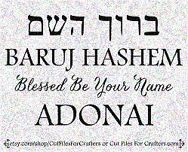
SING MY NAME
Isaiah 44.5
“One will say, I belong to Adonai, another will be called by the name of Ya’akov, yet another will write that he belongs to Adonai and adopt the surname Isra’el”
(Ps 29; 1Ch 16.28-34)

Slide 2
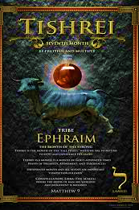
5786 Tishri 5
TRIBE: Ephraim
SYMBOL: Grapes
GEMSTONE: Agate (Onyx)
HEBREW LETTER: Lamed
NUMBER: 30

Slide 3
EPHRAIM
01 Correspond with 3 tribes of Ephraim west of Tabernacle
02 Blessing: B’resheet 49.22 Yosef
03 Cursing of Ephraim: Yarov’am 1Ki 12.32-13.1; 2Ki 17.6-8, Ps 78.9-11
04 Known as Samaria: Mix of Jews & Gentiles (Jn 4.3-4; 11.54)
05 Lesson: Consequences of covenant unfaithfulness & restoration

Slide 4
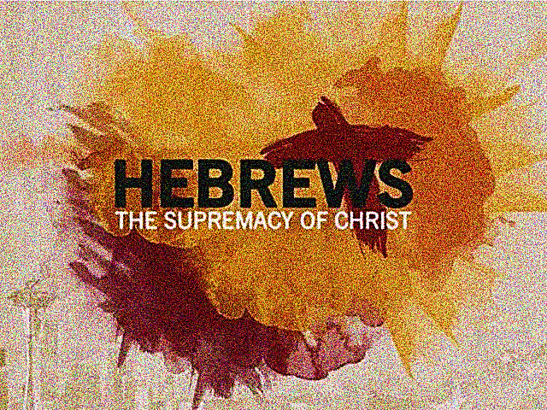
CHAPTER FOUR
Psalms 95

Slide 5
“Let us be terrified…even though…
…you might be judged to have fallen short of it.” Meaning a possible failure.
Your focus is on the past generation’s failures that one cannot see clearly your faith walk.
Over estimating one’s own spiritual position that you can miss the warnings set before you.
Not fully grasping the meaning of “belief” in Messiah that one’s faith does not engulf all you say and do.
V2. “For the Good News has also been proclaimed to us, just as it was to them.”
Simply hearing the Good News is not enough. The Gospel must be met with faith in the hearer.

Slide 6
Yahweh’s Rest
“They never entered rest.”
Yah, who never desires a thing in vain, must have wanted to share His rest; else He would have never extended it.
Yah’s purposes cannot be frustrated, therefore, the offer to enter the enjoyment of His rest must still hold good.
Yahweh is still extending His invitation to men to join Him; shown in His response “Today, if you hear His voice, do not harden your hearts.”
“Today”: This urgent call of Ruach is defining a new period in which the rest is to be open and accessible.
Sabbath-rest cannot be equated with Canaan, for Yah’s second and continued invitation has come through His covenant.

Slide 7
Genesis 2
“And God rested on the seventh day from all His works.” [Gen 2.2]
Yah cannot rest from good works. Rest means to desist, to cease. Yahweh rested from His creation activity.
When man enters God’s sabbath-rest he too must desist from what he has been doing, i.e., attempting to work out his own salvation.
Having peace in the assurance of access to Yah unhindered. This is made possible by Messiah’s purification of sin.
“Let us therefore make every effort to enter that rest.”
V8: In mentioning Y’hoshua the author is saying that Y’shua is superior. It is only in Messiah that we are brought into this rest.

Slide 8
Homework
Looking up the Strong’s number for the following Greek word, use the Biblical usages for each word for “rest” and write your declaration of commitment to the Lord, surrendering to His rest.
G372 Anapausis: Intermission
G2663 Katapausis: Permanent
G1879 Epanapauornai: Lean upon
What is stopping you from entering Yahweh’s rest?

Slide 9
The Word is Alive and a Sword!
There is no possibility of concealing unbelief!
Unbelief is a matter of the heart, it often escapes the notion of man but never of God, Whose word is living, active and a sword.
It has the power to reach right through to inmost parts of one’s personality. (We stand completely exposed – laid bare before the One Whom we will give an account.)
Power to judge both feelings and thoughts [Mt 12.36-37, 2Co 10.5] able to discern and decide on moral value of man.
“Word” refers to the divine message spoken by Yah either through Moshe, His prophets, apostles and Messiah.
His word possesses such dynamic power that when heard and retained it will create afresh [Ro 1.16, Hab 2.4]

Slide 10
Priesthood of Y’shua
The consolation and encouragement that the author now speaks is tied to the priestly work of Messiah.
This life of faith, though it may be difficult, is not devoid of external support. We have a great High Priest.
He has gone through the highest heaven, i.e., the earthly priest passed through the veil into Holy of Holies. Now Y’shua has come into the presence of God.
His name Y’shua, the Son of God…let us hold firmly…
He is both man and God, both sympathetic [v15] and powerful-The High Priest has suffered and was tempted to appropriate His blood; gives us the incentive to persevere.
Our High Priest is representing the needs of His people.
Therefore, come with confidence to Yah’s throne –ultimate result of Messiah’s priestly work.

Slide 11

Superiority of Y’shua Messiah
Angels
Prophets
Moses
Torah
Worship Y’shua
Helpers of Humankind
Scribes & voice of Yahweh
Foreshadow of Messiah
Deliverer of Sinai
Aaron
Y’hoshua
IDOLS
limited to earthly priesthood
Foreshadow of Messiah-Canaan partial rest
Isa 44.20
Jer 16.19-21; 51.17-18

