Slide 1

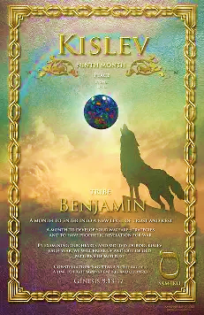
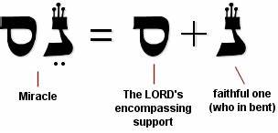
5786, 9 Kislev
TRIBE: Benjamin “Son of My Right Hand”
LETTER: Samech
GEM: Opel/Jasper (many colors i.e., rainbow)
NUMBER: 60 meaning support, strength, self, Divine protection
Aligned with miracles, trust. Focus on faith in Yah’s promise, reflect, embrace Divine protection

Slide 2
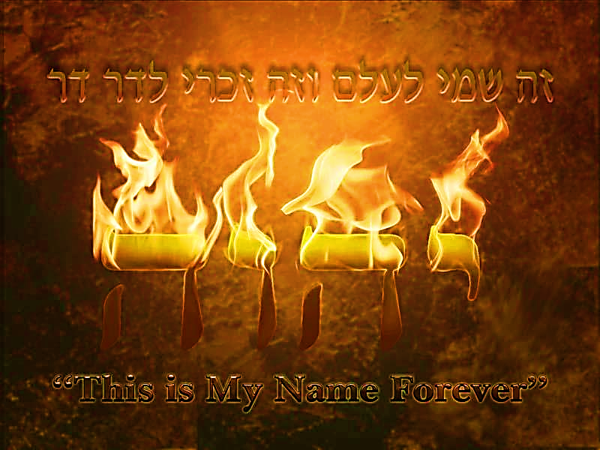
SING MY NAME
Proverbs 18.10
“The Name of Adonai is a strong tower; a righteous person runs to it and is raised high above danger.”

Slide 3
Book of Hebrews Homework
Last Shabbat you were asked to identify from the list of brotherly love traits the one that currently challenges you to express to your fellow servant.
How did you activate this trait this week to bless the Body?
Choose one (1) chapter from the Book of Hebrews that:
1) Impacted your life
2) Brought deliverance
3) Changed your carnal perspective
to Yahweh’s perspective.
Write a short testimony.
(See the attached testimonies)

Slide 4
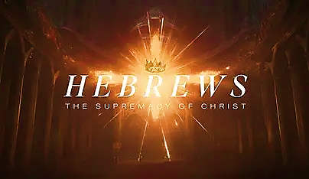
After studying the Book of Hebrews, Adonai reiterates that every Shabbat is about restoration and bringing us back to spiritual integrity.
We will look at the Book of Ezra & Nehemiah to understand fully of how the Lord used them to return Israel to their King. Each of them brought a form of restoration, flawed and incomplete yet it would lead them back to the mercy of Yahweh.
It is only in the superiority of Yeshua Messiah that we can find complete restoration and enjoin ourselves with the spiritual integrity found in our Father God.
The superiority of Yeshua HaMashiach to make all things new.

Slide 5
Nehemiah RESTORATION & SPIRITUAL INTEGRITY Chap.13
Sanctity of TEMPLE: More than physical security, it’s emblematic of Yahweh’s covenant relationship [13.1-14]
Sacredness of SHABBAT: Shut the gates; representative of Intimacy with Yah. [13.15-22]
PURITY: MARRIAGE, Yah’s character and undefiled relationship [13.23-29]
Feast SUKKOT: Appointed times, hearing Yah’s voice, priest service. [13.31]
All things to their design [13.30-31]
They brought restoration to Israel through prayer, effective leadership and strategic planning.

Slide 6
Ezra & Nehemiah Restoration & Spiritual Integrity
This restoration though incomplete and deficient was brought by prayer, effective leadership and strategic planning.
Ezra: Leaders require men who had married foreign wives to divorce, [Mal. 2.16] needing a God-honoring solution.
Refused assistance of the grandchildren who lived in the land, [4.3] causing discord.
Nehemiah: In anger of their broken vows [13.25] publicly humiliated the people by cursing, beating and pulling out beards. [Eph 4.26]
We have Yeshua Messiah full of compassion, grace & mercy bringing us to our goal.
Yahweh wants to share His Kingdom building vision
Overcoming obstacles through the love of Messiah.

Slide 7
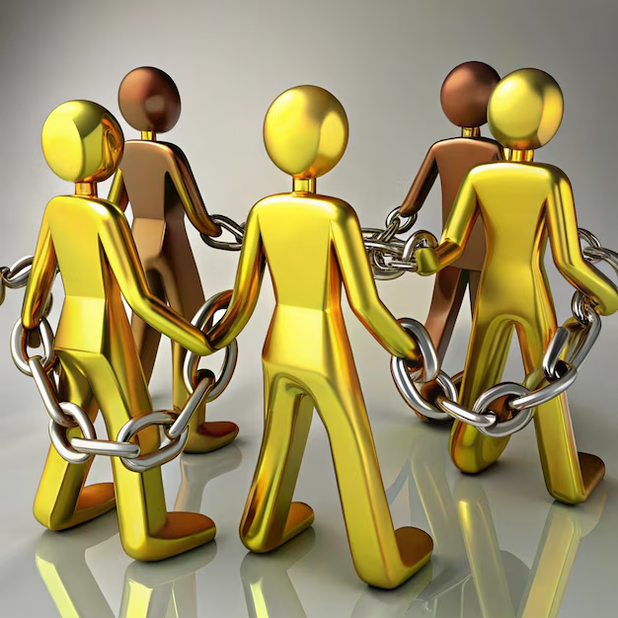
Vision - Restoration
As those who are married laid before The Lord, I saw something that was silver and sounded like handcuffs or like a chain closing over each couple. It was two separate chains or links closing together and locking – now intertwined.
Matthew 19.5-6

Slide 8
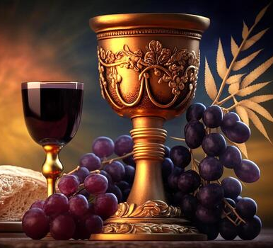
Communion
Redemption
Forgiveness
Cleansing
Justification
Reconciliation
Sanctified
Victory

Slide 9

Bless & Encourage Your Brother
1 | May Abba establish your path this week
2 | May Shalom be with in you
3 | May Adonai dress you with wisdom and strength
4 | May you escape every hunter’s trap
5 | May Yahweh's will be done in your life

