Slide 1

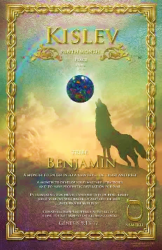
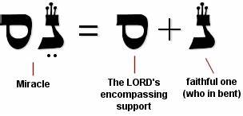
5786, 30 Kislev
TRIBE: Benjamin “Son of My Right Hand”
LETTER: Samech
GEM: Opel/Jasper (many colors i.e., rainbow)
NUMBER: 60 meaning support, strength, self, Divine protection
Aligned with miracles, trust. Focus on faith in Yah’s promise, reflect, embrace Divine protection

Slide 2
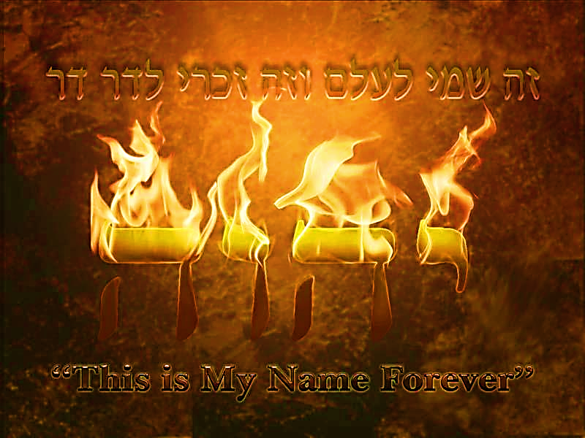
SING MY NAME
Proverbs 18.10
“The Name of Adonai is a strong tower; a righteous person runs to it and is raised high above danger.”

Slide 3
Call and Response [Revelation 7.10-12]
Victory to our God, Who sits on the throne, and to the Lamb!
Amen!
Praise and glory, wisdom and thanks, honor and power and strength belongs to our God forever and ever.

Slide 4

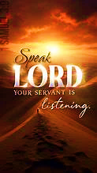
Psalm 52
A prayer directed against liars and informers.
At times liars appear to attain their devious goals, but soon to be discredited; while their innocent victims, with Yah’s help, attains peace and tranquility
1 SAMUEL 3

Slide 5
Night Watches 3rd Watch 12midnight-3:00am
FIRST MEETING:
December 27th Shabbat 1:00
REVIEW MEETING:
January 11th Sunday 12:noon
Elder Dawn Acoff
Deacon Leigh Harris
Elder Jason Smith

Slide 6
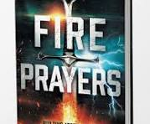
Ten Entrapments that Lead to Satanic Bondage
Rejecting and Living Against God’s Purpose for Your Life.
Inheriting Diabolical Curses
Experiencing Emotional & Physical Trauma
Surrendering to Ungodly Coverings
Embracing Worldliness
6. Owning Cursed Objects
7. Not Paying Tithes/Robbing God
8. Harboring Unforgiveness
9. Mixing World with Messiah
10. Lacking Spiritual Consistency
Satan is obsessed with obtaining again legal right to cause you to sin-he operate with open portals to make his claim.

Slide 7
Experiencing Emotional & Physical Trauma
Whether we’re experiencing emotional or physical trauma, Satanic forces identify places of human vulnerability and move cunningly to capitalize on the opportunity. Demons take league with familiar spirits already at work.
They monitor humans’ actions and reactions awaiting their moment to lure and then entrap any compromised soul into spiritual bondage.
Trauma is described as an intense reaction to a deeply disturbing experience. Trauma may alter one’s sense of safety and/or identity. Severe trauma overwhelms the ability to cope and at times causes changes in brain functioning.

Slide 8
Experiencing Emotional & Physical Trauma
Demons are looking for open doors, areas they can exploit, where they, and confederate spirits can all come in and abide in a human host. They understand spiritual principles and desire to affect not only the individual, but their bloodline as well. Their key aim is keeping Believers bound, and unable to embrace our covenantal relationship with YHVH.
Satanic bondage desires to keep us from living as sons and daughters of the King, and in so doing hinders us from our identity and God-given purpose. 1 Peter 5:8 warns: the Adversary stalks about, looking for someone he can destroy. We cannot concede to Satanic bondage. We must live victoriously in Yeshua! He paid our ransom in advance, at the cost of His Blood

Slide 9
Experiencing Emotional & Physical Trauma
Uproot & Tear Down
Destroy & Demolish
Build & Plant
Satanic bondage wants trauma to affect the way a person thinks and behaves
Trauma persuades individuals through the lens of doubt and fear, to expect negative outcomes.
Yeshua redeemed us from the effects of sin and trauma.
(See attached link for the complete writing)

Slide 10
Trauma
Causes us to be rooted in a cult of “Self” in the spectrum of “Narcissism”.
The BOC has not given grid for processing hurt or hardship - having no workable theology for suffering, disillusionment causes many to believe Christian faith has failed.

Slide 11
Weapon 3 The Blood of Yeshua
This blood brings life and healing; and cleanses us from our sins.
It sounds simple and easy, but under no circumstances should we simplify or reduce this to our human minds of understanding.
It is only after Messiah was whipped with weighted thongs that tore the flesh from His back in strips until bones were exposed, Ro 5.9 can we begin to understand the love of Yahweh manifested in this life-giving liquid.
Biblical Weapons Satan and His Demons Hate to Face
Revelation 12.11

Slide 12
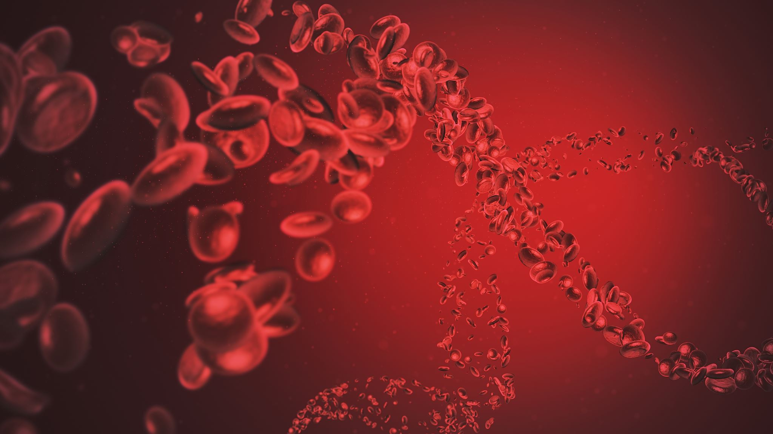
Blood of Messiah
Notes:
In our inheritance of the Blood of Yeshua is where the love of Yahweh is found.
The whole first century Believers moved by Ruach and the Blood of Yeshua. Yeshua was visible in every believer and therefore the Acts of Ruach manifested by Yah followed everyone who believed.
This KEY to the door of much power, signs, miracles and love have been ignored by many in the BOC. Without this element man cannot receive from the Lord his blessing, communion, revelation and power This is the inner-court not of the earthly temple but the heavenly temple.

Slide 13
BROW | Victory over pain & suffering, die to self, deep level of intercession | Lu 22.42-44
HEAD Crown of Thorns | Govern with Messiah, conquered stronghold of the mind, ability to have Mind of Christ | Mt 27.29-30, 2Co 10.5b
BACK | Free from sickness & disease-He bore it! | Isa 53.4-5
BEARD | Reclaimed priesthood, permits us to minister in Yah’s presence | Ps 133.2, Isa 50.6
FACE Disfigured | Triumph over pride & vanity, power to endure humiliation, rejection | Mt 26.67-68; Micah 5.1b
FEET & HANDS | Triumph over iniquity, new pathway destiny enables righteousness, carry the gospel | Isa 59.3a; 53.11, Ps 58.2b
SIDE | Intimacy with the Father, our desires conform to God’s heart. | Ro 12.2, Ps 40.8

Slide 14
Weapon 3 The Blood of Yeshua
This is how the Renewed covenant was wroth and appropriated for us an unprecedented (never-before known) relationship with Yahweh.
Messiah paid a high price to break the back of sin and cleanse us. The prophecy in Isaiah 53.4-5 says we would be healed by His blood.
This healing is threefold: physical, emotional, spiritual. Jn 6.53-56
Seals the Renewed Covenant
Consecrates us
Pleads for mercy
Gives life

Slide 15
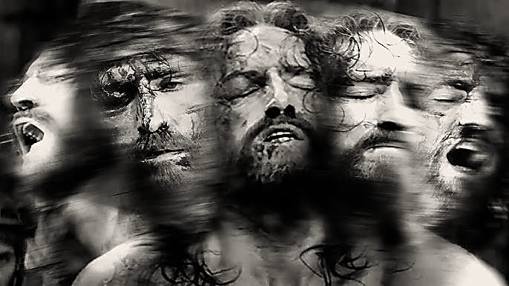
Weapon 3 The Blood of Yeshua
This bold solution to save lives gives us the substance for a restored life and to destroy the activities of the demonic and devils torment-it demands submission. Not only for Believers but also demons!
They recognize Yeshua’s authority.
They submit to His commands.
Fear of Judgement
This same, life-giving sustainable Blood [Heb 12.24] speaks of life and mercy for us. HIS PASSION.
Notes:
The Word of God says that the blood speaks. The blood of Abel spoke of revenge, as we saw before, and the Blood of Jesus speaks of mercy. Blood has a very special sound in the spiritual world.
The innocent blood of martyrs cries day and night for God to bring them justice. Their blood is before the Father’s throne as a memorial that will unleash judgment upon the empire of evil.
The Word says that the Son of God was manifest to destroy the works of the devil. The blood of Jesus is the greatest element of intercession with which Jesus prays for us before the Father. When the blood of Jesus is manifested in the kingdom of darkness, it produces a sound of judgment so strong that it terrorizes the devil’s armies. That sound opens the darkest darkness in order for God’s presence to be manifested.

Slide 16
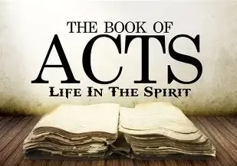
Homework Chaps. 5 & 6
It is important that you engage in the above assignment. We will not study the Book of Acts as we did Hebrews.
On Shabbat we will engage in “Prayer Response” of what the Lord desires for us found in the Book of Acts. If you have not read the assignment, then you are robbing yourself of joining with the community in our Prayer Response and thanksgiving

Slide 17
Acts 5 & 6 Conforming Work & Fruit of Ruach
At the end of chapter four the Believers are all of one heart. No one claimed any of his possessions for himself, shared everything.
In this united community of disciples, chapter five and six the enemy introduces instruments of strife to bring contention against the instrument of Truth, praise and worship.
Yahweh often shows His disapproval openly when sin blackens the beginning of a new stage of His witness, so all may know His mind of the matter; i.e., Achan in Jos 7 and Nadab & Abihu, Lev 10.
Adonai will do this so the fresh dough can continue unleavened [1Co 5.7].
The contentment and willingness of the Believers to share what they had, showed their trust in Yah to meet their needs.

Slide 18
Acts 5 & 6 Conforming Work & Fruit of Ruach
Sin and death during the first century were closely inseparable. Indicating how a holy God cannot tolerate sin.
Hananyah & Shappirah, although saved when lying to Ruach, were removed from the company of Believers.
Unregenerated hearts do not fear God as Messiah [Isa 11.3a] they’re occupied with obtaining self credibility Jn 5.44
A lying tongue is an offence to the God of Truth Pro 19.9, Eph 4.25
A liar wants to see how far they can go with their cravings in opposition to God while in His presence [Mt 4.7, Ex 17.2, Dt 6.16]

Slide 19
Truth about Lying
Proverbs 12:22 “Lying lips are an abomination to Adonai, but those who deal faithfully are His delight.”
Proverbs 14:5 “A honest witness will not lie, but a false witness lies with every breath.”
Proverbs 17:20 “A crooked-hearted person will find nothing good and the perverse of speech will end in calamity.”
Proverbs 19:9 “A false witness will not go unpunished, whoever breathes out lies will perish.”
Proverbs 26:28 “A lying tongue hates its victims, and a flattering mouth causes ruin.”
Matthew 5:37 “Just let your ‘Yes’ be ‘Yes,’ and your ‘No,’ ‘No.’ For whatever is more than these has its origin in evil.”
Ephesians 4:25 “Therefore, stripping off falsehood, Let everyone speak truth with his neighbor, we are intimately related to each other as part of a Body.”
Colossians 3:9 “Never lie to one another; because you have stripped away the old self with its ways,”
Revelation 21:8 “But as for the cowardly, untrustworthy, vile, murderers, sexually immoral, those involved in the occult, with drugs, idol-worshippers, and all liars their destiny is the lake burning with fire and sulfur, the second death.

Slide 20
Acts 5 & 6 Conforming Work & Fruit of Ruach
The Body continued to grow, and signs and wonders followed even as great fear came over the community and others.
The outpouring and overshading of Ruach flowed off Peter’s shadow onto others for healing.
The preached word “Gospel” is what brings signs and wonders – it is Yah’s witness to the Word [Hebrews 2.2]
Opposition rises against Yah’s servants [2Tim 3.10-13, Jn 15.20] because “Truth” of the gospel exposes darkness, human agenda and challenges worldly systems.
Being connected to the Author and power of Messiah found in His Name empowers His servants to be bold witnesses of His Lordship.

Slide 21
Acts 5 & 6 Conforming Work & Fruit of Ruach
In chapter 6 the Greek speaking Jews brought an intrusion of satanic division and confusion, feeling neglected and demanded that their widows be given equal consideration [1Tim 5.4-10; 16]
What prejudices are found in your body of assembly?
Chosen men of honest report, full of Ruach [Eph 5.18] wisdom (application of Ruach) full of faith (not an amount of faith, but an object of faith) to serve & witness
The apostles were willing to share leadership. They would focus on those who hunger for spiritual food i.e., Jn 4.21-34
The chosen men and the remaining of the believers are called talmidim; because the whole of Believers were learners and students of Messiah

Slide 22
Acts 5 & 6 Conforming Work & Fruit of Ruach
The Word of God continues to spread and the number of talmidim (disciples) increase rapidly.
From the chosen men we hear only of the acts of two; Phillip and Stephen. Stephen being eloquent in His bold delivery of God’s message and signs and wonders is confronted with instruments of strife; the tongue of lies.
Stephen’s face showed the wisdom of God as Moshe and Yeshua reflected.
Moshe radiated in Ex 34.29-25. Ecc. 8.1 says “Who can be compared with a wise person? Who else knows what a thing means? Wisdom lights up the face and softens a grim appearance.”
Stephen’s countenance testified he was the Lords faithful servant and like Moshe and Yeshua stood in the presence of Yahweh.

Slide 23
Prayer Response Acts 5 & 6
Blessed be the King of Glory; You desire that all men would radiate Your holy presence. Thank you, Father, You have given us an inheritance of our Savior’s Name and authority to speak boldly of Your divine message of forgiveness. We declare that our tongue be sanctified by grace held by Yahweh and influenced by Rauch. We will not live unto ourselves but unto Yeshua who died for us. We count it all lost, in the Blood of Yeshua Messiah.
We are Your disciples, those who will learn and grow in the knowledge and ways of our Messiah. We will master our own tongues we will not be instruments of strife. Thank you that we are not neglected nor confused since we have regenerated hearts born out of Your mercy. Father, you have birth in this community of Believers contentment and willingness to share what You have given- so we denounce any pursuit of self credibility; our faith and victory is in the Name of Yeshua. Elohim let the fresh dough multiply and allow us to continue unleavened. Send Father, Ruach, let Him overflow and bring healing to many bound to the mischief of the enemy.

Slide 24

Bless & Encourage Your Brother
1 | May Abba establish your path this week
2 | May Shalom be with in you
3 | May Adonai dress you with wisdom and strength
4 | May you escape every hunter’s trap
5 | May Yahweh's will be done in your life

