Slide 1
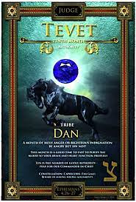
5786, 7 Tevet
Associated with judgment, strategy, vision and overcoming idolatry 1Ki 12.26-30
Genesis 49.16,17: Dan will destroy the enemy without physical contact i.e., Judges 16.30
HEBREW LETTER: Ayin #70 (Ps 33.18) watching & seeing (eyes), spiritual order, wholeness and judgment.
TRIBE ASSOCIATION: Judah (praise, prayer) & Dan (protection, rear guard) Nu 10.25
TEMPLE: B’tzel & Oboli’av, Ex 31.1-6

Slide 2

SING MY NAME
Proverbs 18.10
“The Name of Adonai is a strong tower; a righteous person runs to it and is raised high above danger.”

Slide 3

Call and Response
Amen!
Praise and glory, wisdom and thanks, honor and power and strength belongs to our God forever and ever.
Revelation 7.10-12
Victory to our God, Who sits on the throne, and to the Lamb!

Slide 4
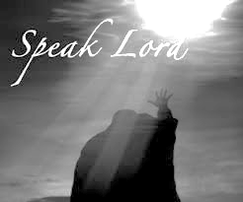
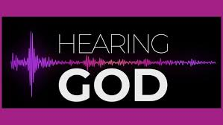
Psalm 53
A maskil
Reflective psalms about the deeds of the wicked, which sees the source of their evil in their lack of faith in divine providence and their misguided assumption that the world has been abandoned to those who are strong and lawless.
(Ps 14 gives a different version)

Slide 5
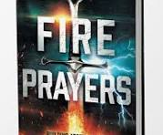
Ten Entrapments that Lead to Satanic Bondage
Rejecting and Living Against God’s Purpose for Your Life.
Inheriting Diabolical Curses
Experiencing Emotional & Physical Trauma
Surrendering to Ungodly Coverings
Embracing Worldliness
Owning Cursed Objects
Not Paying Tithes/Robbing God
Harboring Unforgiveness
Mixing World with Messiah
Lacking Spiritual Consistency
Satan is obsessed with obtaining again legal right to cause you to sin-he operate with open portals to make his claim.

Slide 6
Surrendering to Ungodly Coverings
…It is important to know that a spiritual leader does not hold the power to save you, sanctify you, fill you with the Holy Spirit nor get you into the Kingdom of Heaven. Only Jesus Christ & His Father can do that for you. (If we have made the choice and commitment).
However, a Spiritual leader is a vessel that holds some power, that was given to them by Christ, to lead you back to the Source, which is again, Christ our Lord/GOD. They are here to provide counseling, assurance, direction, guidance etc.
However, if a Leader is dealing with a rebellious spirit, they cannot help any believer, nor lead. In JER 23 V2, we see how the Lord talks to the false prophets. The Lord says to them…

Slide 7
Surrendering to Ungodly Coverings
In marriage the man and a woman will simply think they are meant for one another, just because they are both pursuing the Lord; however, what God has for you, it is for you. Although two believers in Christ are ideal, this does not mean they are equally yoked, let alone in G-d’s will for them to become one.
Entering in marriage that was not intended means entering it with your flesh, which allows the devil to take hold.
Yeshua as Husbandman, is an example of earthly husbands, demonstrating Yahweh ways in Spiritual (leadership), in provision, overall well-being, support, love and care for the family.

Slide 8
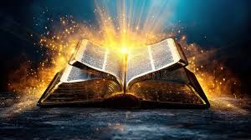
Conclusion
In conclusion, to avoid these ungodly coverings, it is important to seek Christ consistently and be obedient to the Spirit of the Lord on direction. The Lord is The Wonderful Counselor; He is the one who knows all & sees all. We should not be quick to act, especially when in our flesh, nor be quick to sit under a covering without prayer and sometimes even fasting. Lastly, we must also taste and see for ourselves of how good the Lord is. If we do not know the Lord, how can we truly know when a covering is ungodly? Let alone have direction in other areas of our lives, such as marriage, our choice of places we go and the people we associate ourselves with.

Slide 9
Surrendering to Ungodly Coverings
1
  Psalm 91:4 – The greatest covering is under the shadow of His wing, our Refuge and Protective shield. Abide and Seek the Lord for wisdom in all areas
2
Do not rely only on a spiritual leader to replace building a relationship with the Lord. For if you seek Him yourself, you will be able to discern an Ungodly covering by the Holy Spirit.
3
Ungodly coverings can keep you away from your calling and the plans God has for your life; ungodly coverings is a form of a bondage that one must break loose from.
(See attached link for complete writing)

Slide 10
Weapon 4 Speaking in Tongues
Biblical Weapons Satan and His Demons Hate to Face
1 Co 14: Yahweh’s standard instructed through Apostle Paul & his experience. Tongues are not limited to one expression; demonstrating the many ways of Yah. [Eph 3.10; 18-19]
  Fluent language (unknown to speaker not hearer) Ac 2.4
  Serves as a powerful ability to speak in recognizable language-a tool for evangelism. Allowing people from different nations to hear the message of Messiah in their own language (inverse Tower of Babal)
  Mark 16.17 (G110) gloce-sah: Signs & wonders of Believers

Slide 11
Speaking in Tongues
Supernatural language (Gift of Ruach) 1Co 14.2
When Paul uses the word “tongues” with the word mystery it means something much more.
Mystery: a hidden or secret thing, not obvious to understand. A hidden purpose or counsel of Yah: The secret counsels which govern Yah in dealing with the righteous, hidden from ungodly and wicked men but plain to the godly (gift of Interpretation)
The fallen angels (Book of Enoch 1.6-8) who did not stay in their appointed places taught humankind forbidden knowledge.
The knowledge of tongues was not revealed to them (mystery) De. 29.29, Mt 24.36, 1Co 2.11-16; therefore, they cannot interpret the gift of Ruach given to men to supernaturally communicate with Yahweh.
These are words inspired by Ruach that by-passes your natural mind. Jude 1.20

Slide 12
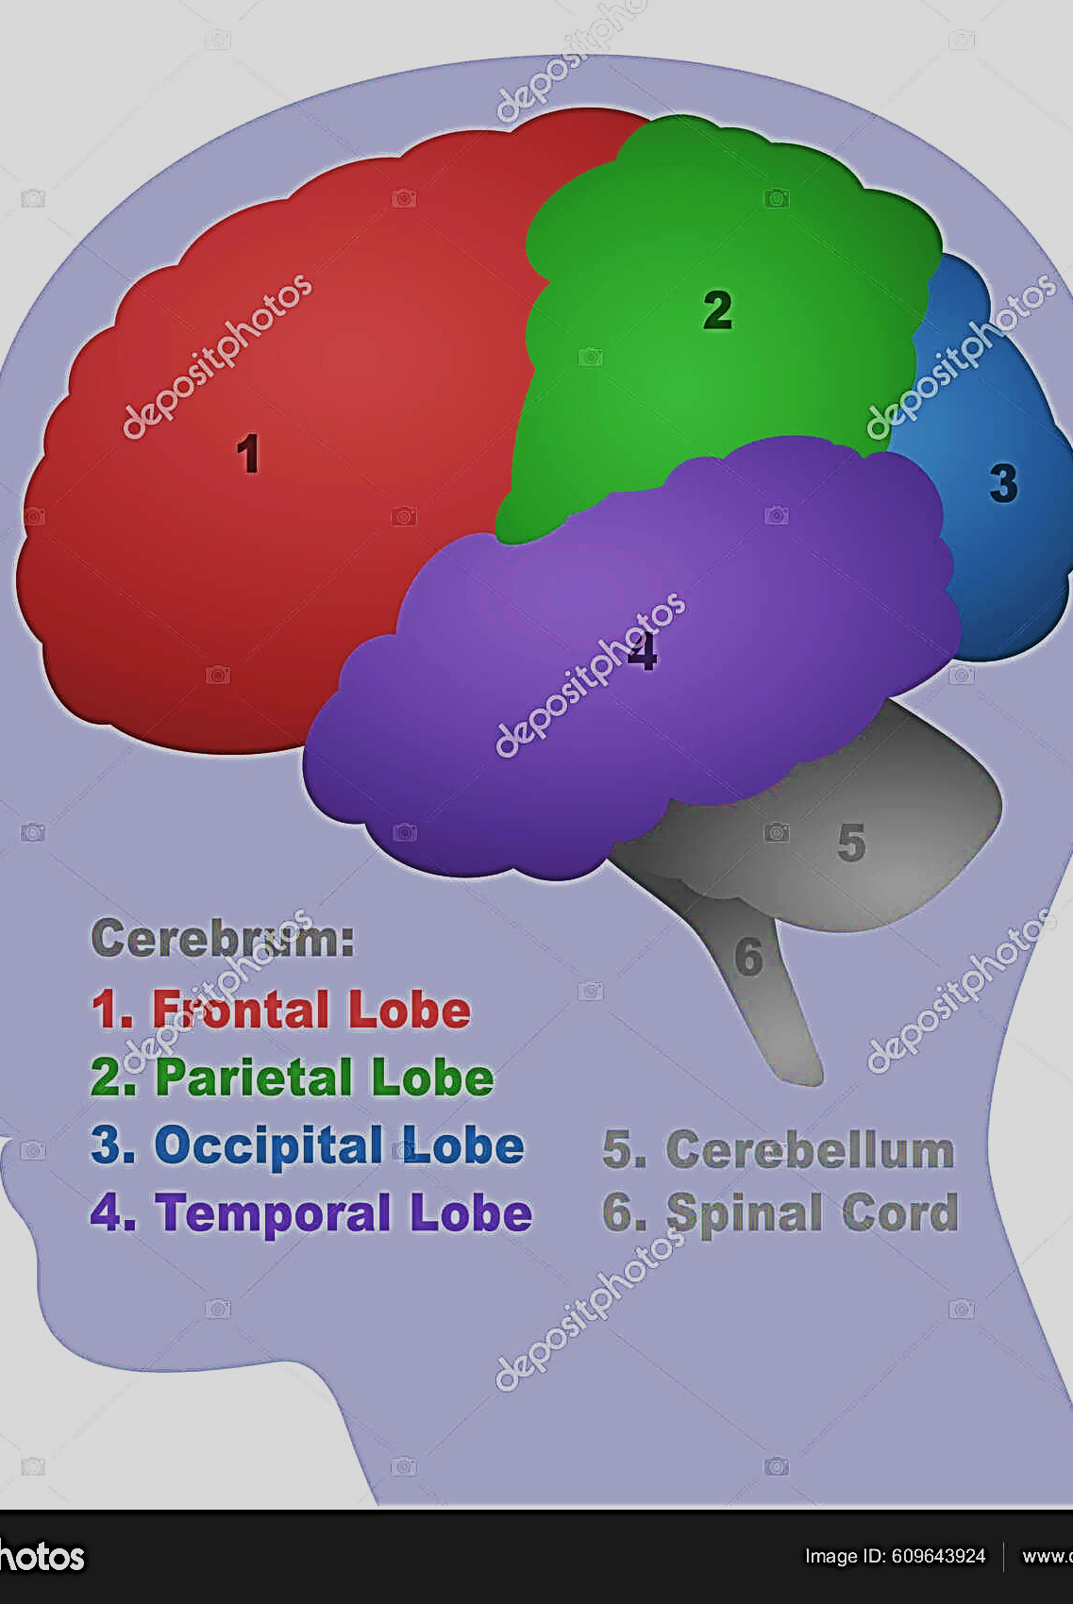
Frontal & Parietal Lobes
Neuroscience & Tongues
SPEAKING NORMALLY: The frontal lobe (control center) lights up. Language, reasoning & decision making.
SPEAKING-TONUGES: The frontal lobe activity decreases and the parietal lobe lights up. This is the receptive area or processing sensory. When yielding to Ruach, allowing Him to speak through you Ro 8.26-27 it reduces stress, boosts immune system (white blood cells function better-peace) and enhance brain function.
Science IAAAS.

Slide 13
Speaking with Tongues of Fire
Many have rejected this powerful tool allowing the enemy to convince them by saying:
You sound silly
That’s not real
You’re making it up
You have made fun of others or talked about them, now you want to do this.
Not realizing that the enemy is stealing from us what frightens him.
Speaking in Tongues is a shield that gives respite to the Believer while engaging in warfare and intercession.
Speaking in tongues is a hidden weapon from the enemy causing confusion in his camp (cannot interpret battle plan); was not revealed until Ruach was dispatched from Heaven as “fire” on Yeshua’s return.

Slide 14

Speaking with Tongues of Fire
When we have witness or even spoke in tongues ourselves, we can hear a melody, it’s like music or singing that connects to deeper parts of the brain.
There is a rhythmic composition to it as we commune with God expressing our inner most feeling that mere words cannot express. It has an unrestricted flow that reaches its fullness as Ruach gives melodic groans.

Slide 15
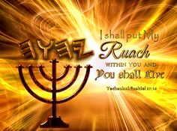

Ask Me!
I Give Good Gifts!
Do NOT doubt
Step out in Faith
Surrender control
Speak words
Continue until it manifest

Slide 16

Homework Chaps. 7 & 8
It is important that you engage in the above assignment. We will not study the Book of Acts as we did Hebrews.
On Shabbat we will engage in “Prayer Response” of what the Lord desires for us found in the Book of Acts. If you have not read the assignment, then you are robbing yourself of joining with the community in our Prayer Response and thanksgiving

Slide 17
Ruach as Teacher
The upcoming narrative of Stephen’s apologetic sermon has sized up the Sanhedrin and caused them to ask the question; “Who is on trial?”
Show how they have continuously misunderstood Adonai.
Divine deliverance was always what Adonai wanted.
Possession of the Temple was not necessary nor a guarantee of true worship of Adonai-Messiah Jn 4.24
ABRAHAM Gen 12.1: “Delayed Obedience” Yah wanted spiritual separation, but Avram waited until his father died.
JOSEPH v.9: Rejected and Cast away as Yeshua. He was a type of Messiah-The Baker & Cup Bearer interpreted dreams would be remembrance of Avram & Melchizedek, then Yeshua - bread & cup of renewed covenant.
Notes:
Call for Avram to “Get out”
Toxic Relationship
Endless worrying and obtain peace
Habitual sin – come into holiness

Slide 18
Ruach as Teacher
V.18 “Arose another king who did not know Joseph” meaning other or strange. This king was of Canaanite origin called Hyksos that assimilated in Egyptian culture i.e., High Priest were appointed by bribery or selection by political authorities.
MOSES V25: “He supposed…understand that God was using him to rescue them, but…” First Delayed Deliverance, 40 yrs until Moses return then 40 yrs in the wilderness. Messiah fed people Yah’s word as Moses, still He was rejected.
The very accusations that was brought against Stephen of…
  Blasphemed Moses, YHVH, Holy Place and Torah.
…Stephen replied: they misunderstood their own spiritual roots by:
Rejected Adonai, even those who he sent to deliver them, disobeyed Torah, showed contempt for the Temple and stubbornly resisted Adonai and His Truth.

Slide 19
Ruach as Teacher
The thorn bush was the Messiah’s crown; the raised-up prophet like Moses.
Ruach will respond to the Sanhedrin as Yah once did calling them “Stiff-necked” [Ex 32.9] withdrawing from them, giving them up to false gods to reveal their wretched state and calling for repentance.
Stephen, full of Ruach sees his home. The glory had departed from Jerusalem and was centered at the right hand of Yah; The Son of Man to receive him. Dan 7.13
Just as Messiah, Stephen was before the same tribunal Mt 26.64-66 and cries out for salvation for his tormentors, saying “Don’t hold this sin against them!” Luke 23.34. They both longed for the blessing of the nation and expresses the joy of a martyr.

Slide 20
Chapter 8
With the approval of Sha’ul, a member of the Sanhedrin, intense persecution came against the Messianic community.
Yahweh brings His purposes to pass through the wrath of men. The death of Stephen, paved the way and prepared the gospel to non-Jews (they were scattered).
Now Philip, the other deacon who was to prepare tables for the widows, is walking in signs and wonders.
In Samaria Philip delivers the good news of the Kingdom of God and the Name Y’shua. Many received the immersion (regeneration) but not the immersion of Ruach (transformation).
Why didn’t Ruach fall upon the Samaritans believers? The Samaritan’s was divorced from Judah and Jerusalem for centuries, God’s channel of salvation. [Jn 4.22] They could have continued in this vein, carrying the schism over to the Body of Messiah.

Slide 21
Ruach as Teacher
Yahweh had to send the Apostles to lay hands and bring the community of believers together in One Body, conveying the fullness of Ruach by prayer and act. 1Co 12.25, Eph 2.14-18
Demon assisted Simon Magus, was impressed by Philip which was superior to his own and believed but he was not regenerated as in vs. 20-23. His unregenerated eyes saw a new power. If he had this in his repertory it would produce a wonderful effect.
According to his standards, everything had a price. He offered to buy “The Spirit of Yahweh”; not for himself but to be known. In rebuke he refused to understand Yah’s way and ask that Peter pray to save him from punishment. He has no desire to draw near to God.
Philip continues to be carried by Ruach to teach the foundation of the gospel to the god-fearing Ethiopian eunuch. This illustrates the principal that “He that seek, finds” Mt. 7.8

Slide 22
Ruach as Teacher
As a true servant evangelist, Philip leaves us with what it means to surrender to Ruach.
To go, say and do the work of the Father according to His divine plan of redemption. He leaves the Ethiopian with the answer to his questions of the Suffering Servant as Y’shua Messiah, the Lamb of God.
After repentance and immersion Philip is once again carried off.
The narrative gives us a picture of how the good news was spread and taught in all kinds of unlikely places during the first century.
How much should we now allow Ruach to orchestrate our work according to Yahweh’s plan.

Slide 23
Prayer Response Acts 7 & 8
Our Father, Who is in heaven, holy is Your Name. We have misunderstood Your many ways of deliverance as our forefathers did and we repent. Your deliverance is perfect as seen in Yeshua Messiah, thank You. You have called each of us to be separated for the work of the Kingdom, stepping out in new territories. Though we may stand before wicked men we will not cling to life but give ourselves in joy as The Righteous One, our Savior, Yeshua.
Lord God, we choose to no longer delay or stubbornly resist Your truth; we stand ready to submit, joining Ruach in declaring the good news of Yeshua to the masses. Yes, Father, saturate us, immersing us once again in a great outpouring of Your Spirit by igniting our tongues with the coals of Heaven. We will give You glory all the days of our lives. May Your will be done as it is in Heaven. Amen.

Slide 24

Bless & Encourage Your Brother
1 | May Abba establish your path this week
2 | May Shalom be with in you
3 | May Adonai dress you with wisdom and strength
4 | May you escape every hunter’s trap
5 | May Yahweh's will be done in your life

