Slide 1
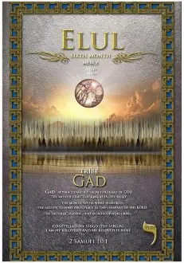
5785 Elul 28
“The King is in the Fields”
2 Kings 8.6
Gad “A Troop”

Slide 2
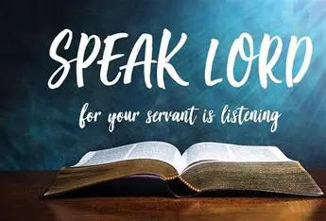
Homework
Read Psalm 39 and write a short statement of what the Lord is saying to you about you.
Please be obedient to the Lord's instructions for engagement, which requires everyone's participation.

Slide 3
Book of Hebrews Chapter 3

Slide 4
Book of Hebrews
Previous chapters we are left with the picture of Yeshua as our Heaven High Priest.
Yeshua is superior to the prophets, angels. Yeshua is the expressed image of the Father.
Therefore, in light of the previous chapter, we are to consider…
1b) Consider the Emissary & High Priest
Consider: means to fix the attention on something in such a way that its inner meaning or lesson designed to teach and learned.
Apostle means ambassador (sent one). Yeshua is the Father’s ultimate ambassador. Yah sent a message of love that was so important He sent it through Messiah.

Slide 5
consider
…that Yah loves you, so He sent the ultimate Messenger, Himself, for us to imitate [2Cor 5.20]
…High Priest position of Yeshua, Who supremely represents us before the Yahweh.
…of our confession: When we confess our sin, we are saying about it what Yahweh says.
… Yeshua as faithful in His duties before the Yahweh. This makes us understand that He will continue to be faithful-To the Father and therefore, he will be faithful to us.

Slide 6
Consider Y’shua as superior to moses
Moses showed amazing faithfulness in his ministry; but Y’shua showed a perfect faithfulness that surpasses Moses.
He was never called a Son as Y’shua. We are to look at Moses in his proper relation to Y’shua.
Moses receive much glory from Yah, shining face (Ex 34) justification before Miriam & Aaron (Num 12) & Korah (Num 16).
Y’shua glory, baptism (Mt 3) His transfiguration (Mk 9) His resurrection (Ac 2) Sitting on Yah Right Hand
Difference between a servant of the house verses the Creator of the house (family)
Whose house are we if we hold fast? We are part of Messiah’s household [1Pe 2.4-5] therefore, we are encouraged to hold fast.

Slide 7
True commitment
Is demonstrated over the long term, not just in an initial burst. We trust that He Who have begun a good work…[Ph 1.6]
Ruach says “do not harden your hearts…” We must hear His voice and not allow our hearts to become hardened. We hear Ruach speak in Scripture, through His people & His work.
How does one harden their heart?
Relapsing into old indifference
Unbelief
Needing a sign
Presuming we know Yah’s mercy
Resisting challenges to what we know
This urgency is not for tomorrow, its today. It is a genuine invitation.

Slide 8
Urgency of Ruach
Execute His office as Comforter-He cannot comfort a rebellious soul (this would be their destruction)
He watches with longing eyes for broken hearts and remorseful spirits that He may apply the balm entrusted to Him and heal their wounds.
“As in the rebellion…” Num 20.1-13 They refuse to trust and enter the promised land [Num 13-14]
Israel rejected all that Hashem had done for them. Because of their unbelief, they faced judgment.
We must learn from the mistakes of Israel

Slide 9
continue
“Therefore, I was angry with that generation”
They refuse to believe Yah for the great things He promised, and they were unwilling to continue to trust.
Vs. 12-15 “Watch out…so that there will not be an evil heart lacking trust…”
Refusing to believe Yah is a serious sin, it shows an evil heart that departs from the living God.

Slide 10
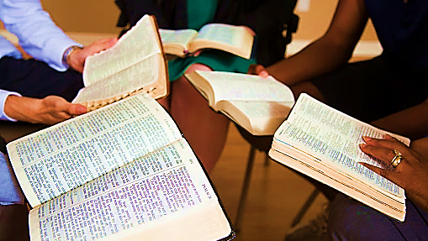
HOMEWORK
The life of a true Believer is proved by endurance, continued confidence in and loyalty to Messiah. This life is not expressed by those who merely professes to know Yahweh [Psalms 95.10].
Do your emotions rule you, causing you to give up thus retreating to Egypt?
Israel’s loss was due to rebellion/unbelief failing to maintain an attitude of confidence and obedience throughout their journey.
Are you currently or have in the past experienced loss not realizing it may have been due to unbelief?

Slide 11
Unbelief Exhort one another
It is not the inability to understand, but unwillingness to trust. It is the will, not intelligence.
Even in doubting we still want Yah’s promise, but our faith is weak. Therefore, unbelief is in opposition to faith.
This is serious encouragement. This shows our responsibility to both give exhortation and to receive exhortation (easy to judge and criticize)
When we are out of fellowship (you can’t exhort, nor can you be encouraged) there is much less around us to keep us from becoming hardened through deceitfulness of sin.

Slide 12
Deceitfulness of sin PARTAKERS (v.14)
It does not come with full revelation, full exposure of all its consequences. It would be unattractive
Sin is deceitful in the way it comes to us
What it promises us
What it calls itself
Excuses it makes, before & after.
Believers are those who turn from sin and self, putting their life’s trust in Y’shua.
We share in His obedience, His suffering, death, resurrection, victory, plan, power, His ministry (reconciliation) 2Cor 5.18, intercession, work, glory and destiny.

Slide 13
“who were the people after they heard…
Quarrel so bitter…” Quarrelling affect one’s faith [James 4.1-2].
It took faith to cross the Red Sea. Yet Indecisiveness and quarrels can reshape what is true reality.
They saw ten plagues
Great revelation from Yah
Received patience & mercy from Yah
They would not enter “Rest”.
This is due to an outgrowth of unbelief not disobedience.
They did not persevere in faith.
There are three Greek words translated rest. One used in Hebrew 3.11 speaks of permanent rest, the eternal Kingdom.

Slide 14
Rest? The ground of your heart & His word
If Hashem did not spare the Exodus generation neither would He spare the current generation.
Entering “Rest” of the Promise Land is like entering Faith in Y’shua, both require faith & obedience.
It is not enough to make a good beginning; real belief perseveres to the end.
If we enter Yah’s rest, then the coming years will only increase our trust and reliance on Y’shua. If not, we will gradually draw us away from a passionate, trusting relationship with Messiah.
Mt 13.1-23 four types of soil – how we respond to the truth of Yah’s voice.

Slide 15
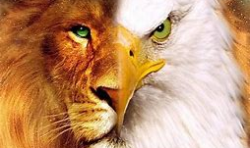
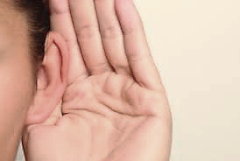
The Power of Communication Amos 3.7-8
Proverbs 1.1-7

Slide 16

Communication
“During the singing of The Lord’s Name, I felt suspended as if my body though on the floor was between the ground and the air.”
“Displacement” meaning normal functions are suspended. Consciousness is absorbed in a spiritual experience, lose full senses when Ruach comes upon you.
I.e., 2Cor 12.3 “only Yah has knowledge of such things

Slide 17
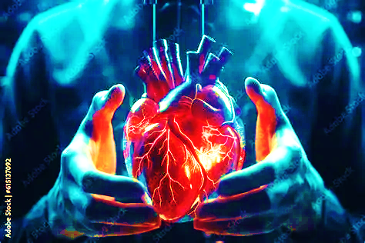
Communication
As Pastor reviewed Hebrews chapter one, I saw an angel or Ruach, Who said, “Restoration in Terrion’s left ear.” Then, the angel or Ruach put their hand into his back, held his heart and began closing their hand and opening it causing his heart to beat.
Spiritual dullness is insensitivity and hardness. Your heart is beating, but to a low rhythm beat that one needs resuscitation.
Isaiah 6.10 Failure to comprehend or embrace divine truth. [Mt 13.15]
Hebrews 5.11-14

Slide 18
Communication
WHITE CLOTHING: Unashamed, points to the apparel of honor of heaven and being stripped of humility and shame due to sin. [Hoshea 2.3]
EYESALVE: Removal or washing from pride-proud of our own intellectual wealth and self-deception. Take the Anointing of Yah and our eyes of understanding will be opened to truth [John 9.7, 1Cor 2.10-14]
“When Pastor ministered about “come and buy” [Rev 3.18], I smelled a fruity/sweet fragrance that was coming and going”. [Isa 55.1] it’s free.
GOLD: Refined by fire, without dross (impurities). Reflection of our faith that points to love. This Love is the currency in heaven [Romans 5.5]

Slide 19
Communication
Psalms 95 Is a divine call:
WHO: Let’s shout…Rock of Salvation
WHAT: Thanksgiving (v6) kneel
HOW: Let’s shout…songs of praise
Number 3: Divine intervention, harmony, wholeness found in the G-d head.
Yah speaks three times 1Sam3.8
Yeshua prayed three times Mt 26.4
Asked of love the feed my sheep Jn 21.15-17
“During soaking, I saw a beautiful image of what was either ice or a big body of water- it was deep, dark blue at the top layer, the middle layer was almost like a Heavenly blue, and the bottom layer was a crystal white. This was throughout the son Psalm 95 as it said, Sing Him a new song.”

Slide 20
communication
As Pastor read over the communication that said, “Pray for Israel, their salvation has come”, there was a vibration or movement in my back (spine area) from the top to the middle of my back. This happened just as I began to thank the Lord for His heavenly hosts…”
The “Spine” represents support, strength and quality of resilience.
Without a spine one would go limp under pressures of life. Causing disloyalty or trust in Adonai.
De. 31.6 “Be strong, be bold, don’t be afraid or frightened…for Adonai Your God is going with you. He will neither fail you nor abandon you.”

Slide 21
Communication
“As Pastor read the last communication saying “Ruach said, This is how My message should be spread like wildfire.” My attention was turned towards the banner, and it began to move as if it became windy.”
Acts 2.1-4 Ruach is heaven’s wildfire. This was the fire dawning of a new era in Yahweh’s work of salvation.
We too should rely on Ruach for igniting the fire of Yah’s revival not man. So, we should be listening and watching for His movement.

Slide 22
Communication
“Despondency” Low spirit, lost of hope, confusion.
Examples:
ELIJAH: Prayed for his own death
DAVID: Ps 42.5 expressed despair then hope in Yah
JOB: Weighed down with confusion and hopelessness
Warfare is the counterattack that dismantles the enemy’s strategy.
During Book of Hebrews teaching (v3) “Then How Will We Escape…” screen, it felt like joy and anticipation that I was feeling vanished, then I felt confused, unable to understand. I began to denounce the spirit of confusion. I was reminded of deaf & dumb spirit, so I denounce the spirit. Looking back at the notes to find the Scriptures that were given.

Slide 23
Continue
Psalms 73:26 “My mind and body may fail; but God is the rock for my mind and my portion forever.”
Flesh: Physical component to despondency (fatigue, listlessness & sluggishness.
Hear: Emotional spiritual dimension causing discouragement, burned out.
Fail: Coming to an end, simply exhausted.
Unbelief is the root to despondency, putting up resistance.
We are to take up the shield of faith so Yah can restore us to our senses.

Slide 24
We are gate keepers
Just as Messiah gave us the gates after He instructed us to pray over the gate of Garfield-He did it!
Not because of us, but because of His principle [Mt 18.18]. What we bound or lose has already has an established agreement in heaven.
Do not let your eyes deceive you. If you have never done exploits for Yah in this manner, do not let your mouth deactivate other’s faith.
We will receive to the level of your participation and faith corporately.
Let us engage by the blood of Messiah and take the territory!

