Slide 1



5786, 7 Shevat (Tevet)

Slide 2
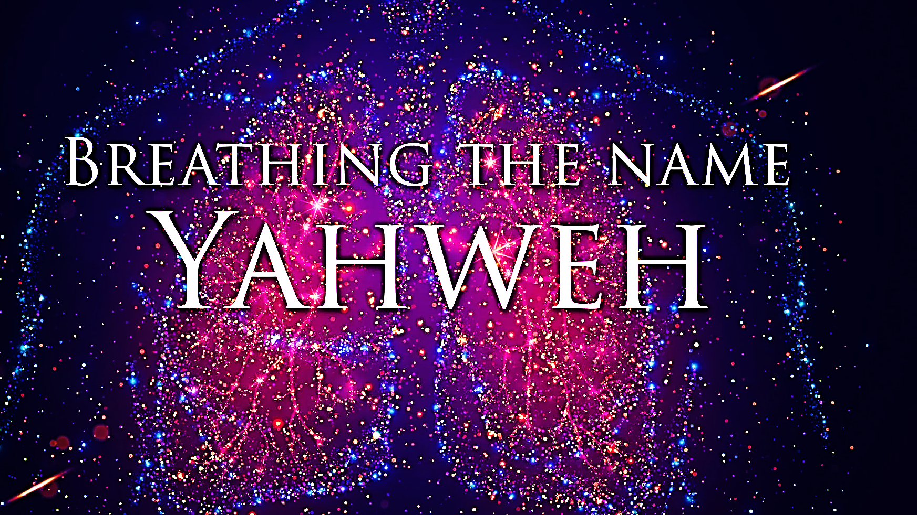
SING MY NAME

Slide 3
Call and Response
“His grace continues forever.”
Give thanks to Adonai, for He is good, for His grace continues forever.
Now let Isra’el say,

Slide 4
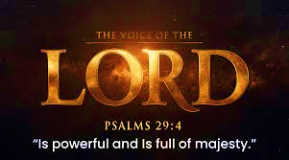
Psalm 57
In time of great distress, the psalmist turns to Yahweh. Although surrounded by enemies, he is confident that he will be rescued, therefore, he gives thanks to God for His salvation.

Slide 5
1st Watch 6:00 – 9:00 pm
Aohna Ogletree
Bernestine Coffer
Brenda Sims
Deborah Brown
Johnna Ogletree
Kim Pendleton
Kharli Wells
Kyra Wells
Minister Lonnita
FIRST MEETING:
January 24th
REVIEW MEETING:
February 4th 6:30
Prayer Dates
Jan 25th - Feb 3rd

Slide 6
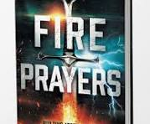
Ten Entrapments that Lead to Satanic Bondage
Rejecting and Living Against God’s Purpose for Your Life.
Inheriting Diabolical Curses
Experiencing Emotional & Physical Trauma
Surrendering to Ungodly Coverings
Embracing Worldliness
Owning Cursed Objects
Not Paying Tithes/Robbing God
Harboring Unforgiveness
Mixing World with Messiah
Lacking Spiritual Consistency

Slide 7
Harboring Unforgiveness
The definition of harboring is to give shelter, to conceal; hide and to keep or hold in the mind; maintain; entertain. Unforgiveness is a tool of the enemy for the purpose of bondage and deception. It is poison that is deceptively disguised as protection and defense, but truly it’s hypocrisy, bitterness and resentment. The wounds that caused unforgiveness are some of the deepest pains one can experience. This burden can only be released by Yeshua.
Yeshua said, “for if you forgive others their offenses, your heavenly Father will also forgive you; but if you do not forgive others their offenses, your heavenly Father will not forgive yours.” (Matt. 6.14 & 15).

Slide 8
We must understand that unforgiveness is sin, this sin has a wage attach to it, it’s death (Romans 3.23). In the parable of Matt. 18.21-35, Yeshua explains to Kefa what it means to truly forgive and there isn’t any limit to forgiving someone. Yeshua’s parable is for character examination; do we exhibit the character of our Father when it comes to forgiveness? Yahweh describes Himself to Moshe as merciful and compassionate, slow to anger, rich in grace and truth and forgiving offenses” Exodus 34. 6-7(a)
The king shows mercy, grace and forgiveness after hearing the cries of the servant asking for forgiveness of his large debt to be paid; the king eliminates the debt. The character examination is shown when the servant is owed a debt from a fellow servant. The servant’s character of harboring unforgiveness resulted in bitterness and hypocrisy when he meets someone who owed him a debt, what happens is assault, anger, and an uncompassionate attitude, which is cultivated by a heart of unforgiveness.

Slide 9
…“You wicked servant! I forgave you all that debt just because you begged me to do it. Shouldn’t you have had pity on your fellow servant, just as I had pity on you?” And in anger his master turned him over to the jailers for punishment until he paid back everything he owed. At the end of the parable Yeshua gives a stark warning for unforgiveness; this is how my heavenly Father will treat you, unless you each forgive your brother from your hearts.”
Yeshua shows through the scriptures how serious it is to forgive, He mentioned in the Lord’s prayer ( Mt 7.12) “forgive us what we have done wrong as we too have forgiven those who have wronged us”, (Mark 11. 25) and when you stand praying, if you have anything against anyone, forgive him; so that your Father in heaven may also forgive your offenses

Slide 10
The most important act of forgiveness is Yeshua at the stake for our sins we committed and he said, “Father, forgive them; they don’t understand what they are doing.” (Luke 23.34).
When we harbor unforgiveness for anyone, it means we refuse to understand whose image we are to represent, the sacrifice of Yeshua, and the debt He paid for our sin.
Forgiveness is not weakness; it is a necessary first step to restoring relationships and living in shalom. It is an act of love toward our brothers and sisters that reflects the same love and concern God has toward us.
The word of Yahweh says that we are not to grieve Ruach, which is an unforgivable sin. Would not unforgiveness grieve Ruach since he dwells within us?

Slide 11
I
Unforgiveness is a tool of the enemy for the purpose of bondage and deception, it is poison that is deceptively disguised as protection and defense, but it’s truly hypocrisy, bitterness and resentment.
3 points

Slide 12
2
We are to show the character of our Father when it comes to forgiveness. When we harbor unforgiveness for anyone, it means we refuse to understand the character we are to represent of the Father, the sacrifice of Yeshua and the debt He paid for our sin.
3
Forgiveness is not weakness; it is a necessary first step to restoring relationships and living in shalom. It is an act of love toward our brothers and sisters that reflects the same love and concern God has toward us, it’s a necessary part of the character He is creating in us.
(See attached link for complete writing)

Slide 13
Weapon 8 Decreeing
  Decree & Declaring a practice that comes from the “Word of Faith” movement emphasis on power of words birth out of New Age
  Invites people to picture a better future
  Release pressure of daily lives through positive words
  Incantations: word said as magic spell or charm
Biblical Weapons Satan and His Demons Hate to Face

Slide 14
Romans 4.17 “…God as the One Who gives life to the dead and calls nonexistent things into existence.” This is regarding the attribute of Yah not Abraham. Yahweh declared it and made it happen.
Job 22.28 “…what you decide to do will succeed…” Elifaz words were rebuked by Yah [Job 42.7] he misunderstood the ways of Yah.
Isaiah 45.9-12 ; 18-23 no one commands Yahweh – Presumptuously command Yahweh is an insult.
What we should do is reinforce Yah’s sovereign power over against the weakness of mankind.
Psalms 2.7 We are to proclaim Yah’s decrees (official, legal authority) not our own, (Proverb 19.21) telling others of what Yah has said.

Slide 15
“Biblical weapons Satan and his demons hate to face”, Decreeing!
When God’s people know their Creator’s word, trusting and standing on His endless promises of hope, life & freedom.
Satan hates it when God’s people speak God’s word with the authority as His covenant children, co-heirs with Yeshua Messiah.
God’s people acknowledge they are standing pillars of eternal life, never to be destroyed and proclaim it in every circumstance.
Yahweh decree (predetermined) His eternal plans (put into law) so by His will and for His glory all comes to pass. Isaiah 46.10
The purpose of the decree is to manifest and bring praise to Yah. Ro 11.33-36, Eph 1.6, 12,14, Rev 4.11

Slide 16

Homework Chaps. 15 & 16
On Shabbat we will engage in “Prayer Response” of what the Lord desires for us found in the Book of Acts.
If you have not read the assignment, then you are robbing yourself of joining with the community in our Prayer Response and thanksgiving

Slide 17
Ruach’s Gift of Faith
Chapter 15 confronts us, obedience or legalism, are we to believe the finish work of Messiah on the cross or the works of Torah?
The debate held by the Jerusalem council is not about has the law passed away! However, to answer the question would be an emphatic NO. Anyone who believes it has, does not know the word of Yahweh.
The debate has two sides. A sect of Pharisees, unauthorized who want to keep the Law of Moses (circumcision) as part of salvation and saved Jewish believers trusting in Yeshua alone.
Keeping the Law yields salvation
Keeping the Law yields obedience in our faith after salvation.

Slide 18
Ruach’s Gift of Faith
The witness of Paul & Bar-Nabba laid the principal that what Yah had established in Cornelius’s house had continued and was confirmed in abundance in their first journey in Antioch.
The council must recognize the God inspired messages confirmed by His mighty works among the people.
Peter (Kefa) proves Yah’s salvation was witness by Ruach, so do not put God to the test, no one should be put under this yoke; which no one can bear. “Gal 5.1, Mt 11.29-30
Peter’s remarks were with simplicity and humility and of spiritual logic.
V.11 “It is through the love and kindness of the Lord Yeshua that we trust and are delivered-and it’s the same with them”.

Slide 19
Ruach’s Gift of Faith
The priority or weightier sins needing immediate action was to abstain from idols, fornication (temple prostitutes) things strangled and eating blood. In short, leave false gods, learn Torah and obey the Law. James 2.26
Then they send Y’hudah and Sila with Paul and Bar-Nabba with a letter of encouragement and recommendation.
They rejoiced and a great cloud was lifted from the minds and heart of the believers.
James gives witness by Amos 9.11-12 to render his decision, and part of the solution is that the “Law of Moses” is preached every Sabbath in synagogues.
It’s expected that Jews and gentiles alike would assemble in brotherhood in synagogues to learn Torah. Ac 15.21
The Law is perfect Ps 19.7-11

Slide 20
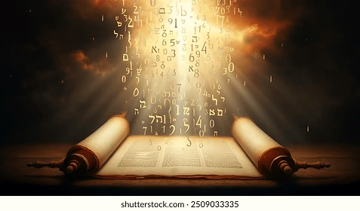
TORAH Is: | Scripture
Perfect | Psalm 19.7
Just | Nehemiah 9.13
Light | Proverbs 6.23
The Way | Psalm 119.1
Good | Proverbs 4.2
Freedom | Psalm 119.43-48
Fixed | Psalm 119.89
Holy | Romans 7.12
Truth | Psalm 119.142

Slide 21
Ruach’s Gift of Faith
V.35 As Paul & Bar-Nabba stayed in Antioch opening the way for others teaching and proclaiming the Good News. Eph 4.7-8
Paul & Bar-Nabba set out to strengthen the faith of other communities of Believers. But a heartbreaking separation comes over a sharp conflict of opinions.
Two spiritual shepherds, one with a tender knowledge of the sincerity of John Mark’s repentance and the other deeply yearning and concerned for the spiritual success of the mission. (Mt 9.23-25, Mk 5.40) Faith must be tried, tested and proved in public.
Mark is later proved to be a help (Col. 4.10, 2 Tim 4.11b)

Slide 22
Ruach’s Gift of Miracles
Allow Timothy to exercise a ministry among Jews and Gentile.
Titus, a Gentile believer to be circumcised before Jerusalem council meeting would have implied that circumcision was necessary for salvation.
Indicated that something was lacking spiritually
Denied the Gospel message
Galatians 2.3-5
On Paul’s second journey Silas replaces Bar-Nabba as Paul’s companion and Timothy was to be the junior assistant.
Timothy verses Titus’ circumcision:
Timothy’s mother was a Jewess believer; his father was Greek.
To avoid cultural barriers; would have created stumbling blocks and been used as concession to Jewish prejudices

Slide 23
Ruach’s Gift of Miracles
Vs 6-10 The time was not yet ripe, they were forbidden by Ruach to evangelize in Asia. Yahweh’s knows the perfect time for His work to be successful. Ps 18.30, Gal 4.4, Ec. 3.11
Yahweh sends them to Macedonia where the Lord provided shelter and a place of prayer in the home of a convert, Lydia.
It says in Psalm 37.23 that God orders the steps of obedient men so one would not wander aimlessly. Pro 5.6, 1Co 9.26-27
The community of believers in Lycaonia and Phrygia were near enough to the dispute in Jerusalem, that it was advisable for them to receive the letter before reckless men came to infiltrate and discourage believers.

Slide 24
Ruach’s Gift of Miracles
Vs. 16-24 Why an evil spirit should have given witness to the apostles, is a mystery-unlike those who cried out to Yeshua signifying fear and distress in Mt 8.29, Lu 4.34
Yet in Yeshua silencing the demons from speaking of His identity, He didn’t need nor want the testimony of demons. Yeshua wanted to avoid evil association and to control the timing of His messianic revelation Mk 1.21-28, Ps 28.3
Afterwards the city was filled with the witness of the apostles. Ruach allowed the slave girl to be healed, though it brought imprisonment. In triumphant of songs and prayers for the other prisoners a thundering earthquake now secures a whole household to embrace the miracle of salvation.
The joy of the officer is shown by caring for the Lord’s servants whom they had treated so brutally before.

Slide 25
Prayer Response Acts 15 & 16
Lord, thank you. You have freed us from the traditions of men, allowing us to express our love while clinging to and obeying Your commands from a surrendered heart. You have been faithful to place Your Torah on our hearts.
Father, we will never deny the Good News by placing a yoke upon Your sons and daughters, making it difficult for them to turn to Yeshua Messiah.
As the simplicity of Your word is proclaimed may it open the way for many gifted laborers, producing an army that will change the atmosphere and release those who are prisoners of sin.

Slide 26
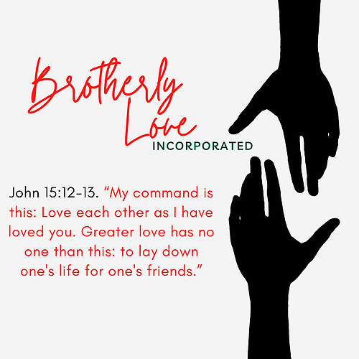
1 | May Abba establish your path this week
2 | May Shalom be with in you
3 | May Adonai dress you with wisdom and strength
4 | May you escape every hunter’s trap
5 | May Yahweh's will be done in your life

