Slide 1


5786, 4

Slide 2
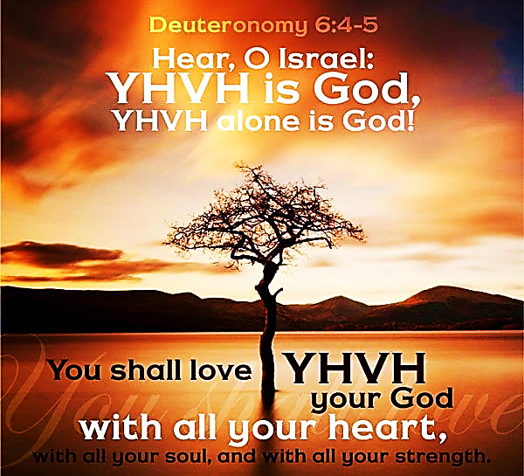
SING MY NAME

Slide 3
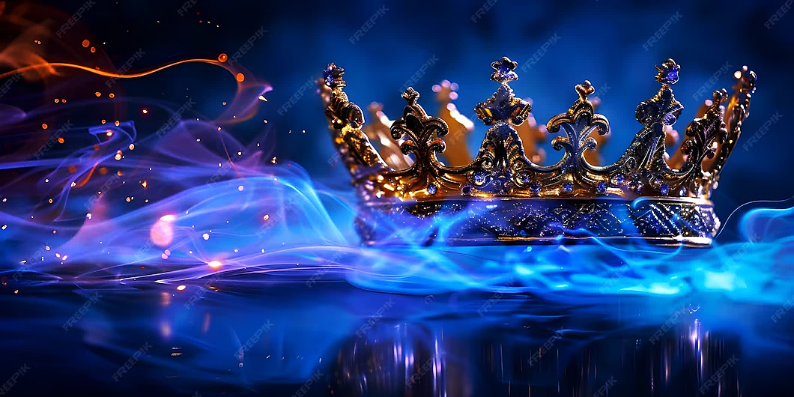
Call and Response
He is Adonai, strong and mighty,
Adonai, mighty in battle.
He is the King of Glory!
Who is He, this glorious King?
Melech HaKavod?

Slide 4
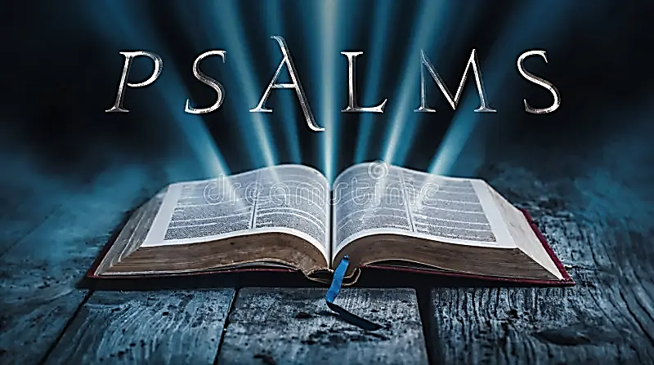
61
A song of thanksgiving to God for His providing aid and shelter at a time of distress.

Slide 5
Letters to the body of messiah
WATCH | SHABBAT | SCRIBE
4TH | Feb 21 | Dea. Nichelle
1ST | Feb 28 | Min. Lonnita
2ND | Mch 7th | Sis. Michelle

Slide 6
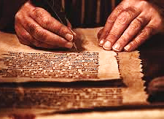
Why do we write a letter to the Body of Messiah?
We don’t want to turn prayer into an idol! We look with expectation, fulfillment, purpose and alignment with Yahweh. 1Co 9.19; 26; 10. James 1.24
We were designed as Believers to care and help with the maturing of every believer. Eph 4.13, Pro 9.9

Slide 7
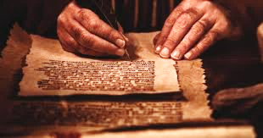
Letters to the body of
Dea. Nichelle | Letter to the Body
Frances Brown | Prayer Response
Kameron Smith | Declaration of Faith
Watch 4th

Slide 8
Prayer Response
Jehovah Shammah (The Lord is present) thank you for drawing near to Your people, Lord, and for speaking your warnings and admonishments into the hearts Your people. Lord, We thank You for Your fire; the consuming fire that we can call on as an arsenal against the tactics of the enemy of our souls. Jehovah Nissi, thank you that Your victory goes before us and that in victory we are broken free from demonic activity, curses, and strongholds that were meant to destroy.
We praise you Adonai that each arrow of heavenly fire that hits the mark within the enemy's camp of darkness brings forth Your beautiful light and becomes a place where heaven touches down. El Shaddai we thank You for revealing that we have not guarded the boundaries of Your truth in our hearts allowing access to the adversary through our preconceived notions, false ideologies, and carnal opinions

Slide 9
Prayer response
We Thank you El Roi that we are liberated from the spirits of intimidation, manipulation and from the grip of satanic schemes because of the victory of Messiah’s blood. We repent that we have drifted into conformity with the world by letting our thinking be influenced by the world. Strengthen our resolve, Lord; fortify our faith and continue to refine us as vessels of your light. In Yeshua’s name we pray! Amen
We repent before you Lord for denying Ruach access to search our hearts before we stepped into agreement with the blurring of the heavenly boundaries you set for us in your word. Thank you for the urging Lord to pay careful attention to how we conduct our lives. Loving Father, thank You for revealing that we have been entrapped by the enemy’s fear tactics.

Slide 10
Declaration of Faith
Adonai Elohim, You are The Sovereign One and everything You do is good, trustworthy, and able to succeed. Therefore, we arise in Yeshua’s Name to take up our position as soldiers in Your army and take hold of Your Word which is victorious over the enemy. We will not be bound to demonic hindrances and delays, but we surrender to You and we will walk in obedience to You so that we can be transformed into being like our Master Yeshua.
We will not be hesitant or fearful when it comes to Spiritual Warfare. You are Immanuel (God with us), and we will rely on You as Yahweh Chereb (The Lord the Sword) our offensive weapon that cuts down the adversary’s tactics and as Yahweh Maginnenu (Lord our Defense) who guards our hearts, minds, and spirits to be one with You and in line with Your standards. We will move forward into the abundance and blessings that You have already laid out for us.

Slide 11
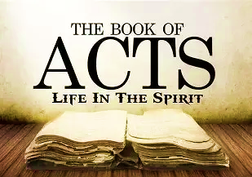
Homework Chaps. 23 & 24
On Shabbat we will engage in “Prayer Response” of what the Lord desires for us found in the Book of Acts.
If you have not read the assignment, then you are robbing yourself of joining with the community in our Prayer Response and thanksgiving

Slide 12
Ruach’s gift Teaching
Paul begins, “I have been discharging my obligations to God with a perfectly clear conscience, right up until today.”
Paul is not saying that he is innocent 1Co 4.4. But while evaluating his life after conversion he aligns himself with the purposes of YHVH.
A conscience is a good goad but will not guide one to righteousness. i.e., Paul was sincerely wrong when killing Believers. His conscience told him he was helping God.
Was this another opportunity to win souls for the Lord Yeshua?
Paul is brought before the counsel of seventy men. Addressing them as Brothers, indicating that he is on equal footing.
Common people addressed the spiritual counsel as, Elder, Fathers and or Rulers of People.

Slide 13
SCRIPTURE | CONSCIENCE | NOTES
1Co 8.7,10 | WEAK | Belongs to immature believer
1Co 8.12 | WOUNDED | Intense guilt, shame (Do not know how to apply Holy Scripture)
Titus 1.15 | DEFILED | Unregenerated
Heb 10.22 | EVIL/BAD | Departed from Yahweh
1Tim 4.2 | SEARED | Covered with scar tissue. Every message is for others, do whatever they want.
1Tim 1.5, 19 | GOOD | Yahweh is the moral compass
Acts 24.16 | BLAMELESS | Upright moral integrity
1Tim 3.9 | CLEAR | Inner peace free of guilt, shame and remorse

Slide 14
Ruach’s gift teaching
Hanayah is offended by Paul’s integrity, which lay against his character.
Paul replies, “God will strike you, you whitewashed wall! Will you sit there judging me according to the Torah, yet in violation of the Torah order me to be struck!”
White veneer of purity covers obvious corruption (Tomb of dead bodies) which makes one unclean.
Deut. 25.1-2 No one is to be beaten without due process and only upon one’s back.
When Hananyah heard Paul’s statement of a clear conscience, he instructed those close to him to smite (G5180-typto) beat, whip, with fist or hand. Metaphorically it means to wound and disquiet ones’ conscience.
The historian Josephus said that Hananyah was known for his greed and one of the worst High Priest. He would take tithes for himself becoming wealthy by means of thievery.

Slide 15
Ruach’s gift teaching
Just because others have wronged us does not give us license to do wrong to them.
V.6 Paul’s cleaver ploy, he perceives the atmosphere is not conducive to share the gospel. Divide the Sanhedrin so only half would be against him.
Paul referred to his heritage as a Pharisee, and declared, “concerning the hope and resurrection of the dead I am being judged.” He knew this was a matter of great controversy between the two parties.
In this dialogue Paul is rebuked stating he is addressing the High Priest.
Paul says the Hight Priest is one who suppose to be an example of the Law of Moses and not contrary to its spirit
Exodus 22.28 “You are not to curse God, and you are not to curse a leader of your people.”
Paul’s excuse and explanation were prophetic. In the end Hananyah’s final days were of a hunted animal by his own people.

Slide 16
Ruach’s gift teaching
Paul’s strategy saved him from the counsel but left empty the opportunity to share the gospel. Instead, Paul is now a symbol of the Sanhedrin’s long-standing resurrection dispute.
23.11 There is not a whisper of reproach but encouragement and comfort from the Lord. The Lord gives him confirmation of the purpose that Paul should witness in Rome. This visitation should remind us that God has a purpose and direction for our lives too, and He has not lost sight of us.
The center of Paul’s gospel was a resurrected Messiah. He was being judged over the matter of the resurrection of the dead. [Acts 24.20-21]
Dissension rose and he received the Pharisees as ally.
Paul is rescued by the Roman Commander fearing his possible demise by the violent men. The previous riot was over Gentiles, now the riot is over Resurrection.

Slide 17
Ruach’s gift teaching
V.16 Paul’s nephew warns him of a plot against his life. Relatives would feed their family members who had been imprisoned, this allowed his nephew access to inform Paul and the Commander.
The commander believed Paul’s presence would continue to be a source of disturbance.
The strongest commitment of the Roman Empire was to protect its citizens. Picture of Yah’s provision and care for His people, who are “Royal Priesthood”
23.12-15 Did the Jews who bound themselves with an oath not eat or drink until they killed Paul or did they starve? Mat 5.33-37
There are four kinds of vows set in the Mishnah without penalty:
Incitement
Exaggeration
Made in error
Cannot be fulfilled -constraints

Slide 18
Ruach’s gift teaching
I rescued him, having learned he was a Roman citizen.
No charges against him deserved death or chains
Felix was man who exercised the power of a prince with the mentality of a slave. He became the first former slave to become a governor of a Roman province. His brother was a friend of Emperor Claudius which helped Felix gain his freedom. To gain a position through nepotism (a position one has not worked for) can move one to compromise their position trading on influence.
Not risking an assassination, the Commander quickly moved to get Paul to Caesarea (Capital) 25 miles away.
Paul was escorted as royalty, 475 Roman soldiers and spare horses for Paul.
Vs.25-30 Lysias’ letter to Felix, expressed what was needed for objective overseeing Paul.

Slide 19
Ruach’s gift mercy
Politically dangerous - a plague, making Paul out to be a terrorist.
Ringleader of sect Nazarene: Associating Paul to a generally despised and lowly place with a poor reputation as a city [Jn 1.46]. Considered a backwater, or small city with no historical significance.
Yeshua lived in Nazareth – inscribe on the cross which was a sleight or pun to Yeshua and the Jews that a King of theirs would come from an obscure city. Another example of turning the tables, Yeshua was associating Himself with the poor and obscured people.
Tertullus introduces his accusation against Paul with flattery toward Felix [Pr. 26.28; 29.5, Ro 16.18, Jude 1.16]
Psa. 78.36 Insincere praise to the Lord is considered flattery.
Tertullus flattery of Felix was untrue-he did not bring peace or prosperity to those he governed.
What were the specific charges?

Slide 20
Ruach’s gift mercy
Unlike Tertullus, Paul states the obvious that Felix has been a judge over the nation for years. Not using flattery. 2Co 4.2
I’m glad to make my defense: Knowing there was no case against him it gives another opportunity for the gospel.
12 Days: There are no witnesses to prove that he was inciting a crowd since it had been twelve days and no crowd was present.
There were no such eyewitnesses of the alleged sacrilege.
Among all Jews throughout the world: This is an unintended compliment (meant to be negative) a failed attempt of criticism which describes the extent of Paul’s work.
Tried to profane the Temple: He gave no evidence for this charge, based on rumor. Mt. 5.11-12
In Paul’s defense he exposes the weakness of their case.

Slide 21
Ruach’s gift mercy
Vs. 22-23 Felix’s decision:
He avoided a decision of the case under pretense of waiting for further evidence for Lysias
Knowing Paul was innocent (trying to walk the middle ground) he allows Paul to have liberty while in custody.
Vs 24-25 Felix avoids making spiritual decision as Paul speaks of, RIGHTEOUSNESS (ours in Messiah) SELF-CONTROL (evidence of Ruach in our life) and JUDGMENT to come (eternal accountability)
Vs. 14-21 Paul explains his ministry of “The Way”.
Resurrection of the dead, both the just and the unjust.
He brought alms and offering [Gal 2.10, Ro 15.26, 2Co 8.1-9]
Believers should never be timid of the Truth-it is our evidence we belong to Yahweh.

Slide 22
Ruach’s gift mercy
Vs. 26-27 The motive of Felix’s heart was greed. Waiting for Paul to possibly bribe him.
He left Paul bound because he wanted to do the Jews a favor. This is the same reason Pilate condemned Messiah-even while knowing he was innocent.
Felix & Drusilla, the daughter of King Agrippa I, is confronted with their laid-back morals.
Drusilla is twenty years old who was seduced by Felix away from her husband and made her his third wife. The conscious of Felix was troubled enough to be afraid, but not enough to repent.
The gospel should make those who are intent on rejecting Yeshua afraid

Slide 23
Prayer Response Acts 23 & 24
Our Merciful God, El Rachum Your mercies are new each morning. Lord, You have waited patiently for us to resolve to discharge our service to You unhindered and with a clear conscience; a conscience that is good and has You as its compass; We surrender.
Father, You have shown us such mercy that we have not lost courage as we do the work You have given us. This has caused thanksgiving to overflow bringing glory to Your Name.
Because You have fortified us, there is no need to employ flattery in our testimony of the gospel, and so, we will never be timid of the Truth, for Truth is our Salvation. Blessed be He Who sits on the Throne.

