Slide 1



5786, 20 Shevat (Tevet)

Slide 2
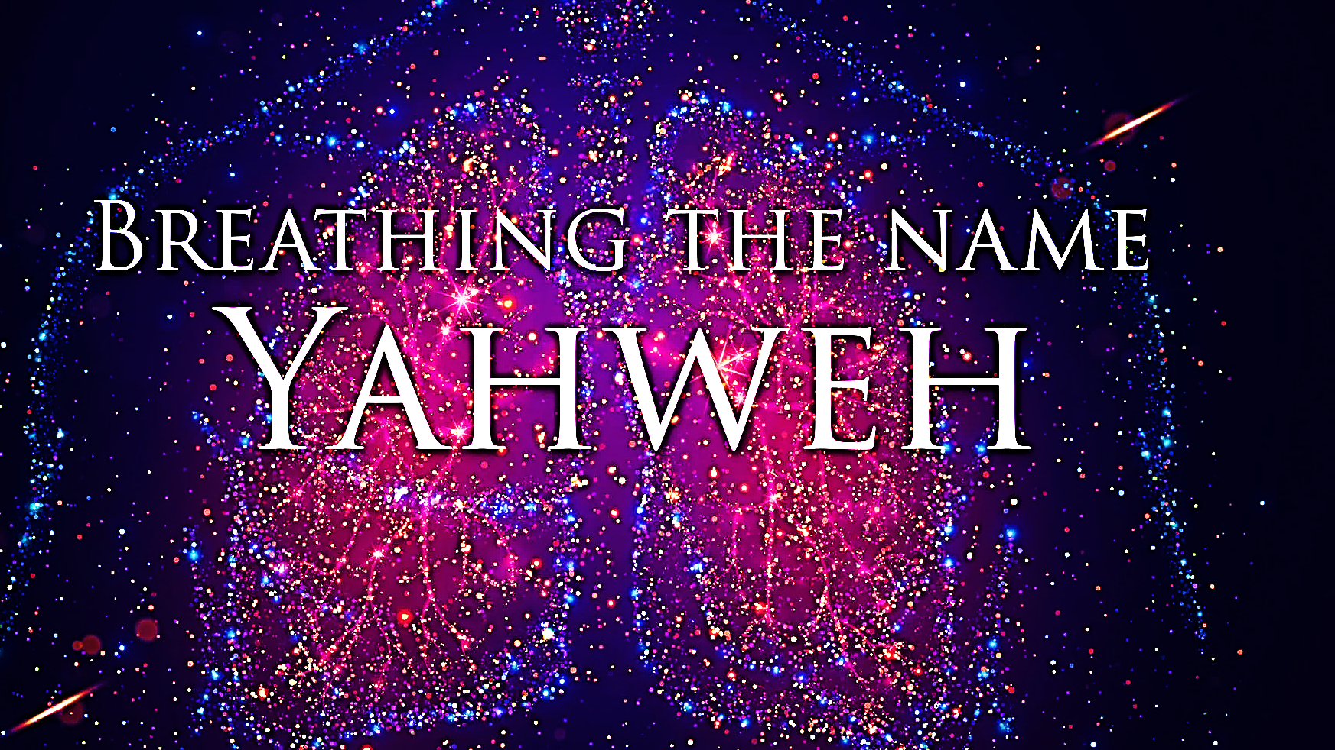
SING MY NAME

Slide 3
Call and Response
“His grace continues forever.”
Give thanks to Adonai, for He is good, for His grace continues forever.
Now let Isra’el say,

Slide 4
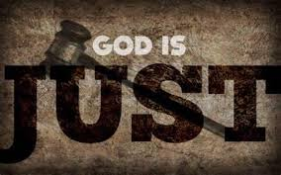
Psalm 59
David, the persecuted innocent has unshakable trust in Yah’s sovereignty.

Slide 5
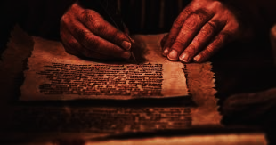
Letters to the body of messiah
WATCH | SHABBAT | SCRIBE
3RD | Feb 14 | Eld. Jason
4TH | Feb 21 | Dec. Nichelle
1ST | Feb 28 | Min. Lonnita
2ND | March 7th | Sis. Michelle

Slide 6

Ten Entrapments that Lead to Satanic Bondage
Rejecting and Living Against God’s Purpose for Your Life.
Inheriting Diabolical Curses
Experiencing Emotional & Physical Trauma
Surrendering to Ungodly Coverings
Embracing Worldliness
Owning Cursed Objects
Not Paying Tithes/Robbing God
Harboring Unforgiveness
Mixing World with Messiah
Lacking Spiritual Consistency

Slide 7
Lacking Spiritual consistency
What does it mean to lack spiritual consistency? To lack consistency, means to not be in line with your actions and principles, often leading to unreliability, failed goals, and frustration. You add the word spiritual to it, it means your faith practices, mind, and body actions don't align with the word of God.
Consistency is a fundamental principle in life. Almost everything we do requires it.
When consistency is lacking, the desired results often remain out of reach.

Slide 8
Lacking Spiritual consistency
How to know if you’re spiritually inconsistent and slipping into darkness?
Dryness and feeling burnt out, such as Elijah, after facing off with the false prophets; he was tired and feeling worn especially after Jezebel's threats.
A lack of focus, motivation, discouragement and not setting goals or having a clear vision all of these are indicators which contribute to spiritual inconsistency that draw you away from the Lord.

Slide 9
Lacking Spiritual consistency
How to know if you’re spiritually inconsistent and slipping into darkness?
Spiritual inconsistency becomes a reality because of
Doublemindedness (James 1.6-8)
Lukewarmness (Rev 3.15-16)
Unfaithfulness (1Ki 18.21).
If the purpose behind your actions isn't compelling enough, consistency can fade.

Slide 10
Lacking Spiritual Consistency
Being spiritually inconsistent can draw you back into the old nature, the sin that the Lord has already rescued you from. It causes you to straddle the fence, choosing to walk with Yeshua in purpose or run with the world.
(Titus 1:16)” They claim to know God, but with their actions they deny him. They are detestable and disobedient; they have proved themselves unfit to do anything good.”

Slide 11
Lacking spiritual consistency
Spiritual inconsistency is a form of idolatry because anything that distracts you can eventually become an ultimate priority in your life over Adonai. Your mindset shifts from focusing on Adonai to lesser unimportant things like (money, materialism, power, career, and self).
Spiritual inconsistency is due to an identity issue, you need to know you belong to Adonai, the God of heaven and earth.

Slide 12
Lacking spiritual consistency
Spiritual inconsistency is a form of idolatry because anything that distracts you can eventually become an ultimate priority in your life over Adonai. Your mindset shifts from focusing on Adonai to lesser unimportant things like (money, materialism, power, career, and self).
Spiritual inconsistency is due to an identity issue, you need to know you belong to Adonai, the God of heaven and earth.

Slide 13
Lacking Spiritual Consistency
Going through hardships can also cause you to walk inconsistently and question Adonai, like Samson when his wife was used as a pawn to torment him. You feel like Adonai has abandoned you, you begin asking questions, where is Adonai?
Why isn’t he answering my prayer? I made a mistake, He doesn’t love me anymore, this is why you need to know your identity because you can endure anything you go through when you know your identity is in Yeshua. You can survive anything you're going through because you're connected to Yeshua.

Slide 14

How to combat spiritual inconsistency?
Add a 1
3
Remember who you were called to be, your identity in Christ
Pray and meditate on the Word of God. (Jos 1:8)
2
Change your Mindset and Approach.
(See attached link for the complete writing)

Slide 15
Weapon 10 fasting
Fasting is a spiritual discipline that draws us closer to Yahweh; denying the physical, focusing on our spirit.
Yahweh offers this spiritual discipline simply because He wants to spend time with us.
No where in Scripture does it demand that we fast. Yet the implication that Yeshua gives us in Mt. 6.16, Mk 2.18-20 & Lu 4.1-2, helps us to derive at a decision to surrender to fasting
Biblical Weapons Satan and His Demons Hate to Face

Slide 16
Fasting makes us dangerous
Makes us sensitive to the activity of the spiritual realm.
Ruach re-aligns us with heavens viewpoint.
Brings us to the reality that we no longer have reliance for what the world offers. Spiritual food is enough. Ex 34.28
Leads us to a richer relationship with Adonai that can only elevate our spiritual growth. Ps 91.14-15
Allows us to overcome barriers that might keep us from living a victorious life.
Breaks our appetite for ungodly things and disarms the enemy of any open doors, closing portals of the demonic and bringing an end to his kingdom influence.

Slide 17
Mark 2.18-20 the disciples will fast when Messiah is seated with the Father. Why?
Yeshua is saying that they should be rejoicing now because of His nearness, and they are able to ask Him directly of what is needed. However, when He is no longer visibly with them, they will seek Him through fasting and praying.
Mt. 17.21 & Mk 9.28-29 Yeshua is implying that this spiritual battle requires a more intense deeper level of dependence on Yahweh.
Daniel surrendered his appetite to reinforce his temple for Ruach
John Established more influential testimony & witness
Esther needed protection from the evil one and his demonic forces
Elijah needed healing and strength that only comes from Yahweh

Slide 18
What we need to know: Fasting
Every natural act of faith, there is a divine reaction. [Ex 4.2-4, 14.21, 7.8-9]
Whatever strengthens our spirit weakens our flesh [2Co 12.10] True strength isn’t in self-reliance, but reliance on Yah.
Fasting turns our vulnerability into opportunities of breakthrough.
DAYS | RESULT
3 | Resurrection/New Life
5 | Grace
6 | Overcoming human nature
7 | Perfection
8 | New Beginnings
21 | Release Breakthrough
40 | Completion / Readiness

Slide 19
Face off!
Prayer plus the action of fasting causes quick and immediate destruction for every part of his kingdom.
Prayer plus fasting confronts the enemies' authorities, spirit, power and principalities releasing shame and vex his army.
It lays boundaries, blood line of Yeshua. It throws to the ground every evil horsemen Jer 51.21, spirits of the valley 1Sam17.1-4 and spirits of the desert Isa 34.11-15, etc.
Biblical Weapons Satan and His Demons Hate to Face

Slide 20

Homework Chaps. 19 & 20
On Shabbat we will engage in “Prayer Response” of what the Lord desires for us found in the Book of Acts.
If you have not read the assignment, then you are robbing yourself of joining with the community in our Prayer Response and thanksgiving

Slide 21
Ruach’s gift of tongues & indwelling
End of chapter 18 leaves us with the gifted Greek trained Jew, Apollos with Priscilla & Aquila who graciously ministered the birth, death and resurrection of Messiah Yeshua.
This is a preamble to chapter 19 where the Apostle Paul in Ephesus ask disciples of the Way had they received Ruach after believing.
During this first century, Yahweh is establishing the foundation in which all believers will hold on too.
There is a distinction between the water immersion of John and the infilling of the Spirit of Yeshua.
John, a witness of the original covenant represents a transition into the New, which Yeshua is the substance.

Slide 22
Ruach’s gift of tongues & indwelling
Yahweh has already shown His intent of the Gospel for all in the four distinct groups of people.
Jews at Pentecost
God fearers
Samaritans with Peter & John
Gentiles (Corneilus)
Yahweh is setting the foundation in which the world will rely as their source of truth. Eph 2.20
Now after the Gospel has been spread; it is bathed in the blood of the Prophets, Disciples of Yeshua. Mt. 23.37, Mk 12.3-8, 1Thess 2.15
The Ruach comes and indwells in each believer and gives witness of Yeshua.
The question we need to ask is do I know Ruach HaKodesh?

Slide 23
Ruach HaKodesh
Is the Source of Joy | Testifies Concerning Yeshua
Loves Singing | Convicts The World Of Sin
Critiques Every Moment, Motive and Movement of Your Life | Reveals The Truth You Need To Live Victoriously
Becomes An Enemy To the Rebellious | Shows You Pictures Of Your Future
Withdraws When Offended | Know the Person To Whom You Have Been Assigned
Is A Person, Not A Dove, Wind Or Fire | Confirms That You Are A Child of YHVH
A Teacher | Is Your Intercessor On Earth
Testifies Concerning Yeshua | Knows Every Detail Of The Purpose & Plan of YHVH For Your Life

Slide 24
Ruach’s gift of tongues & indwelling
When man gets their hands on God’s Divine Word; it will become visible through their prejudice. Ro 8.7-8
This chapter is not about if you don’t speak in tongues or if you haven’t had hands laid upon you then you are not saved.
It is about Yah’s order and integrity.
If you don’t speak in tongues, which is a gift from Ruach; you are not lacking nor less than your counterpart! Jn 14.15-18, 2Tim 1.14, Ez 36.27
The 12 talmidim are now immersed in truth, Ruach comes upon them and just as the previous group of believers they speak in tongues.

Slide 25
Ruach’s gift of tongues & indwelling
V.11 now Yahweh worked unusual miracles by the hands of Shaul. These miracles are in response to the truth and preached word of God.
This revival begins with the word. Signs and wonders follow the word. The revival ends with the word increasing. These miracles, signs, and wonders are exceptional and out of the ordinary

Slide 26
Ruach’s gift of tongues & indwelling
V.13 The misguided Jewish exorcists, sons of Skeva thought they could simply put the names of Yeshua and Shaul into their bag of tricks and use them without the power of Ruach and a personal relationship with Yahweh. Matthew 7.22
Borrowed Authority
Wrong motives
Relationship- not ritual, witchcraft or magic
Capitalization/make money
Ruach’s power-make a name for themselves
Demons know who Yeshua is; Mk 1.24
Reverence for the Messiah increases as many confess and repent (vs. 17-20)

Slide 27
Ruach’s gift of tongues & indwelling
V.23-41 The riot in Ephesus. “All for nothing”
Superstition is entwined with material interest resulting from local cults. The number of converts was so considerable that Demetrius realized that the business of the shrine-makers was on decline.
It was still possible to inflame the masses into violent opposition against men who they thought brought discredit to their goddess.
Paul and his disciples never addressed people’s false religion or evils of Ephesus. Paul only preaches Messiah, and then the people changed their own minds finding no validity in their religion.

Slide 28
Ruach’s gift of prophecy
What do you consider a defining moment in your life? Eutychus’s story is his falling from third story and then revived by Sha’ul’s intervention.
This incident underscores the divine power of Ruach working through God’s apostle. These miracles illustrate God’s sovereignty and confirms the truth of the Gospel of Messiah.
After Eutychus is restored, the community continues with listening to Sha’ul’s teaching.
They displayed eagerness for learning and priority of gathering as believers. Their devotion gave way for Yah’s compassion and power over life and death.
Everything was subordinate to the Word.

Slide 29
Ruach’s gift of prophecy
Sha’ul summons the Elders of the Messianic community and encourages them, for he will never see them again.
V.19 Example of Service: Nothing helpful was withheld from them.
V.22 Prophecy: By Ruach’s leading-no matter prison or any other course, his life was only…
…precious to himself as means of serving Yahweh and teaching the will of Yah.
V28 Warning: Ruach has fitted them for their labor
V32 Commendation: Sha’ul commends them to the Lord and His word. Since he will not be with them, he leaves them to the mighty hand of Yah as an inheritance.

Slide 30
Ruach’s gift of prophecy
V.33 Generous: Do not turn the sacredness of God’s word into self-interest, financial gain or wealth.
Sha’ul challenges the Elders and leaders of the community to follow his example of humility and tears.
His final words are of warning, be alert wolves will come, from within and without. Move as Ruach compels you. Don’t avoid hardships, trust the Spirit and care for your people. Not in managing but in relationship. Do not covet but be generous in all things.

Slide 31
Prayer Response Acts 19 & 20
Oh Lord, what love you have lavished on us, that we should be called sons of God. Father, you have given us the foundation of the prophets, the disciples and Yeshua so we will not go astray. Blessed be He, Yahweh.
In Your generosity Lord, You have endowed us with Your Spirit that gives witness to Your Only begotten Son, Yeshua HaMashiach.
Yahweh cut down every attempt in us to serve You on our own merit. Let Your truth of the Gospel compel many to throw down false idols and destroy demonic evils in and around Your people. As we follow the examples of your servants that have given their lives as an offering, show forth your divine power and sovereignty.

Slide 32

1 | May Abba establish your path this week
2 | May Shalom be with in you
3 | May Adonai dress you with wisdom and strength
4 | May you escape every hunter’s trap
5 | May Yahweh's will be done in your life

