Slide 1


5786, 11
5786, 25

Slide 2
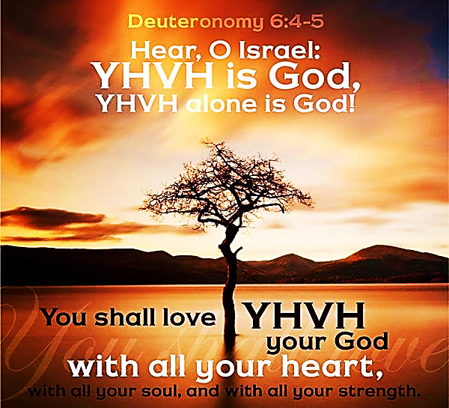
SING MY NAME

Slide 3

Call and Response
He is Adonai, strong and mighty,
Adonai, mighty in battle.
He is the King of Glory!
Who is He, this glorious King?
Melech HaKavod?

Slide 4
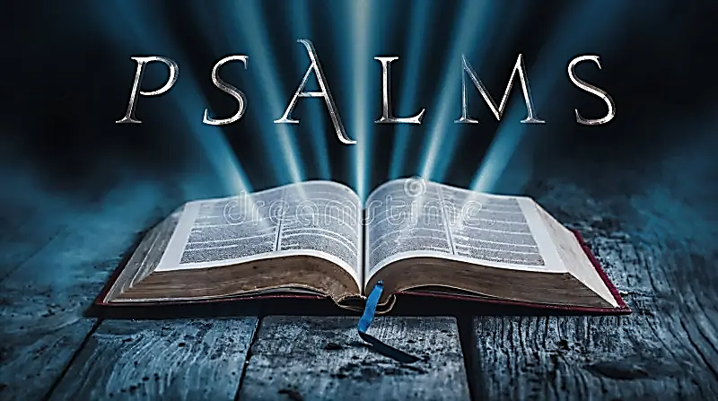
64
A plea for protection from those who are pursuing to do harm visible and covert.

Slide 5
Letter for Yahweh
As we meditate on the Book of Psalms, obtaining a front row seat to the challenges and trials of men and witnessing the victories of HaShem, we can glean a formula of success.
It is here in the Psalms that HaShem speaks to His people in a manner that builds intimacy and faith.
Robin Peters
Jerrard Brown

Slide 6
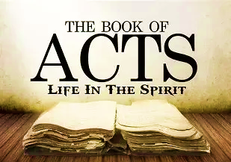
What did I learn?
Charles Pratt
Ravenne Coffer
Kameron Smith

Slide 7

COMMUNICATION
“I Make All Things New”
Mark 13.3-8 Yeshua says that the end brings the new.
Rev 21.5 Heaven is the home of those who are godly, which sin and sinners are excluded.
Spiritual shift from earthly limitations to heavenly realm. Eph 3.18
Advancing in faith, power, glory 2Co 1.2
Mind shift Ro 12.2 obedience to instructions and aligning with Yah’s timing.
Every season has a divine purpose. There is a season for everything; when one thing dies something comes to life. This should remind us of our mortality that carries us into the eternal.
As the following was spoken, “Thank you for bringing us to the end, though it’s not finished yet.” I saw an unfinished tower with scaffolding. It looked rough but in progress.

Slide 8
5786
1Thess 5.1 To Know Prophetic Times
TAV | Ex 29.4 Belonging to Yah | Completion, mark of a covenant, end of cycle
SHIN | Dt. 4.24 Remove & refine | Fire, transformation, refining, Divine presence
PEH 80 Decade | Pr. 18.21 Alignment | Speech, mouth
VAV Year | Jn 14.6 | Connection between Heaven & earth To join
Prophetic signpost of massive shift. Began September 22, 2025
We are in the decade of the Mouth, to speak, decree what Yah has said and release the Word of Yah in the atmosphere for change.

Slide 9
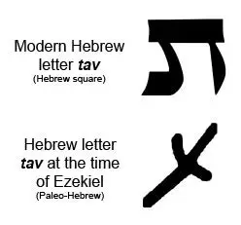

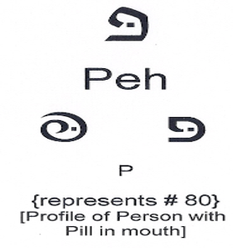
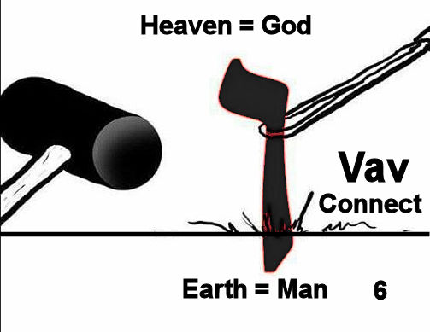
Ancient symbol was in the form of a cross
Yahweh’s presence removes what does not belong
Dot represents something inside the person’s mouth
Nail or hook that joins together
Yah’s Divine Connection
Yeshua

Slide 10
5786 Year of re-connecting
This season carries with it energy of re-connection in wisdom and training in discernment.
Mt 24.22 “time shorten” G2856 Koloboo, to be amputated decisively. There is a season where grace is extended and a season where things are cut off.
If you are not paying attention, you will watch from the sidelines while others step into breakthrough.
Feeling of spiritual urgency is discerning the mystery of 5786; a season of finality.
Eph 4.3 Make effort to keep the bond. Ligaments are under attack.

Slide 11
Re-connecting
Matthew 7.21 Salvation is not a one-time (once saved always saved) encounter, it is continuous. 1Co 15.2, Mt 24.13
Transformation is not about information (Bible study, sermons, conferences, etc.)
We can have all the information but do not know the voice of Yahweh or His presence.
We must have a daily encounter with Yahweh. He is willing to release grace to those who are humble enough to repent.

Slide 12
Review
This year and decade means a massive shift. Allows us to re-connect with Yahweh allowing Him to send His fire to refine and transform us by His Divine Presence. (WATCH-HOURS)
There is no middle ground (Josh 5.13), so we should make every effort to keep the bond with Yeshua by our daily encounter.
Our speech under Divine manifestation will bring completeness while separating things that do not belong to Yahweh.

Slide 13
Prayer Response 5786
Oh God, You are Ha El Hagadol (The Great God) Who has saved us from ourselves. You are great in all Your ways. Yes, You are God and we will praise You forever.
Your divine plan has given us the ability to re-connect with Your will. To align ourselves, hear and obey Your Word.
We will enjoin with Pey and speak Your word without hesitation or compromise. We will speak boldly as Your prophets of old and testify of Your power and might.
In the Name of the Almighty One, Yeshua.

Slide 14
Spring Fast Samuel
AIM: The Samuel Fast for revival & soul winning (Pgs. 61-79)
VOW: Yahweh being my strength (Ha El Ma’uzzi) Psalms 27.1 & 2 Sam 22.33. “My flesh and my heart may fail, but Yah is the strength of my heart and my portion forever” Ps 73.26.
Partial Fast
March 22nd 6:30 pm Passover Celebration

Slide 15
D’varim 6.4 & Mattityahu 22.37
Sh’ma, Yisra’el! Adonai Eloheinu, Adonai echad
Hear, Isra’el Adonai our God, Adonai is one
…and you are to love Adonai your God with all your heart, all your being and all your resources.
I will listen with my heart, understand with my mind, and respond with my actions.

