Slide 1


5786, 11
5786, 11

Slide 2
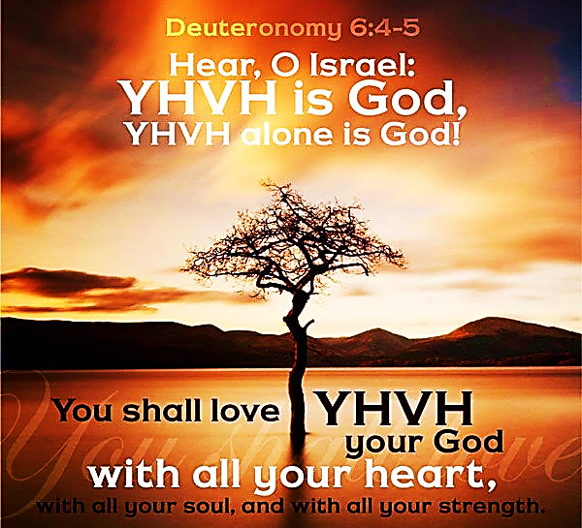
SING MY NAME

Slide 3
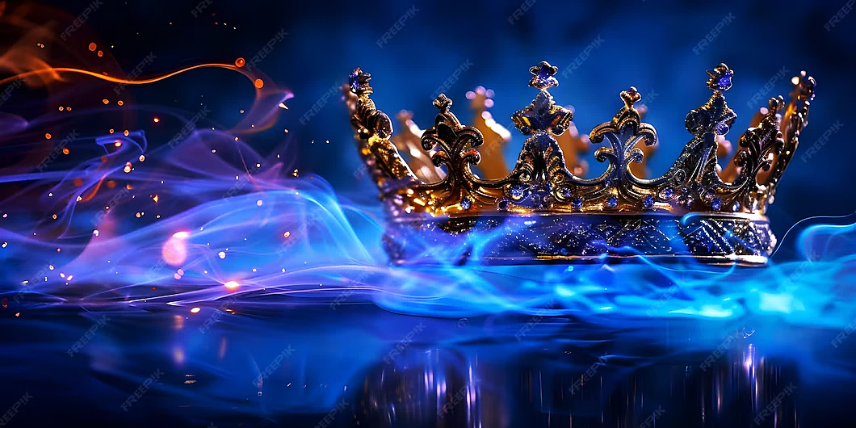
Call and Response
He is Adonai, strong and mighty,
Adonai, mighty in battle.
He is the King of Glory!
Who is He, this glorious King?
Melech HaKavod?

Slide 4
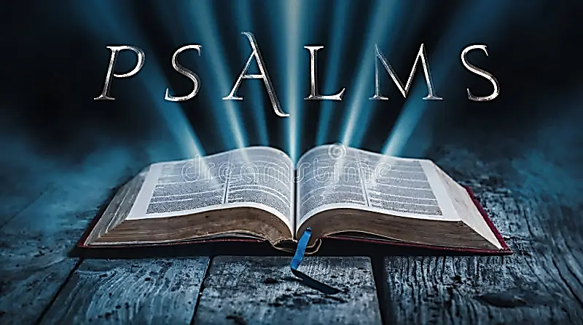
62
A contemplative Psalm.
The lives of the wicked, whose success is temporary, verses those who embrace Yahweh are bound for eternity

Slide 5
Letters to the body of messiah
WATCH | SHABBAT | SCRIBE
1ST | Feb 28 | Min. Lonnita
2ND | March 7th | Sis. Michelle

Slide 6
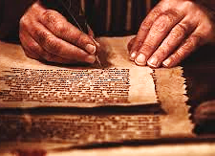
Why do we write a letter to the Body of Messiah?
  We don’t want to turn prayer into an idol! We look for with expectation, fulfillment, purpose and alignment with Yahweh. 1Co 9.19; 26; 10. James 1.24
  We were designed as Believers to care and help with the maturing of every believer. Eph 4.13, Pro 9.9

Slide 7
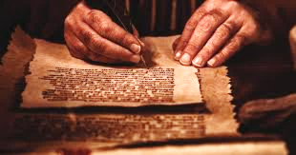
Letters to the body of
Min. Lonnita | Letter to the Body
Kyra Wells | Prayer Response
Aohna Ogletree | Declaration of Faith
Watch 1

Slide 8
Prayer Response
Thank you, Adonai Rohi (the Lord our Shepherd) for your watchful eye, protecting your people from all harm. We repent for not being awake to the spiritual activity around us and allowing the enemy to paralyze us in fear. Thank you for cutting down every demonic monitoring system that has accused us or attempted to create demonic futures or sin cycles. We will allow the truth of Ruach to stimulate and renew our minds, proclaiming new futures in Yeshua. Thank you for cutting off and draining any neurological blood supply of fear, replacing it with love, peace, prosperity, holiness, truth, faith, hope, and joy. Elohim Azar, the Lord our Helper, you are the doorkeeper and governor of our thoughts. There is no enemy you don’t promise to spoil on our behalf, we thank you from our position of victory in Yeshua!

Slide 9
Declaration of Faith
We declare that Elohim Azar is our mighty Helper, fighting for us and strengthening us in every battle. El Roi sees every hidden trap and every unseen threat against the Body of Christ, and nothing escapes His watchful eye over our lives. Yahweh Tsuri you are our unshakable Rock and firm foundation, and we will not be moved. We renounce fear, doubt, and every scheme of the Adversary, and we stand clothed in divine authority. No weapon, no curse, and no spirit of darkness has power over us. We walk boldly as one people protected, aligned with heaven, and anchored in unbreakable victory.

Slide 10

Homework Chaps. 25 & 26
On Shabbat we will engage in “Prayer Response” of what the Lord desires for us found in the Book of Acts.
If you have not read the assignment, then you are robbing yourself of joining with the community in our Prayer Response and thanksgiving

Slide 11
Ruach-spirit of truth
Paul’s two years of imprisonment in Caesarea was providential care provision against murderous intentions. It was also a season of rest and replenishment after his years of hard missionary service and preparation for what was ahead.
Since Paul was a scholar of Torah, would he have contemplated on 2Samuel 22.2-3?
At times Believers do not recognize the hand of the Lord upon their lives, especially when facing trials. Ro 5.3-5, Jam 1.2-3, 1Pe 1.6-7
Porcius Festus is the new gentile procurator of Judea. He was known as an honest ruler despite all the problems Felix left him with surrounding the Roman practice of creating civic privileges for Jews.
Despite wanting to have a good working relationship with the Jews, Festus refused the request for a changed venue. He welcomed all who would accompany him to Caesarea.

Slide 12
Ruach spirit of truth
Because of Paul’s citizenship, Festus had to ask if he would allow the trial to be moved. Romans 8.28
Spiritual wickedness will try every possible avenue to stop the will of God in your life.
Even so, Paul would graciously surrender himself to death if proof of the accusations were true.
1Peter 5.8 says the enemy is full of rage and wants to destroy us. The roar implies hunger and determination. So, we must immediately give our attention and keep our appetites and passion under restraints.
After Festus re-opens the trial in Caesarea, he understood that the case brought by the religious Jews was empty delusions. It had less to do with Paul and more to do with their religious dominance. (V.18)
The danger of a religion that is not in line with Yah, it is not truth. If this religion allows you to be a thief, liar or murderer then it is a religion of demons.
Festus was impartial and dealt with the case straightforward. This was in contrast with his predecessor.

Slide 13
Ruach spirit of truth
This was more than a hearing of evidence; it was an event.
At Festus’ command Paul is brought before the incestuous couple, Agrippa & Bernice who would hear the testimony of the risen Savior. Isaiah 45.6b-7
Paul stands before the great-grandson of one who tried to kill Yeshua as an infant, his grandfather had John beheaded, his father had martyred James.
25.13 Agrippa & Bernice, brother & sister of Agrippa I, was invited into Festus’ court.
Agrippa’s curiosity meant that Paul had another opportunity to speak of Yahweh’s truth to gentile rulers (Felix Festus & Agrippa). This was the confirmation of Yah’s intent. Mt 10.18, Isa 49.6b, Ac 9.15
V.23 Agrippa & Bernice enters with pageantry into the auditorium with commander and prominent men of the city at Festus’ command.

Slide 14
Ruach spirit of truth
It is the assurance of those who through the blood of Yeshua Messiah have the privilege of calling Yahweh our Abba (Father). He is passionate, devoted protector Who is jealous for us (El Quana). He cares for us and will fight for us.
Paul’s appeal to Caesar was to avoid a ploy against his life from the High Priest & chief men of Jerusalem. Festus’ concern was he didn’t have any specific charges to prepare a brief nor explain his purpose for sending him to Caesar.
When we listen to accusations without truthful grounds it will cause confusion.
Most everyone present except Paul was wrong in their estimation of who was important and who was not. Paul had authority and dignity greater than any of the self-important people at the hearing.
When you know that you are important to God, nothing else matters.

Slide 15
Ruach’s gift
Paul was aware of Agrippa’s fascination with Jewish culture and laws. Once again Paul sees the opportunity to share the gospel of Yeshua. This was a partial fulfillment of Act 9.15
After the hearing, Agrippa & Festus said, “If he hadn’t appealed to the Emperor, he could have been released.”
Of course this was not the will of Adonai, Paul was to go to Rome and complete his assignment.
No matter what course our life is taking, rather it appeals to our senses or not. If Adonai is orchestrating your journey, it should be a privilege to serve Yahweh in every circumstance.
Yahweh orders the steps of the righteous. Ps 37.23-24

Slide 16
Ruach’s gift faith
It is late in the year and typically no one traveled these water after 11th of Nov (Yom Kippur). Paul warns of the danger if the centurion continues their course. They set sail anyway.
Just as Paul warned, they are caught in a terrible storm. 2 Ch 20.20, Jer 26.5
On the fourteenth day Paul is given a vision “God will keep the whole” – they dropped a plumbline.
Paul and Luke and other prisoners are handed over to Julius the centurion, which Paul was treated with courtesy and kindness.
In Myra (27.5-6) Julius left the smaller costal vessel there and arranged for transport on a great grain ship traveling to Rome.

Slide 17
Ruach’s gift faith
Three things characterize Paul’s assurance.
Paul knows that he belongs to God
Paul serves God
Paul has faith that God will keep His word.
If this characterize our relationship with Adonai, we too can have courage, no matter how dark the situation may appear.
Yahweh gave a vision not just for His servant but also for the frightened crowd on board. Mt 5.45
Adonai said: “Don’t be afraid, Sha’ul.” So, therefore I trust God and believe that what I have been told will come true. (We need to trust in the reliability of God’s words)

Slide 18
Prayer Response Acts 25 & 26
Abba, how great Thou art. Lord, we rejoice that you have supplied all our needs through the inexpressible gift of Your Spirit, our Comforter and Guide. Thank You.
Lord, You have given us the ability to endure because of Your great promises, it enables us to walk in victory.
May we embody Your character of integrity, justice, and grace as we stand before self appointed kings of today.
Abba, arrest our hearts, empowering us to use every opportunity to witness the gospel of Yeshua HaMashiach.

