Slide 1


5786, 11
5786, 18

Slide 2
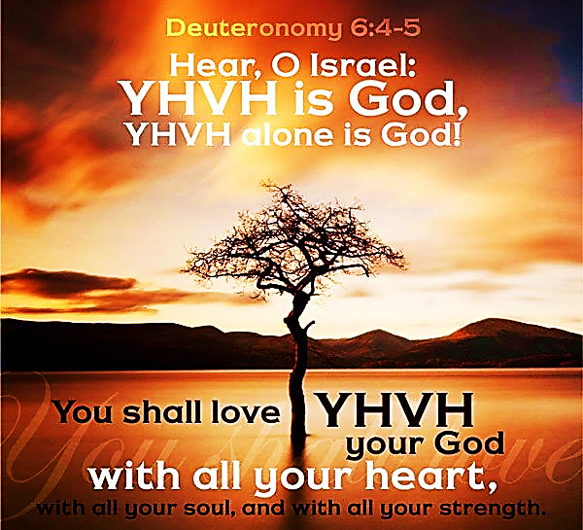
SING MY NAME

Slide 3
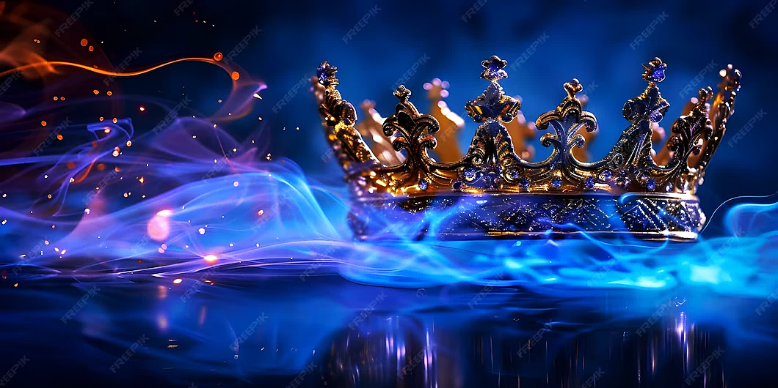
Call and Response
He is Adonai, strong and mighty,
Adonai, mighty in battle.
He is the King of Glory!
Who is He, this glorious King?
Melech HaKavod?

Slide 4
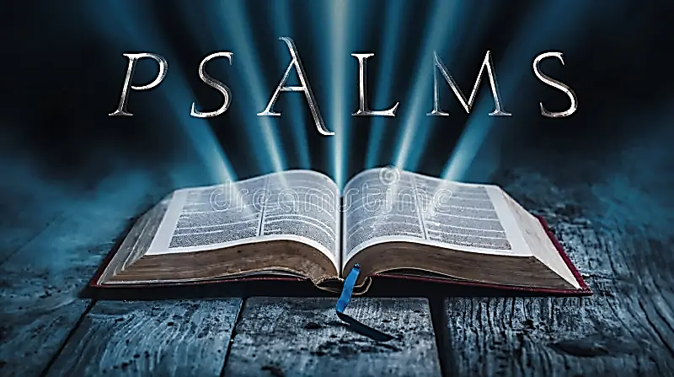
63
A contemplative Psalm.
The lives of the wicked, whose success is temporary, verses those who embrace Yahweh are bound for eternity

Slide 5
Letters to the body of messiah
WATCH | SHABBAT | SCRIBE
2ND | March 7th | Sis. Michelle

Slide 6
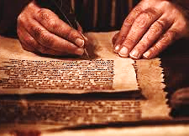
Why do we write a letter to the Body of Messiah?
We don’t want to turn prayer into an idol! We look for with expectation, fulfillment, purpose and alignment with Yahweh. 1Co 9.19; 26; 10. James 1.24
We were designed as Believers to care and help with the maturing of every believer. Eph 4.13, Pro 9.9

Slide 7
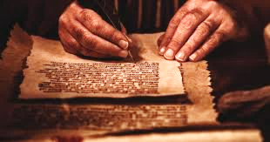
Letters to the body of
Sis Michelle Smith | Letter to the Body
Bro. Victor Podis | Prayer Response
Sis Jasmine Gunter | Declaration of Faith
Watch 2

Slide 8
Prayer Response
Heavenly Father, We are so grateful for the fact that you have redeemed us by the blood of Yeshua, and that we are Your children, and as Your Word tells us, "Nothing can pluck us from Your Hand." We are also thankful that Your Word not only tells us that our battle is against "principalities and powers of this dark age," but it also instructs us that we have power and authority as Your children and that nothing is impossible (Matthew 19:26). As we rely solely on Your strength and power through the Ruach HaKodesh. Father, we also must rely on You to help us to surrender to the Ruach as we walk in Your ways.
Father, please help keep us from walking in a spirit of fear, as we must not be fearful as we engage in spiritual warfare against the Adversary. Guide us as we stay in Your Word, pray, and walk in Your ways to have communion with our Heavenly Father. Then we know that everything we need is in Jehovah Shammah (The Lord is there). The battle is already won; rejoice now with triumph! Psalm 34:7

Slide 9
Prayer Response
We thank You that You are "Elohay Mishpat" (God of Justice) and that in You is found the power to destroy satanic dedications and agreements, like every evil ordination, demonic ceremony or dedication, mystical alignment, and every satanic dedication and agreement that our corruption has involved us in. Lord, we thank You that we can even come against such dark forces, which those who came before us may have entered into and break generational curses through Your Power and Might. Halleluyah!
Father, we know that we were lost in our sins and dead, and we are forever thankful that You redeemed us and cause us to remember that the Lord established hope through His resurrection, so that we may achieve eternal life through Yeshua HaMashiach, and that You allow us the privilege of sharing this truth with others.
Lord Your Word says that if we will repent and turn from our wicked ways then You will restore us. (II Chronicles 7:14) Then You will give wisdom and strategy on how to close open doors of rebellion, disobedience, and delay. Then and only then will the lies of the enemy no longer draw God's people away from our Creator and Redeemer. Thank You for forgiveness and calling us as Sons and Daughters of God. BaShem Yeshua Moshichaynu,

Slide 10
Declaration of Faith
Father we will no longer forget the power and authority You have given us through Yeshua, and we will no longer forget who we are in Him. Jehovah Ma’ozi, the Lord our strength, we will not rely on ourselves because it is you alone who gives us strength. We will take up the authority given to us in Yeshua and we will not be afraid to wage war against the enemy.
Jehovah El-Emeth, We will commune with You, stay connected to Your word and remain unified with the Body. We will speak Your truth and be alert to the schemes of the enemy, so we don’t fall for them or cause others to. We will continue to worship and praise You as you are the One Who realigns us, Your people with our Savior, Yeshua Messiah.

Slide 11
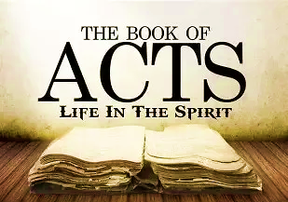
Homework Acts 28.25-27
On Shabbat we will engage in “Prayer Response” of what the Lord desires for us found in the Book of Acts.
If you have not read the assignment, then you are robbing yourself of joining with the community in our Prayer Response and thanksgiving

Slide 12
Homework Isaiah 6.9-10
Give one Scripture from the Torah you would use to minister the: Choose ONE of the following
Kingdom of God,
God's plan for humanity
Gospel of Yeshua the Messiah.
Give one Scripture that has shown that your heart had "grown thick" as described in verse 27

Slide 13
During Paul’s imprisonment
EPHESIANS
Yahweh the Father & Sustainer, the Great Architect
Yeshua is the Builder
Holy Spirit as Divine Presence
God’s temple is not constructed of stone, not weathered edifice but living flesh…
…growing nursing fellowship, which keeps building itself up in love.
This contrasts with Artemis’ cult temple, pagan religion that leaves life empty.

Slide 14
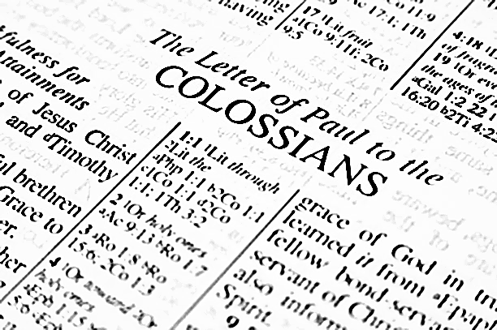
During Paul’s imprisonment
COLOSSIANS
Combat heresy against pagan & Jewish elements that masquerade as form of true Christianity.
Centrality of Yeshua and how it relates to us guarding against pagan concept.
Messiah our Supreme Lord & Sufficient Savior [Col 1.13-20; 2.9-10]

Slide 15
Letter to the Philippians
Paul’s letter was warm and personal.
Ch 2 Messiah as One Whose very nature is God. He became human, suffered and exalted Yahweh.
Sent encouragement because of his imprisonment “Joy” (1.5,18; 3.1) Paul believed this was not his end, he was to go to Spain.
Paul was given financial & spiritual support (Epaphroditus)
Sent Epaphroditus back after his illness-Welcome Timothy

Slide 16
Timothy, Titus, Philemon
1 Timothy
Paul writes to individuals rather than a community of believers.
Instructions for young leaders
Urge them to maintain purity of doctrine and lifestyle.
Pastoral letter
Encourage
Organism of the Community of Believers

Slide 17
Paul’s 2nd imprisonment
TITUS
2 TIMOTHY
Paul looks back over his life with deep satisfaction. He kept faith looking forward to his reward.
Encourages Timothy to stay committed and warning
Guidance and instructions
Gentile believer who had great success-settling conflicts, collecting gifts for the poor and working in difficult places e.g., Crete 1.12; 3.8

Slide 18
Philemon
Paul had written to a wealthy believer named Philemon. Asking him to forgive a runaway slave, Onesimus, and receive him as a brother (family)
Reconciliation!
The conversion of Onesimus is now considered “faithful”, who became helpful to Paul
The stunning impact of the Gospel allowed Onesimus to rise within the community of believers.
Smallest book but explosive
Paul’s prayer 1-7
Koinonia = All of Yah’s people are partners sharing in the gift of Yah’s grace
Actions of Paul demonstrate the Messiah’s heart
[vs. 17-19]

Slide 19
WHY SPAIN? (or Tarshish)
The Jews that are scattered all over the world (nations) because of exile returns to Jerusalem for Passover.
They witness the fulfillment of the coming of the Holy Spirit; evidence of the Apostles speaking in their language.
They hear and receive the gospel narrative of Yeshua Messiah . (To the Jew first)
God sends them back to the nations with the indwelling Spirit seating Evangelist in every part of the world.
Acts 2 & Dt. 32.8-9 (Ge 10; 11-1-9)
Dt. explains Gen 11 where Yahweh disinheriting the people-separated them as nations. Also, gives clarity to Ps 82 Spiritual beings in charge of nations gave into idol worship instead of Yah.
Acts 2- Shavuot reversed the disinheritance of the nations division.

Slide 20
WHY SPAIN? (or Tarshish)
Jerusalem/Judea Ac 2-8
Sameria Ac 8 (Phillip meets Ethiopian Eunuch)
Phillip in Azotus (Phillistine) Ac 8
Saul’s conversion Ac 9
Gentile nations
Damascus Ac 9
Cornelius Ac 10
Missionary journey
Rome Ac 20
SPAIN better known as Tarshish
Now it is time to draw people from the nations and bring them back to Yahweh.
Gen. 10; 11-19 & Acts 2: same geographic region
The Disciples go first to the regions that are associated with Biblical Israel (the Jew first then transition to Gentiles)

Slide 21
WHY SPAIN? (or Tarshish)
In Dt. where Yahweh divided the people; He entered a covenant relationship with a new people, Israel that had not yet existed.
God dividing the nations finds its resolution in the narrative of Acts, the inclusion of all nations.
Acts demonstrated the awesome power and divine order brought by Yahweh’s Spirit.
He was making all things new. Fulfilling Yahweh’s promise of returning His people back to Himself.
Paul didn’t believe he would die during his first imprisonment in Rome. Romans 15.20
Spain (Tarshish) was considered the end of the earth, and he knew it had not been covered by the Gospel.
He had to go every place that was disinherited at Babel. He was obsessed with accomplishing His calling.

Slide 22
Prayer Response Acts 28
Ancient of Days, You are the Everlasting, Eternal God, King of Nations. We will live in reverence and fear of You.
You have wiped away every secret and self-deceit, leaving us with no reasonable excuse, not to surrender our lives.
In You, Adonai are endless promises of hope, life and freedom as co-heirs with Yeshua Messiah; Who is an Ensign to all people and His dwelling is glorious. Your redemption is beautiful and unshakable. Blessed is He that Comes in the Name of the Lord (Baruch Haba B’Shem Adonai).
Thank you for Ruach, our Comforter. He enables us to keep covenant with You, producing unshakable faith. Let faith arise bringing every soul into Your Kingdom.

