Slide 1
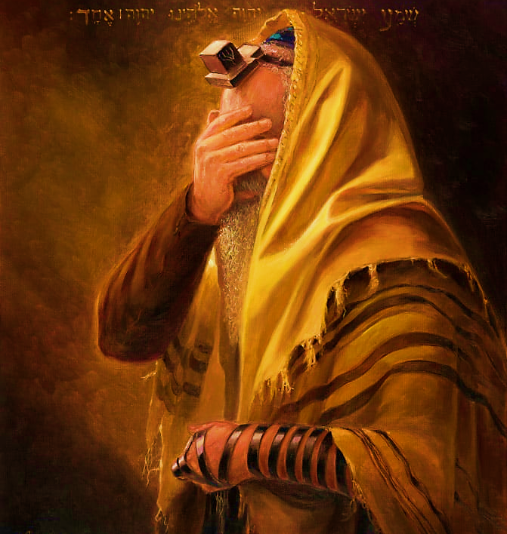
SHEMA
Sh’ma Yisra’el! Adonai Eloheinu, Adonai Echad
Hear, Isra’el Adonai our God, Adonai is one; and you are to love Adonai your God with all your heart, all your being and all your resources.

Slide 2

SHEMA Declaration
I will listen with my heart, understand with my mind, and respond with my actions.

Slide 3
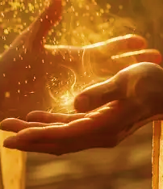
5786, 1 Iyar Month of healing
“I AM the Lord your Healer” YHVH Ropheka Ex. 15.26
Covenantal name, relating to Hebrew word Ohr for light. Ps 27.1, Jn 1.5, Mt 4.13-16; 5.14
Tribe: Issachar
Sense:Thought(introspective, self-refinement prep for receiving Torah & Spirit anew)

Slide 4
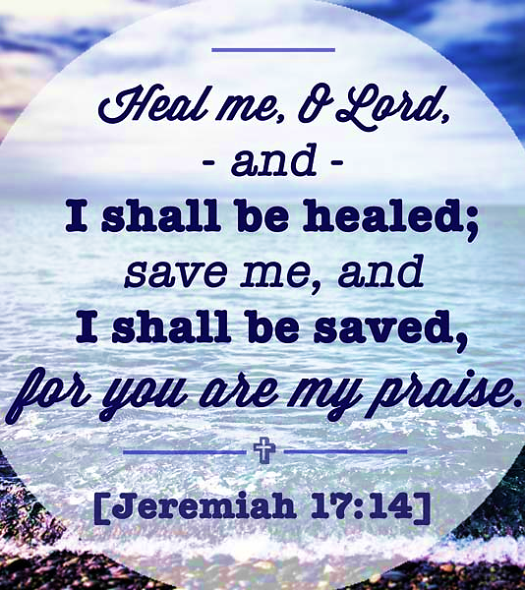
Praying for spiritual healing
Pattern: 1 Samuel 1.10-17 Hannah
Ridicule of others
Acknowledge her lack
Prayed
Made a vow of firstfruits
Falsely Accused
Yah restored dignity
Gave Praise
Yah grants healing
Met her vow
Yah gave increase

Slide 5
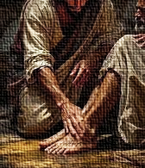
Communication
During the song ‘Heal Our Land’, Yeshua stood at the front of the Sanctuary (Ruach said, Holy room where My people find peace and rest).
He had something like a white towel over His left arm and something like an apron tied around His waist. He said, “For those who are willing” and He knelt down to wash feet of the person to His left.

Slide 6
Exodus 15.26
Yahweh is a Healer!
All have sinned and come short of the glory of Yah.
Adonai is sovereign and able to do all things; He created all things therefore He can repair that which is broken
Understanding spiritual ailments requires us to look beyond the physical and explore the emotional. We face challenges that are rooted in unresolved emotional issues, which can create disharmony within us.

Slide 7
Exodus 15.26
When we ignore emotional aspects, they may surface as physical ailments, reminding us that our mind, body and spirit are intricately linked. By acknowledging these spiritual ailments, we open ourselves to healing.

Slide 8
Diseases are rooted in…I loose myself and command these spirits to come out in the name of Yeshua
ARTHRITIS Self-hatred and low self-esteem
ASTHMA Fear concerning relationships
CANCER Bitterness, unforgiveness, resentment and slander
CHOL. Anger and hostility
DIABETES Rejection, self-hatred, guilt inherited
H. BLOOD Fear and anxiety
IMMUNE Broken spirit/heart
SINUS Fear and anxiety
STROKES Self-rejection, self- bitterness and self-hatred
“I speak healing and strength to my mind and body. By Yeshua stripes I am healed (Isa 53.5) I break, rebuke and cast out any spirit that does not operate in the purity of spirit of Yeshua”

Slide 9

What is the goal of healing? “FRUIT”
John 15.1, 5 “I AM the true vine” Yeshua emphasized the importance of living a vibrant intimate relationship with Him as the source of our spiritual fruitfulness. In Him we draw our sustenance.
Tribe of Issachar 1 Chronical 12.32 Attuned to Yah’s purpose
Prayer Warriors-communities, the lost, governments, repenting on behalf of people petitioning heaven’s court.
Spiritually awake: Understand chronological and specific times, carrying discernment & knowledge about what to do
Take action against wickedness by activating the word of Yah. Dan 11.32-35
Have a radical devotion to Yeshua & things of Yah, anointed with power.

Slide 10
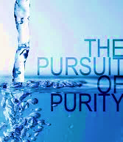
Homework
How does Adonai’s word... Cleanse, Control, Correct?
2. What “spiritual deposit” has been entrusted to you needing the help of Ruach? 1Tim 6.20, 2Tim 1.14, 2Pet 3.17
3. What can we learn from Yahweh enlisting spiritual beings to watch/guard over us? Psalm 91.11
Write your own “I Will’s” using Vs. 1-16 as an example.

Slide 11

Praying for the presence of Yahweh to be with his people A time of refreshing

Slide 12

Secret of Yah’s Presence
Having a consistent awareness of His companionship.

Slide 13

Recognized our need for Yahweh’s presence
Our relationship should mature beyond wants and needs for ourselves, e.g., Samuel & Moses.
Our walk should be stained with His presence to draw others.
We are to carry the Spirit of Prophecy in word and deeds.

Slide 14
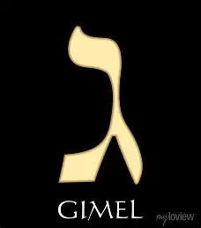
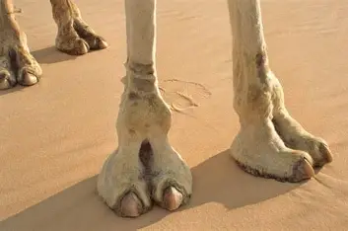
Gimel = Progression & Movement
Bet established the existence of two opposites. Alpha being the Creator & Giver and Bet His creation & receiver.
Gimel represent transformation, change and movement.
Gimel drives from “gemul” means both giving of reward as well as the giving of punishment.
In Torah both reward and punishment have the same aim, to bring one into agreement with Yahweh and receive His light.
It is a picture of Yeshua, giving of Himself (charity) as Yah’s sacrifice which pursues us.

Slide 15
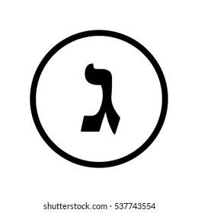
Psalm 119.17-24
V17 Humble request for blessing “deal bountifully” with large expectation, generous about of grace.
Then I can live (not for comfort or carnal needs) and observe Your word. The psalmist realized a good life is not only connected to Yah’s word but that he has a responsibility to guard, treasure, keep, live and practice Yah’s word.
V18 Open my eyes…parallels Luke 24.45 spiritual vision.
V19 The faithful should see themselves as strangers seeking and longing for a heavenly home Heb 11.13-16; 2 Cor 5.20
V20 Spiritual desire for intimacy and revelation, 1 Pet 2.2 as a babe longs for the comfort of a parent.
V21 “Proud” In Pro. 6.17-19 list six things Yah hates. “Curse” The consequences of our separation from Yahweh.
V22 “Remove scorn and contempt…” Mt. 13.55 To deny the essence of Yeshua, reducing Him to our corrupt standard.
V23 The psalmist who is a pilgrim finds himself to be a stranger in the enemy’s world. He appeals to Yah as one who is a friend clings to Yah’s word which hold the blueprint for life. The word becomes a refuge & guide against the enemy. 2 Tim 3.16-17

Slide 16
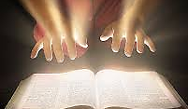
Psalm 119.17-24
The wonders of Yahweh’s word cannot be grasped without His Spirit. As strangers on earth, we find our counsel, stability and delight in His statues.
APPLICATION
Pray for spiritual sight, opening your eyes to a deeper truth. As you live as a pilgrim, Yah is faithful to supply all your needs Phil 4.19. Crave His word daily, letting scripture guide your way of life. Then turn to God’s word when misunderstood, rejected or when resistance is present; let His word be your counselor.

