Slide 1
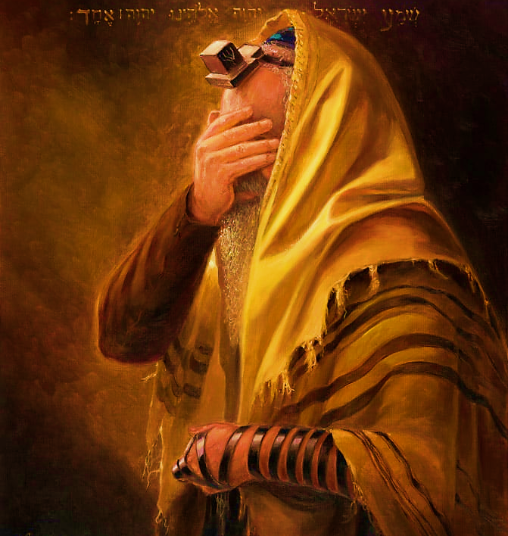
SHEMA
Sh’ma Yisra’el! Adonai Eloheinu, Adonai Echad
Hear, Isra’el Adonai our God, Adonai is one; and you are to love Adonai your God with all your heart, all your being and all your resources.

Slide 2

SHEMA Declaration
I will listen with my heart, understand with my mind, and respond with my actions.

Slide 3
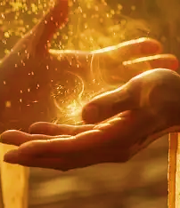
5786, 15 Iyar Month of healing
“I AM the Lord your Healer”
YHVH Ropheka Ex. 15.26
Covenantal name, relating to Hebrew word Ohr for light. Ps 27.1, Jn 1.5, Mt 4.13-16; 5.14
Tribe: Issachar
Sense: Thought (introspective, self-refinement prep for receiving Torah & Spirit anew)

Slide 4
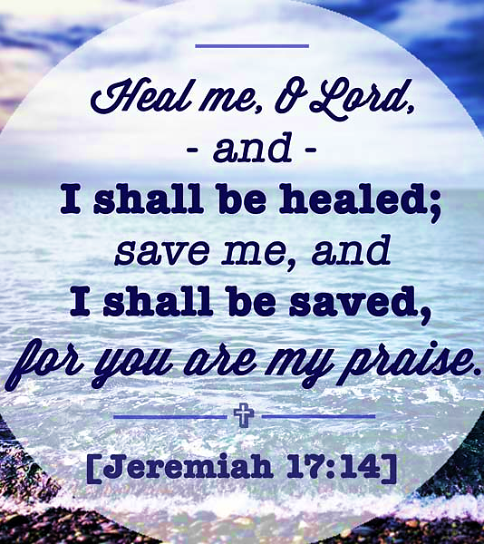
Praying for spiritual healing
Pattern: 1 Samuel 1.10-17 Hannah
Ridicule of others
Acknowledge her lack
Prayed
Made a vow of firstfruits
Falsely Accused
Yah restored dignity
Gave Praise
Yah grants healing
Met her vow
Yah gave increase

Slide 5
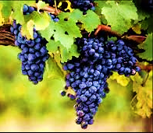
What is the goal of healing? “FRUIT”
John 15.1, 5 “I AM the true vine” Yeshua emphasized the importance of living a vibrant intimate relationship with Him as the source of our spiritual fruitfulness. In Him we draw our sustenance.
Tribe of Issachar 1 Chronicles 12.32 Attuned to Yah’s purpose
Prayer Warriors-communities, the lost, governments, repenting on behalf of people petitioning heaven’s court.
Spiritually awake: Understand chronological and specific times, carrying discernment & knowledge about what to do
Take action against wickedness by activating the word of Yah. Dan 11.32-35
Have a radical devotion to Yeshua & things of Yah, anointed with power.

Slide 6
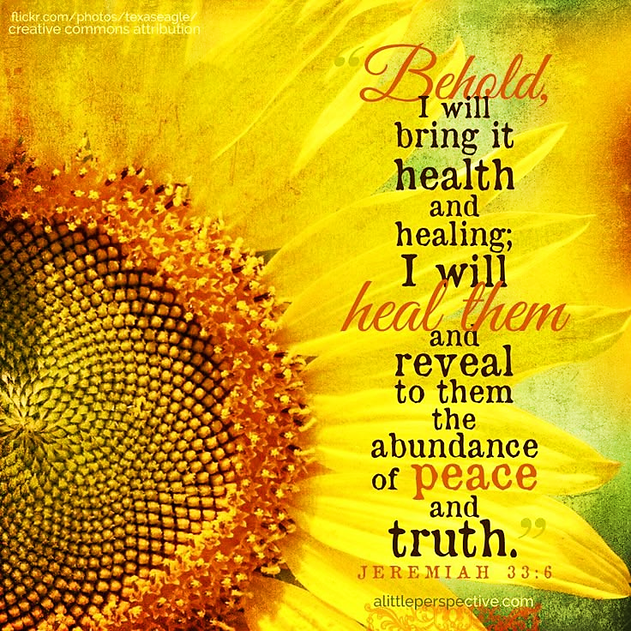
Prayer for healing
Lord, let Ruach break and demolish every toxic spiritual relationship that formed through fear, intimidation, or unhealthy dependence to be known. Separate me from every counterfeit covering, every corrupt connection, and every demonic attachment that came through abuse, deception, or bullying. I belong to You. My conscience is Yours. My future is Yours.

Slide 7
Abram & Sarah | Gen 16 | Doubt Adonai’s timing, forcing issues to fit into Adonai’s promises. Controlling others for what is lacking in their life.
Lot & Wife | Gen 19 | Tie you to destruction, choosing comfort over obedience
Hosea & Gomer | Hosea 1-3 | Commitment one-sided. Running from real love because of familiar spirit of pain.
Samson & Delilah | Judg. 16.4-21 | Love is one sided. Wants one to trust over their discernment. Give access to someone who keeps betraying you.
Saul & Doeg | 1 Sam 22.9-19 | Not part of the Body of Messiah. Know how to play into carnal needs. In desperation allow genocide of innocent.

Slide 8
David & Bat-Sheva | 2 Sam 11.2-27 | Abusers of authority. Ignore conscience, giving into lust desires. Use others to satisfy own pleasure
Amnon & Tamar | 2 Sam 13 | Setting up a ruse meant to lure and bring shame and isolation Proverbs 12.26
Solomon & Wives | 1 Kings 11 | Compromise spiritually for lust and physical connection. He let relationships pull him away from Adonai rather than closer.
Ahab & Jezebel | 1 Kings 16.31-33 | Passivity, refuse to confront sin enabling evil by staying silent
Woman at the well | Jn 4.11-29 | Cycle of unstable relationships, repeating patterns of brokenness fueled by shame. Seek love from unstable person.

Slide 9
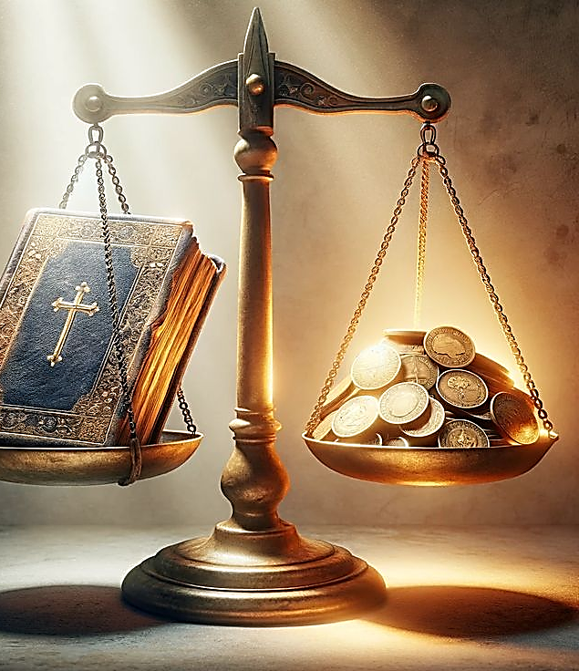
Homework
1. Heaven and earth are like two scales in balance, that which is taken from one is put into the other.
What side of the scale outweighs the other?
Do you view yourself as heaven’s ambassador?
2. How will you apply Shabbat’s teaching to your life this week?
3. A veil had to be removed from Paul and Balaam’s eyes. The problem was not Yah’s word but their lack of wisdom. They didn’t need new revelation or new eyes, just clear vision.
What area have you asked the Lord to give you clear vision, not revelation but the removal of the veil that has caused you to have skewed vision?

Slide 10

Secret of Yah’s Presence
Having a consistent awareness of His companionship.

Slide 11

Recognized our need for Yahweh’s presence
Our relationship should mature beyond wants and needs for ourselves, e.g., Samuel & Moses.
Our walk should be stained with His presence to draw others.
We are to carry the Spirit of Prophecy in word and deeds.

Slide 12
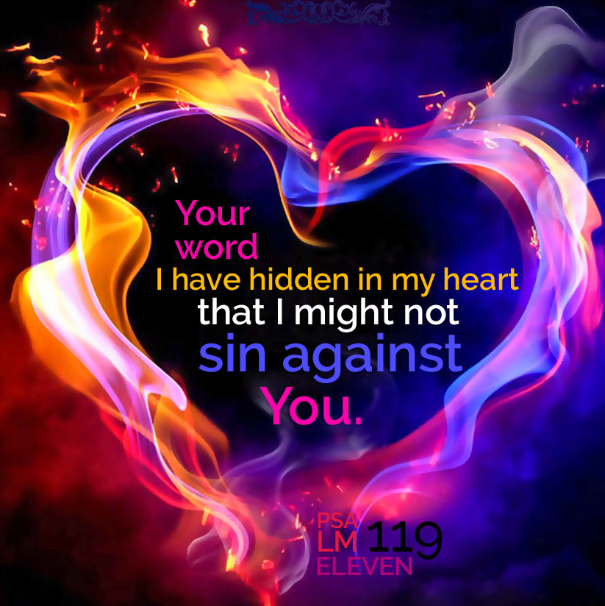
Psalm 119 showcase a structured and intentional composition that forces us to examine our desire for Hashem

Slide 13

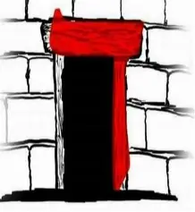
Dalet = Door, pathway Entrance to a tent
Represents opportunity, transition and access to Yahweh
John 10.9 “I Am the door”
Dalet also connects to the word ‘dal’ meaning poor in spirit, humble. One should enter the doorway to Yahweh in humility Mt. 5.3, Isa 61.1
King David’s name has two dalets on each side, the middle is vav (hook or connect) emphasis that David was a connector between Hashem and His people as Yeshua is in John 14 stating “I AM the Way and the Truth and the Life, no one comes to the Father except through Me.”

Slide 14
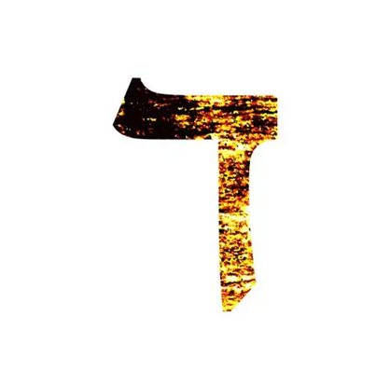
Psalm 119.25-32
V25 In deep despair and dishearten, clinging to the dust the only thing the psalmist can do is pray saying revive me in Your word. Grant me life just as there is life in the words of Your Torah Job 10.12
V26. I recounted to You the matters and troubles in my life, “and You answered me” You responded to my prayers. Now that You have granted me relief, asking for revival. I have a request “Teach me Your statutes”
V27 The psalmist is acknowledging his personal ignorance, he does not have complete understanding. When Hashem brings us into understanding His precepts, all that is left is to marvel at His wonderous works (creates hope, confidence in Yah, increases awe, etc.)
V28 The image is of a soul crying incessantly to the extent that he becomes thoroughly dried out, lacking vitality. It is only Yah’s word that restores.

Slide 15
Psalm 119.25-32
V29 Asking Yah to grant wisdom to avoid living a life in accordance with falsehood, meaning they have experienced what a life in deception looks like with its benefits of destruction. True path is only found in the miracles of the word of God.
V30 A deliberate conscious action and commitment to Hashem’s rulings . Contrasted with I’ll try; meaning I will not commit myself. I may change my mind when things are going better for me…etc. He goes further to commit to set Yah’s ruling as his focus point.
V31 Covenant declaration of clinging for the psalmist implies protection, produces transformation, builds confidence, gives comfort and allows freedom, that is only found in a relationship with Hashem.
Deut. 13.4 tells us what it means to be in this covenant relationship: To SEEK after Yahweh (Jer 29.13) FEAR Him, KEEP His commands, LISTEN to His voice and SERVE Hashem Romans 8.38-39.
There is shame in disobedience, but not in Messiah Ro 8.1

Slide 16
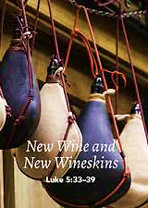
Psalm 119.25-32
V32 The psalmist says if You grant me new wine skin, new heart, revival and ability, he would fulfill Yah’s commandments cheerful, eager in spirit and readiness.
Willing to lay down life to be emptied, crushed (new creation) given new skin, making a new vessel to receive fresh revelation.

Slide 17
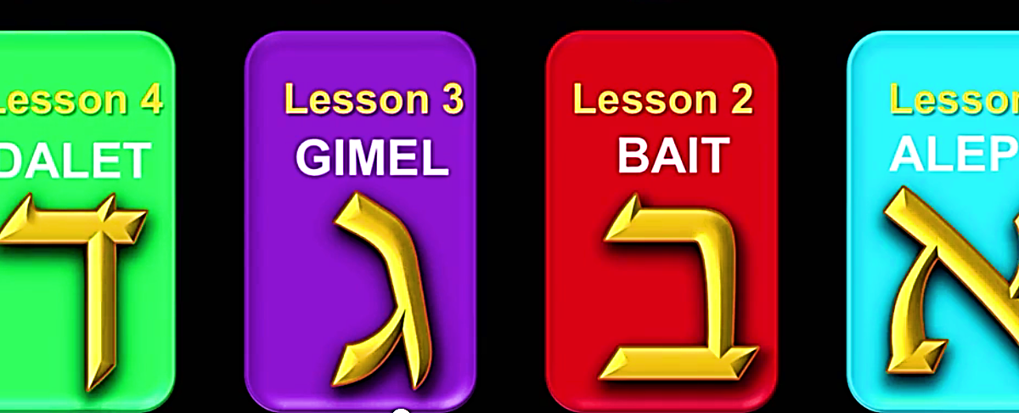
Psalm 119.1-33
Alef introduced us to HaShem, the Giver, our strength and the arm of YHVH that brings us into His bosom causing us to be bless. Bet taught us to make a house in our hearts for Yah’s presence and the genuineness of His word that cleanses, control and corrects us. We are to receive the pure undefiled word of our Leader. Gimel gives us a picture of the nurturing Giver of Life and charitable Spirit of Yeshua as we journey through our life trials bringing us to a spirit of humility. Dalet reminds us of Yeshua as the gate for all sheep and how we are to enter the tent of Hashem.

