Slide 1
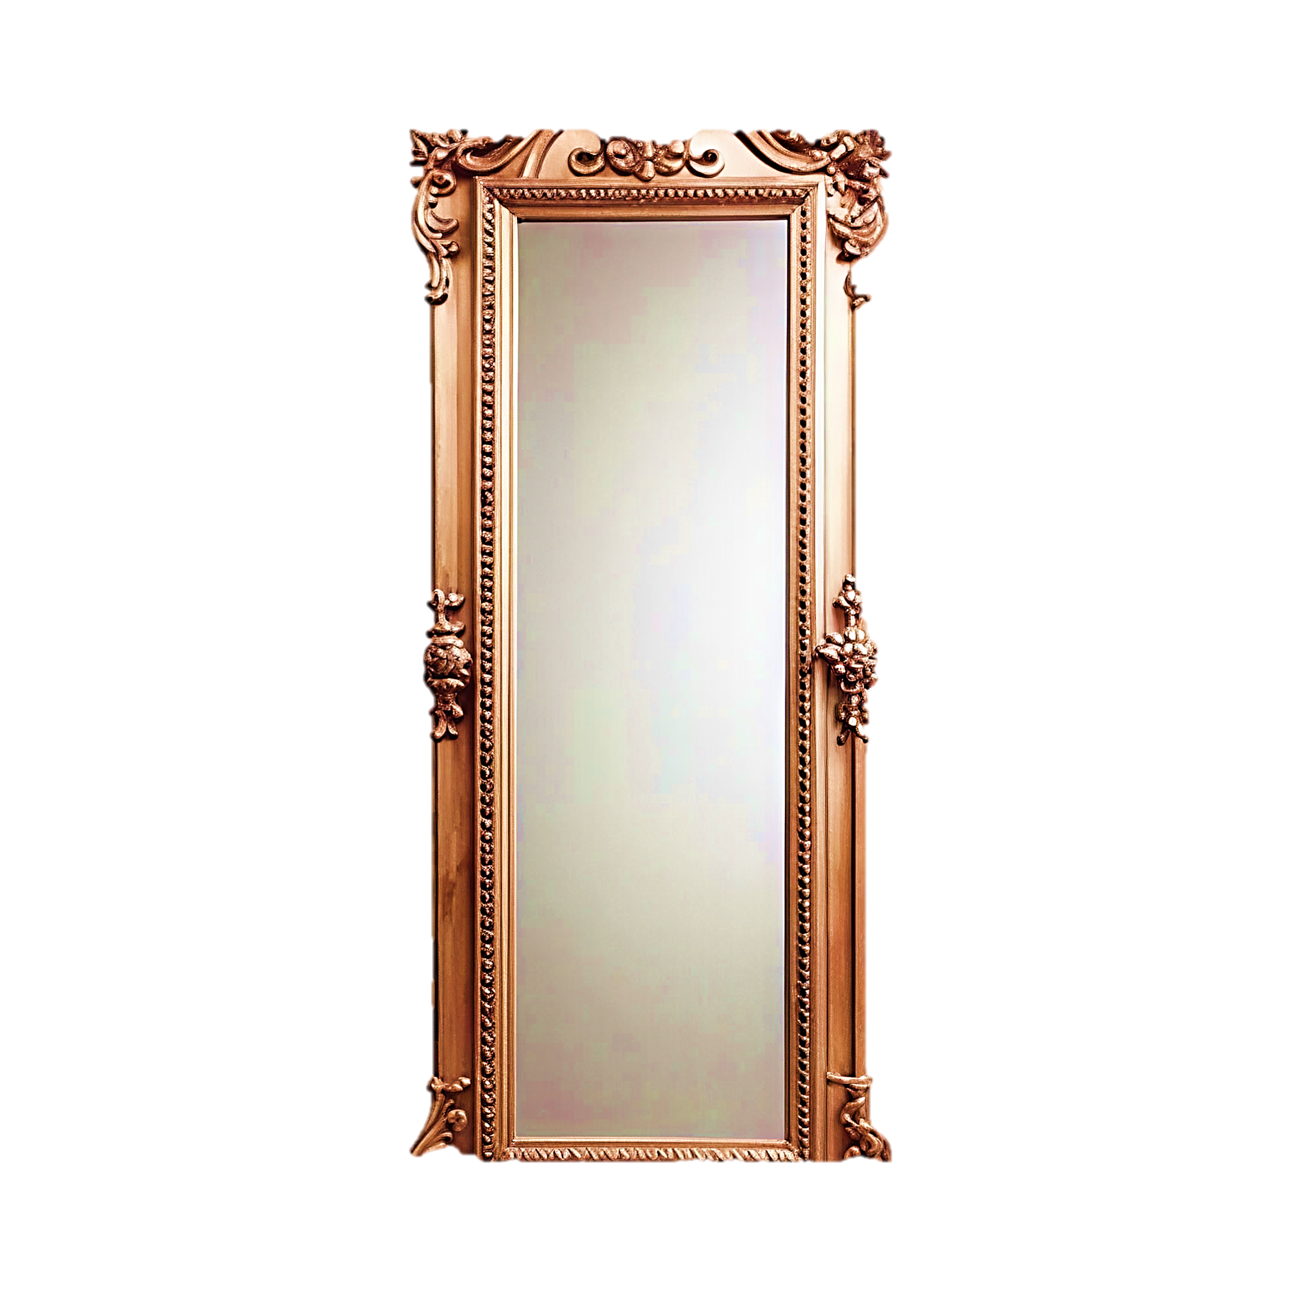
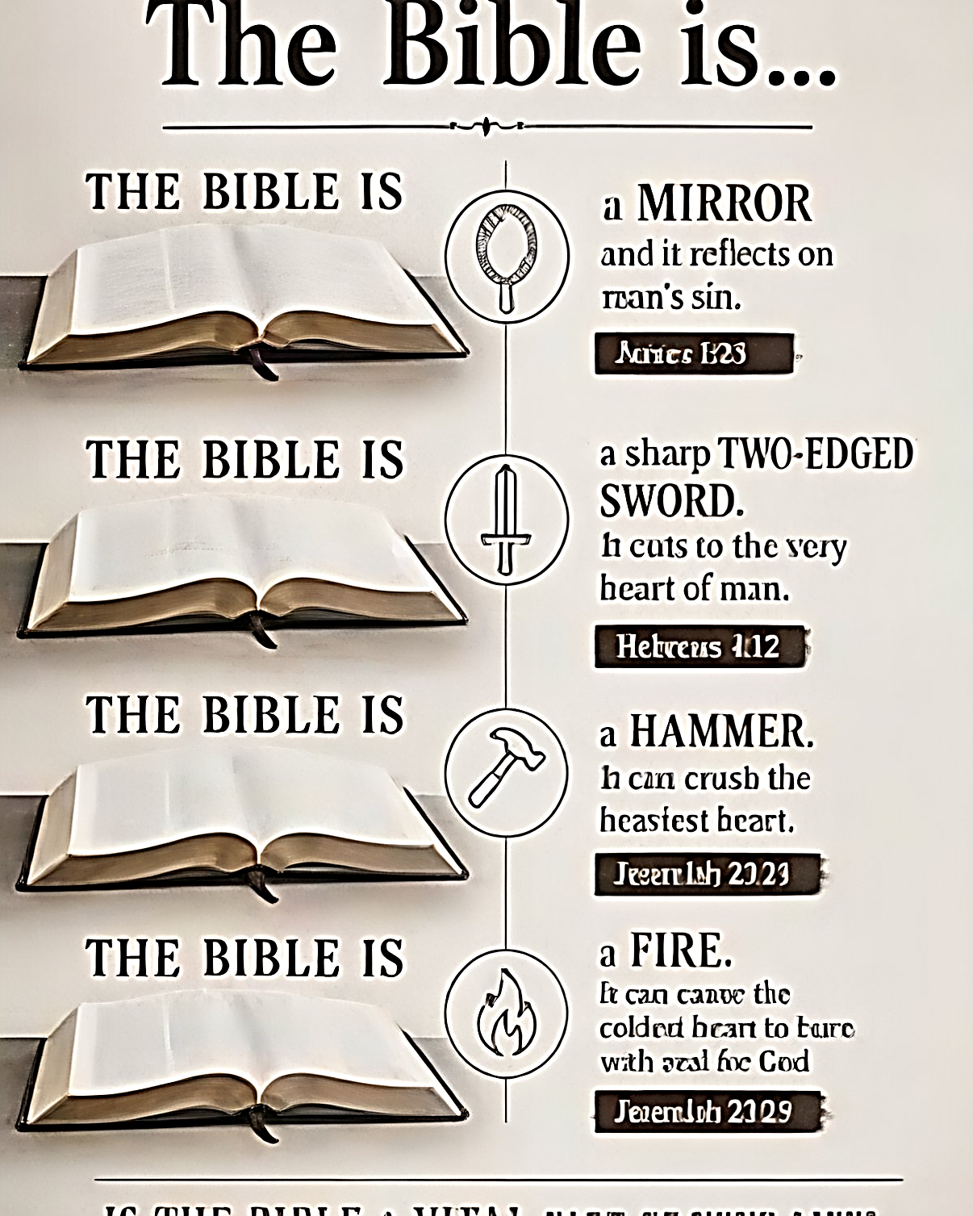
See yourself
The Bible is a
mirror that can lead to transformation but it requires a response.

