Slide 1
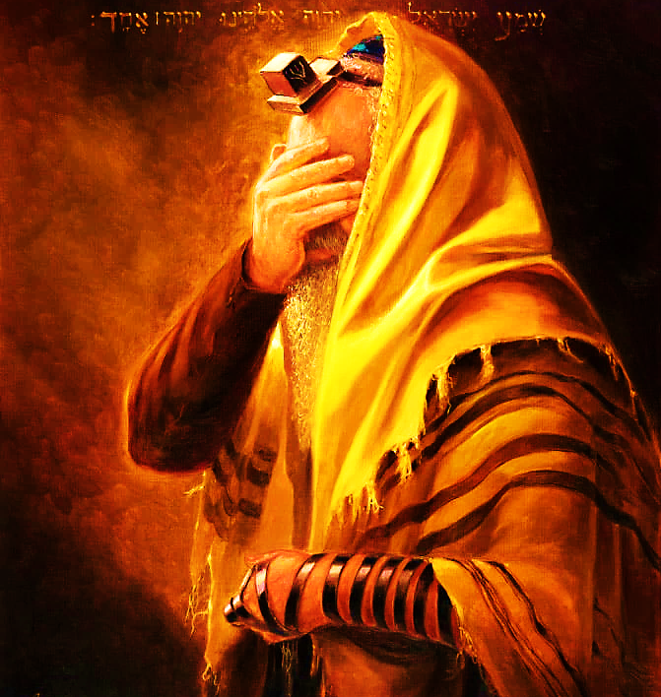
SHEMA
Sh’ma Yisra’el! Adonai Eloheinu, Adonai Echad
Hear, Isra’el Adonai our God, Adonai is one; and you are to love Adonai your God with all your heart, all your being and all your resources.

Slide 2
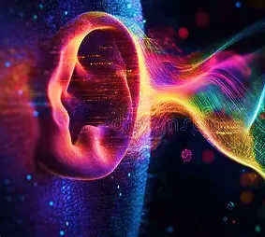
SHEMA
Declaration
I will listen with my heart, understand with my mind, and respond with my actions.

Slide 3

5786, Iyar
Month of healing
“I AM the Lord your Healer”
YHVH Ropheka Ex. 15.26
Covenantal name, relating to Hebrew word Ohr for light. Ps 27.1, Jn 1.5, Mt 4.13-16; 5.14
Tribe: Issachar
Sense: Thought (introspective, self-refinement prep for receiving Torah & Spirit anew)

Slide 4
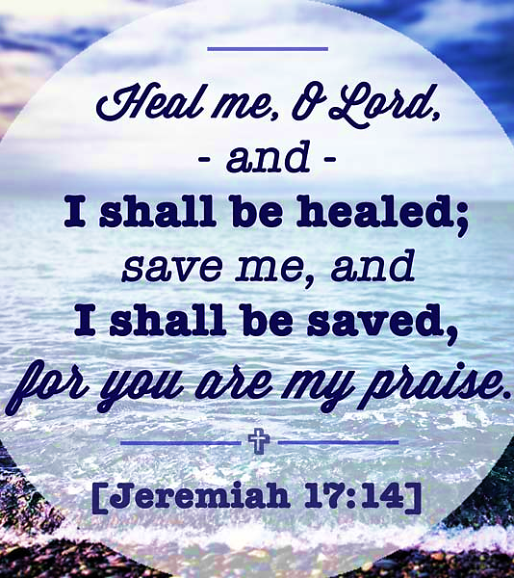
Praying for spiritual healing
Pattern: 1 Samuel 1.10-17 Hannah
Ridicule of others
Acknowledge her lack
Prayed
Made a vow of firstfruits
Falsely Accused
Yah restored dignity
Gave Praise
Yah grants healing
Met her vow
Yah gave increase

Slide 5

What is the goal of healing? “FRUIT”
John 15.1, 5 “I AM the True Vine” Yeshua emphasized the importance of living a vibrant intimate relationship with Him as the source of our spiritual fruitfulness. In Him we draw our sustenance.
Tribe of Issachar 1 Chronicles 12.32 Attuned to Yah’s purpose
Prayer Warriors-communities, the lost, governments, repenting on behalf of people petitioning heaven’s court.
Spiritually awake: Understand chronological and specific times, carrying discernment & knowledge about what to do
Taking action against wickedness by activating the word of Yah. Dan 11.32-35
Have a radical devotion to Yeshua & things of Yah, anointed with power.

Slide 6
Toxic Love-soul ties
Deep emotional and spiritual bond between two people- sexual partner, close friends, mentor, authority figure (physical, sexual, mental)
The Adversary attacks our body and spirit, but also our soul through forming of ungodly soul ties 1Co 6.15-16
Obsession with a person (angered if told to separate)
Taking traits of the person (Not married)
Remaining in abusive relationship (not valued)
Thoughts and fantasies
Keep objects (gate kept open, just in case)
Dream constantly of a person
HEALTHY: Energized, secure, unconditional & selfless love, respect, encourage godliness, mutual commitment, mutual support.
Covenant Marriage
Ruth & Naomi
Jacob & Benjamin life was intertwined Gen 44.30
David & Johnathan 1 Sam 18.1
TOXIC: Jealousy, possessiveness, co-dependency, feelings of on edge, passive, trapped, cause division Romans 16.17, hot tempered Proverbs 22.24-25

Slide 7
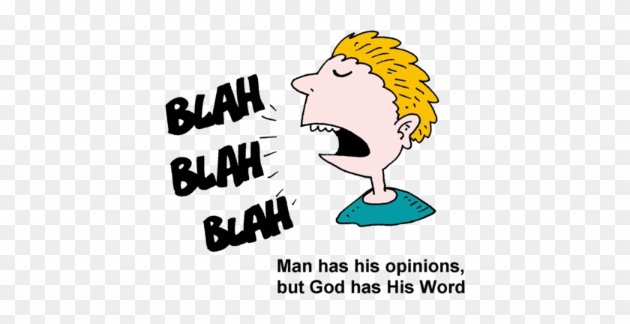
Toxic Words
Speech that is reckless and destructive. Includes slander, malice, abusive language and gossip.
James 3.6-17 speaks of how the destructive power of the tongue contrast heavenly wisdom.
Gossip is worst form of witchcraft. It tarnishes the reputation of another. It takes the form of gang stalking; changes how others view them. Proverbs 12.18
Leviticus 19.16 “Do not go around spreading slander among your people but also don’t stand idly by when your neighbor’s life is at stake; I am Adonai.”

Slide 8
Toxic –unprofitable words
  Yahweh created words (Gen 1)
  Words have power (seeds) Pr. 18.21
  Mouth reveals the new heart Col. 3.10
  Gate open to sin 2Tim 2.16
Idle speech in Mt 12.36-37 where each of us will be held accountable on Judgment Day. In verse 24 Yeshua was accused of demonic activity.
Greek (G691) inactive, lazy, useless, barren.
Yahweh is saying that our words should be working for us causing change, etc.
Our words cooperate with our heart action. It cannot hide from the Discerner.
Edification is a way our words work for us in building up Eph 4.12; 29, 1 Th 5.11, Ro 15.2
M’tora (infected one) Lev 14-15 is the cause affect of gossip & idle words.
Blood & oil ceremony must be conducted
Re set-apartness
Re purification

Slide 9

Secret of Yah’s Presence
Having a consistent awareness of His companionship.

Slide 10
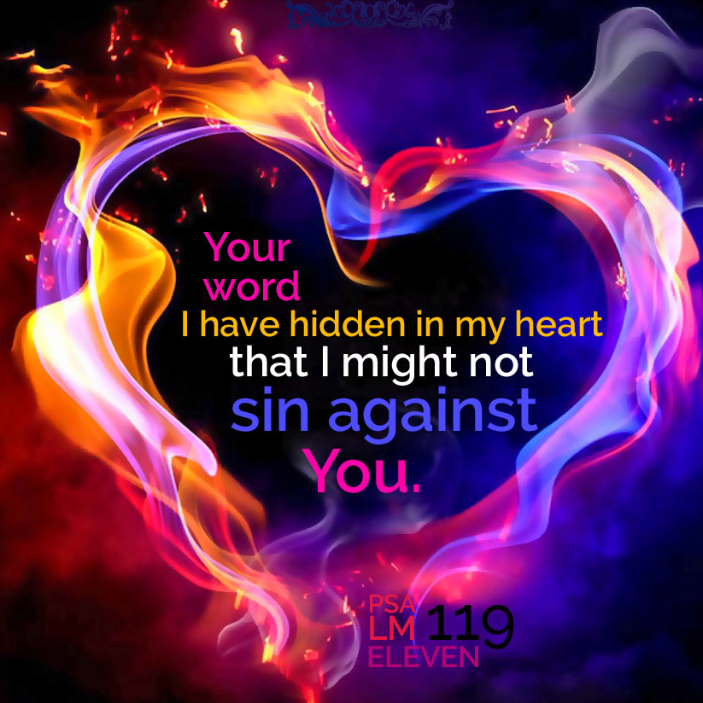
Psalm 119 showcase a structured and intentional composition that forces us to examine our desire for Hashem.

Slide 11
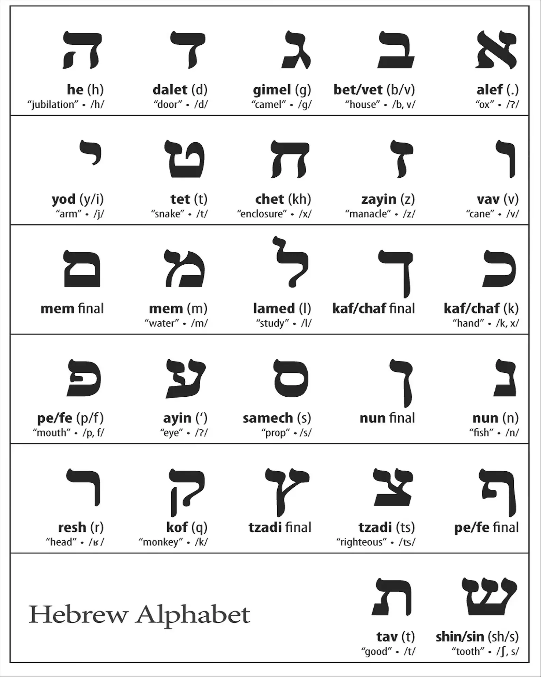
Going deeper
Psalm 119
Every verse begins with the Hebrew letter
Blue letter bible.com
Click on verse
Interlinear
Hebrew word to left
Transliteration with root word
Example:
Verse 41 “May Your grace” (V’ibo’uni) root H935 “bo”

Slide 12
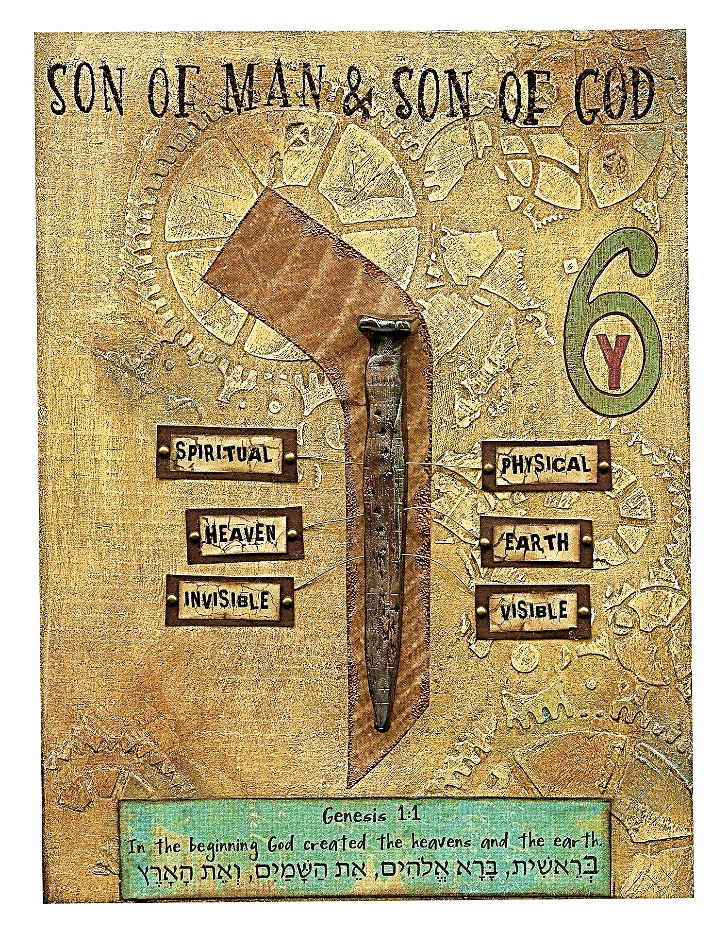
Vav #6
Nail, make secure, add connecting, bind together, peg or wooden hook and transforming.
Acts as conjunctive, hook or peg.
Connect life to Yah’s word and salvation
Hebrew numbers have a personality and metaphysical meaning (not just having quantitative value, but carries profound spiritual, symbolic meaning & divine essence that help to reveal truth of Torah)
#6 Completed Work of Creation. Natural world and man. Preservation, labor, sorrow, weakness of man, falling short.

Slide 13
Six areas of our lives
VERSE (S) | AREA OF LIFE | EXPLANATION
41-42 | CONVERSATION | Isa 30.21 His word in us, in our mouths & around us
43-44 | VALUES | When the Lord’s word dwells in us it transforms (obedience)
45 | IDENTITY | Growth and personal development (liberty/freedom)
46 | AREA OF INFLUENCE | Those we are in constant contact and authorities
47 | AREA OF INTEREST | Activities, hobbies, dreams etc. it will connect everything to God
48 | THOUGHT OF LIFE | Renewed mind

Slide 14
Psalm 119.41-45 WAW
V41: “May Your grace”, YHVH works through His mercy to bring salvation to us. Yah’s word has inherited power within it to transform. Mercies (Hased) unwavering, covenantal loyalty, Lam. 3.22-23
Mt 25.20-21 Man has been empowered to use what is given and then expand upon it.
V42: “So, I will have an answer” He will have the strength and confidence to answer and stand firm against those who criticize and hate the truth with courage of conviction.
V43: “And do not take…” Do not hold back my ability to speak truth and avoid falsehood. He anticipates and hope that God’s goodness will never cease in this matter.
V44: “So I will keep”… Commitment of a deep heart resolve to be a covenant participant. To look and act like His Creator.
V45: “And I will walk…” He understands his freedom. He is free from confinement of distress.
Because he has sought Adonai’s precepts, he is free to exercise what has been rooted by Yah’s truth.

Slide 15
Psalms 119.46-48 WAW
V46: “I will speak…” He is committed to discussing the Torah truths, before all men on every level as one who is consumed with a profound love and wonder of Yah’s word.
V47: “For I will delight…” He has a profound pleasure in Scripture enjoying it in studying and treating it as treasures as he leans into it.
V48: “And I shall lift up…” Lifting his hands in prayer and praise to be able to explore greater heights and depths into Yah’s presence.
“I will” statements tells us that he has made his choice to delight, give honor and deliberately spend time to know Yahweh.
In studying the Psalm, it gives us prospect to be recalibrated.
Remember that this Psalms, in particular is touching on the six areas of our lives.
It sets the stage for us to see ourselves in Scripture and be re-set, set-apart and purified.

Slide 16

Psalm 84.12(11) Declaration
Yeshua Messiah is my Sun & Shield and the source of unlimited power, favor and blessing. As I walk in uprightness before Him, He will not withhold any good thing from me.

