Slide 1
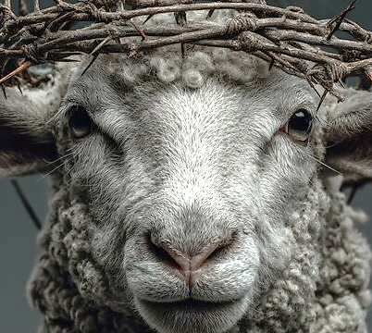
Revelation 5.13b
To the One sitting on the Throne and to the Lamb
Belong praise, honor, glory and power forever and ever.
AMEN

Slide 2
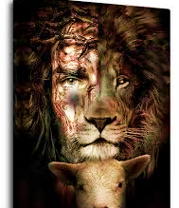
Declaration
Bless the Lamb Who was slaughtered for me,
El Melech Ne’eman
The Lord is a faithful God & King!

Slide 3
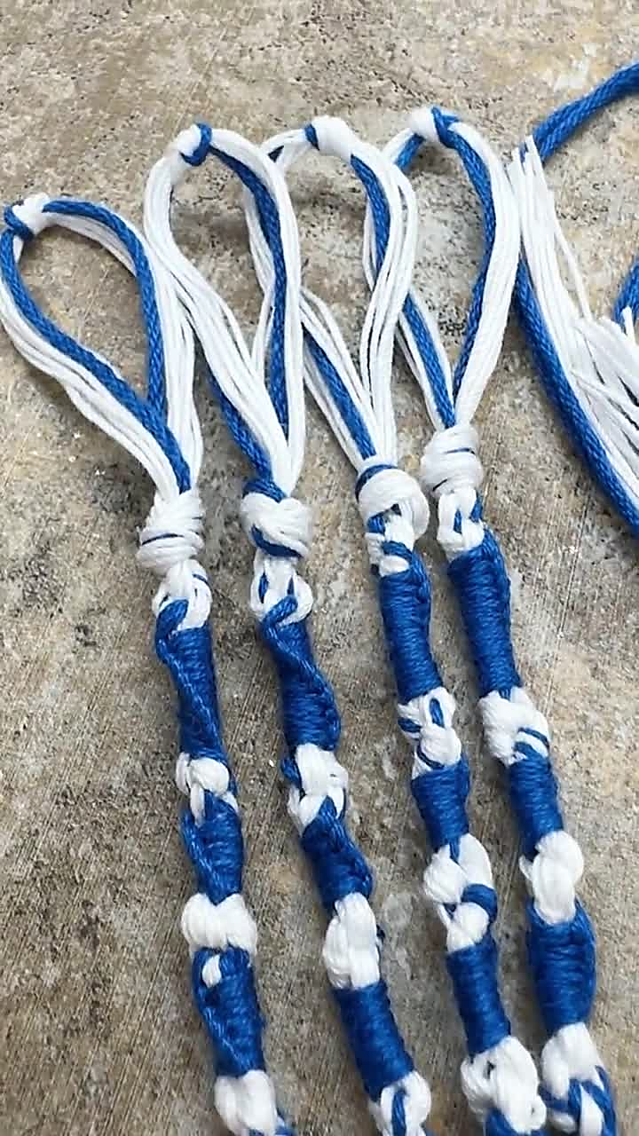
5786 Sivan A time of joy, harvest & spiritual purpose
Taking hold of Yahweh’s instruction and claiming our identity.
We are to connect & align with Hashem’s spiritual purposes, applying them to our lives and therefore bringing fullness into us. Ja 2.33, Ro 12.2, Jn.1.12
Letter: Zayin, means weapon, sword or crown, sustenance or nourishment
TRIBE: Zebulun, who harvested Chilazon an aquatic creature that creates the blue dye used for coloring the blue tassels on the tallit. The tribe of Zebulun had the anointing for abundance and locating hidden treasure.
Numbers 15.38 “Dyeing to be Holy”

Slide 4
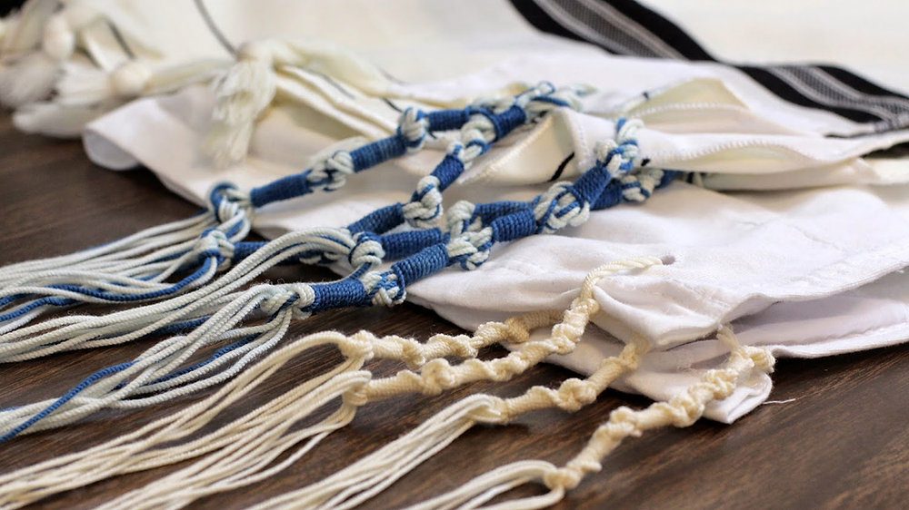
Prepared & Ready to Receive
Wait on Hashem, be present to receive Hashem’s instructions
1
Acknowledge hashem’s in all ways live in a place of wholeness and completion
2
Embrace the word of yah as spiritual sword that nourishes and give you assignment
3

Slide 5

Prepared & Ready to Receive
Like Zebulun answer Hashem’s call to battle, worship and live generously
Place your feet under the Kings table at Shavuot and receive His instructions for next season
Bring an offering to Yahweh giving with expectation

Slide 6
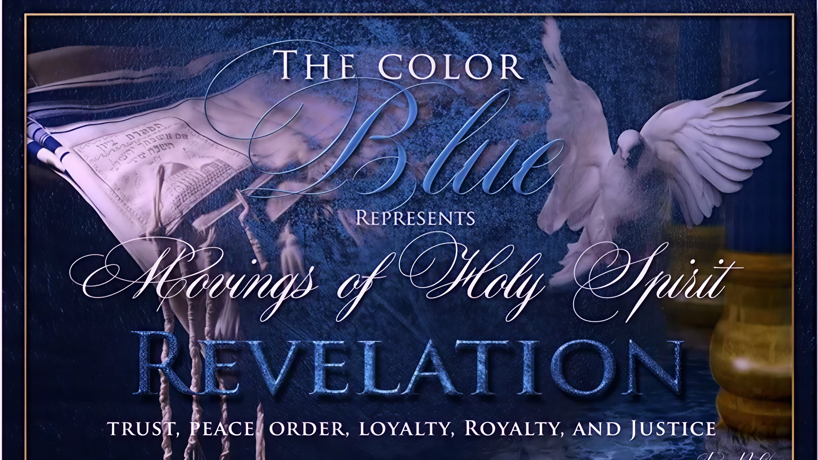

Slide 7
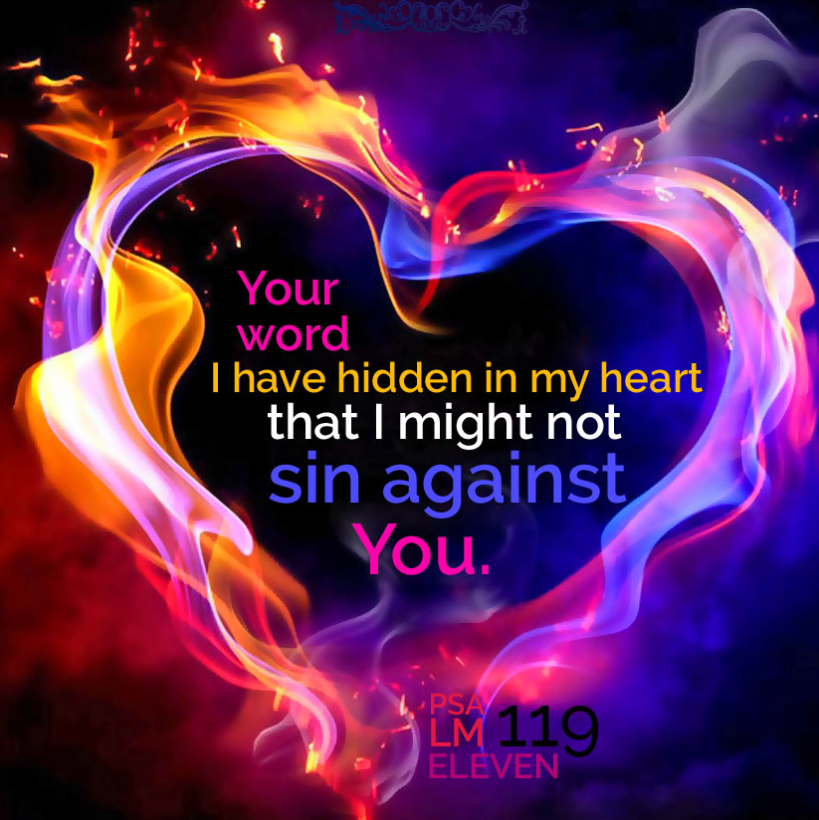
Psalm 119 showcase a structured and intentional composition that forces us to examine our desire for Hashem.

Slide 8
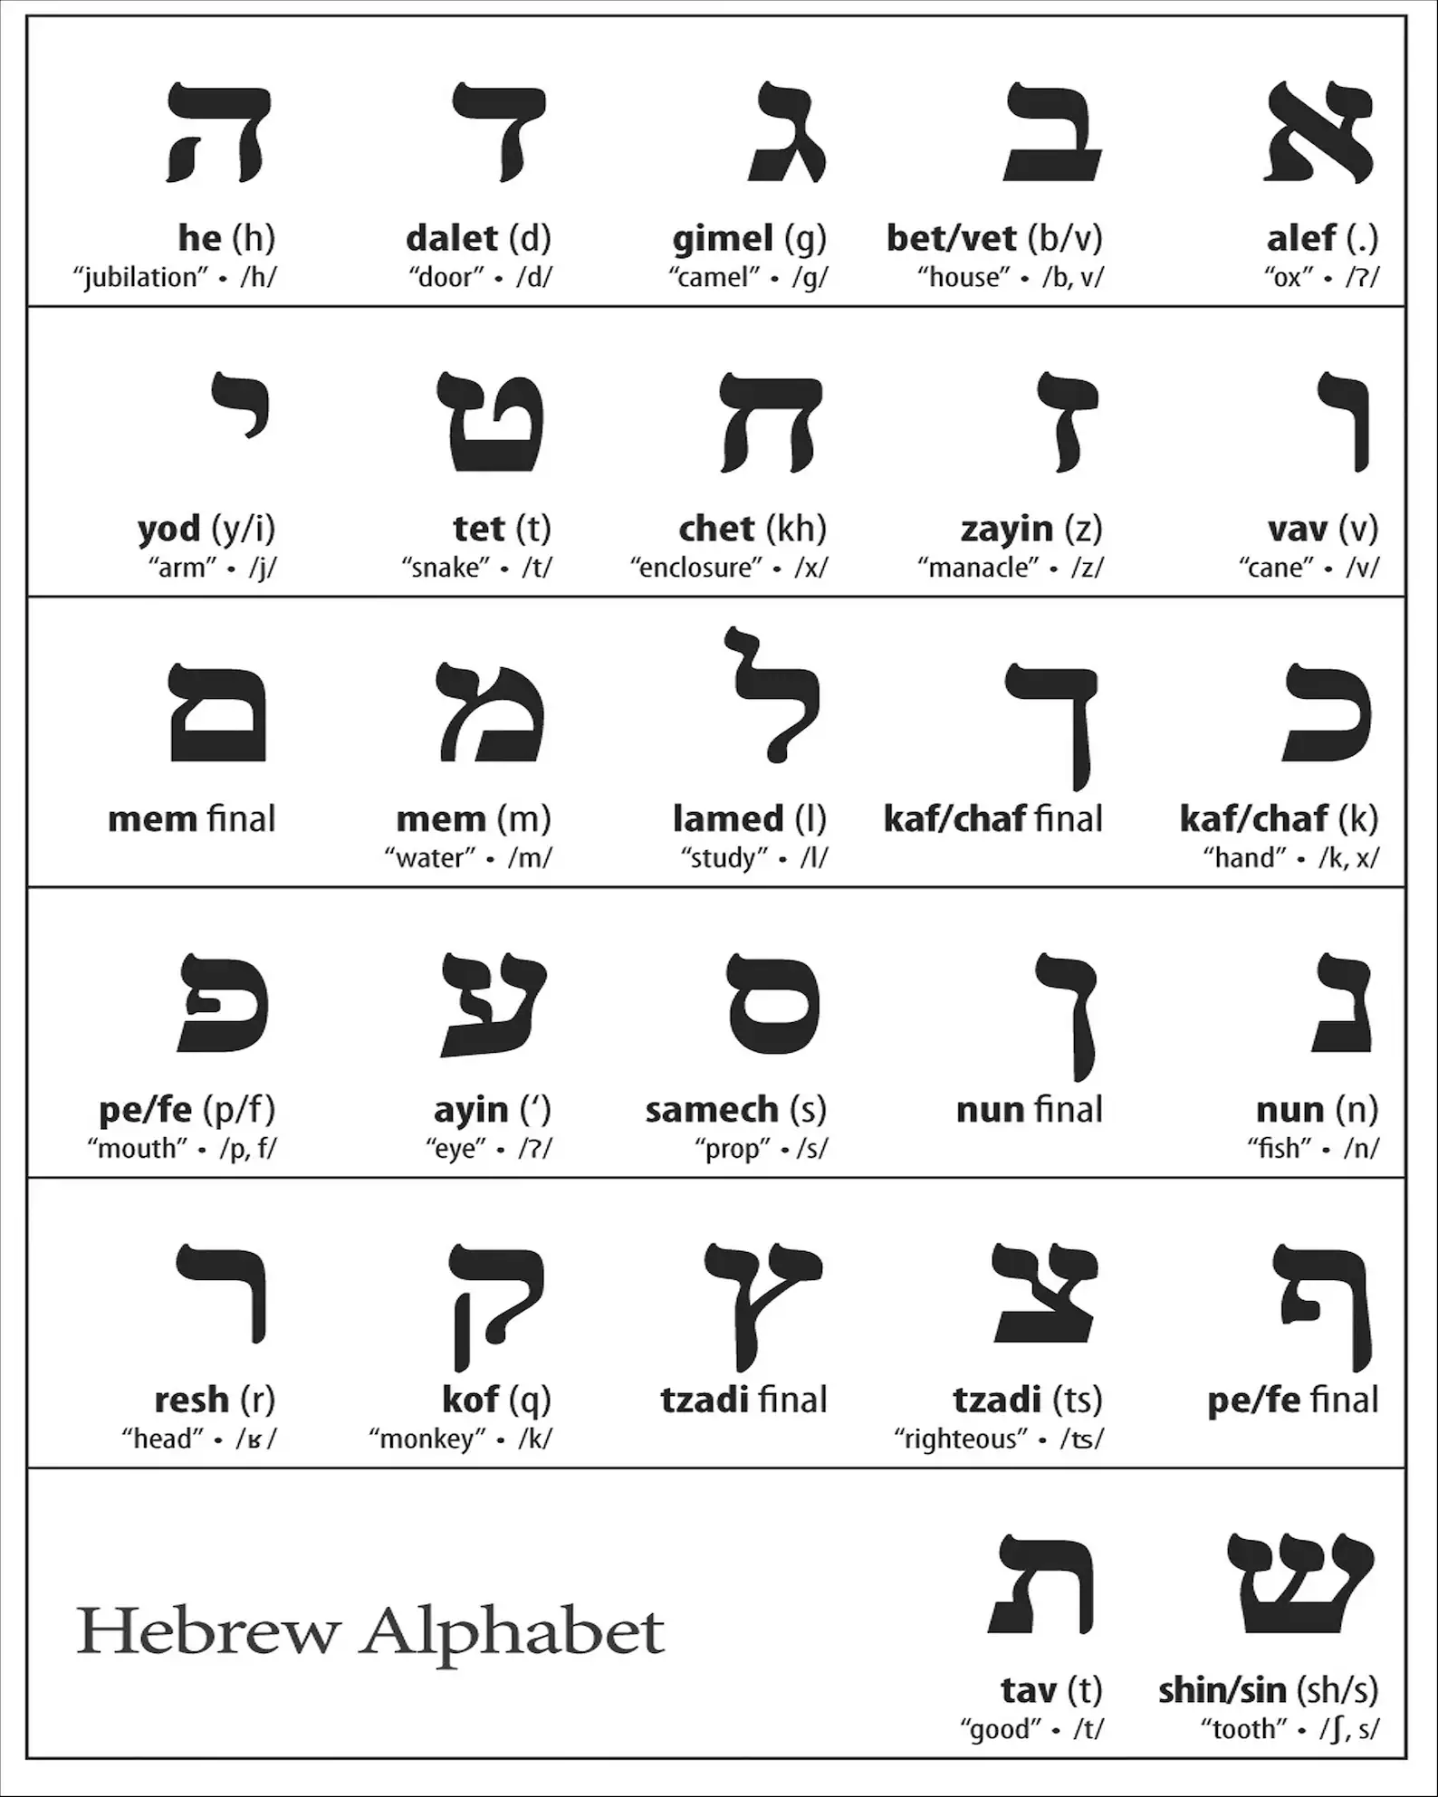
Going deeper Psalm 119
Every verse begins with the Hebrew letter
Blue letter bible.com
Click on verse
Interlinear
Hebrew word to left
Transliteration with root word

Slide 9

Psalms 119.65-72
Unifying Theme
The goodness of Yahweh, based on good intention in judgment and afflictions
Goodness of “The Most High” implies something which fulfills the purpose for which it was created. Genesis 50.20; Psalms 23.6; 34.8
Another word for covenant Numbers 10.29-30

Slide 10
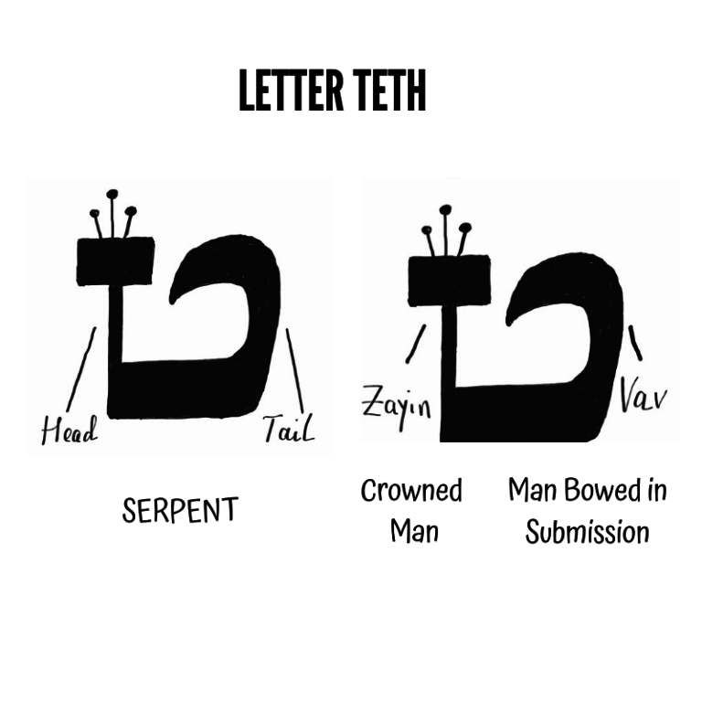
Verses 65-72 Tet
To surround, twist, entwine, encircle, ensnare, to spin, rolled together, snake, womb, basket
#9
Wrath, entrapped, judgment of man, divine perfection magnified, fruits of the Spirit, divine completeness, conclusion of a matter, last of the digits, summation of man’s work.

Slide 11
Paradoxical definition
GOOD
How does #9 parallel with TET verses
65-66 | Teachable
67-68 | Humble
69-70 | Compassionate
71-72 | Faithful
Life can turn around when we have Yahweh’s perspective
EVIL

Slide 12
Psalms 119.65-72 H2896 Tov
V65: (H2896 Tov) This is a personal testimony of God’s goodness, revered through a humble designation. The psalmist acknowledges that God owes him nothing.
“According to thy word…” He’s been cared for according to Yah’s word of promise and divine faithfulness. He received the word by faith and believed on it.
Believers must know and fellowship with Yahweh and His word without predisposition.
V66: “Teach me good judgment…” This is a prayer for what is needed to live a good life.
Our conscious is influenced by the fall, the world, our flesh and Satan. We need Yahweh’s word to live purposefully, with our destiny of eternity as our focus.
“I trust in Your mitzvot.” His faith is full. His faith is not casual belief, but a state of activity. He is no longer doing things out of routine, duty or obligation since Yah is not moved by our religious performance. Isaiah 29.13, 1 Tim1.13-14, Heb 11.1

Slide 13
Psalms 119.65-72
V67: (H2962 Terem) “Before I was afflicted…”
Affliction: Yahweh allows hardship to purify, build endurance and draw us closer to Him.
Temptation: To deceive, entice to sin and turn from Yah. God will give permission for the sake of us becoming aware and sensible of our strength.
The psalmist recognizes his affliction had come by the hand of God. Heb 5.8
Nor is he hesitant to express his sorrow but discern the affliction is working in him.
Lam 3.22-23 This verse declares Yahweh’s faithfulness. It was written in the context of severe affliction demonstrating the faithfulness of the Lord to His word.
Under his season of affliction, lessons that were learned the hard way has humbled him and caused him to be devoted to Yah.

Slide 14
Psalms 119.65-72 H2896 Tov (good)
The psalmist did not accuse Yah of acting uncharacteristic of who He is.
“Now I observe Your word.” He is satisfied and although he may not have expected affliction, it satisfies his longing. He is wanting what will cause him to be as those who hunger and thirst after righteousness Mt.5.6. as a result, he grows to love God.
His devotion will require more affliction.
V68: “You are good and You do good…”
“God’s Goodness ” This is the moral excellence of Yahweh, and its tangible blessing.
Toviel: In Hebrew, Tov means goodness, and El is a shortened form of Elohim, meaning God. Thus, Toviel can be interpreted as My God is goodness. This name encapsulates the belief in a compassionate God, highlighting the importance of divine goodness. Psalm 23.6

Slide 15
Psalms 119.65-72
V69: “Slandering” They purposed a lie, but it did not distract him (he does not have a victim mentality). Their slandering moved him to greater obedience.
We are to live in a way that proves the accuser is wrong. Ps 37.32-34, 1Thess 5.23
V70: (H2954 Tapas) Fat with grease, meaning dull, insensitive.
A heart covered with fat is a sign of unresponsiveness / indifference. Deut. 32.15-20 Jeshurun (a poetic name for Israel meaning upright even when they are acting the opposite)
Lev 3.17 Fat (Helev) Belongs of Yahweh, so human consumption amounts to theft.
Yahweh chose not the largest cut of meat, nor well muscled, but rather that which stands guard over our lives. This fat covers the vital internal organs that gives life (protects the vulnerable).

Slide 16
Psalms 119.65-72
V71: The psalmist repeats verse 67 which shows us the necessity of repetition. Yah’s word is concreted, meaning it’s literal and fact-based, not abstract. It is hemmed in our spirit. Heb 12.5, Job 5.17-18
“So, I would learn Your laws”. God’s laws are for us to grow in a love relationship with Him and others.
To know and learn of God’s laws will allow the psalmist to give himself to obedience which should be the natural response to God’s goodness.
V72: (Better = good) Truth is precious and should be seen as valuable.
Whatever we value it does not compare or carry the same breadth (extensiveness, scope, coverage, etc.) of God’s word.

Slide 17

Quick overview

Slide 18
Passion of a well cared for servant
V66: He has a passion to learn God’s word.
Prayer for Divine instructions
Request for spiritual discernment
Request for sound doctrine
He begins with a request and ends with the reason for the request.
The character of the Teacher adds strength to the validity of the instructions
V67: Passion to live the word of God
Not willful rebellion, it is his sin nature
In affluence, he went astray shows the dangers of prosperity
In affliction, he kept the word of God, displays the benefits of adversity.

Slide 19

Perspective of a well cared for servant
V68: Affirmation of God’s good character God’s nature is good and His ways are good
Deuteronomy 32.4-6
Isaiah 30.18
Psalms 34.9(8); 89.14
John 3.16
Ephesians 2.4-5
James 1.17
1 John 3.1; 4.8-10

