Slide 1
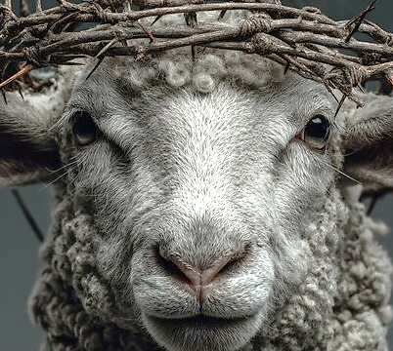
Revelation 5.13b
To the One sitting on the Throne and to the Lamb
Belong praise, honor, glory and power forever and ever.
AMEN

Slide 2
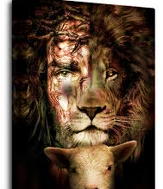
Declaration
Bless the Lamb Who was slaughtered for me,
El Melech Ne’eman
The Lord is a faithful God & King!

Slide 3
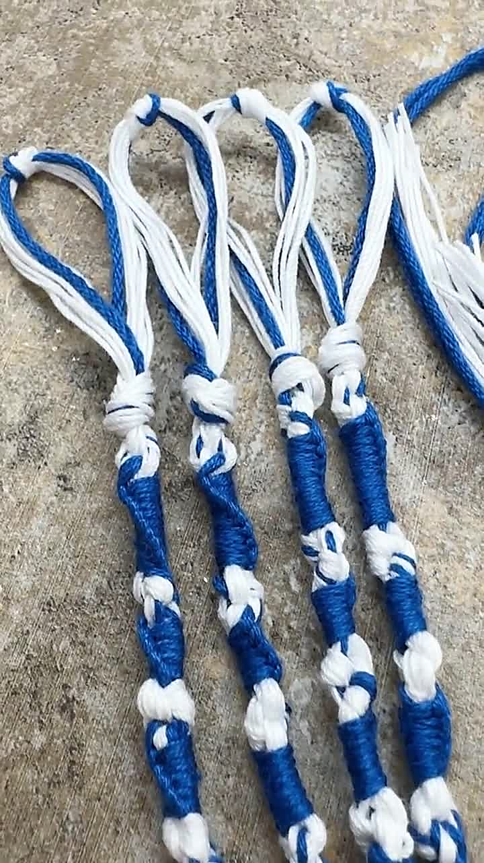
5786 Sivan A time of joy, harvest & spiritual purpose
Taking hold of Yahweh’s instruction and claiming our identity.
We are to connect & align with Hashem’s spiritual purposes, applying them to our lives and therefore bringing fullness into us. Ja 2.23, Ro 12.2, Jn.1.12
Letter: Zayin, means weapon, sword or crown, sustenance or nourishment
TRIBE: Zebulun, who harvested Chilazon an aquatic creature that creates the blue dye used for coloring the blue tassels on the tallit. The tribe of Zebulun had the anointing for abundance and locating hidden treasure.
Numbers 15.38 “Dyeing to be Holy”

Slide 4
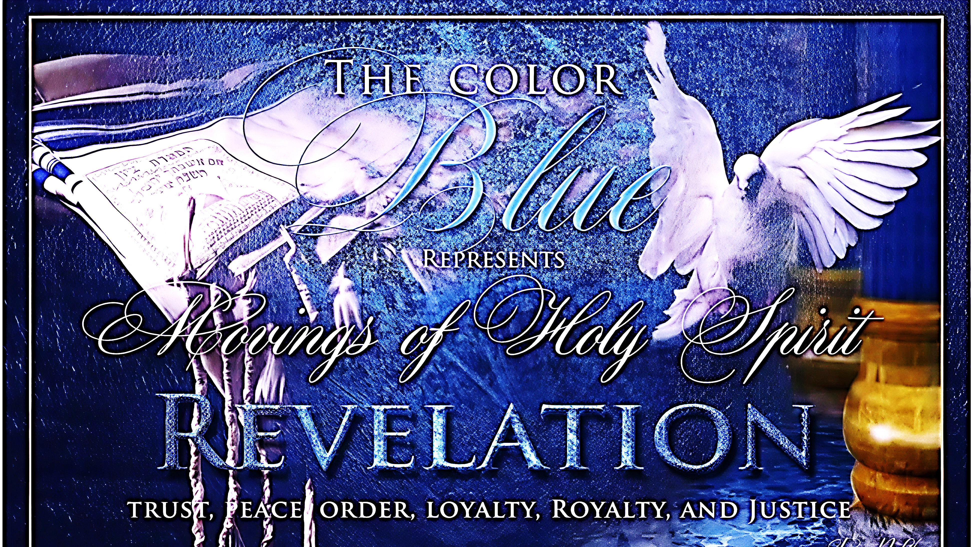

Slide 5
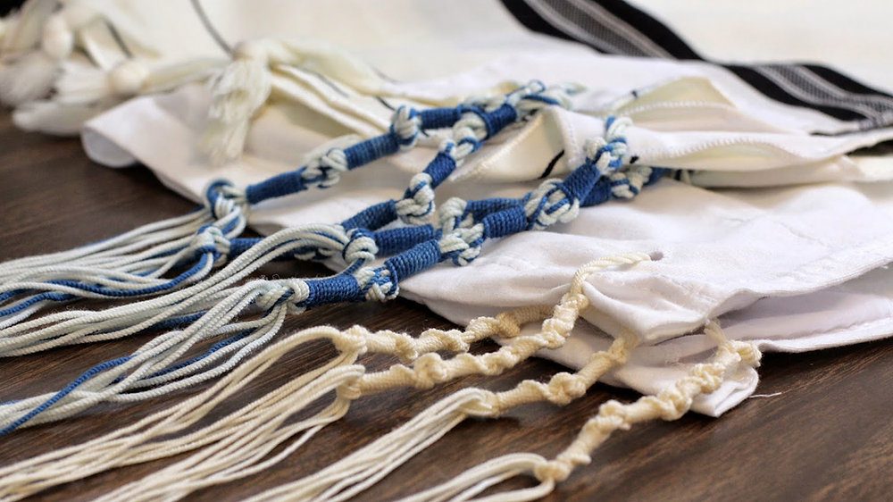
Prepared & Ready to Receive
Wait on Hashem, be present to receive Hashem’s instructions
1
Acknowledge Hashem’s in all ways live in a place of wholeness and completion
2
Embrace the word of Yah as spiritual sword that nourishes and give you assignment
3

Slide 6

Prepared & Ready to Receive
Like Zebulun answer Hashem’s call to battle, worship and live generously
Place your feet under the Kings table at Shavuot and receive His instructions for next season
Bring an offering to Yahweh giving with expectation

Slide 7
Why are we studying psalms 119?
Demonstrate the power of prayer & prophetic nature
To enhance your communication with the Father
Teach us how to search and seek Him diligently, which is not done haphazardly or halfheartedly, but requires earnest, persistent and constant effort Hebrews 11.6, Matthew 7.7
Make preparation for weightier things to come.
To examine yourself
Does humility saturate your character. Pro 22.4
Are you conscious of the affect of an undisciplined tongue.
What does it have to do with me?
I don’t understand
We should be learning about…
I don’t see myself in any of this!

Slide 8
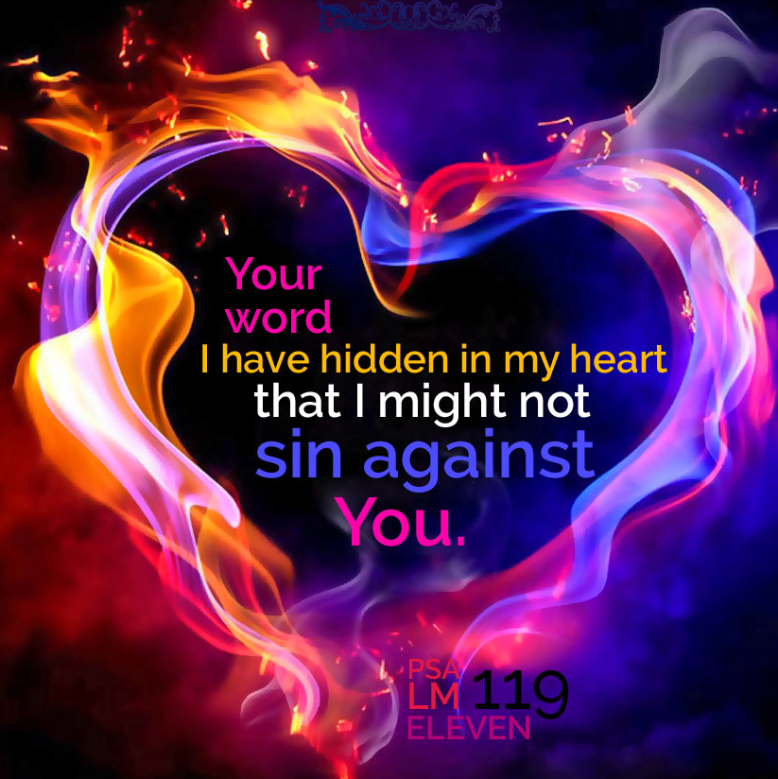
Psalm 119 showcase a structured and intentional composition that forces us to examine our desire for Hashem.

Slide 9
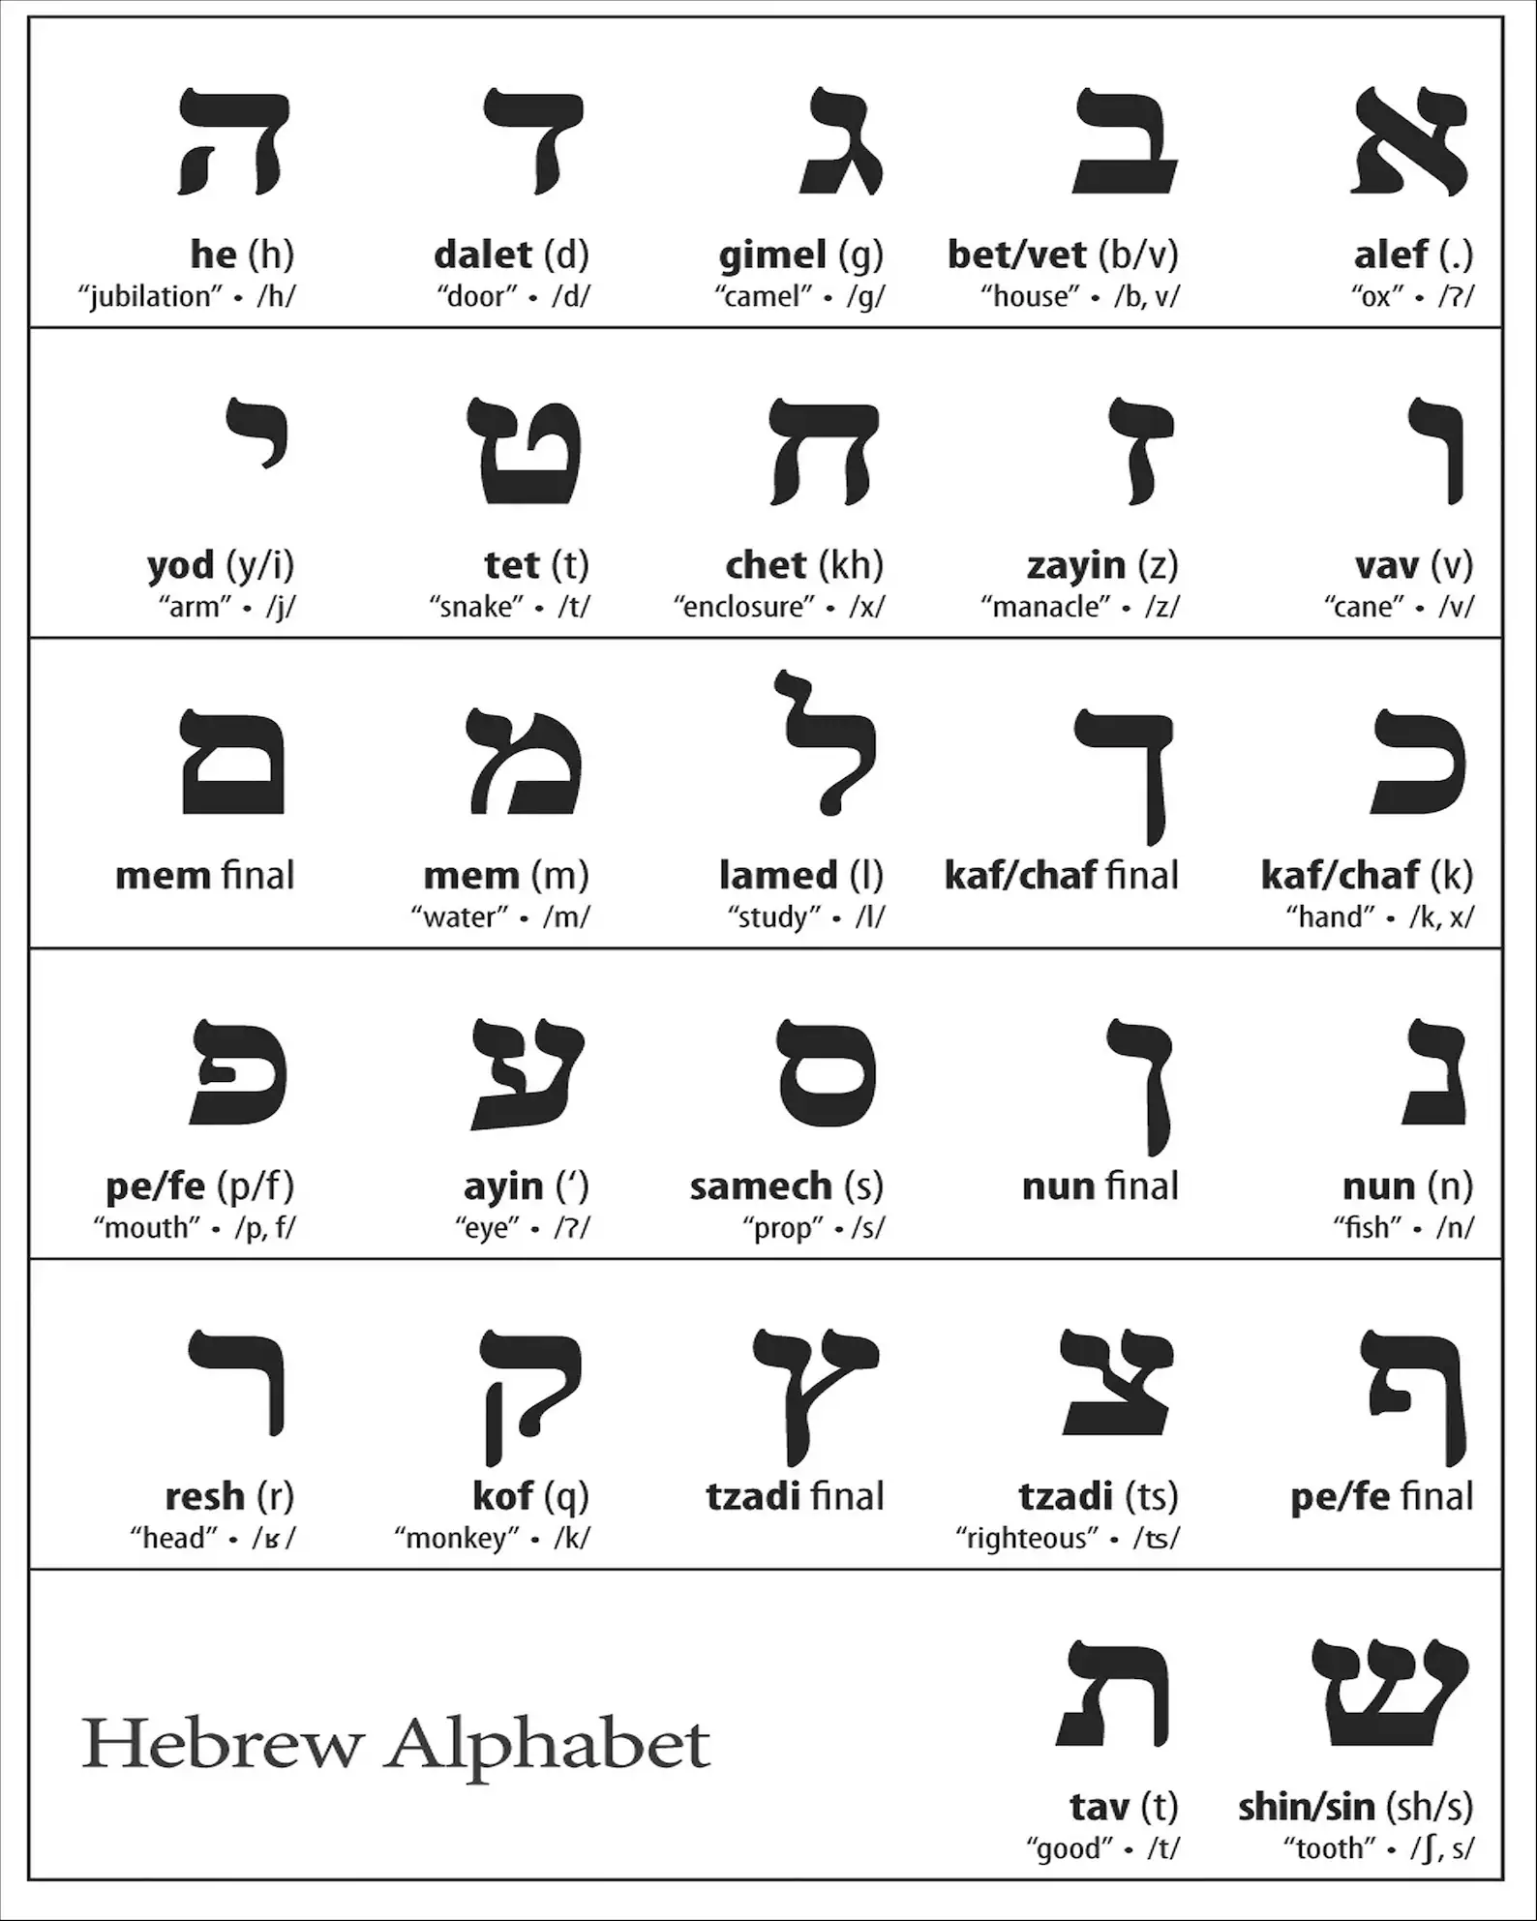
Going deeper Psalm 119
Every verse begins with the Hebrew letter
Blue letter bible.com
Click on verse
Interlinear
Hebrew word to left
Transliteration with root word

Slide 10
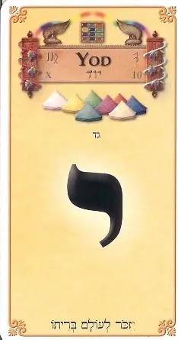
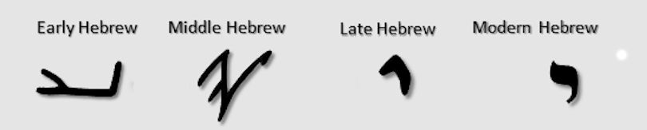
Psalms 119.73-80
To work, a mighty deed, a deed accomplished, to make, arm and hand accomplishing a purpose

Slide 11
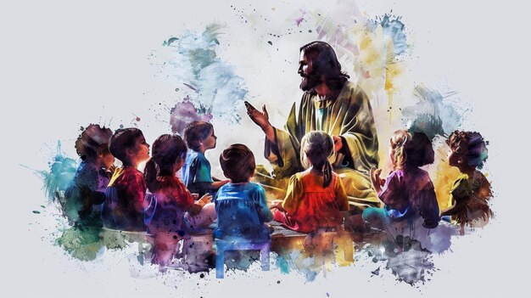
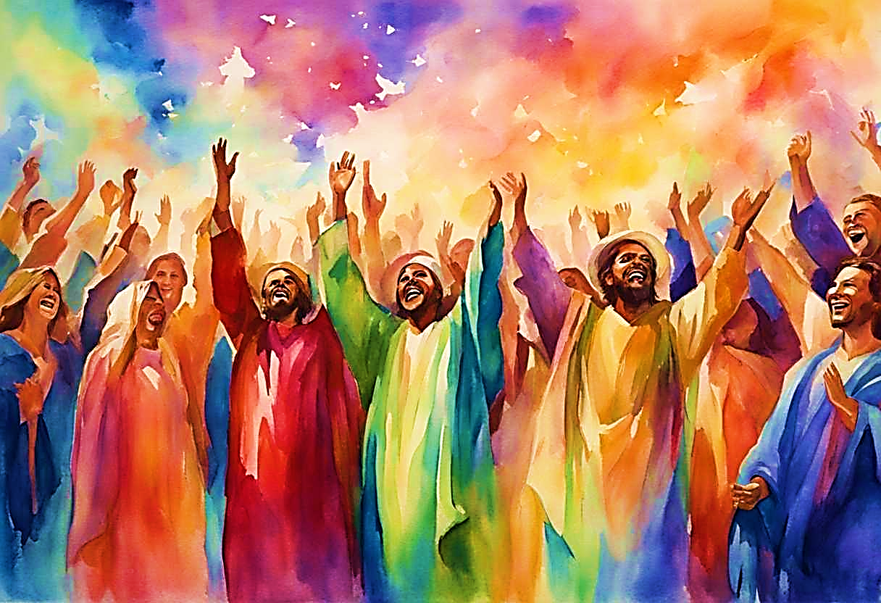
Psalm
119.73-80
Restore
to state of innocence

Slide 12
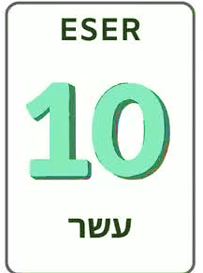
Yud
Psalm 119. 73-80
Perfection of Divine order, completeness of order, testimony, the Laws, Ten Statements, responsibility, divinely ordered events, ordinal perfection

Slide 13
Psalms 119.73-80 Yud #10
V73: (H3027 Yadeka) “Thy hands” David acknowledges God the Creator has intricately designed and shaped every aspect of his being. John 1.3-4, Col 1.15-17
The understanding that God is his Creator is grounded in the belief that God has intentionally formed him and he has obligated himself to complete that formation through wisdom and mercy.
He makes a plea to understand Yah’s word. This reflects a deep desire for wisdom to navigate life’s complexities.
We need to remember the One Who made us.
V74: (H3373 Yare) “They that fear You” We see the rippling effects of one’s faithfulness. His un-wavered hope in Yahweh’s word not only sustains him but becomes a beacon of encouragement for those who fear Yahweh.

Slide 14

Psalms 119.73-80
Others should find spiritual hope as well as encouragement in our presence because of our shared beliefs. Pro 23.15-16, Act 28.15, 1 Th 3.6, 3John 1.3-4
Interconnectedness within the community is reminiscent of Heb 10.24 & Ph 2.15-16
There are many examples of the joy of community in God’s word. Ac 28.15, 1 Th 3.6, 3 Jn 1.3-4, Ro 1.8, Ps 133.1
Galatians 3.28 Our joy of unity begins with God.
The Word of God reveals a universe designed for interconnectedness. Our world is a divine tapestry where every thread, every person, every part of creation, is intricately linked, reflecting the very nature of our relational God.
This is not just a philosophical idea; it is a spiritual reality, fundamental to understanding who God is, who we are, and how we are called to live.

Slide 15
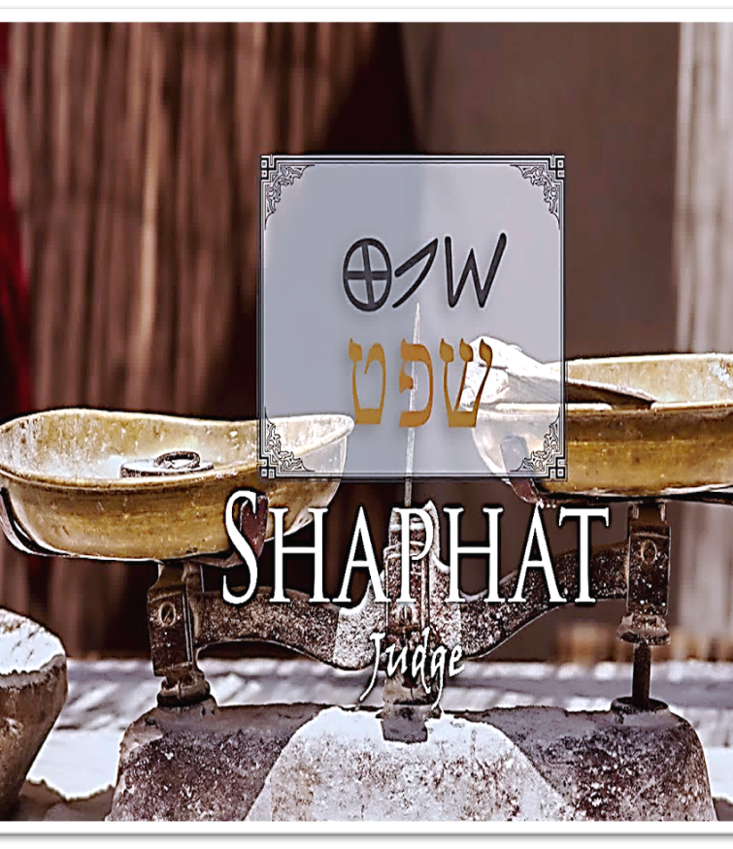
Psalms 119:73-80 Yud #10
V75: (H3045 Yada) “I know…” Yahweh is just and upright in purpose.
H8199 Sha-phat to judge, govern, decide, defend and deliver (Isaiah 33.22)
Decides Psalms 94.14,15
Defends: Romans 8.1
Delivers: Psalms 32.2; 7
Disciplines: Hebrews 12.6
Isaiah 30.18 centers on the idea of exercising judgment in every sphere of Israel’s life; legal, military and prophetic.

Slide 16
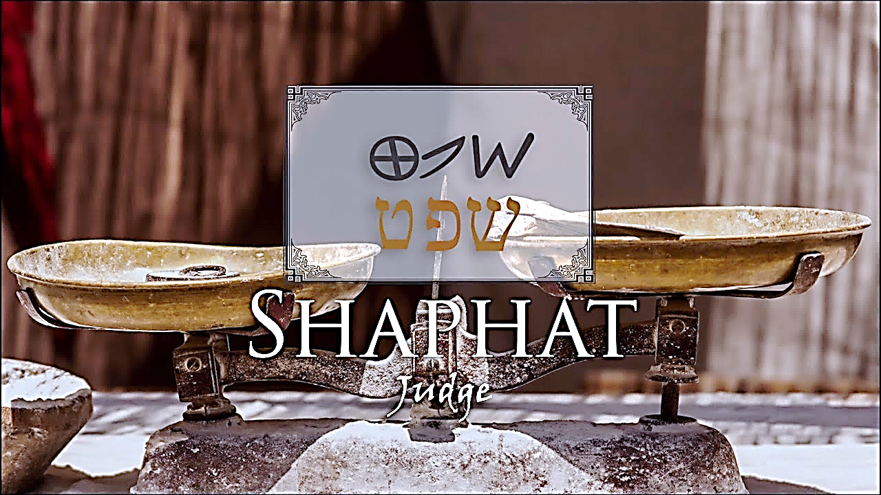
Judge (Shaphat)
The love of Yahweh (Shaphat) flows from His heart in every judgment.
His pronouncements are permanent that can alter the course of our lives if we would receive and believe.

Slide 17
Psalms 119:73-80 Yud #10
V76 (H1961 Haya) “Let…” The word of the Lord is a comfort for all and becomes a lifeline in times of distress Psalm 23.4, 2 Co 1.3-4
“In keeping with Your promise to Your servant.” 1 Kings 8.56
Yah’s promises are based upon His unchangeable nature.
Do not let go of Yah’s promises or prophecies. He has spoken through His Servant (Amen Rev 3.14) His word, including His promise, Rhema cannot fail 2 Co 1.20-22
Yahweh’s Promises
Equips you for every battle
Gives hope to every situation
Our stewardship of Yah’s promise
See our situation through the lens of Yah’s promises (Complaining delayed Israel entrance to the Promise Land)
Be persistent in hope & expectations (unlock breakthrough)

Slide 18
Psalms 119:73-80 yud #10
V77: (H935 Ybo) “Let come unto me…” Tender mercies are found in Adonai’s word.
Finding delight in God’s law amidst adversity reflects a deep-rooted joy that transcends circumstances Ps 1.2, Lam 3.22-23
Yahweh exist beyond the entire universe, independent, self-existent One, El Shaddai, Who He is.
Yahweh enables us to live in Him and cause us to exist beyond by stepping into the eighth day of existence. The mystery of Shemini Atzeret- what comes after the end is the last of the appointed holy days. Lev 23.36
The Book of Joshua is when the wilderness journey ends, then they cross over to Jordan into the Promise Land.
8th Day the number that transcends, breaks out of time-when creation ends, we will enter it.

Slide 19
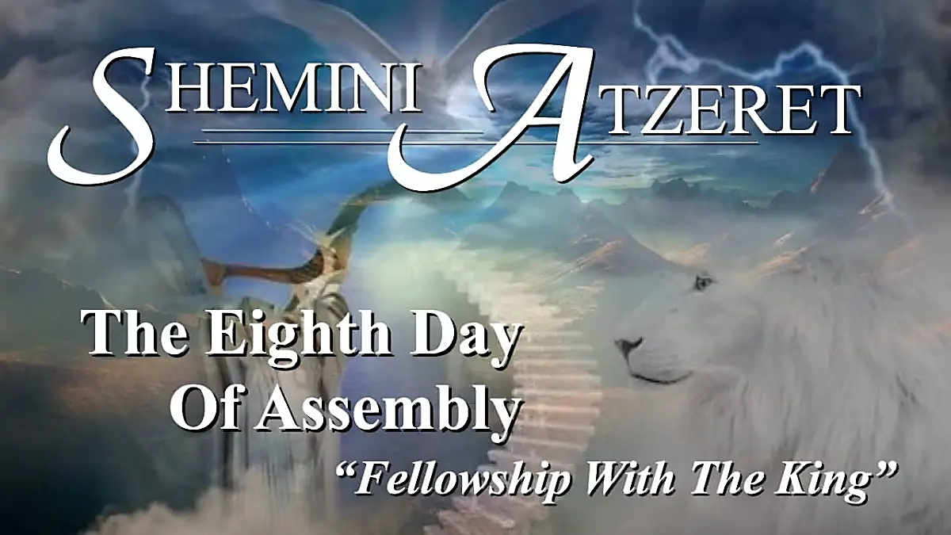
Mystery of the eighth day
We can live beyond our circumstances, beyond the world, beyond flesh, beyond the finite.
The realm of the heavenly.
We are children of our Father, children of the 8th day.

Slide 20
Psalms 119.73-80 yud #10
V78: (H954 Yebosu) “Let be ashamed…” Many will be brought to shame who hold contempt for Yah’s word and His people. Psalm 73.6
“Lies…” Just as the psalmist we are to focus and meditate (commune, ponder, sing) on Yah’s word and not become our own defense. Trusting in Yah’s sovereignty not holding to the abomination of vengeance which belongs to God. Romans 12.19
Chapter 41 of Job speaks about Leviathan who has a proud spirit (vs. 12-14 or 4-6 KJ)
Ga’av H136 meaning haughtiness, arrogancy, proud, swelling.
Lord God, we bind Leviathan and all the proud spirits arrayed against our lives. In the matchless name of Yeshua HaMashiach.

Slide 21
Psalms 119:73-80 yud #10
V79: (H7725 Yasubu) “Let turn…”
Even when I have sinned and caused the God-fearing people to shun me because I may have sinned; making myself unfit to serve. May those who fear You and who know Your precepts, turn to me and again draw near to me.
Return their confidence in me when they see that I am not forsaken, I’m a recipient of Your tender mercy.
God humbles and He also exalt according to His word. 1 Peter 5.5b-6
It can be easily said that God’s judgments are true, until it comes to us. We are to have the same compassion when it comes to others and bring joy to their affliction or trial.
Each of us should desire to be a guiding light for those who fear the Lord, leading them to deeper understanding of Yah’s compassion and mercy.

Slide 22
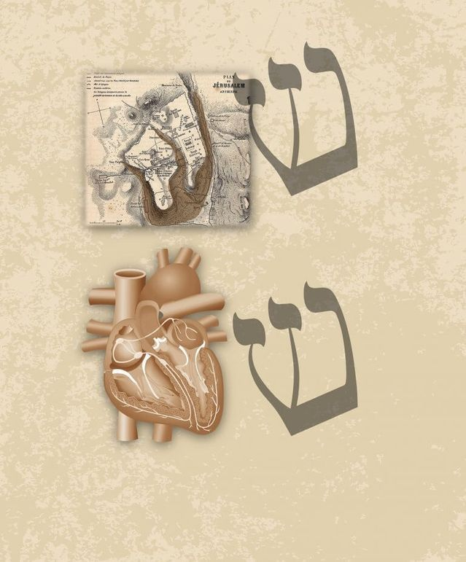

Psalms 119:73-80 yud #10
V80: (H1961 Yhi) “Let be…”
The psalmist want his heart to be blameless, sound, complete, wholesome and unimpaired.
He may conduct himself with complete integrity, virtue not straying away for Yahweh’s path.
Each of us should desire for Yahweh to imprint His word on our hearts, so there is no difference between our God and us. Receive it!

