Slide 1
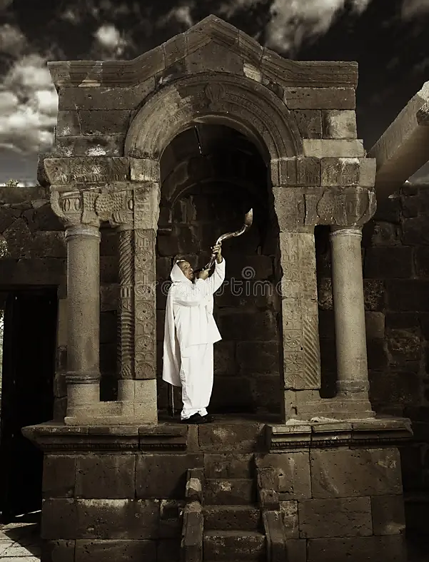
Revelation 19.5a
“Praise our god, all you his servants, you who fear him, small and great!”

Slide 2
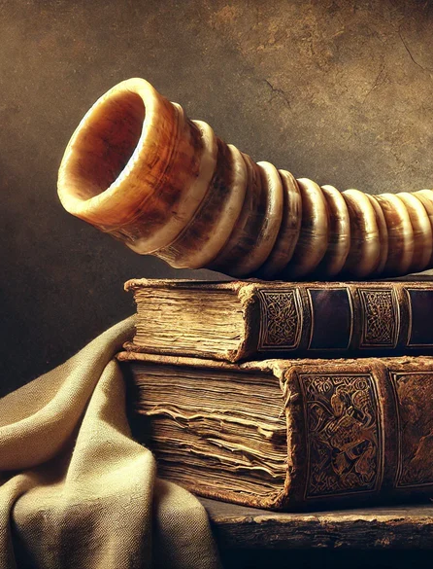
Declaration
“You are worthy, Adonai Eloheinu, to have glory, honor and power, because You created all things, yes, because, of Your will they were created and came into being!”

Slide 3
Month of Tammuz
Ezekiel (8.14) speaks of idolatry in the temple and names the idol as a parasite that lives off our human tendency.
A cult life of tragedy is a shallow approach to life’s true sorrow or pain.
This is done when trust and faith in Yah’s goodness and lovingkindness has been cast away.
Associated with sight (Hab 2.2) vision, revelation purpose (open & closed doors)
In Aramaic Tammuz means heating, like a furnace
Named after a false prophet that was tortured to death. A statue was resurrected as an idol.

Slide 4
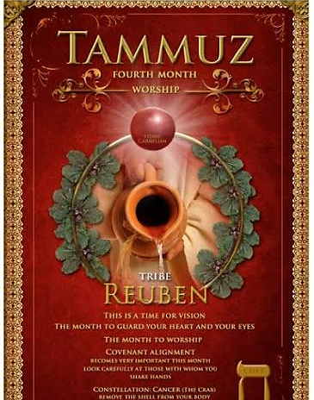
Anniversary of the sin of the Golden calf
Spying out the land (Joshua & Caleb of a different spirit)
Commemorates the destruction of the Holy Temples. Tisha B’av
17th A fast day in remembrance of the walls of Jerusalem being breached by Romans.

Slide 5
Tammuz & Reuben Mandrake & Water
Gen 30.14-16 “Mandrake” symbolize desire for fertility, love, seeking fertility without asking God.
Jacob’s wives bartered for relational & sexual intimacy which should not be so grossly traded.
Gen 49.4 Jacob’s prophecy describes his son as volatile as water. His character was fluid like water which indicates his arousal inclination 1Ch 5.1-2
Parallels creation: as water was the beginning of creation and gave birth to everything else, as it would be with the firstborn son who preserves and continues the family name. Judah is given the honor of leadership and prominence (Gen 49.8-10) while Joseph’s sons were given economic advantage.

Slide 6
Associated with sight (Seer) vision, dreams and revelation (purpose).
A month to guard your heart and your eyes. “What you see, is what you say and what you say is how you feel” Pro 4.23
With eyes of faith - cling and align with God’s covenant and care

Slide 7
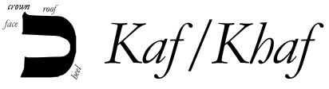
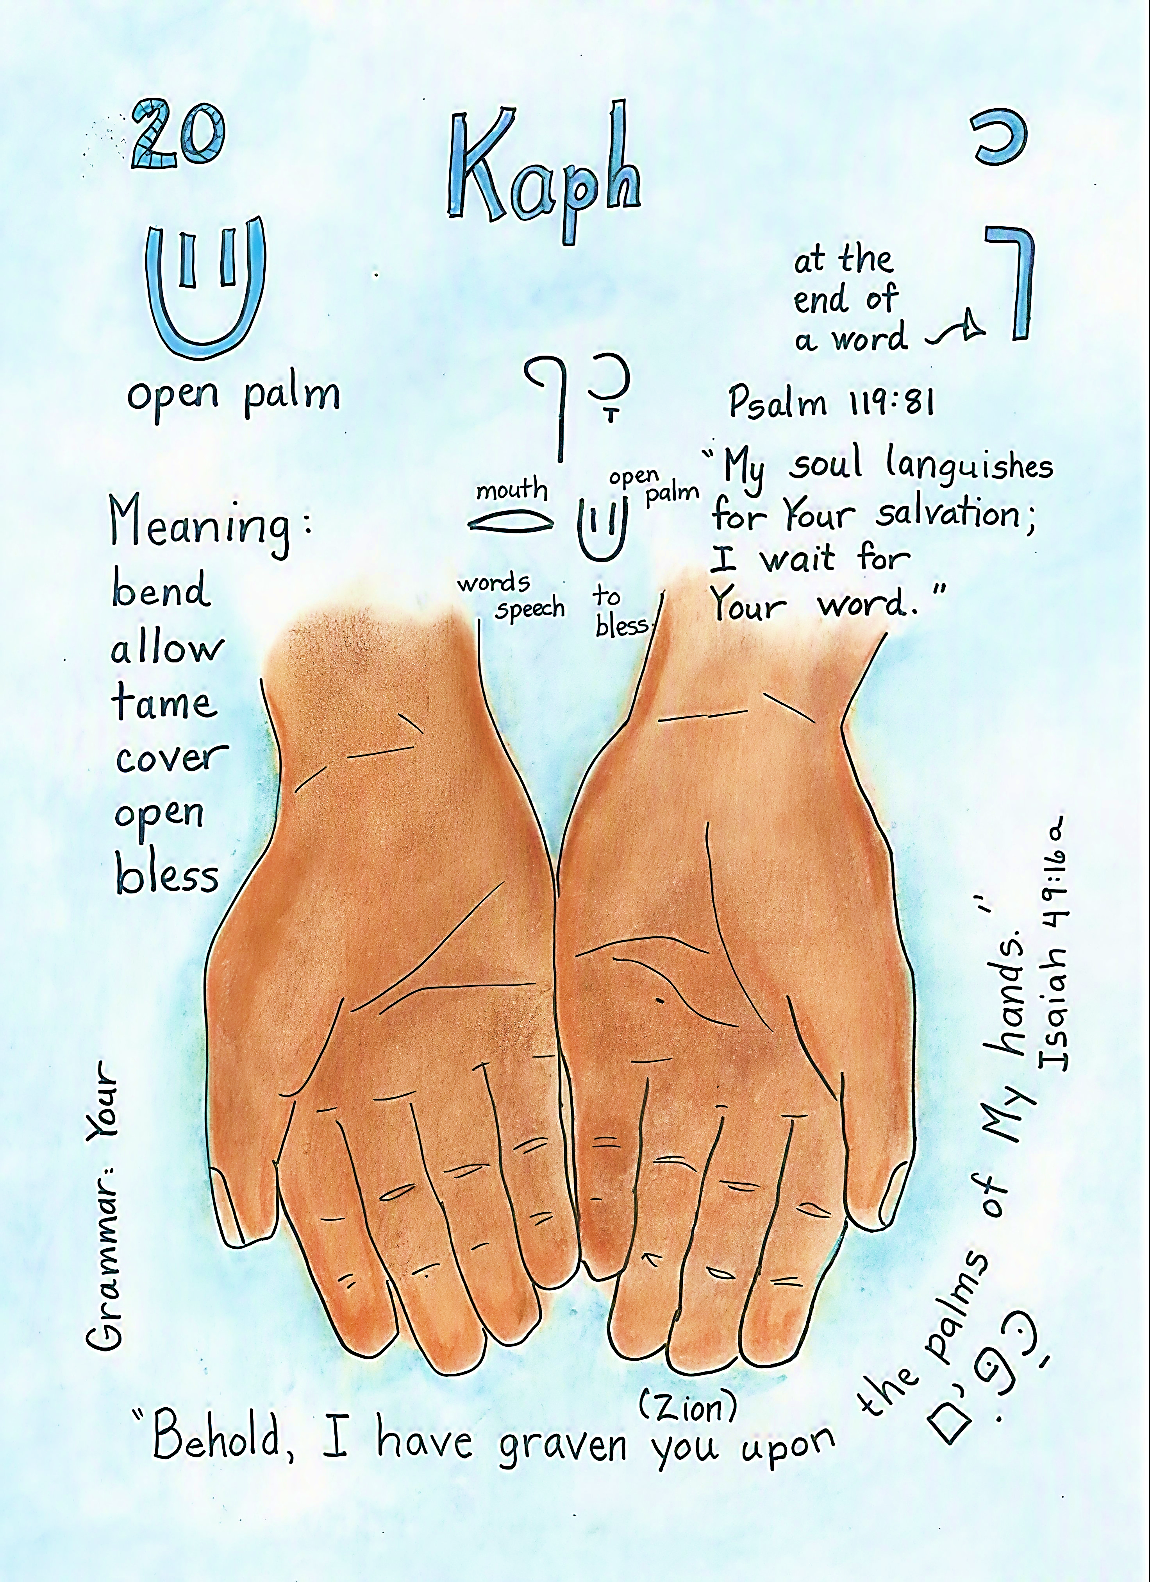
Palm of hand: implying productivity & potential actualizing Exodus 4.3-4 This is what Adonai has given you.
To cover, to open, to allow atonement. Isaiah 49.16, 1John 2.2 Ro 3.25
Associated with Priestly blessing representing generosity and giving

Slide 8
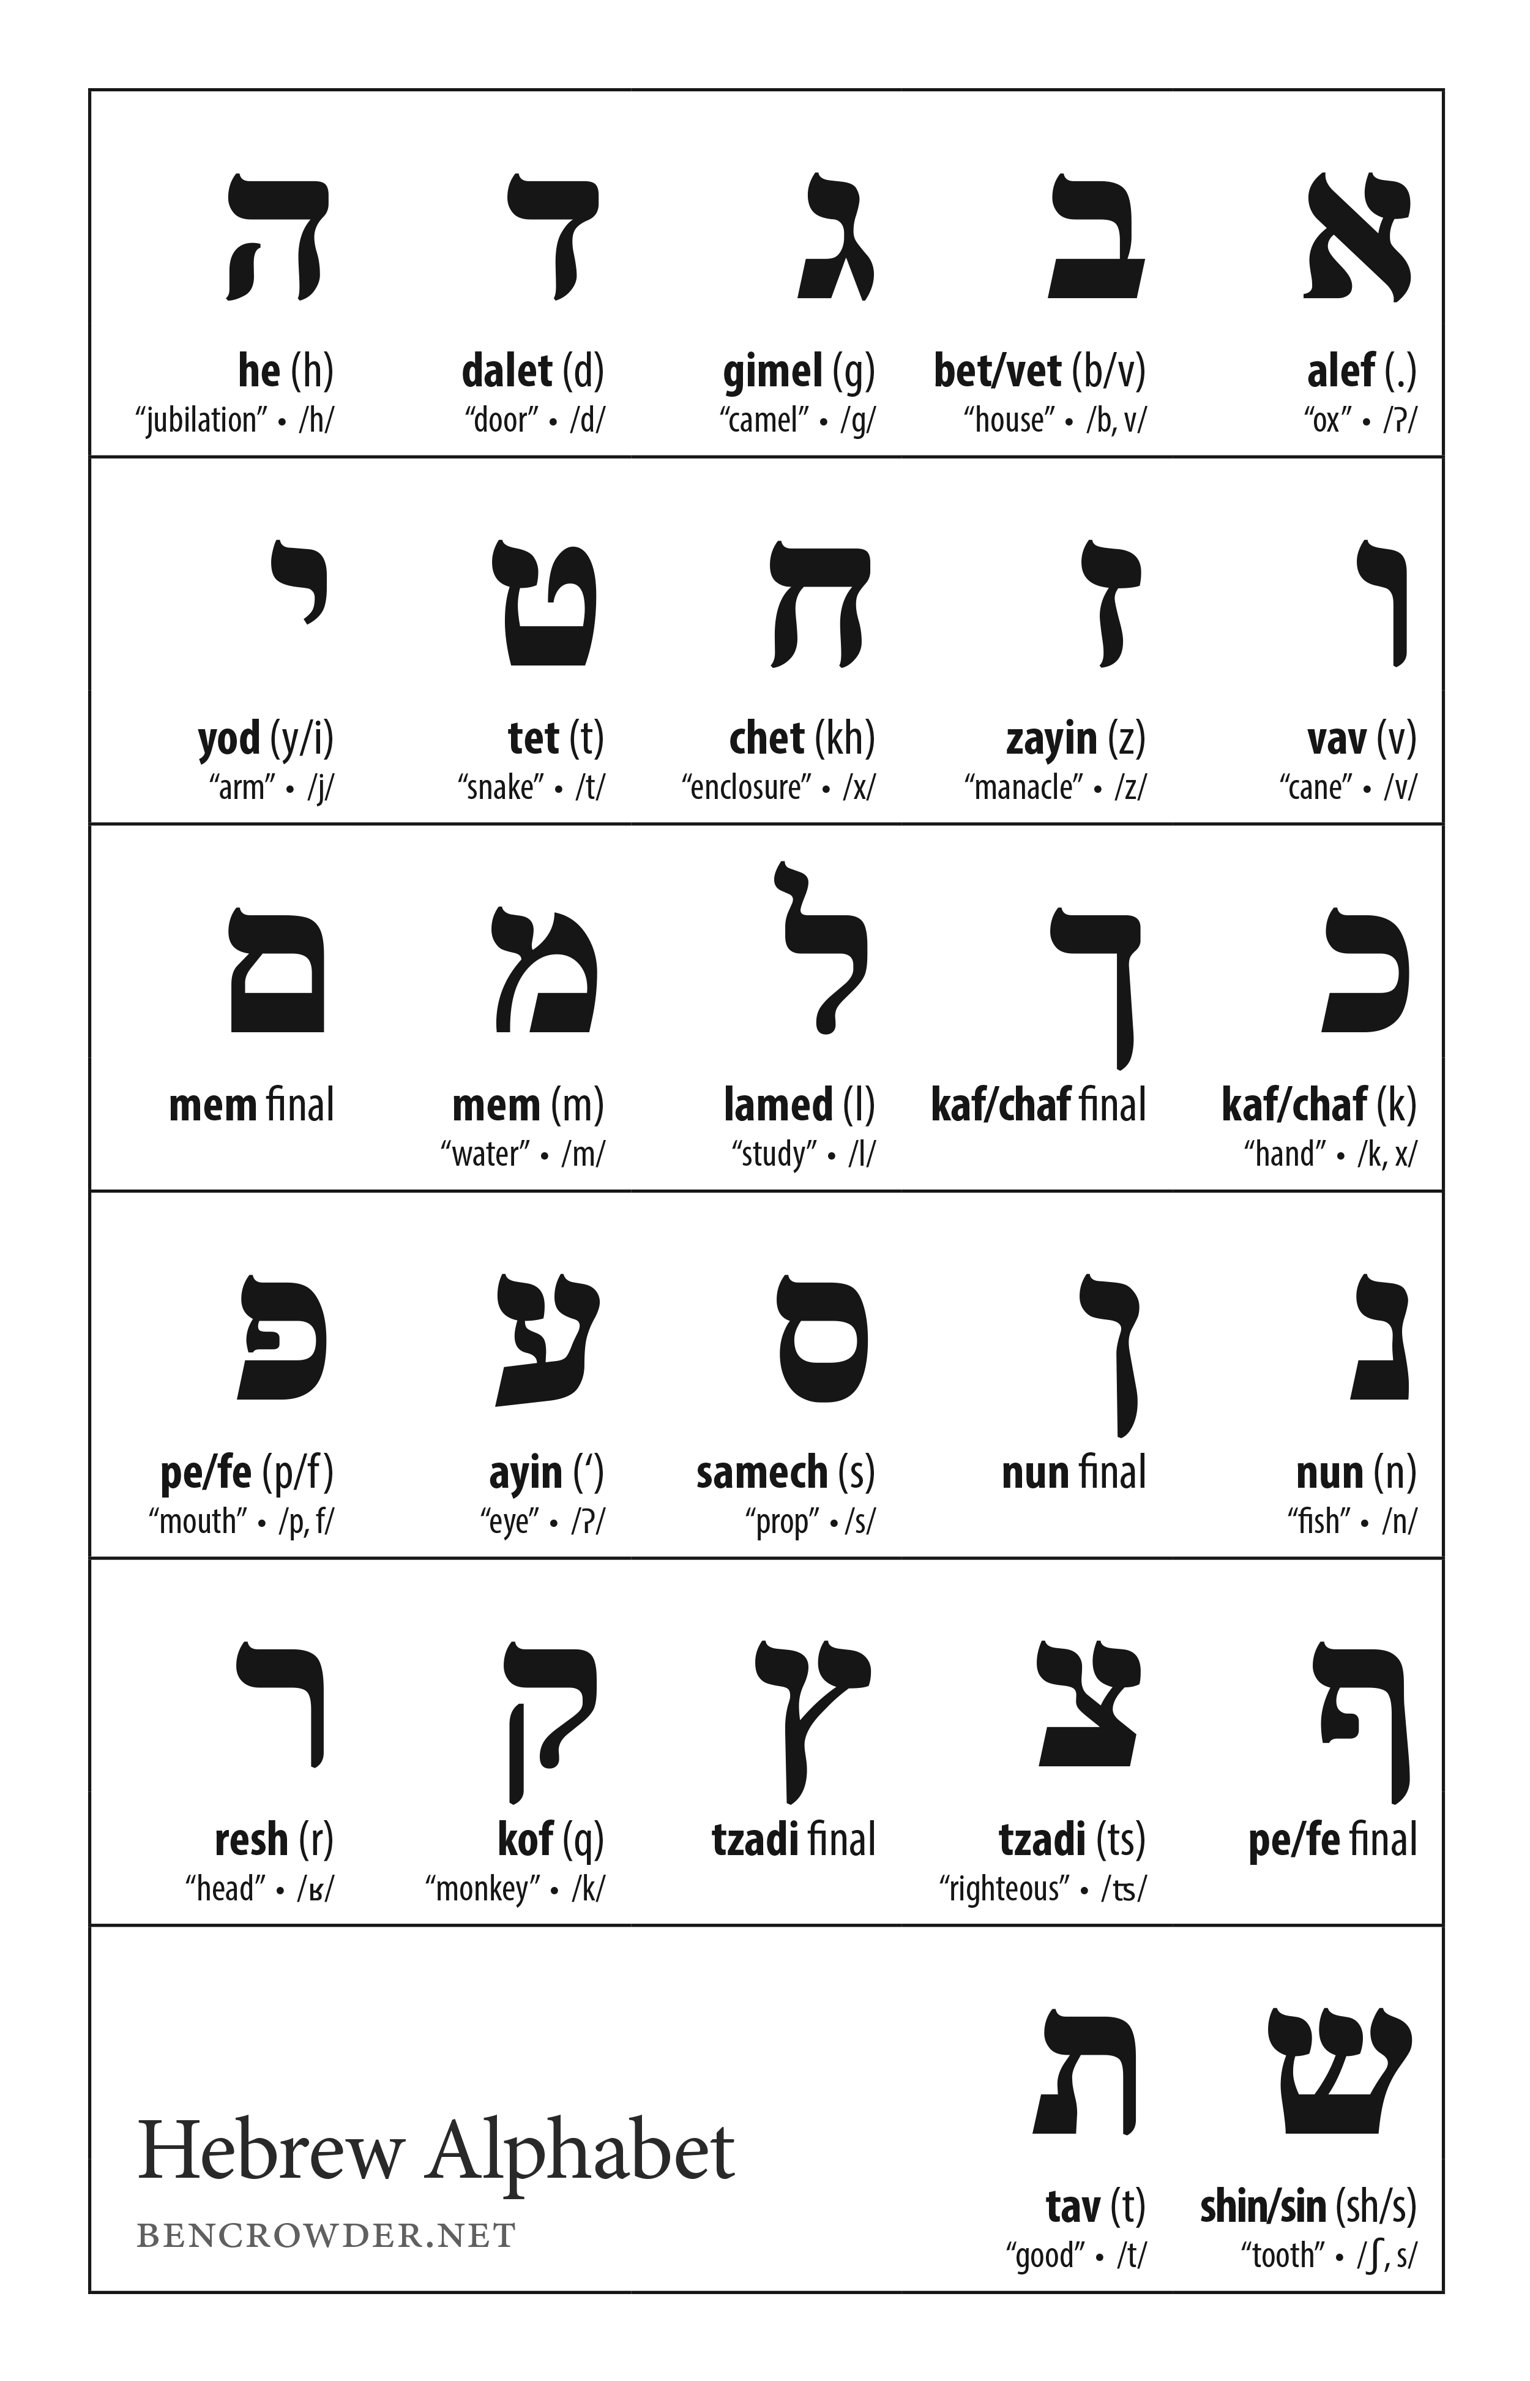
Kaf ends the first sequence of letters:
1st RESCUE: Yeshua’s atonement
2nd RACE/WALK: Our need to persevere to the end in faith
Kaf comes after Yud which represent Yeshua’s two hands
Yud = hand
Kaf = open hand (atonement, righteousness imparted to us.

Slide 9
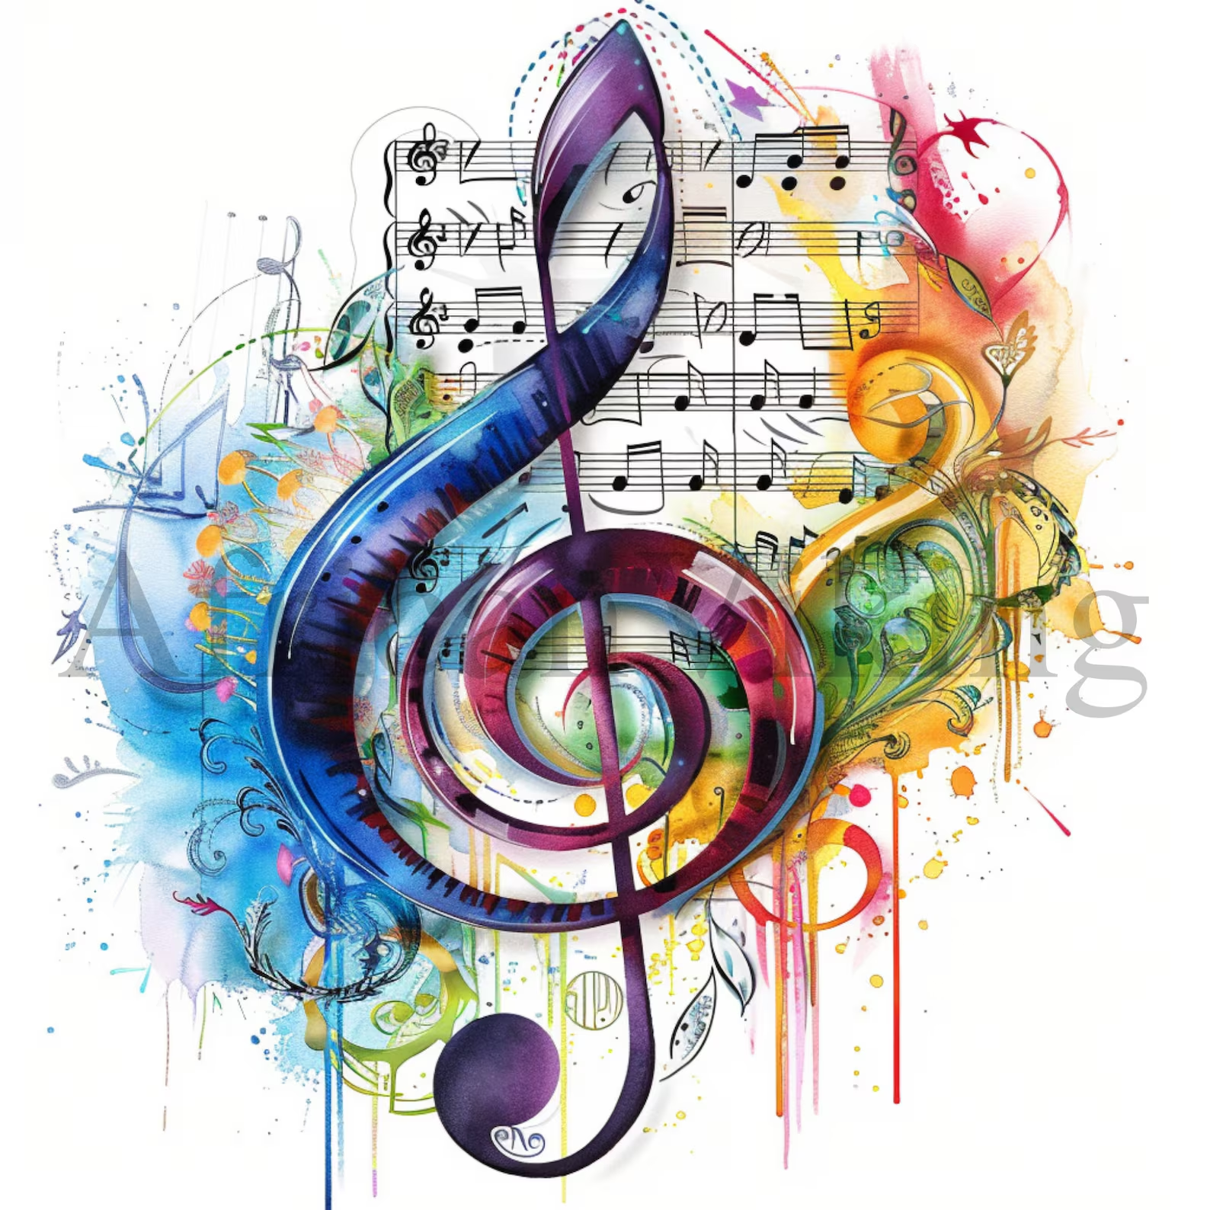
Why are there Hebrew letters before the stanza?
The Hebrew letter serves as a mnemonic aid (assist in memory, helps in memorization and understanding of the content).
The letter is not just a linguistic feature by symbol. But it brings completeness and order that represents the comprehensive nature of Yahweh.

Slide 10
# 11
Achat Esreh
1 10
Judgment, disorder, deliberate manifestation of chaos and disorganization, imperfection, subversion of an order to bring about confusion, consequences of deliberate rebellion against Yah’s authority.
After the number 10

Slide 11
Psalm 119.81-88
V82: (H3615 Kala) Faint “My eyes fail…” He diligently studied Yah’s word. When confronted with despair or personal need, it is a motivation for study.
Spurgeon quote:
God’s timing for comforting?
When we put away unbelief
When we have finished complaining
Put away sin we have tolerated
Fulfill what we have neglected
V81(H3615 Kalta) “Faint to know Your salvation…” The psalmist has a deep craving for the fullness of salvation, that covers his total well-being (body, soul, spirit)
Eph 1.17 Intimate knowledge
The emotional toll of waiting for deliverance is not lost, for there is steadfast confidence in God’s character and salvation 2Co 4.8-9, 1Thess 1.3

Slide 12
Psalm 119.81-88
V84: (H4100 Kamma) “How long” He asks not due to lack of faith but feeling as if his days are short, feeling the weight of oppression, he asks for divine judgment and how long…?
The request indicates a belief that God’s ways are righteous and ultimately will bring resolution to every injustice.
Notice that this is the only verse that does not mention God’s word
V83: (H3588 Ki) “I shriveled” He likens his condition to an old dried out container, exposed to harsh conditions, dry and weary. “As smoke” flies away but is not burned up. Yet no loss of memory for God’s command
He has unwavering devotion & perseverance no matter how uncomfortable or prolonged the refiner's fire.

Slide 13
Psalm 119.81-88
V86: (H3605 Kal) “All…show Your faithfulness” He sees the contrast of men’s unfaithfulness verses the faithfulness and refuge in God’s commandments. His ineloquent groans of “help me” is grounded in knowing that any thing else is insufficient, only Yahweh, Ebenezer – our stone of help can rescue.
1Sam 7.12 tells us that we are to keep our ears and heart open, willing to receive what goodness and grace God has for us.
V85: (H3738 Karu) “Have dug” The psalmist is being hunted as if he were an animal (Ex 21.33) by men who are in opposition of God’s principals.
Hostility often rises from those who refuse to align themselves with the holiness of God, attempting to ensnare the faithful. Matthew 5.10-12

Slide 14
Psalm 119.81-88
V88: (H2617 Khasdka) “In keeping with Your grace…” The psalmist is saying that he doesn’t necessarily deserve Yah’s lovingkindness but ask for that which accords to His word.
David’s trust is in Yahweh not what God would do for him.
“Revive” The purpose for revival is to heighten his faithfulness and obedience not for carnal excitement.
V87: (H4592 Kim’at) “Almost made an end…” The psalmist reveals how close he came to ruin.
God sets a limit to how long and when the enemy will attack Lu 22.53, Job 1.12; 2.6, 2Thess 2.6-7, Ps 91.2-4
Nothing would cause the psalmist to forsake God’s work and word 2Co. 11.23-29

