Slide 1
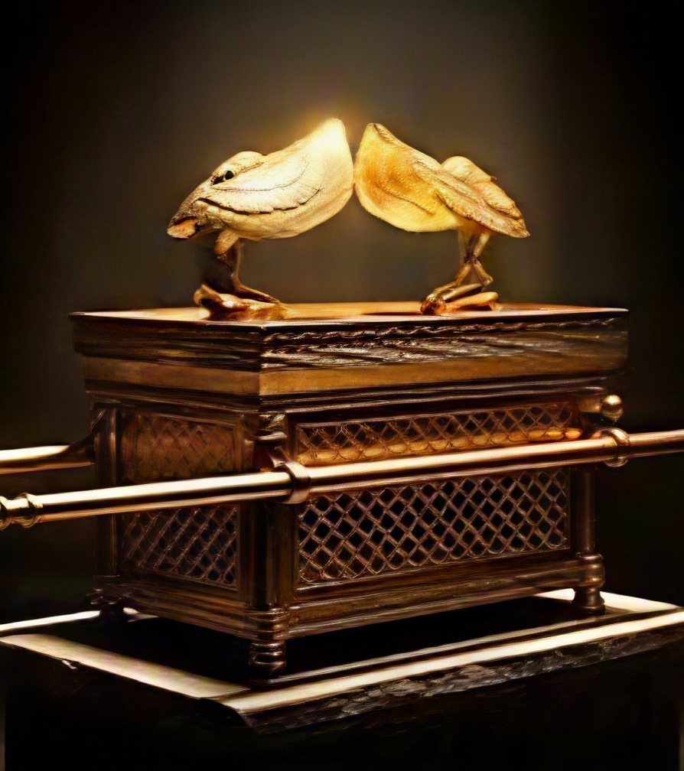
Psalm 89.34
“I will not profane My covenant or change what my lips have spoken.”

Slide 2

You are El HaBrit,
The God of Covenants.
Through Yeshua, I have entered an everlasting covenant with Yahweh that is sealed with His oath and promise. Your Word cannot fail. All Your promises will be fulfilled.
Declaration

Slide 3
Calendar/ News
Aug 8th | Taste of Turney 10:30 am (Shabbat first!) Colors: Purple, white, beige/tan, blue jeans Shorts should reflect purity & holiness
ASAP | T-shirts: Cost $25.00 (sponsorship availability)
Food service | All certificates due Meeting today
Provide Staff names | Prayer Tent Fingerprinting Book station give-away
Everyone bring | Compassion, love for thy neighbor Shofars, Flags, tambourines, etc.

Slide 4
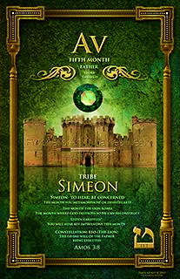
Month of AV
Av: Meaning “Father” or Menachem Av, “The Comforter Father”.
Connected to sense: HEARING
This month brings a balance of divine comfort and tragedy. A month of many contradiction and choices, so embrace your relationship with Adonai.
A month where strict justice will come when judgment is rendered.

Slide 5
Month of Av Tribe of Simeon
Simeon’s name means hearing/listening
Tribe of Simeon was the only one that didn’t receive a blessing from Jacob or Moses. Gen 49.7
Jacob aligns Simeon with Levi because of the anger unleashed at Shechem Genesis 34.24-30
Moses gives the border lands in Judah’s territory to Simeon losing his tribal identity. Joshua 19.1
Numbers 25.6-9, 14 Zimri’s action with the Moabite cause death and pain in the community.
Simeon was believed to be the instigator for Joseph being sold as a slave
Simeon the second born became the smallest and weakest of all the tribes because of his choices. He had passion without discipline and was persistent in trying to obtain notoriety and position.

Slide 6
Month of Av
Embrace your relationship with Yah- repent, ask for justice
With opposition comes opportunity
Cast off what causes you to lose focus
Listen, hear, be transformed
Protect your ear gate
Do not act impulsively

Slide 7
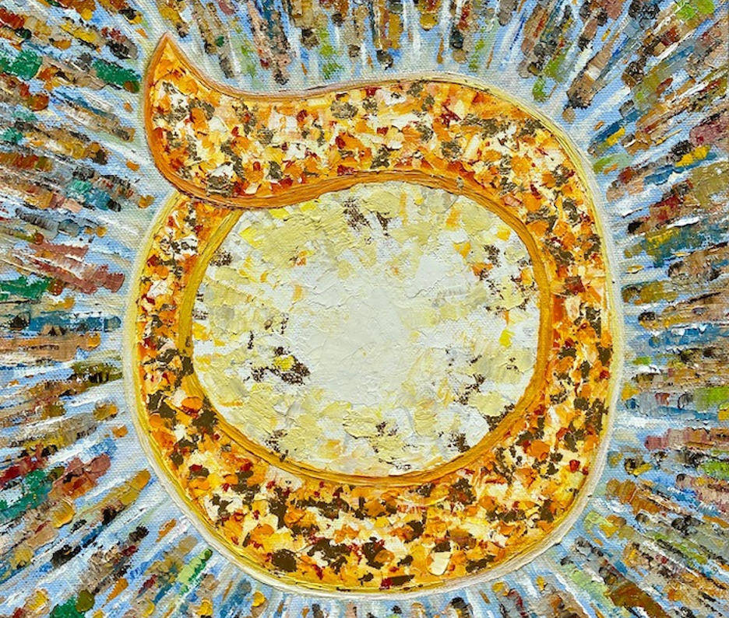
Homework
Where do we see Yeshua in this stanza?

Slide 8
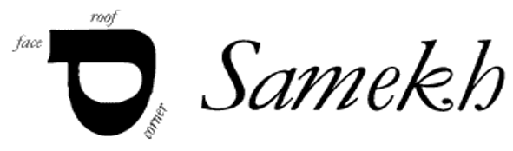
Samech
Samech means to support, surround, protect, twist, to turn to assist and prop or pillar.
The circular aspects of Samech represent commitment such as the marriage band.
The root word for Samech is “Shield”, for support as Adonai is our Consolation (Luke 2.25) or to lean upon, as one would lay hands to consecrate another.
Consolation means comfort, or refreshment. So, Simeon was looking expectantly – hoping for the fulfillment of Adonai’s promise of Messiah and to him.

Slide 9
Number 15
Represent the elevation from physical to spiritual i.e., Psalms accents
2Kings 20.6 Deliverance of King Hezikiah
Hoshea’s wife redeemed with 15 pieces of silver
Esther 9.15 Celebration on 15th of 12th month brought rest, restitution.
Feast of the Lord Passover/Tabernacle celebrated on 15th - restoration

Slide 10
Psalms 119:113-120
Rev. 3.14-15 Yeshua addresses the doubleminded Church of Laodicea who was neither hot or cold which is described as a chameleon.
A chameleon is someone who easily adapts to the atmosphere they are in. This person possess enough HOT to blend in with fire believer and enough COLD not to standout around unbelievers.
V113 (H5588 She/ah/fee-m) “The doubleminded”
David is saying that people’s ideas and thoughts are twisted. He is frustrated in dealing with the uncertainties and uncommitted people who contrast Yahweh’s word.
They know about God but are not determined to worship nor serve, they want the benefits of Yah and sin too.

Slide 11
Psalms 119:113-120
Being “doubleminded” comes against the standards of the Lord in every aspect of life.
Titus 1.16 Deny Yeshua by lifestyle and subtly twisting the word to accommodate sin of inconsistency.
The death trap of sexual immorality, homosexuality, greed, gender ideology, abortion and other practices against Yahweh’s holiness.
Jude vs. 3-4 | Grace as an excuse to sin
James 4.3-4 | Want what I want
2 Pet 2.2 | Warned of false teachers
2 Tim 4.2-3 | Sound teaching obsolete
Col 3.5-6 | Yahweh justice is soon

Slide 12
Psalms 119:113-120
V114 (H5643 See-t/ree) “My hiding place…” The palmist is guarded from all uncertainties Ps 32.7; a reliable concealment from danger all around.
“I put my hope in Your word”. He has confident expectancy; this is not wishful thinking. He is addressing the God of Hope (Ro 15.13)
This hope is not by academic or intellectual position; it’s founded on his relationship with God, where he draws strength. Ps 71.5-6;14
V.113b “But I love Your Torah”
God’s word is steady, consistent and trustworthy in contrast with the inconsistency of a “doubleminded person”.
If I can not recognize integrity, it is because I have none!

Slide 13
Psalms 119:113-120
…the word of God passes onto us, certain tendencies , disposition and authority. It is an overcoming seed 1 Peter 1.23
David does not see God’s word simply as words on a scroll, but it has life impressed in its pages. Hebrew 4.12
Yahweh will manifest the power and glory of His great Name through us as we trust in His word.
V.114b “I put my hope in Your word”
Luke 8.11-15 says God’s word is a seed, a parenting seed, meaning it produces after its kind.
A parenting seed pass on its character and actions.
Therefore, since God’s word has come from Him and is Him….

Slide 14
Psalms 119:113-120
If a friend/associate has no ambition, they will sabotage yours.
If they have no confidence, they will make you doubt yours.
If they have no peace, which only comes from Yahweh, they will take from you.
If they have no direction, they will become a distraction.
Be careful who you keep close, not everyone will help you grow!
V115 (H5493 Soo/roo) “you all depart”
These evildoers promote chaos. The psalmist wants space between him and evildoers.
Show who your friends are, those you choose to influence your life, and I’ll show you your future.

Slide 15
Psalms 119:113-120
V117 (H5582 She/ah/Deh/nee) “Hold me up”
This is the psalmist second request for support from Yahweh. This request is for him to use the sustaining power for further obedience.
He has a constant dependance knowing it fortifies him in His walk.
The parable of the persistent widow Luke 18.1-8 is a reminder to keep bringing our prayers before the Lord.
Then he will be free to turn his attention to Yah’s statutes.
V116 (H5564 So-m/Kheh/nee) “sustain me”
The psalmist is saying he cannot stand before his enemies without God’s word.
The word is the only way he can live a good life, so Yah will not disappoint according to His promises. John 14.16; 18,19; Romans 8.38-39

Slide 16
Psalms 119:113-120
Clear deception is when a Narcissist redirects or steers a conversation away from core issue, to avoid accountability or discomfort.
They will begin to accuse you to cause you to stop addressing the issue.
Not willing to repent openly but say: Ok I probably should not have said it that way or you are so sensitive. You take things so seriously, I was just joking, etc.
V118 (H5541 Sa/Lee/ta) “You have rejected.”
Yahweh uses His word as a measuring line.
Evildoers attempt to justify their actions by means of deceptions and excuses. These justifications, however, are nothing but lies.

Slide 17
Psalms 119:113-120
V119 (H7673 See/Gheet/m) “like dross”.
The wicked are likened to dross, waste that is separated from precious metal and discarded.
When dross first comes to the top of this hot process it looks as if it is valuable, rich as the gold/silver, but when the process is finished, it has no quality.
In Yahweh’s judgment He has a purifying effect. He will cleanse the earth from the wicked by scraping away the impurities.
He will make what is left richer in brilliance when the dross is discarded.
In the 2nd verse he says “, I love Your precepts”, so I should not be treated in this fashion.

Slide 18
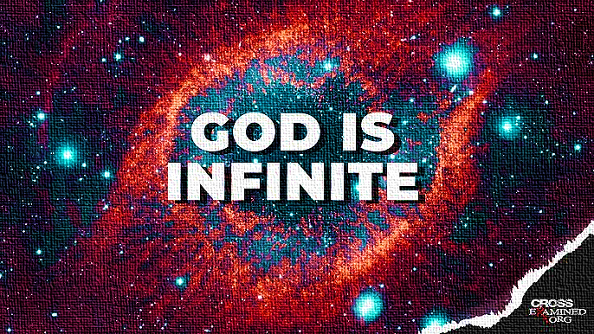
Psalms 119:113-120
V120 (H5568 Sa/ma-r) “Tremble”
As the psalmist considered the unsearchableness of Yahweh as well as His judgment he fears and stands in awe of the greatness of God.
Yahweh’s word does not just judge the wicked, but us. 1Peter 4.17

