Slide 1
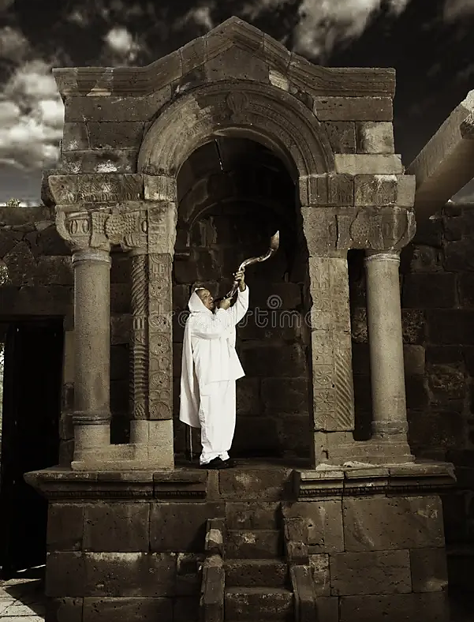
Revelation 19.5a
“Praise our god, all you his servants, you who fear him, small and great!”

Slide 2

Declaration
“You are worthy, Adonai Eloheinu, to have glory, honor and power, because You created all things, yes, because, of Your will they were created and came into being!”

Slide 3
Month of Tammuz
Ezekiel (8.14) speaks of idolatry in the temple and names the idol as a parasite that lives off our human tendency.
A cult life of tragedy is a shallow approach to life’s true sorrow or pain.
This is done when trust and faith in Yah’s goodness and lovingkindness has been cast away.
Associated with sight (Hab 2.2) vision, revelation purpose (open & closed doors)
In Aramaic Tammuz means heating, like a furnace
Named after a false prophet that was tortured to death. A statue was resurrected as an idol.

Slide 4
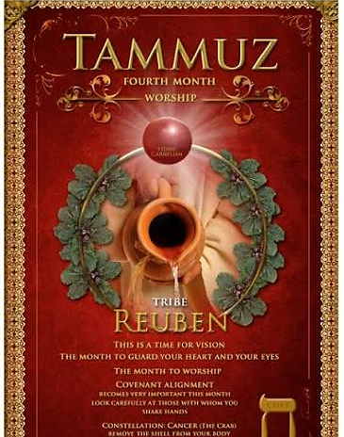
Anniversary of the sin of the Golden calf
Spying out the land (Joshua & Caleb of a different spirit)
Commemorates the destruction of the Holy Temples. Tisha B’av
17th A fast day in remembrance of the walls of Jerusalem being breached by Romans.

Slide 5
Tammuz & Reuben Mandrake & Water
Gen 30.14-16 “Mandrake” symbolize desire for fertility, love, seeking fertility without asking God.
Jacob’s wives bartered for relational & sexual intimacy which should not be so grossly traded.
Gen 49.4 Jacob’s prophecy describes his son as volatile as water. His character was fluid like water indicate his arousal inclination 1Ch 5.1-2
Parallels creation as water was the beginning of creation and gave birth to everything else, as it would be with the firstborn son who preserves and continues the family name. Judah is given the honor of leadership and prominence (Gen 49.8-10) while Joseph’s sons were given economic advantage.

Slide 6
Associated with sight (Seer) vision, dreams and revelation (purpose).
A month to guard your heart and your eyes. “What you see, is what you say and what you say is how your feel” Pro 4.23
With eyes of faith - cling and align with God’s covenant and care

Slide 7
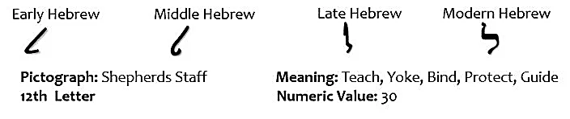
Law’-med
To shepherd, a goad or staff (urge forward), to teach (control the tongue, voice of authority)
Symbol of learning. Learning is connected to shedding.
Ps 80.1 speaks of a Shepherd from a position of supreme power & authority Who comes to aid His people.
Represents the heart
At the heart of our human existence, our course in life is to learn from everything and express spiritual matters with our every breath.

Slide 8
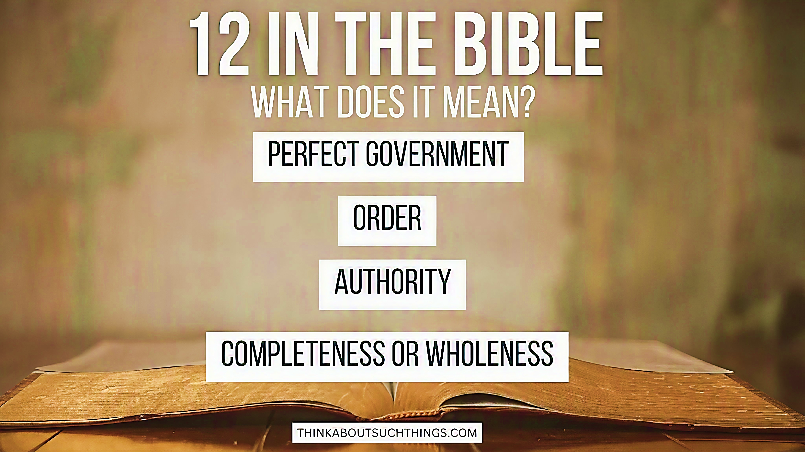
The establishment of a perfect order, which can only come about because of divine intervention, can only be maintained by Divine governance and supervision of government perfection.

Slide 9
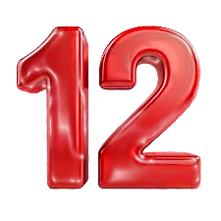
Bread of Presence in the Temple -Yah’s provision, presence and covenant
Minor Prophets
12 Sons of Jacob, Patriarch from Shem, Apostles of Yeshua
Passovers in the Word of Yah
Pre-Bar mitzvah Yeshua in the Temple (son of commandments)
Prophetic Bride wears a 12-star crown (Rev 12)
Rev 21.12 Twelve gates, angels, tribes of Isra’el
Notes:
When Yeshua was 12 and found in the Temple is significant. The 12th year was the final year of preparation for a son before he entered full participation in the religious life of the synagogue. Up until that time his parents, especially his father, were teaching him the commandments of the law, but at the end of the 12th year the son goes through a ceremony by which he formally takes on the yoke of the law and becomes a bar mitzvah or "son of the commandment."
Yeshua subtle demonstration for those who had eyes to see that his would be more than an ordinary Jewish bar mitzvah; his insight into the commandment was more profound than ordinary men, and his relationship with Yahweh would be unique.
SHEPHERD: Ps 80.1; 95.7, John 10.14

Slide 10
Psalm 119.89-96
V89: (H5769 Leh/o/lam) “Forever…” Unchangeable nature of the word.
The word of Yah, which created the world, is what continues today to sustain the heavens.
No one can unsettle it or establish a place to try to unsettle it.
2Tim 3.16 These are the very words of Yahweh which every man can stand on.
Mt 5.18 (yod & vav) can be left out of a word and not be misspelled. So, Yeshua was saying even the letters that can properly be left out of a word would not be omitted from the Torah as long as the Earth exists.

Slide 11
Psalm 119.89-96
V91: (H941 Leh/mee-sh/pa/Te/Kha) “For your judgments”
Not only is creation founded by Yah, but it endures in faithful obedience to His will.
All creatures are Adonai’s servants-they are obedient and humbled to His judicial decision. They remain in that estate in which He has created them.
V90: (H1755 Leh/doe/r) “to generation…”
The stability and steadfastness of Yahweh’s word is His faithfulness for the past as well as the future. Isaiah 40.6-8
Every generation is upheld by Yah’s word. Psalm 102.12

Slide 12
Psalm 119.89-96
He has committed himself, trusting and resting in the pleasure of Yah’s word. He delights…
WAY: Ps 18.30-32
WONDERS: Ps 37.4
WORSHIP: Ps 36.8(7)-10(9)
VOICE: Ps 29.3-4
Ps 37.23 When men follow the steps (Mits’ad H6805) that Yahweh has ordered, He delights in man.
V92: (H3884 Loo/leh-y) “If it had been…”
He delights in Yah’s Torah. Psalms 37.3-4; 23(H2655 Chaphets) This is an intermingling of Yahweh and man delighting.
The psalmist has experienced a high degree of joy and satisfaction in Yah’s word giving strength that sustains him.

Slide 13
Psalm 119.89-96
This is not a feeling or simply an emotional up or down. But steady, trusting in Yahweh’s Torah.
The psalmist recognized that when he reads, study, rest and delight in Torah, Yahweh meets him in His word, relieving any possible areas of distress.
Mits’ad is Akkadian language for soldiers marching in perfect harmony with their General.
This creates fear in the enemy because their opposition has one mind and one purpose.
Therefore, the psalmist is expressing that when He is delighting in Torah, he is not alone and not following his own conscious.

Slide 14
Psalm 119.89-96
They forgot the miracles Yah performed on their behalf (v11)
Doubted His power to provide (V19-20)
Broke covenant with God (V37)
Forgot how He had delivered them from enemies (V42)
Despised His laws (V56)
Provoked God to anger through idolatry (V58)
Do not limit the life found in the word of God by unbelief or doubting His promises.
V93: (H5769 Leh/o/Lam) “Forever…I will not forget”
Testifies of the life-giving power of Yah’s instructions. Because it’s alive, it runs after me.
Psalm 78 gives us insight on what happens when we forget Yahweh’s instructions and fidelity, limiting God’s hand of mercy.

Slide 15
Psalm 119.89-96
James 1.21b “…receive meekly the Word implanted in you that can save your lives.”
Implanted: Metaphor for being deeply rooted
Many had not received or accredit the word so as to produce the saving effects of eternal life or bring about transformation.
To receive the word: In humility, meaning teachable and submissive spirit.
V94: (ah/nee Leh/Kha) “I am Yours…” Reveals the psalmist sense of belonging and dependence on Yahweh and the wonderful relationship flowing from the word of God.
“Because I seek Your precepts”. He does not rely on his opinion. He submits to Yahweh’s principals, guidelines, instructions.
Notes:
Ah/nee (H589)

Slide 16

Psalm 119.89-96
The Word cannot thrive in a prideful or resistant heart. It can only flourish in a heart willingly submitted to God.
To accredit the Word means to grant authority, credibility and legitimacy.
Notes:
Ah/nee (H589)

Slide 17
Psalm 119.89-96
V95: (Li or ah/nee H589) “For me…” The psalmist simply acknowledges what the plans of the enemy are. He is not fixated on them.
He refuses to abandon the truth of God’s word, deliberately focusing on the Lord’s testimonies.
He ponders the precepts because they are a source of strength in the face of the adversity.
Even more so, because they heighten his awareness of the fact that Yahweh oversees the world, and his enemies can do nothing to him against God’s will.
Notes:
Ah/nee (H589)

Slide 18
Psalm 119.89-96
V96: (H3605 Le/kal) “To all…”
The psalmist sees there is an end to all things, even great and complex things. The mountains, the seas, the sunsets even the world, yet they all have their limits.
No boundary is found in God’s commands they are exceedingly never-ending.
Never-ending in its salvation, revival and transformation.
Notes:
Ah/nee (H589)

