Slide 1
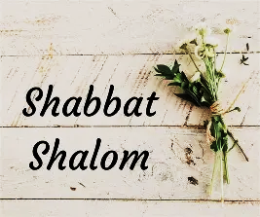
Rosh Hodesh
“New Moon”
Month of Elul
Praise, Testimonies, Confessions, Repentance,

Slide 2
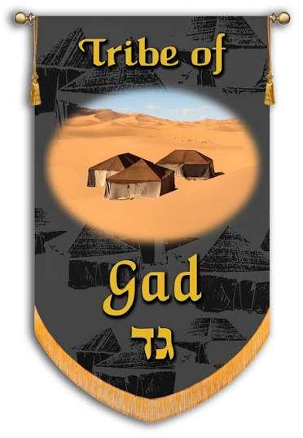
Month of Elul “To Reap”
6th month of religious calendar & 12th month of civil calendar
In Aramaic it means “To search”
Associated with the tribe of Gad [Deut. 33.20-21] Moshe describes him as a lion that rest in confidence against the enemy
The name Gad means an army of Yahweh, a troop cometh or to overcome an attack.
Sense: Mercy

Slide 3
Elul & Gad
This month is a time of preparation, calling for repentance before the Fall Feast. As the shofar is blown each day-it calls for us to have access to Yah’s love and mercy during this time that the “King is in the field”, therefore, repent.
Yahweh wants to meet with us in our everyday affairs, especially when we are hard press, He is with us.
Gad’s colors are yellow, orange, golden brown representing “fiery battles won”.
There is an acronym for this month from Song of Solomon 6.3 “I am my Beloved’s and my Beloved is mine.”

Slide 4

Prayer Entrances & Exits
EYES: Shape our thinking, focus attention on Holiness (Pro. 27.20, Lu 11.34, 1Jn 2.16)
EARS: Make one dull of hearing and unable to discern God’s voice which leads to a reprobate mind (Ps 95.7-9, Mk 9.25, 1Co 14.8, John 10.27)
MOUTH: Words give permission or cancel demonic influence (Mt 18.18, Pro. 18.21, Ro 3.13)
Clean Heart

Slide 5
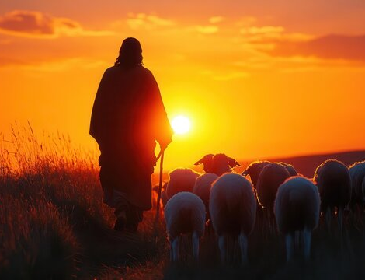
1 Peter 5.4
“And when the Chief Shepherd appears, you will receive the crown of glory that will never fade away.”

Slide 6

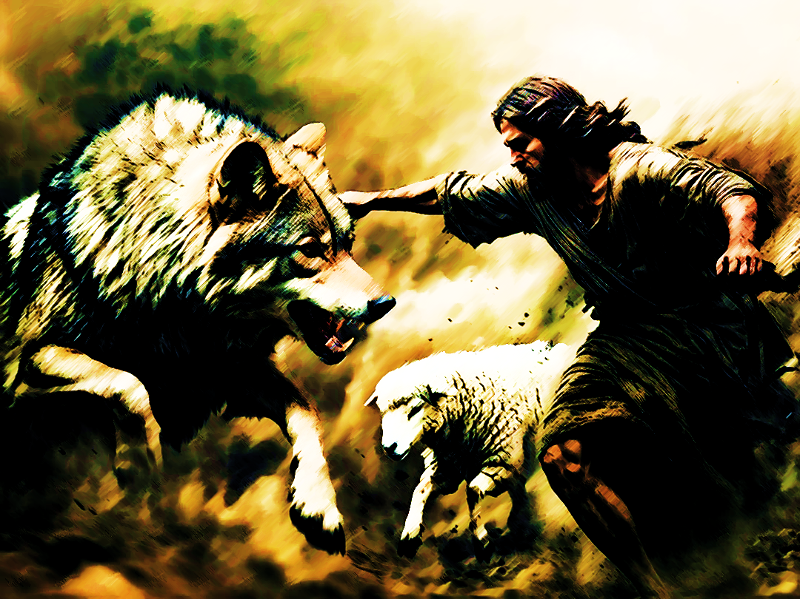
Lord Yeshua, You are the Good Shepherd, the Great Shepherd and the Chief Shepherd Who died for me.
Thank You for feeding, guiding, protecting, preserving and giving me eternal life.
Declaration

Slide 7
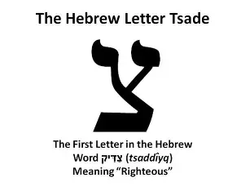
Tzadeh (Tsadde) 18th letter
Picture of fishhook or person lying on their side (Ezekiel 4.4-8)
One who bows before Yah in humble posture
Points to Yeshua as the Righteous One i.e., Malki-Tzedek
Represents pursuit of justice and right living

Slide 8
Psalm 119.137
H6662 Tsa/Dee-K “Righteous”
Many things can be in doubt, but there is no doubt of who Yahweh is. There is no difference in the God of the Bible and the God that exist today.
There is more to Yah than what we can receive from His word, but what we do have in His word accurately displays who He is.
“Righteousness” is action
Revelation 16.5-7

Slide 9
Psalm 119.138
H6680 tsee/Vee/ta “You have commanded”
The statement “You have commanded” emphasizes Divine initiative carrying authority of the Author.
His words are not arbitrarily righteous, but intrinsically insightful
We receive a share of Yah’s righteousness. We can miss sharing in Him when we see His commands as law. We should see His commands as receiving and sharing in His essence.

Slide 10
Psalm 119.139
The psalmist is not worn out from duty, but the exhausted anguish of one who loves what Yah loves cannot be indifferent to its desecration.
Understand every man is eaten up with some kind of zeal.
H6789 tsee/meh/TA-T/nee “consumes me”
The more the enemy rejected Yah’s word, the more the psalmist was determined to be zealous.
When others have forgotten the living and active word, he made certain to honor it.

Slide 11
Psalm 119.139
A drunkard is consumed with drunkenness
A whoremonger is spent with whoredom
The Heretic is eaten with heresies
The prideful consumed with self
They have loss proper zeal for good!
This ought to show us how much we should be full of zeal with something good.
Elijah in 1Kings 19.10 (forgot the covenant of Yah and raised idols)
Phinehas in Numbers 25.11 (deflected the anger of Yah by being zealous as Yah is)

Slide 12
Psalm 119.140
Scribes prescribed meticulous practice.
Visual transcription — Looking at each word in the master copy
Oral confirmation — Speaking the word aloud before writing
No memory copying — Never writing from memory
Letter counting — Tallying all letters, words, and verses
H6884 tseh/roo/FA “refined”
The psalmist appreciates the purity of Yah’s word.
It is extremely reliable - it has been tried not only by the psalmist’s experience (just as metal is refined by fire; Yah’s word has also been tested in the furnace of his life)

Slide 13
Psalm 119.140
If any discrepancies were found—such as totals of letters, words, or verses not matching the master copy—the sheet or even the entire scroll would be destroyed, demonstrating unwavering commitment to textual fidelity
Sacred protection: Placement beside the Ark
Authoritative recording: I.e., Baruch Jer 36.4 He recorded the words of Jeremiah for preservation and transmission
Preservation mandate: Yahweh’s word guarded for generations (Dead Sea Scrolls and other Judean desert caves)

Slide 14
Psalm 119.140
The New Testament is still a reliable and valuable source. The living memory of the Disciples were held as sacred text besides being written decades later.
“Any man that persist to say the Scriptures have been changed does not want to focus on the truth of Yah; they want to continue to deny that Yeshua is the way, truth and life”.
Yeshua frequently appeal to Scripture presuppose that the text handed down through centuries of Scribal transmission accurately represented Yahweh's word. Matthew 4.4-7

Slide 15
Psalm 119.140
“…and Your servant loves it”.
There are unending reasons to love God’s word!
What Scripture ignites your heart?
His Word speaks of…
Who God is and His Kingdom
Salvation, Grace, Good News, Increases our faith, brings us into the work of reconciliation, tells us of truth, life, Messiah, and His power….

Slide 16
Psalm 119.141
H6810 tsa/EE-R “least or young”
The psalmist realizes how insignificant in his own eyes he is compared to Yahweh, yet in the world’s eyes he is held in contempt which is different from Yah’s view.
The world’s eyes contrast with fidelity to Yahweh’s word.
“When I am weak, He is strong…” 2 Co. 12.9-10 esp. v11
Isaiah 53.3

Slide 17
Psalm 119.142
H6666 tsee-d/ka/teh/KHA “your righteousness”
Represents this stanza’s theological drumming (Vs.137, 138) Torah is truth revealing the everlasting character of God.
Today we are told that everything is relative. Meaning whatever makes sense at any moment or what is helpful for one.
This personal frame of reference leads to confusion and denial.

Slide 18
Psalm 119.143
The soul can be under pressure and still find its deepest pleasure in God’s word.
John 16.21 A woman in labor
2Co 6.10 Paul says spiritual wealth and life’s hardship coexist.
Isa 61.3 God brings joy even during grief.
H6862 tsa-r “trouble”
Trouble and anguish has taken hold of me…The psalmist is seized, compressed and hemmed in. Yet he has deep joy from meditating on God’s word.
The co-existence of anguish and delight is not contradiction but a paradox of a Believer’s life.

Slide 19
Psalm 119.144
H6664 TSEH/deh-k “Righteous”
This stanza closes with a petition hidden in a declaration “Give me understanding that I may live” or ve’echyeh “and I shall live.”
Ve’echyeh meaning Presence.
Hidden in that word is the three-fold name of God, encompasses all possible state of being Rev 4.8b “I AM”
Exodus 3.14 Divine self-designation Ehyeh Asher Ehyeh
The psalmist is calling for the God whose Word raises the dead to life.

