Slide 1
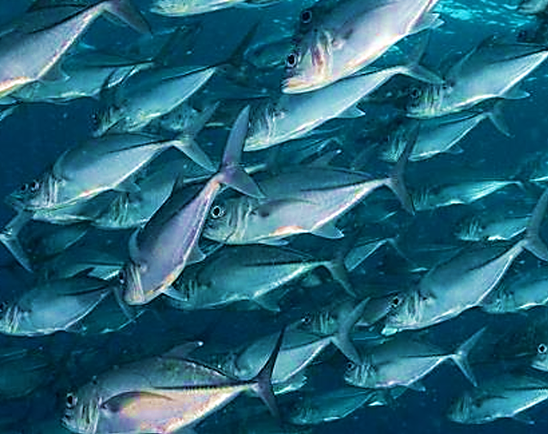
Evangelism Outreach
Taste of Turney

Slide 2
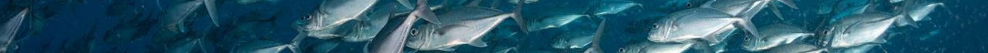
Luke 7.34 Matthew 9.13b
The Son of Man has come eating and drinking; and you say Aha! A glutton and a drunkard! A friend of tax-collectors and sinners!
“For I have not come to call the righteous, but sinners.”

Slide 3
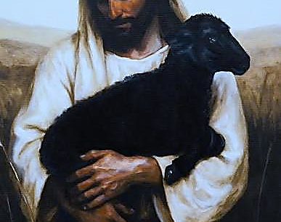
Declaration
Lord Yeshua, thank you for being the friend of sinners.
Even while I was a sinner, You were my Friend Who loved me and died for me.
Romans 5.8

Slide 4
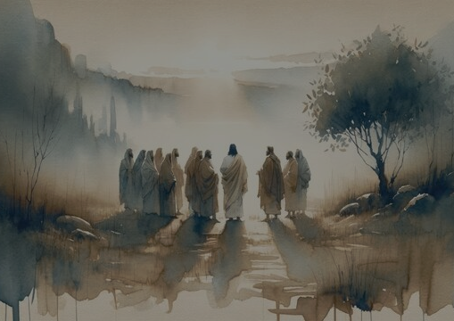
Why
Friends of the Bridegroom?

Slide 5
Friendship
John 2.23-25 Yeshua did not trust them.
Luke 22.28 Yeshua says a friend remained with Him through His trials.
V29-30 Benefits of relationship.
Yochanan (John) understood his role and ministry as one who was a friend of the Bridegroom John 3.29
John 15.15: Friends of the Bridegroom
Knows what the Father is doing
We did not choose Him, He chose us!
They bear fruit!
Friend (H7453 Rea) suggest intimacy, companionship and reciprocal relationship with freely flowing open communication.
Abraham - 2Ch 20.7, Isa 41.8 speaks of him as a friend (ahab H157) which involves deep love for each.
James 2.23 uses philo (G5384) meaning faithful relationship
Lazarus was a friend (philo) of Yeshua (John 11.11) close companion, actively fond of the other.

Slide 6

Matthew 9:37-38 Haadon Hakatzir
(Lord of the Harvest)
Keep our focus-Fulfill the Will of the Father
Depend and recognize Yeshua as Lord of the Harvest
Move with compassion as Yeshua
Pray for the Harvest
Submit yourself, allow Yah to anoint you as a laborer

Slide 7
Psalm 77.13-14
“Your ways, O God are holy. What god is so great as our God? You are the God Who performs miracles; You display Your power among the people.”
Yahweh, I acknowledge You as my miracle-working God. I will not limit You. I believe You still work miracles today. By faith, I believe, expect and receive what miracles You want to perform today and praise You for it!

Slide 8
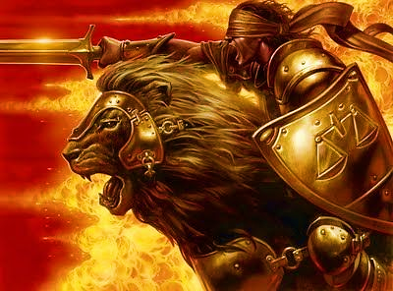
Go out as My Anointed Ones
Posses the Gates, rip open shut doors and snatch the innocent

