Slide 1
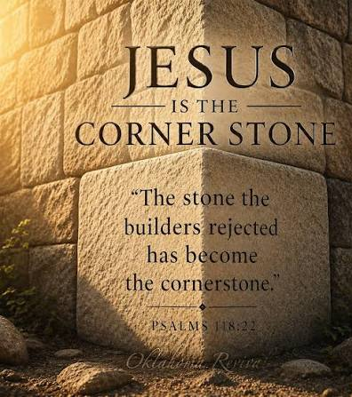
Isaiah 28.16-17a
“Therefore, here is what Adonai Elohim says: Look, I AM laying in Tziyon a tested stone, a costly cornerstone, a firm foundation stone, he who trust will not rush here and there.
I will make justice the plumb line and righteousness the plumb bob…”

Slide 2
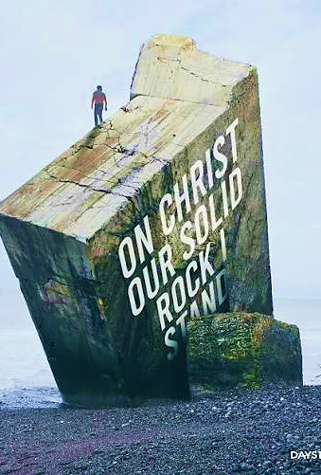
Lord, Yeshua, You are the tried Stone. You remain strong and immoveable under every test and trial.
And You are my strong and firm foundation upon which I stand.
Declaration

Slide 3
DAYS OF AWE
FEEDING & SHARING IN COMMUNITY
Manna House
Dr. Franklin Smith
8019 Cedar Avenue
Cleveland Ohio 44103
September 6th
12:00
Worship Service
2:00
Community Meal
Time may fluctuate per Holy Spirit!

Slide 4
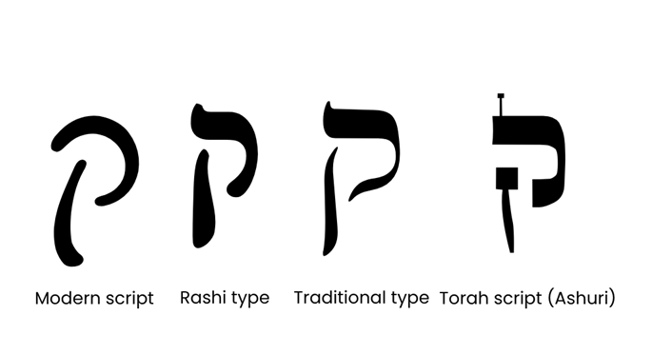
Kuf/Koof
Symbolizes both the material and spiritual realm. Two opposite concepts
The letter is made up of three lines that represent unholy thought, profane speech and evil actions
These negative qualities are illustrated within the actual form of Kuf. Its long, left line plunges beneath the baseline – one who ventures below the acceptable, who violate the circumscribed boundaries of Torah.

Slide 5
Kuf - beginning of name = Holiness, Kof (monkey)
Monkey/back of neck: Animalistic side of human nature, impulses of physical more than spiritual.
19th letter Divine order, spiritual completion, fulfillment of Yah’s promise.
100: Completeness and perfection. Represents holiness, sacred separation, and the call to be set apart. Its descending tail suggests reaching into depths that other letters cannot — the deep things of God. Its value of 100 represents fullness and completion of holiness

Slide 6
Psalm 119.145
H7121 ka/RA/tee “I cry/call”
Wholeheartedly…A heart oriented entirely toward commitment to Yahweh.
Hebrew word “Shalem” meaning complete, whole, full perfect and peace. This is where we get the word Shalom.
1Kings 8.61 Solomon tells the people that a lack of devotion to the Lord leads to disobedience.
At the beginning of Solomon’s rule, he was devoted, but because of his lack, he fell to the warning of Deut. 7.3

Slide 7
Psalm 119.145
Ruach testifies to Caleb’s wholeheartedness on three separate occasions; He speaks of his undivided loyalty.
Caleb: Joshua 14.8
Moshe: Joshua 14.9
Yahweh: Numbers 14.24
Caleb could not fabricate this spirit on his own. The word tells us he was one of a different spirit (Num 14.24) Yahweh provides what we need to carry this same Spirit so we can be consistent, complete and loyal. Jn 14.16-17

Slide 8
Psalm 119.145
Vocal prayers help one to engage heart and mind. Enhancing clarity.
Speak declaration to the spiritual realm
Deepens connection with Adonai
Elevate your experience and confidence.
Yet, effectiveness of prayer hinges on sincerity.
“I Cry”… his crying out is connected to obedience. The psalmist wants to keep God’s word, and he knows when he entreats God with a sincere heart heaven hears and respond.
The psalmist cry is not a silent prayer but vocal prayer.

Slide 9

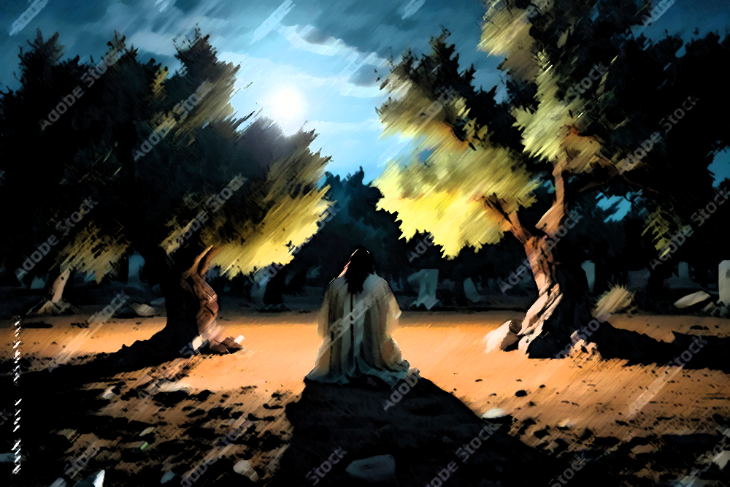
Psalm 119.145
His prayer is not based upon its eloquence, length, or how sweet it sounds but sincerity.
Mat. 26-36-39 Yeshua’s prayer was filled with grief and anguish.

Slide 10
Psalm 119.146
H7121 keh/ra/TEE/Kha “I cried out to You”
Verse 145 was so important the psalmist repeats himself. Emphasizing his passionate plea.
“Save me”…Without the Lord’s ever presence, the psalmist understands that he has no power to hedge himself in.
1Co15.2 Paul says that salvation depends on faithful custody of the truth of God’s word.

Slide 11
Psalm 119.147
H6923 Kee/Da-M/tee “I rise before”
The psalmist tells us of his passion of how he depends on Yah’s word.
When we get up early for something it shows how much we are in need and devoted.
His pursuit of Yah’s word is essential to his effective prayer life. The Bible gives us sustenance for our prayers.
When we rise before dawn it shows that we are prioritizing time for God and it signals heaven.
This pattern of intentional priority means to give exclusive attention, willingness to sacrifice to be reset.

Slide 12

Psalm 119.147
Every “watch hour” is important but, the early watch will choreograph you with Heaven’s purpose and align the day.
Mk 1.35 Yeshua rose early
Gen 22.3 Abraham
Ex 34.4 Moses
Job in Job 1.5 intercession

Slide 13
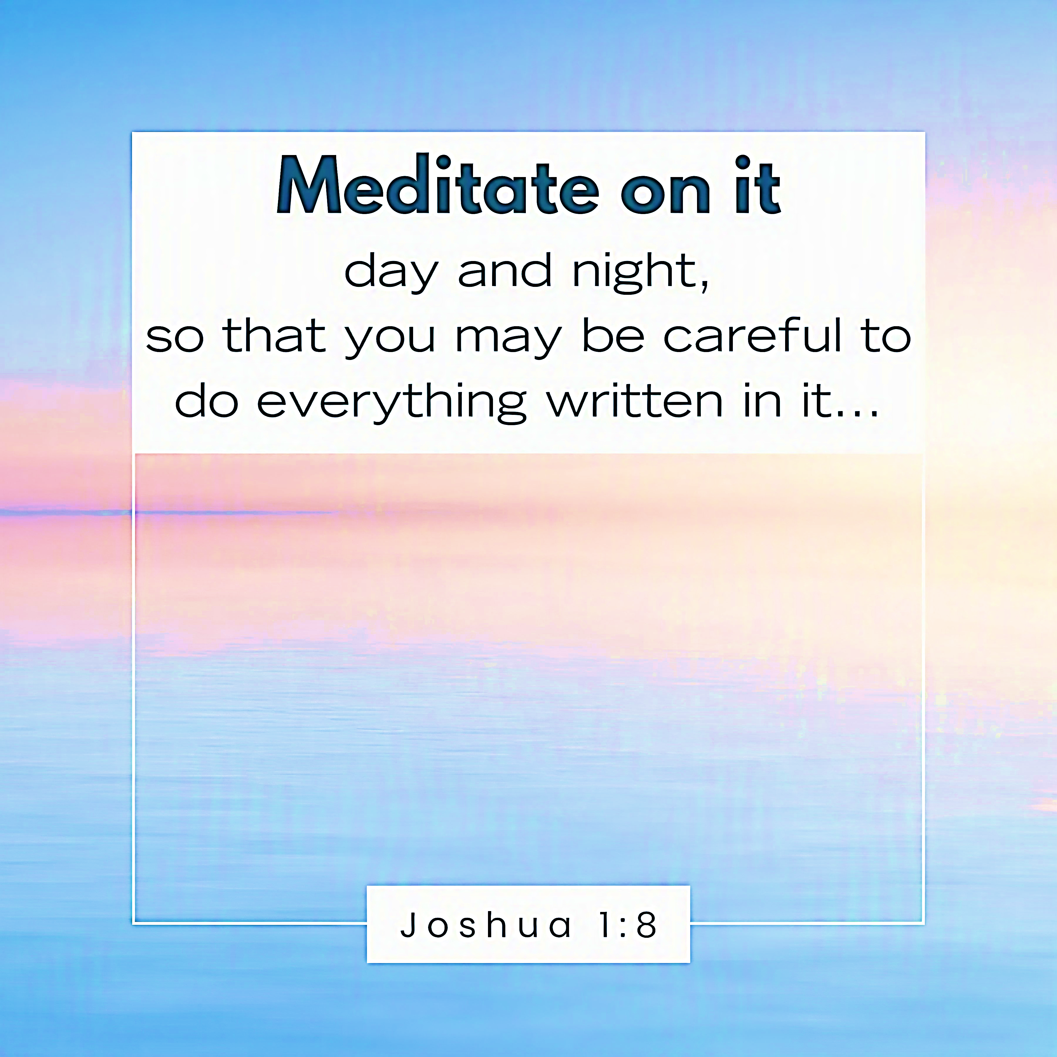
Psalm 119.148
H6923 kee/deh/MOO “They are open before”
The psalmist had internalized God’s truth to an extent that it becomes more important than sleep.
Yah’s word is so intense that when eaten it causes how differently one thinks and function

Slide 14
Psalm 119.149
H6963 ko/LEE “My voice”
God is our Caretaker! He shows loving kindness as it befits His character.
Yah’s loving kindness (Hesed) refers to going beyond the minimum
Hesed is a Hebrew word that defies translation. It is love, mercy, favor, grace, forgiveness, kindness, gentleness, patience, and more rolled into one.
David knows when Adonai remembers him, he will be revived.

Slide 15
Psalm 119.150
H7126 ka/reh/voo “they draw near”
The psalmist says the wicked; pursuers of carnality is coming closer.
The carnal pursuers live a life consumed by satisfying their fleshly desires. They are in a state of depravity, starving the soul
Many loved the miracle of Yeshua, enjoying the compassion and love he shared. But when he began to teach, most walked away (Jn 6.66). This is what his pursuers are like; they distance themselves from Torah.

Slide 16
Psalm 119.151
H7138 ka/RO-V “near”
In the previous verse David speaks of evil approaching, yet he is sustained because Yahweh is closer.
Realistically, no matter what is happening around us, God is always nearer. This is the greater truth we are to hold on too.
Another way Yah comes near to us is in His word. This allow us to experience Him in a different way.
“all Your commands are true” God’s word is infallible -history, poetry, human experience, prophecy. No one can dispute it.

Slide 17
Psalm 119.152
H6924 Keh/deh-M “long-ago”
The psalmist has had an old relationship with the Scriptures that is deep rooted.
This long love for God’s word has led him to understand that they are eternal and of Divine origin.
This is the psalmist testament to answered prayer, and of his habits.
How he prays v.145
What he prays for (rescue) v.146
How long he prays v.148
Reason (justice) v.149
Confidence v.151-152

