Slide 1
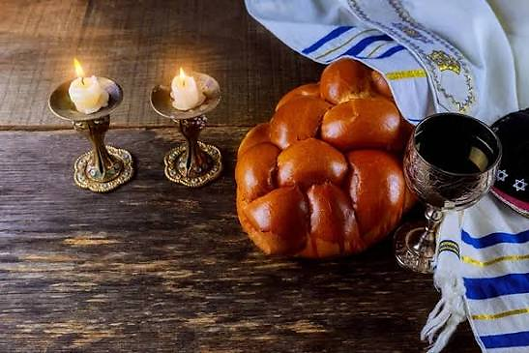
Shabbat (New Moon)
Prayer
Intercession &
Testimony

Slide 2
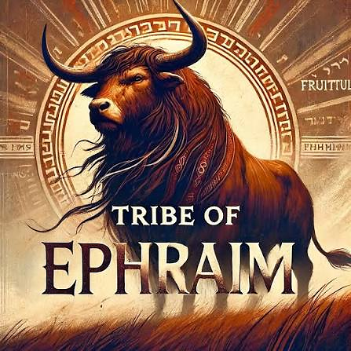
Tishri New Moon 9/11 8:59 pm
7th month of Civil (Head of Year). A soul’s journey gradually unfolding during this special month of the fall feast.
Lev. 23.24 it is a time for Blowing the Shofar. A time of awakening the prophetic voices
Lamed: Our desired hope of Messiah’s return
SYMBOL: Ephraim (fruitful & multiply) Ox or Bull (Deut. 33.17) Leadership, military power, strength & authority
SENSE: Touch COLOR: Black

Slide 3
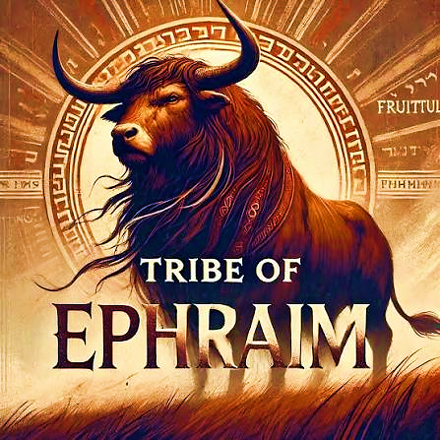
Hebrew Year 5787 Amos 3.8
Prophetic shift from 5786 (man) and 5787 (Yahweh) while in century of 80 Pey .
Zayin: Year of the sword, weapon or plow
Symbolizing God’s word as the sword of the Spirit (Eph 6.17) authority to cut through deception Heb 4.12-13 expose motives, thoughts, hidden things, genuine and false (soul refining).
And yet, Adonai wants us to speak with clarity, authority so he can accelerate restoration

Slide 4
Deliverance:
Ethnicity & Racism
Superior
Inferior
Culture idolatry

Slide 5
Community Repentance
Lord, You’ve made all nations to dwell on earth, and You created all of them equal. I’m grateful for the ethnic family You allowed me to be born into. I repent for being racially proud and indifferent toward those who are not like me. I renounce all forms of racism, racial indifference and racial intolerance. My identity, faith is realized in Your covenant of blessing, and my family heritage is not solely about biological lineage but encompasses spiritual aspect of my fellowship with You as my Father.
I repent for my cooperation in bringing racism into Your Body of believers and tolerating racial humor, slander, jokes and mockery; causing riffs. I repent for carrying generational prejudices and the ideal of cultural intolerance as a weapon to bring self importance to the secrets of my heart.

Slide 6

Community Repentance
I dismantle any generational curses of racial pride now in Yeshua’s name. I release over my life love, unity, racial acceptance, reconciliation, and forgiveness in Yeshua’s name.
May every part of my heart, mind, and soul view all ethnicities as equal. Amen.
Communion
1 Corinthians 11.27-31

Slide 7
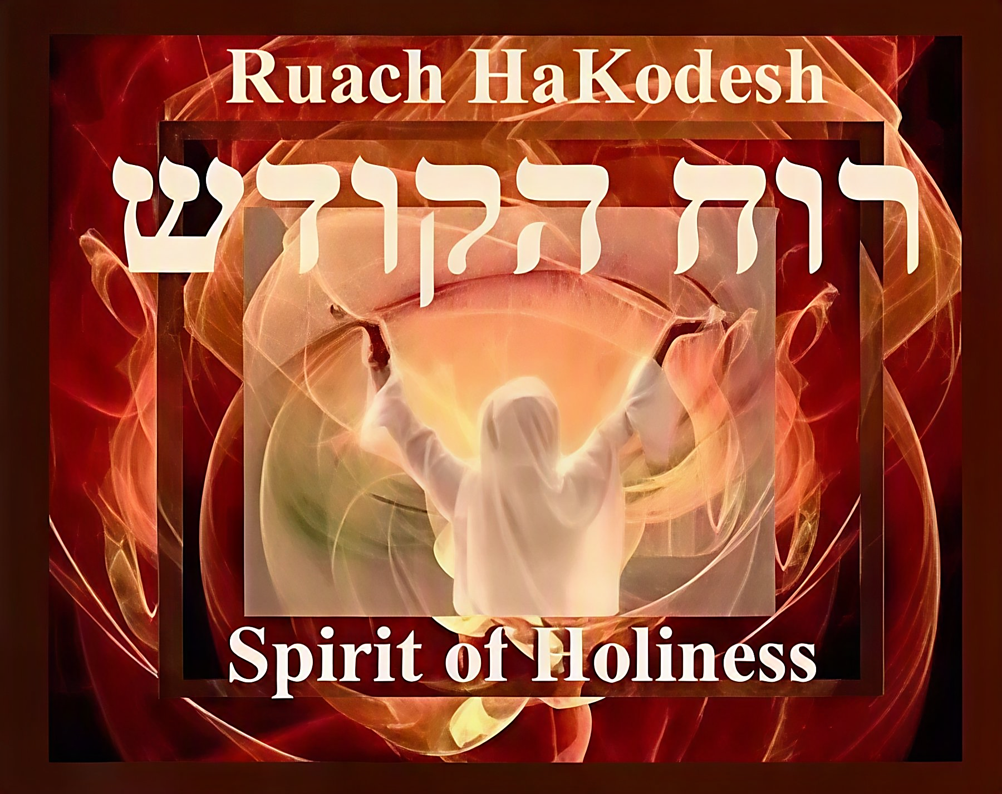
Hebrews 9.14
“…then how much more the blood of the Messiah, Who, through the eternal Spirit, offered Himself to Yahweh as a sacrifice without blemish, will purify our conscience from works that lead to death, so that we can serve the living God!”

Slide 8
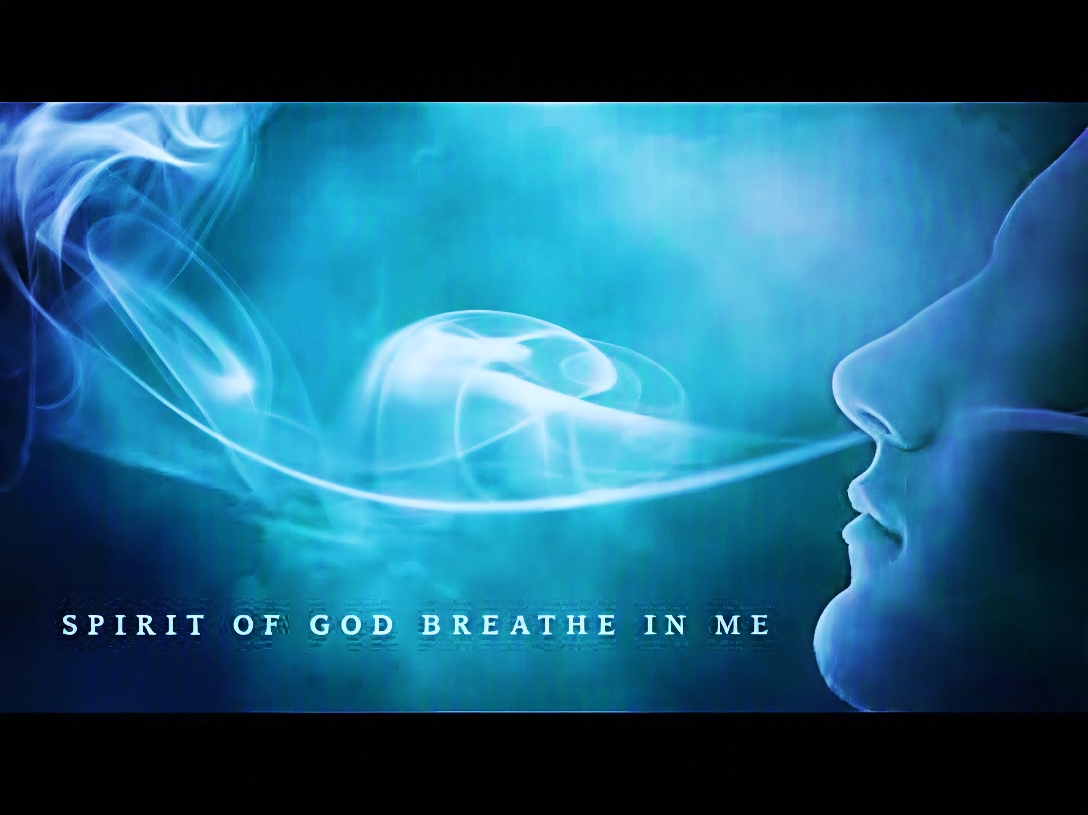
Ruach, You are eternal (Ruach Olamim) and ever-present with me. You live and remain in me! I will walk in the Spirit, totally relying on You to manifest Your power in me and through me.
Declaration

Slide 9
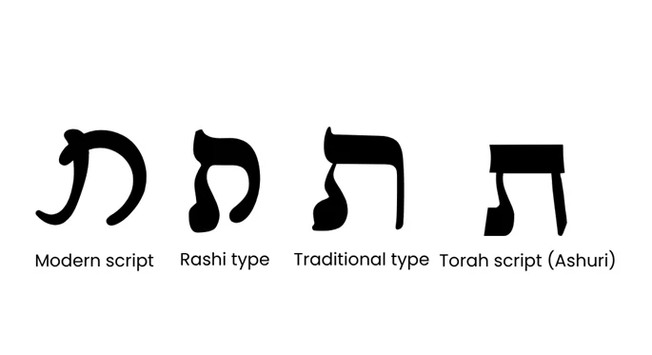
Tav 22nd letter 400 value
Represents completion, perfection, end of cycle, life
Cross or mark (Yah’s goal obtained)
Tav & Vav (cross & nail) Both letters point to Yah’s judgment & selection.
Yeshua (Rev 1.8, 11; 22.13)
Reach Tav, we begin again with Aleph, the source of everything; beginning of something new.

Slide 10
Introduction & Closing
The role of surrender is inviting us to release our grip on anxiety, fear and turmoil, yielding to the shalom offered by Yeshua.
The psalmist knows that Yahweh is ready to rescue, but He will not protect us from harm when it is to cause us to look like His son.
The stanza begins with five supplications (petitions) unto the Lord.
The psalmist uses the word “let” calling for intervention and transformation.
Letting embodies an ironic truth. In that when we surrender our will, we discover a strength far greater than our own. This requires humility, trust and faith.

Slide 11
Psalm 119. 169
H7126 tee-K/RA-V “Let come near”
The psalmist’s appeal is not in distress (cry vs song) but in rejoicing that true insight can only come from Yah’s revealed instructions.
The plea for understanding suggest that spiritual comprehension is not…
…automatically achieved, but by grace.
As believers we must know that Yahweh hears our song of persistence and is ready to respond.

Slide 12
Psalm 119. 170
Our prayers should ascend to Yahweh with full confidence of Yah’s character found in His word, an unwavering foundation.
H935 ta/VO “Let come”
only Yahweh’s intervention can provide rescue from personal trials.
James 1.2-4 tells us that persevering in our trials will allow us to look like Yeshua.
By linking rescue directly with Your word, he again underscores how Yah’s revealed truth is the basis for real salvation and protection.

Slide 13
Psalm 119. 171
H5042 la/BA/ah/na “will speak”
Act of celebration in gratitude because Yahweh is His teacher and is imparting spiritual insight.
This verse affirms that our learning process of Yah’s word leads not only to knowledge but also worship
The psalmist praise flows from a heart that has been guided by divine instructions.
Genuine understanding of Yah’s word fosters deeper sincere worship rather than stale academic exercise.
Knowledge of Yeshua brings us to a deeper relationship with Him leading to a life of adoration.

Slide 14
Psalm 119. 172
H6030 Ta/ah-a “shall sing”
The psalmist tongue/mouth is a vehicle that insist on being used to glorify the splendor and majestic of Yahweh.
The moral perfection of Yah’s word inspires confidence and celebration.
The psalmist testifies of the unblemished word, having no flaws nor being unjust.

Slide 15
Psalm 119.173
The psalmist is acknowledging that Yah is His strength and He answers, not from above with a shout, but from within-with presence. He does not shame us for needing help. He becomes our help. Ps 40.17
The heartbeat of EZER is the love that shows up. The strength that meets us in our lack.
H1961 the/HEE “Let or may it be”
Help me… EZER does not mean servant. As misunderstood in Gen 2.18.
EZER most often refers to Yah Himself – Psalm 70.6(5) This is a desperate soul crying for divine rescue Ps 33.20
Ezer is used to describe the One Who rescues, upholds, strengthens, and saves.

Slide 16
Psalm 119. 174
H8373 ta/AH-V/tee “I long/desire”
The psalmist merges his delight and longing for deliverance.
“Delight” (H6026) in Hebrew is “anag”, meaning to take exquisite pleasure, to bend toward something with softness. Psalm 37.4
Delighting in Yah goes beyond joy or pleasure…
It means it is a delicate bending to Yah’s will, treating Him as the greatest and most valuable treasure of our heart.
It is a longing, yearning and desire for a moment alone with Yahweh.

Slide 17
Psalm 119. 175
H2421 the/KEE “Let live”
The psalmist prays for life so his life can be centered on praising and magnifying God’s goodness; wanting his life to radiate the glory of Yah.
God’s laws sustains him, fortifies his faith and guarantee fruitfulness.
As believers we should recognize that in Yeshua we live and move and have our being Acts 17.28 so our days can be directed toward praise

Slide 18
Psalm 119. 176
He appeals confidently for the Lord to seek him out.
For us to seek God includes a rejection of passivity toward God and move to obedience of His commands. Isa 55.6
But for Yah to seek means for Him to obtain something for Himself, to pursue-He is motivated by Divine love
We need divine grace to seek us out, to bring us back to His covenant of peace and committed obedience.
H8582 ta/EE/tee “I have strayed”
The psalmist closes his love song to Yahweh by conceding to his own waywardness. Confessing his tendency to roam as a sheep without a Shepherd would. Once again, he is willing to display his dependency upon the Lord.

