Slide 1
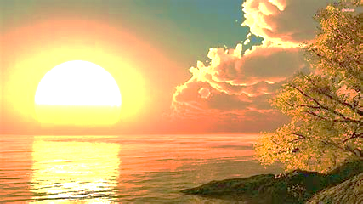
Yahweh alone deserves the Praises
Psalms 113 Halleluyah!

Slide 2
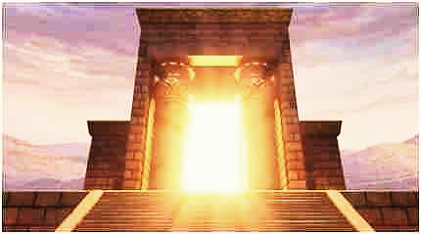
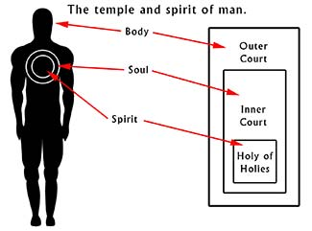
Introduction
“I am the dwelling place of Ruach” study.

Slide 3
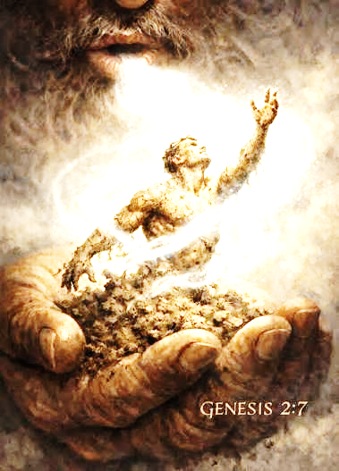
Neshimah (Breath)
H5397
Genesis 2.7 “Then Adonai God, formed a person (Adam) from the dust of the ground (Adamah) and breathed into his nostrils the breath of life, so he became a living being.”

Slide 4
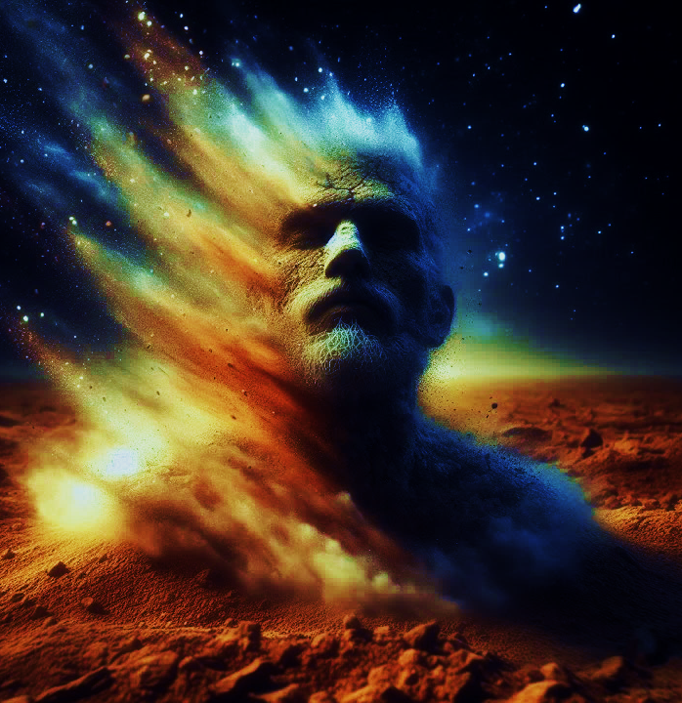
APHAR
What we are made of… Genesis 2.7;3.19
Breath in Dust: Infused with the breath of Yah, one becomes animated.
Symbol of fragility. Not cohesive like soil or clay. Job 30.19, Gen. 18.27, Ec. 3.20
Dust is a beginning, not the end- Jn 12.24 a cycle, rhythm of life Job 33.4
Divine Compassion: Ps 103.14; 113.7 He meets it with grace.

Slide 5
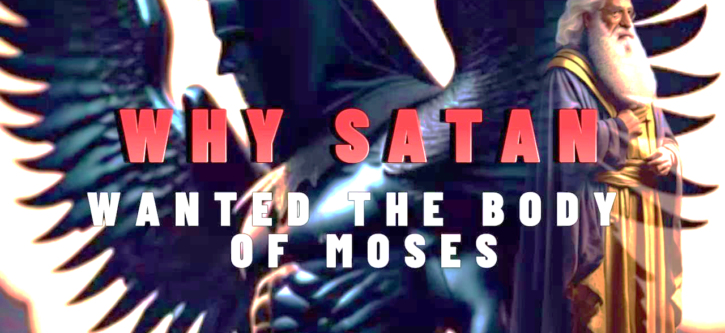
Jude v.9
Ps 116.15
The death of those who are faithful to Him is costly (precious, valuable)
Psalms 72.14
Satan wanted to take that which is holy and pervert it.
The Accuser (Dt 32.51 Meribah or Ex 2.12 Murder of the Egyptian)
Deceive humans turning the grave of Moses into idol worship

Slide 6
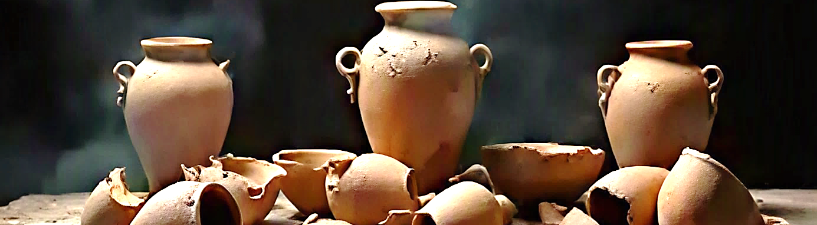
“I am a broken vessel for His use.”
“Nonetheless, I am…the dwelling place of Ruach”
Notes:
The I AM Redemption: The Linking Verb.
When we speak of our existence, we must speak the Name of Yah! I AM
Even when we speak of our fallen existence, we are telling the truth, but we are joining the sacred name I AM to sin. We are bearing witness against Yah; which could be called blasphemy. But…
When Messiah died for our sins, it was I AM- joining Himself, rejoining Himself, to our fallen, sinful and unholy I am. The I AM becoming sin, joining Himself to all that is not His I am so, all separation would be ended. therefore, we see Yeshua joined to us. It is after Messiah’s resurrection that we find our new I am, alive, victorious the I AM risen.
The Victorious I AM has become the I am of our life
Ex 3.14, John 8.58, Colossians 2.9-12

Slide 7

Death
Death is a curse and an enemy. It raises barriers between Yah & His people.
Yeshua gave His life to cleanse the world, reconcile the broken and restore the human temple.
Messiah’s death was the moment when human wickedness was laid bare, where our evil and wickedness met HaShem’s forgiving and restorative justice.
Yeshua’s blood was poured out to cleanse the world (us) from its downward spiral toward death. Reunites us with Yah.

Slide 8
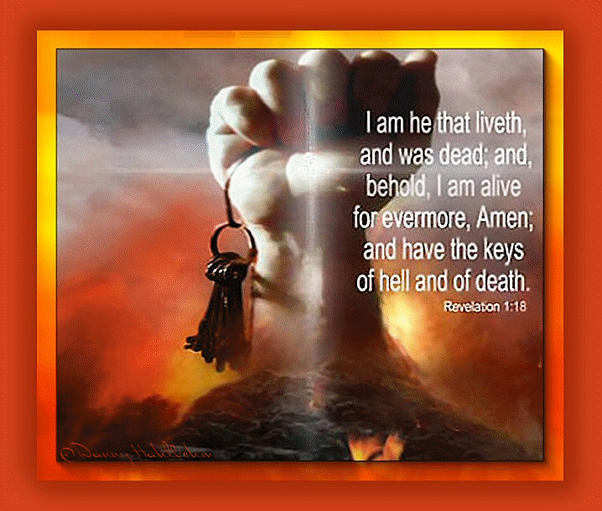
Revelation 1.18
Messiah has the authority over death and the grave.
Death is not the end, and Yeshua has the authority to grant eternal life.
He has the power to determine the destiny of souls.
Messiah has sovereignty in all matters concerning life, death and eternal destiny.

Slide 9
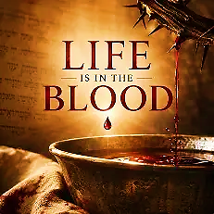
DAM
Dam=Blood
ADAM – Life is tied to blood
ADAMAH = Ground
Life in the Blood Lev 17.11 Power is in the life, not death!
Blood purifies; an antiseptic represents a return of life where death crept in. Lev 16.18-19
Our reconciliation is in the blood, its vitality, its sacred energy poured out for the sake of another. Jn 15.13
Notes:
Dam, Adam, Adamah
Blood is not a symbol of Yah’s anger no it portrays it as a medium of reconciliation through purification.
The verbal link highlights the profound biblical concept that human life is inseparably tied to blood, both physically and spiritually. Leviticus 17.11 because of spiritual sterility in the Temple (removal of defilement) the living God could remain among His people. Lev 16.18-19
Just as the Tabernacle, we live in a death-saturated world. For Yah to remain, the space must be sanctified. In Yeshua, the entire sacrificial system take on flesh. When He offered His blood to a broken world in need of restoration. His blood speaks shalom. Heb 13.12
His blood, our transfusion. Life to replace what death had taken.

Slide 10
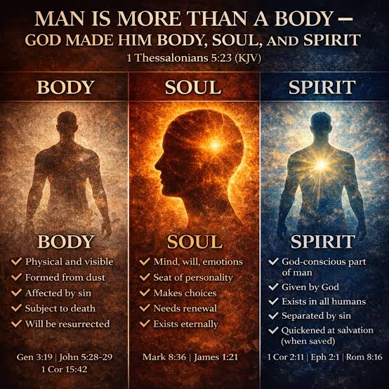
1 Corinthians 6.19-20
The author asks a very important question. “Or, do you not know that your body is a temple for Ruach HaKodesh…?
We must be willing to be a host.
The state of the vessel is not even important (broken). It’s Yahweh’s glory within us that makes the difference.
The body or flesh is not evil-after all Yeshua came in the flesh.

Slide 11
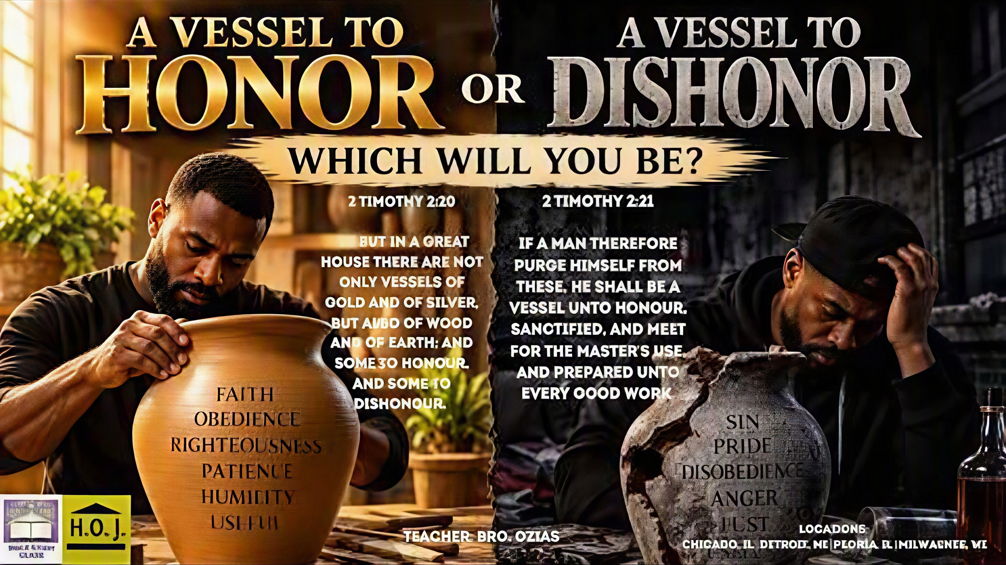
2 Timothy 2.20-21

Slide 12
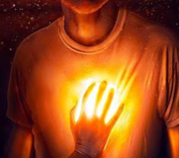
2 Corinthians 4.7
Clay Jars (G3749) meaning fragile, low-grade material and inexpensive.
But we have “Treasure” in clay jars.
Hebrew word “Otzar” storehouse or treasury, a room, stacked floor to ceiling filled with precious wealth
We are Glory carriers; the presence of God.

Slide 13
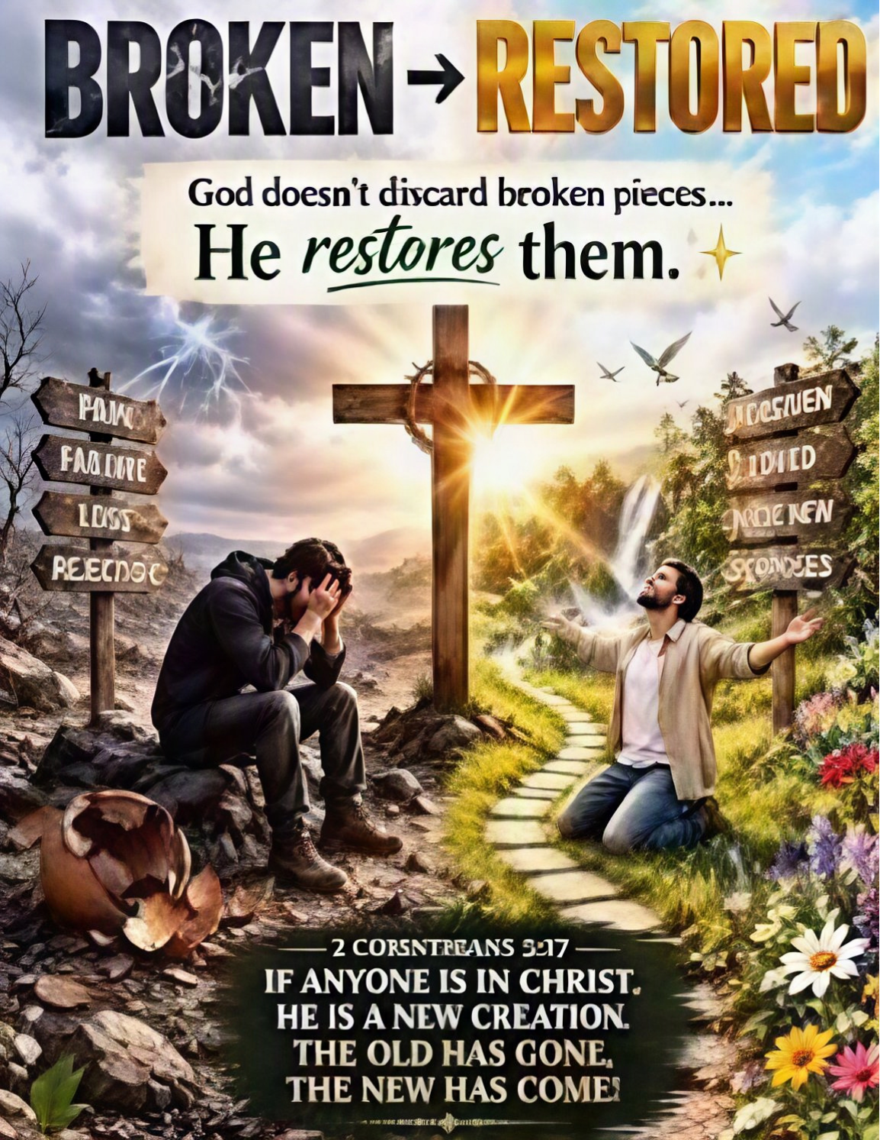
Yah’s Plan & Goal
Sin does not threaten, intimidate nor does it diminish God’s holiness, Yeshua our healer never recoiled from the sick or sinful. He touched them. He restored, forgave and loved them. Therefore, know sin is not the end of the story. God restored us placing within us Ruach for intimacy and oneness as with His Son.

Slide 14
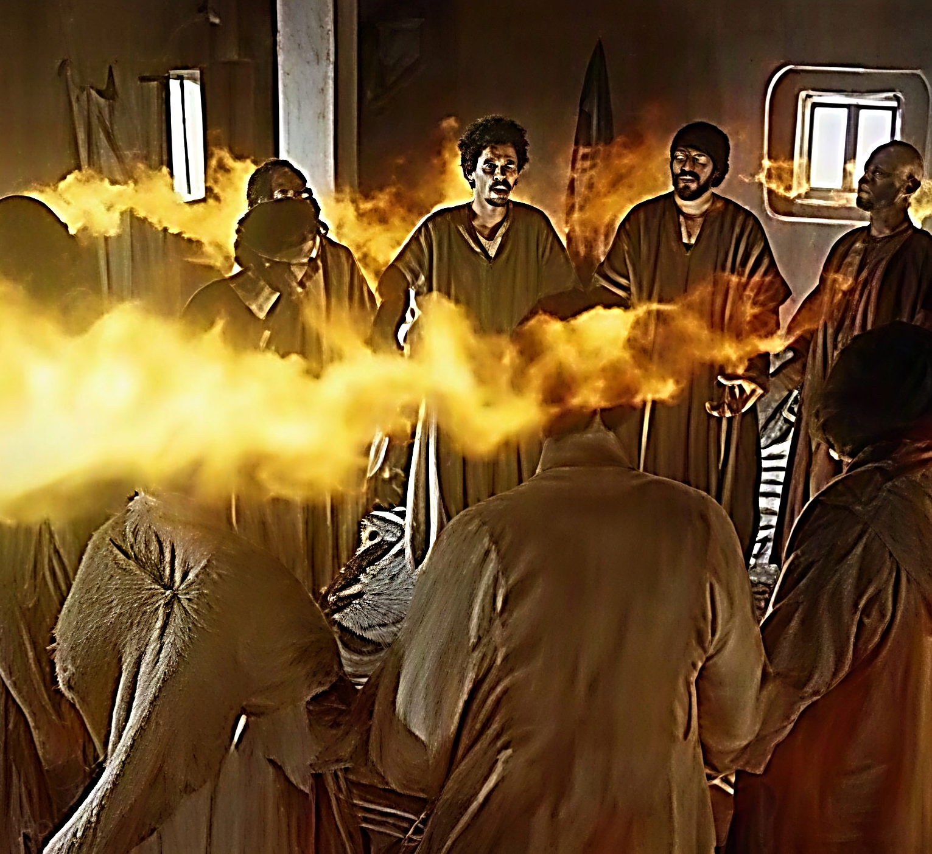
Ruach Has Come
John 14.16-17 “…and I will ask the Father, and He will give you another comforting Counselor like Me. The Spirit of Truth, to be with you forever. The world cannot receive Him, because it neither sees nor knows Him…”

