Slide 1

5787 Cheshvan 13

Slide 2
Isaiah 43.15
“I Am the Lord, your Holy One, the Creator of Israel…”
Declaration:
Lord You are our Creator, our Redeemer, our Holy One and our King! You have placed Your Name on us and claimed us as Your own.

Slide 3
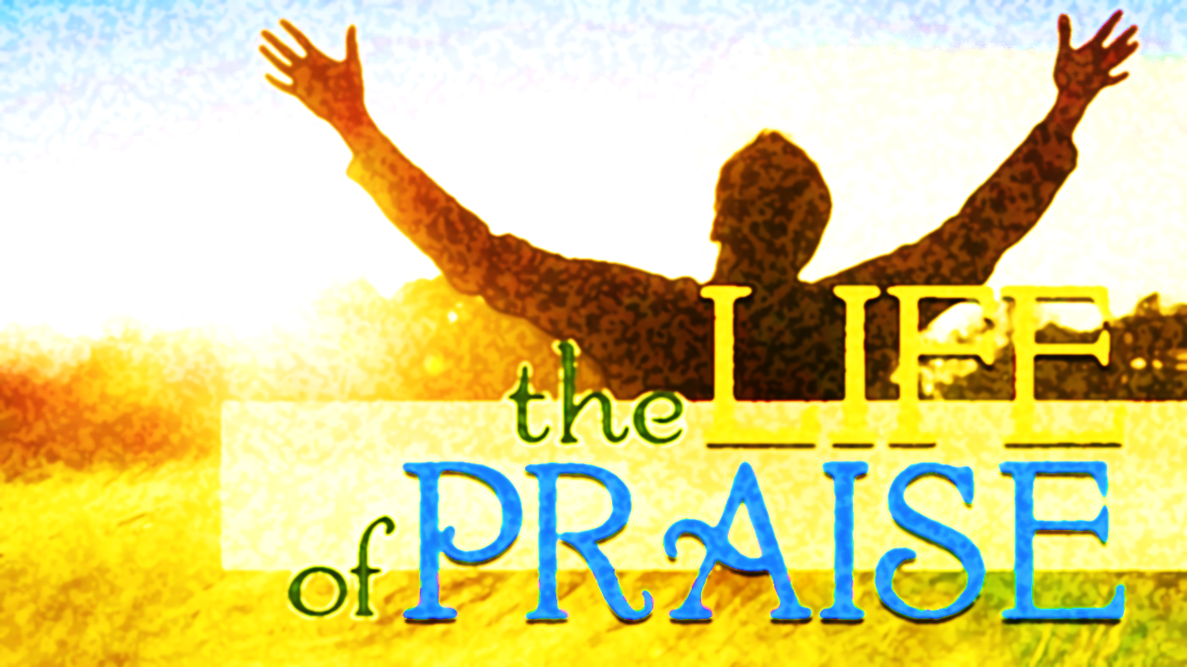
Psalm 146

Slide 4
UPCOMING
ONEG
Chanukah/Hanukkah
Oct. 31st (Next week)
Show your love by bringing a dish to share with the community while continuing to worship Yahweh.
December 5th Shabbat Service
After Shabbat – Oneg
Return for Chanukah celebration – Theme “Live as a candle in the darkness that contrast its surroundings”
After – Dessert and games and challenges
December 6th – 12th @ 6:30 pm Teaching (minor prophets) each night on Conference Call Line. (use cell or download app on laptop to view candle lighting and teaching)

Slide 5

Review
“I am…. a dwelling place of Ruach”
Eat from Spiritual food of the Lord

Slide 6
The WHOLE narrative
When reading Scriptures, are you aware of how the following is used…?
Metaphors
Literal
Symbolism
Allegory
Figure of Speech
Parables
Typology
Ask yourself, when I think of Yeshua where does my mind retreat to first –
As an infant
On the cross
In the grave
Resurrection
At the right hand of the Father
Intercessor
Victory, Etc.
Does one event reframe the entire trajectory of how YHVH dealt with sin?

Slide 7
What is the WHOLE narrative? Why Yeshua Died!
King-Redeemer (Ga’al)
Family/relational obligation to rescue from debt, danger or slavery Ex 6.6; Lev 25.25; 47-49
Redemption is tangible and literally. Yah sees His people in bondage and sets them free Ex 20.2
Jn 15.3 No greater love than to redeem someone at the highest cost-not just as a fragment of humanity but the whole world.
This includes human empires and the spiritual power behind it. Eph 6., Zec. 4.6 by invisible force.
He overthrew the ancient serpent Gen 3.
Yeshua did not save from a vengeful Father, but from the grip of Satan (Heb 2.1-15) He absorbed the violence & nullified the enemy’s claim by unstoppable love 1 Tim 2.5-6
We are saved from sinning-Messiah was obedient and so we can be also.1Jn 3.8

Slide 8
What is the WHOLE narrative? Why Yeshua Died!
Our Perfect Kaphar
History reveals the violence and hatred that causes people to look for someone to take the blame for their anger, bitterness and hatred.
Yeshua was the tool of collective blame-Yeshua died willingly as the perfect scape goat to expose humanity’s anger Jn 10.17-18
The scape goat in Lev 16.10 carried away Israel’s sin. Ps 103.12
For Az’azel
When Yeshua was driven to the wilderness (Mk 1.12) Yeshua confronted the realm of chaos, danger and temptation where Azael (HaSatan) domain lay. Heb 13.12-13
This same place where sin was banished is where Israel faced their battles.
Yeshua entered the same chaos as Israel and returned. (i.e., David fled Jerusalem during Absalom’s rebellion and returned in triumph and restoration.
Yeshua died to teach us not to participate in the blaming of others Gen 3.12-13. We are to embody radical love. Lu 23.34

Slide 9
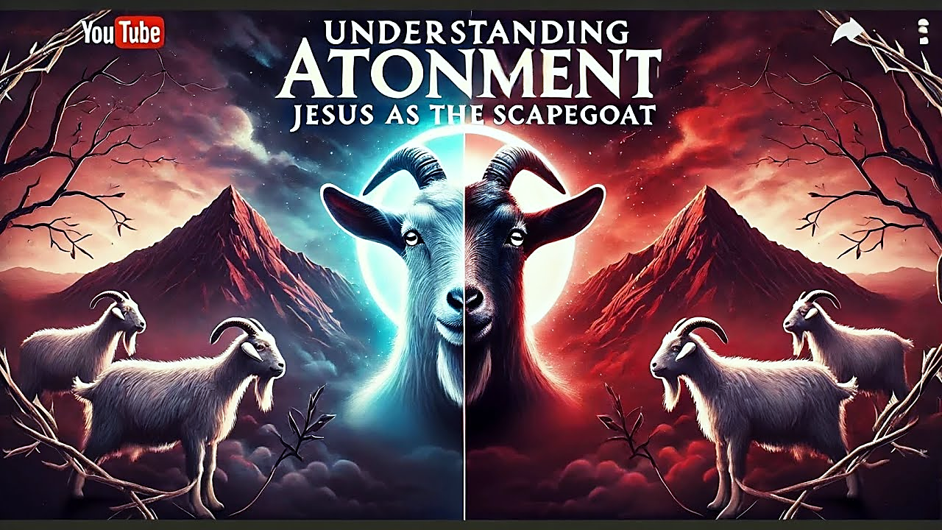
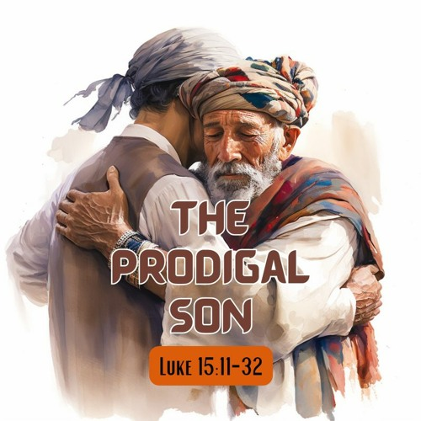
What is the WHOLE narrative?
HOMEWORK:
The word “Kaphar” is made visible in Luke 15.22
What does the robe (G4749 Stolen) and ring represent in the parable?
Notes:
Robe: Covered and removal of the son’s shame
Ring: Restoration of status & authority (re-instatement of sonship)
“The Best Robe” was the father’s since he was the head of the house and where prosperity and inheritance was formulated.
All of this was done before the servants and household so there would be no question of the son’s position.

Slide 10
What is the WHOLE narrative? Why Yeshua Died!
Flawless Rabbi /Teacher
Embodied truth, Yah’s wisdom lived out lessons and taught with flesh and blood.
To follow a Rabbi meant to imitate his way of life, not just memorize his teachings. Learn how to speak, act and respond to the world as he did.
Yeshua’s call to follow Him was a summons to a radically new way of being human/servants.
Rabbi Yeshua is not like other teachers; he didn’t simply teach about love as a moral lesson-He fully incarnated it. He died to teach Yah’s love that would never fade into history. It’s a vivid unforgettable demonstration.
HOMEWORK
Explain the following phrase:
“Follow Me”/ “Come after Me” that Yeshua spoke. Mt 4.18-22; 9.9, Jn 10.27
What is He saying of Himself and what position is He calling us to?

Slide 11
What is the WHOLE narrative? Why Yeshua Died!
High Priest: Rev 5.5
A priest stood at the intersection between heaven and earth Ex 19.6, 1Pe 2.9 a shadow, flawed representatives.
Israel’s priest own sins had to be atoned for-Creation longed for a true mediator.
Heb 9.11-12 “setting people free forever for eternal redemption” refers to quality rather than duration, incorruptible, divine kind.
Yeshua entered the human experience fully Phil. 2.6-8 He responded with perfect obedience.
Where Adam (1st Priest) failed in Eden, humanity inherited death. Yeshua (new Patriarch-Priest) was faithful in agony in Gethsemane, humanity inherited life. Romans 5.12,19, 1Co 15.21-22
Yeshua’s priesthood didn’t end at the cross Ro 8.34 He is interceding for us, advocating for us as our High Priest.
Yeshua died so we can approach the throne of Yah with confidence.

Slide 12
What is the WHOLE narrative? Why Yeshua Died!
Healer and Life Giver
Yeshua entered into the human death experience so He might conquer it from within. For humanity to overcome death we needed something greater than a fragile human life. (Christ did not cease to exist Job 34.14-15)
Death has no claim over He Who did not sin, death could not hold Him because death has no true power over divinity. John 10.28
Yeshua is not just our Priest; He is the one who gives us life; which is only found in the Creator.
Yeshua grafted us back into the Tree of Life; to reconnect us to the very life source, God and heal us with eternal life. Ex 15.26
Death is the visible consequence and power of sin. 1 Co 15.26 meaning once death is vanquished the wage of sin is gone.
YHVH’s final victory isn’t forgiving sins it’s erasing their consequence: Death! 1Co 15.54-55.

Slide 13
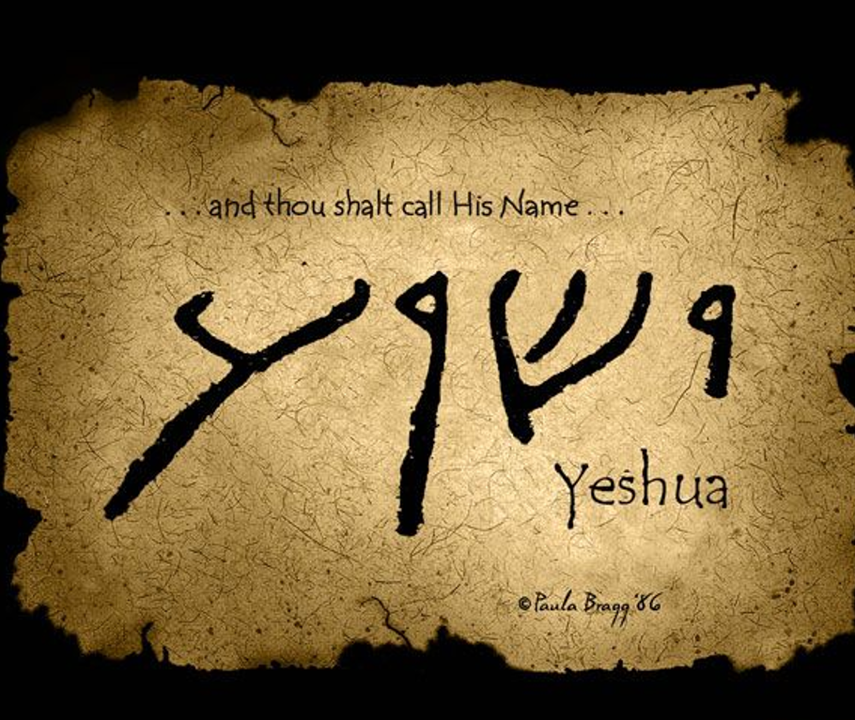
Salvation
Y’shua’s name expresses His mission.
To rescue, deliver, to give aid, individual well-being
He restored what was lost John 17.22

Slide 14
We already have eternal life!
We do not follow a fallen martyr, or dead teacher. But the Great Healer whose life flows in us as living water.
John 6.47 “Yes, indeed! I tell you, whoever trusts has eternal life.”
John 5.24 “…I tell you that whoever hears what I am saying and trust the One who sent me has eternal life…”
1John 5.13 “I write these things to you who believe in the name of the Son of God so that you may know that you have eternal life.”
  Eternal life is about quality (mindset, lifestyle), not duration. God’s life that breaks into the present. John 10.10

Slide 15
Essence of Yahweh’s Sacrificial System
Life, Cleansing, and Covenant Renewal
SACRIFICE | PURPOSE
Peace | Fellowship with shared meal (Yah, priest, worshiper) symbol of restore relationship & joyful communion i.e., Last Supper
Gift | Expression of gratitude, devotion & generosity. Acknowledging Yahweh as the Provider of life’s blessing Jn 17.4, Ro 12.1
Sin/ Purification | Cleansing impurity-removing from the altar what would defile Yah’s dwelling among His people. 1Jn 1.7 Blood to cleanse & purify us.
Guilt | Restoring what was lost or broken. (Isa 53.10) The cross – covered sin, gave peace, surrender, cleansing, restoration, thanks…
Burnt | Symbolized total surrender, complete dedication to Yahweh. Ph 2.8

